Slide 1
Real time Facial expression recognition in Python

Slide 2
ABSTRACT
We offer Real-time Facial Expression Recognition in Python with CNN for detecting facial emotions in real-time and in bulk to obtain a higher classification result in this project. We create a real-time vision system to see if our model is effective. The objective of emotion classification is accomplished by this system, which uses CNN Model Architecture. Facial expression recognition computer technology may extract emotional information from a person's expression in order to determine the person's condition and purpose.

Slide 3
A model of a convolutional neural network is proposed in this article (CNN). This model is used to recognize facial expressions. The article starts by constructing a CNN model and learning the local features of the eyes, brows, and lips. Finally, the model's output result is chosen and fused to get the final recognition result. The system will compile the model and use the fit function to apply it. There will be 32 batches in all. The average validation accuracy was 90.00%, and the average training accuracy was 90.00%.

Slide 4
EXISTING SYSTEM
The current facial expression identification methods are mostly separated into two categories: traditional manual approaches and network models based on deep learning. Although the traditional approach is frequently utilised, its practical applicability are severely constrained. Learning how to employ strong supervision methods to describe the emotional aspects of large sample data is usually the first step in using deep learning to categorise facial expressions.

Slide 5
For the formalisation of the Facial Channel neural network for Facial Expression Recognition, Barros et al. suggested a network model based on the topological structure of VGG-16 (FER).
Koujan et al. proposed a CNN that recognized human emotions from a single face image.
Xiao et al. combined the Region of Interest (ROI) and K-Nearest Neighbor algorithm for facial expression recognition and solved the problem of the poor generalization ability of deep neural networks in the case of small data.

Slide 6
Liu et al. proposed a deep learning method based on the geometric model of the facial region for facial expression recognition.
Zhao et al. proposed a lightweight expression detection model that can solve the delay problem under natural conditions.
Abate et al. proposed a neural network model for face attributes recognition based on transfer learning to group faces according to common facial features.

Slide 7
DISADVANTAGES OF EXISTING SYSTEM
Too many parameters
Slowing down the training speed
It is easy to over fitting problem
When the network is deeper, it means that the parameter space is larger, and the optimization problem becomes more difficult. Therefore, simply increasing the depth of the network causes more training errors.

Slide 8
PROPOSED SYSTEM
We propose and design a convolution neural networks framework for identifying facial emotions in real-time and in large batches in this study.
The categorization model is based on data from kaggle, and this dataset contains all forms of expressions. The dataset is also preprocessed before being used to develop the model. We can get all of the information in the dataset with the use of preprocessing. It assisted us in determining the quality of data and, on the other hand, preventing data redundancy. Preprocessing the data set improves both of our models, which is significant in our research.

Slide 9
Following the training of our CNN Model Architecture, it was discovered that the model was successfully trained and provided individual training accuracy. Furthermore, the epochs were expanded to a specific limit, and it was discovered that the accuracy was improving as well as the production.

Slide 10
ADVANTAGES OF PROPOSED SYSTEM
The proposed system model will have a high anti-disturbance capability as well as a high recognition rate.
In the final experimental test, we got good findings.
We remove the interference components of the various faces in the image, considerably improving the effect of emotion recognition.
Our proposed model has a 90% accuracy rate, which is the highest among existing system models.
We found that the proposed method outperforms existing state-of-the-art methods in terms of accuracy, and we statistically examined it.

Slide 11
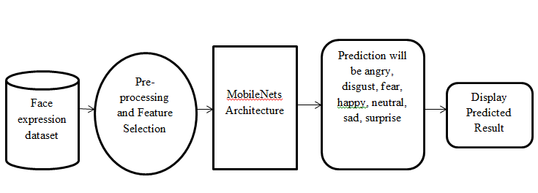
SYSTEM ARCHITECTURE

Slide 12
HARDWARE REQUIREMENTS
System : Intel i5 Processor.
Hard Disk : 500 GB.
Monitor : 15’’ LED
Input Devices : Keyboard, Mouse
Ram : 4 GB

Slide 13
SOFTWARE REQUIREMENTS
Operating system : Windows 11.
Coding Language : Python

