Slide 1
FLIGHT BOOKING SYSTEM *TRAVELO*

Slide 2
PROJECT PROFILE:-
Project Title:- Online Air Ticket Reservation System
Project Description:- Passenger can get ticket conveniently.
Front End Tool:- HTML,CSS & JAVASCRIPT.
Backend Tool:- MYSQL & JAVA
Submitted To:- RCC INSTITUTE OF INFORMATION TECHNOLOGY.

Slide 3
PREFACE:-
Travelo is a computerized system , convenient for the customers to book the flights.
Works on enhancing the relationship between customers and airline agencies.
It is basically a different form of execution of online transactions in which the customer can reserve for tickets and can pay online for their ticket conformation.
Allow the customers to access database and allow new customers to sign up for online access.
If customer needed to cancel his/her reservation due to any reason, he/she may easily cancel out reservation.

Slide 4
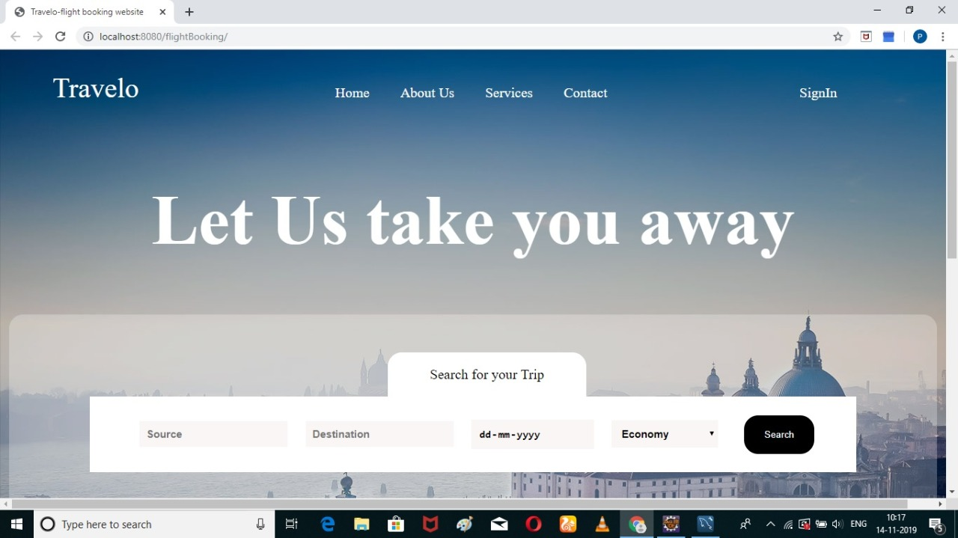
HOME SCREEN LAYOUT:-

Slide 5
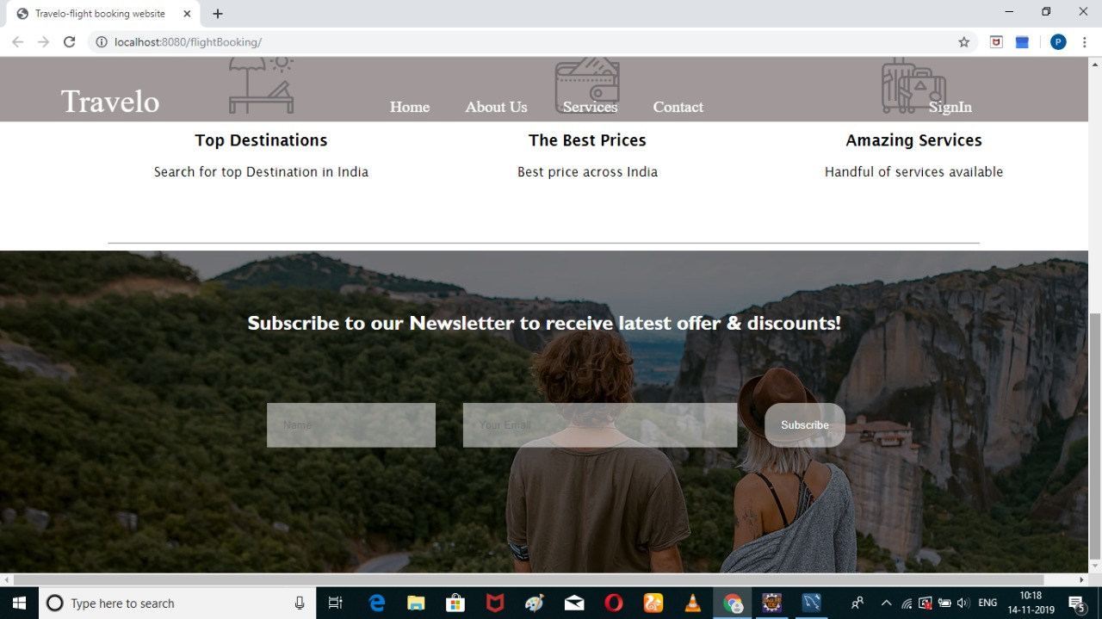
HOME SCREEN LAYOUT 2:-

Slide 6
GOAL:-
The primary goal is to help the passengers make flight reservation.
The system will be able to find all the flights fulfilling a passenger’s needs and therefore the passenger will decide the flight reservation based on that displayed information.
Saves Millions of rupees each year by serving through their toll-free customer service telephony systems.
The secondary goal is to provide a means for the airline manager to manage the flights.
The airline manager will be able to schedule new flights , drop flights from the schedule and change the fare for a flight.
The manager can decide to add flights if there are high demand of reservation at a certain time.

Slide 7
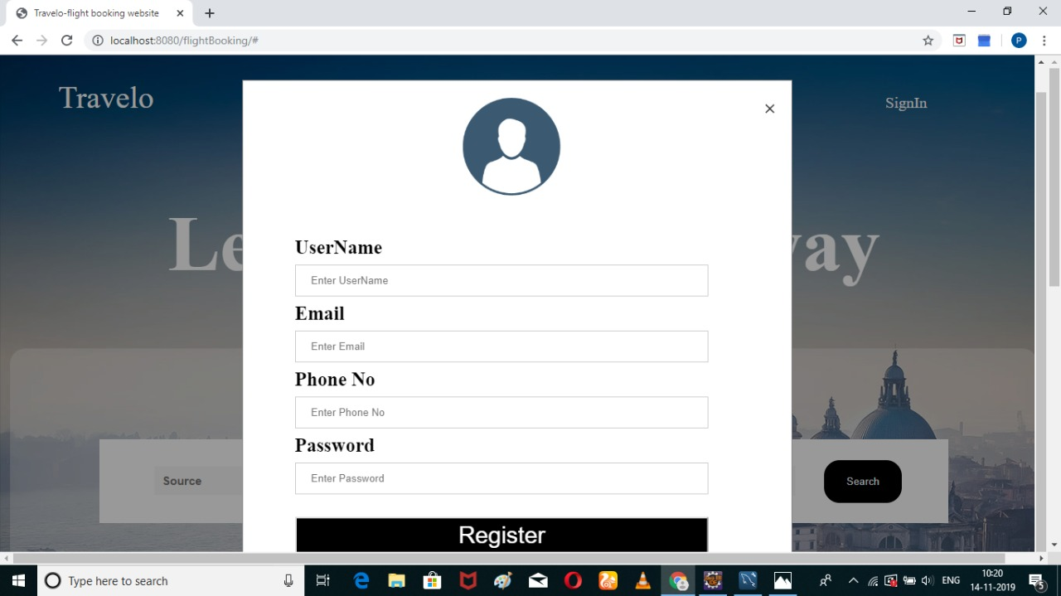
REGISTRATION PAGE:

Slide 8
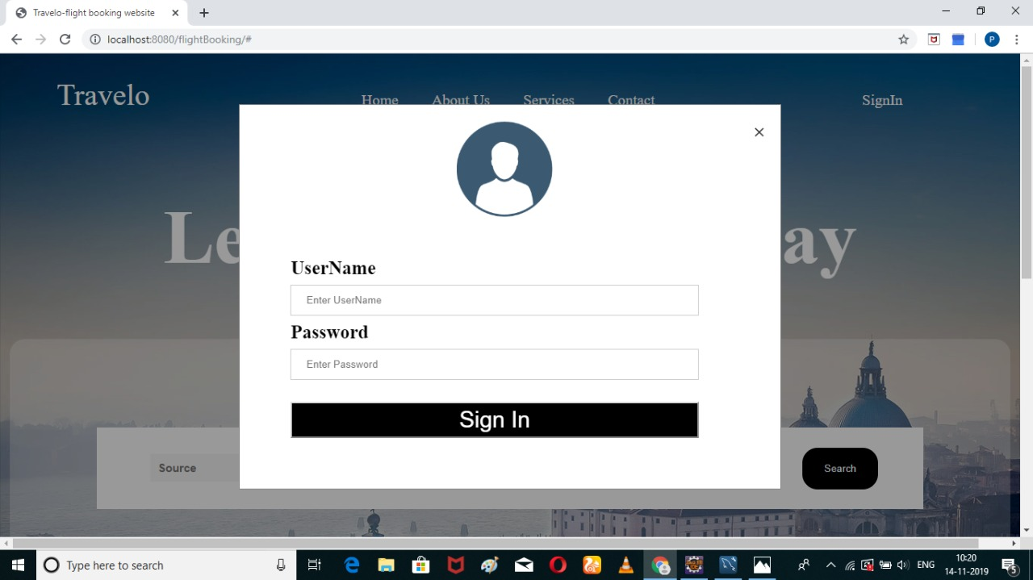
USER LOGIN PAGE:

Slide 9
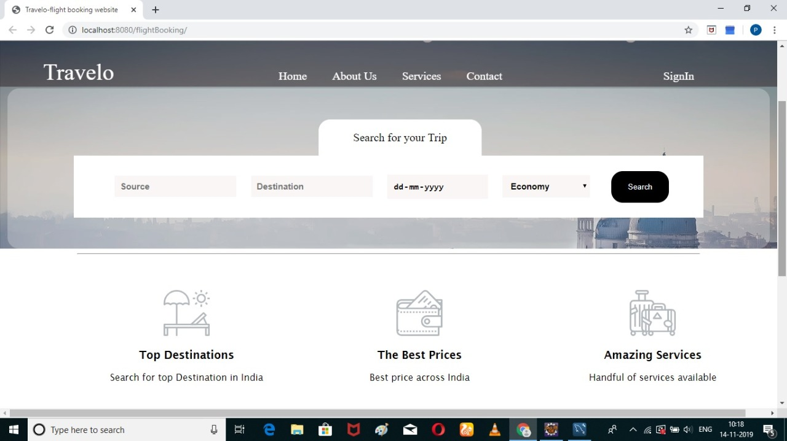
FLIGHT BOOKING PAGE:

Slide 10
OBJECTIVES:-
Better storage capability.
More Efficient operations.
This system saves the time and manpower.
The objective of the project is to provide the passenger the better reservation in turn the fast service to get the reservation over in time.
To give information about baggage/luggage, airport, airbus, and airport tips, about pets and healthy traveling tips.
Easy and fast retrieval of data.

Slide 11
MAJOR FUNCTIONS:-
Providing flight details.
Date & Time is provided along with the travel class.
Better user interface for the users.
Security for the reservation of the customers.
User can sort the choice of flights according to the travel cost.
User can search for specific flight.
A customer can also view his/her conformation using Passenger Number provided during reservation process, which is for security.

Slide 12
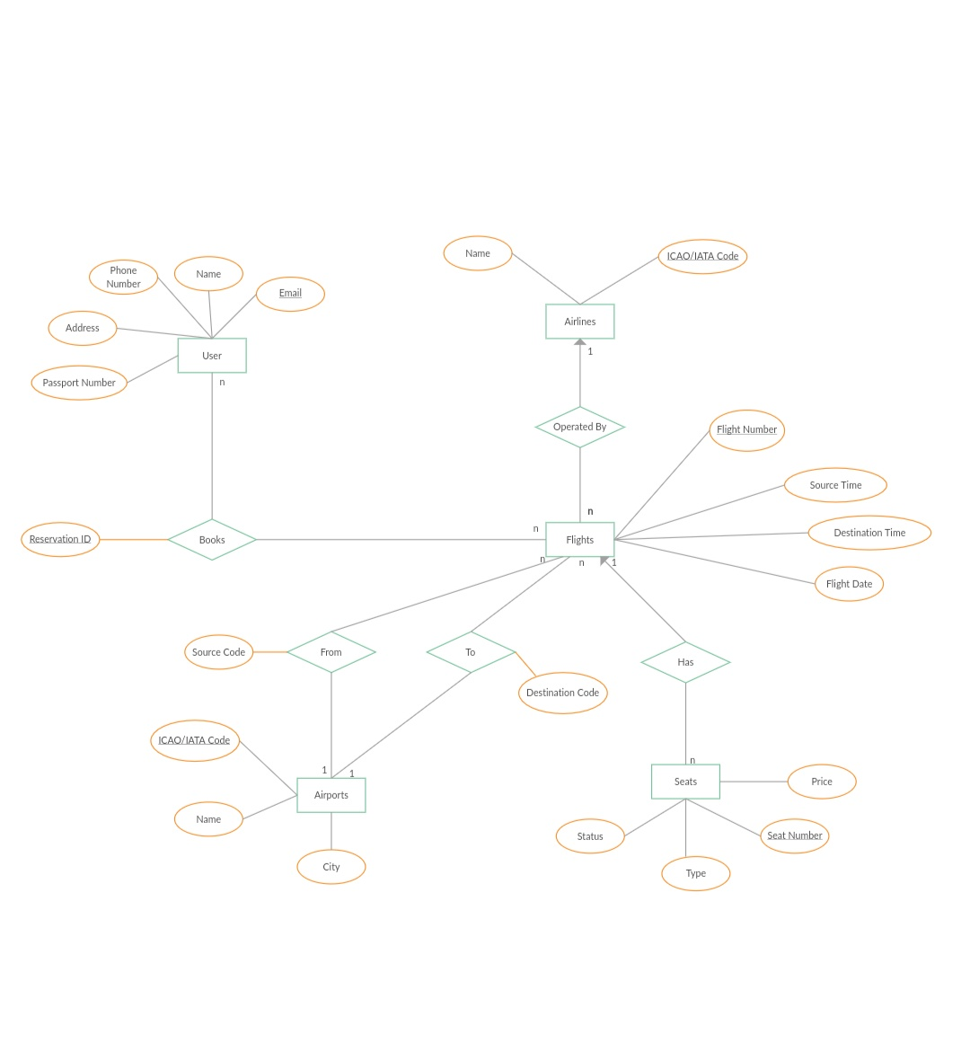
E-R DIAGRAM:-

Slide 13
MODULE DESCRIPTION:-
Registration Module:
After registering with us the passenger can logon to his/her own account and can view all flight details such as Timings, Prices, Availability of seats and can book the ticket with unique ticket id and gives its personal details. Once Passenger registered with us he/she can book any number of tickets.

Slide 14
Administrative Module:
Administrative module is provided for the sake of administrators to manage the site and update the content at regular intervals, the major operations included in this module are:
Create and maintain airline schedule, fare and timings of the flight.
View the passenger list.
View the available seats in the flights.
Updating the flight schedule and timings and fare.

Slide 15
Passenger module
This module is meant for passengers, where a user logging into his/her owns account will view this panel. The major operations included in this module were:
View all airline schedules, timings, fare details and seats availability.
Book for the tickets.
View the ticket.

Slide 16
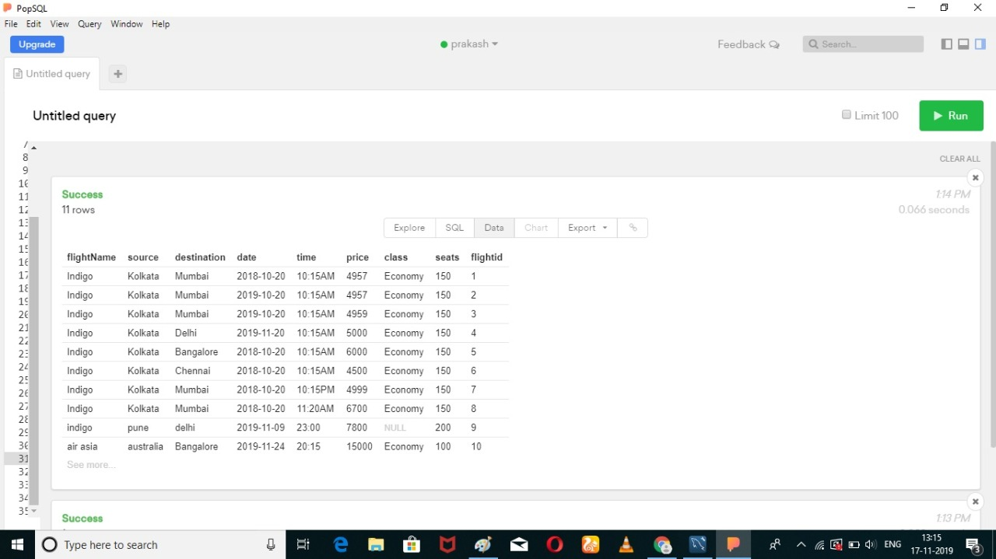
DATABASE: (Flight Details)

Slide 17
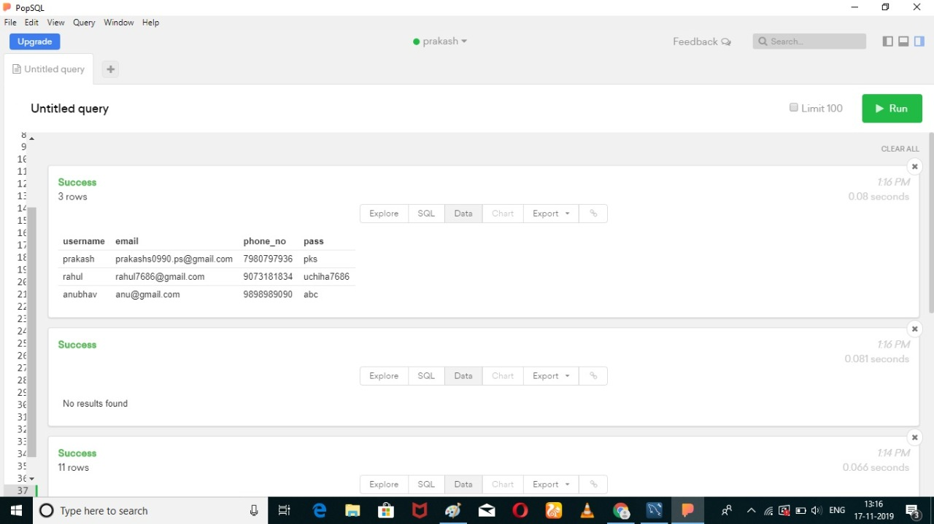
DATABASE: (Admin Info)

Slide 18

DATABASE: (Passenger Info)

Slide 19
ADVANTAGES:-
Book a flight at home. Changes and Cancelations.
Sort the choices of flights according to user suitability.
Cost benefits.
Many choice, save a lot of time by checking in online.

Slide 20
FUTURE ENHANCEMENT:-
Automatically e-mail communication to passenger about flight scheduling and new schemes and discounting.
We provide different types of tour packages in nominal cost.
Sending messages on mobile of delaying or cancellation of flight.

Slide 21
CONCLUSION:-
“TRAVELO” is an online reservation system, which enable customers to check the availability of tickets & book their tickets.
It provides an easy way to get tickets online rather than queue up to buy tickets.
With these specific characteristics like faster system , accuracy, reliability, informative & many more , TRAVELO is such a preferable application that one should must try.

