Slide 1
Collinearity
BUAN / MECO 6312
Dr. Moran Blueshtein
University of Texas - Dallas

Slide 2
Poor Data Quality, Collinearity, and Insignificance
When data are the result of an uncontrolled experiment, many of the economic variables may move together in systematic ways.
Such variables are said to be collinear
When variables are collinear, this may lead to a collinearity problem.

Slide 3
Poor Data Quality, Collinearity, and Insignificance
The Consequences of Collinearity
Consider the model:
The variance of the least squares estimator for β₂ is:

Slide 4
Properties of the Least Squares Estimators
The Variance of the Least Squares Estimator
(New!) A larger correlation between x₂ and x₃ leads to a larger variance of b₂ (and similarly b₃)

Slide 5
Poor Data Quality, Collinearity, and Insignificance
The Consequences of Exact Collinearity
Exact collinearity exists when x₂ and x₃ are perfectly correlated, in which case r₂₃ = 1 and var(b₂) goes to infinity
Similarly, if x₂ exhibits no variation equals zero and var(b₂) again goes to infinity
In this case x₂ is exact collinear with the constant term

Slide 6
Poor Data Quality, Collinearity, and Insignificance
The Consequences of Exact Collinearity
Whenever there are one or more exact linear relationships among the explanatory variables, then the condition of exact collinearity exists
In this case the least squares estimator is not defined
We cannot obtain estimates of β_{k}’s using the least squares principle

Slide 7
Poor Data Quality, Collinearity, and Insignificance
The Consequences of Collinearity
In the more general case when correlations between explanatory variables might be close to one, or the variance of an explanatory variable is close to 0:
standard errors are large, and it is likely that the usual t-tests will lead to the conclusion that parameter estimates are not significantly different from zero
Confidence intervals very big.
Estimators may be very sensitive to the addition or deletion of a few observations, or to the deletion of an apparently insignificant variable.

Slide 8
Poor Data Quality, Collinearity, and Insignificance
An Example
Example
Estimating the effect of power and size of a car on mileage
MPG (Y)- miles per gallon,
CYL (X) - number of cylinders
ENG (X) - engine displacement in cubic inches.
WGT(X) – vehicle weight in pounds.

Slide 9
Poor Data Quality, Collinearity, and Insignificance
An Example
Example (continued)

Slide 10
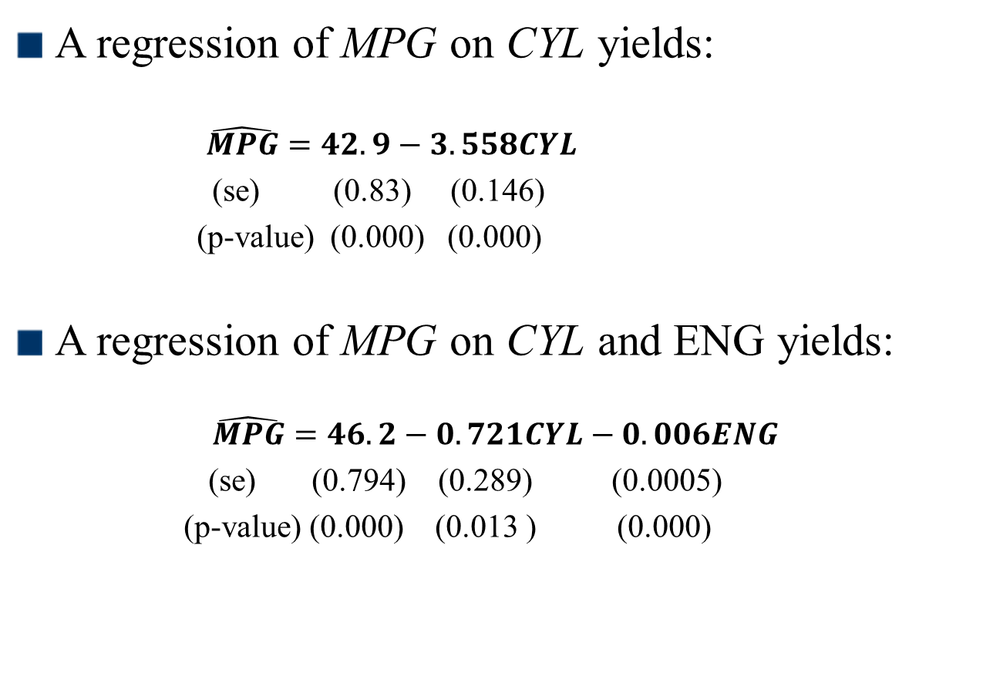
Poor Data Quality, Collinearity, and Insignificance
An Example
A regression of MPG on CYL yields:
$\hat{MPG}=42.9−3.558CYL$
(se) (0.83) (0.146)
(p-value) (0.000) (0.000)
A regression of MPG on CYL and ENG yields:
$$\hat{MPG}=46.2−0.721CYL−0.006ENG$$
(se) (0.794) (0.289) (0.0005)
(p-value) (0.000) (0.013 ) (0.000)

Slide 11
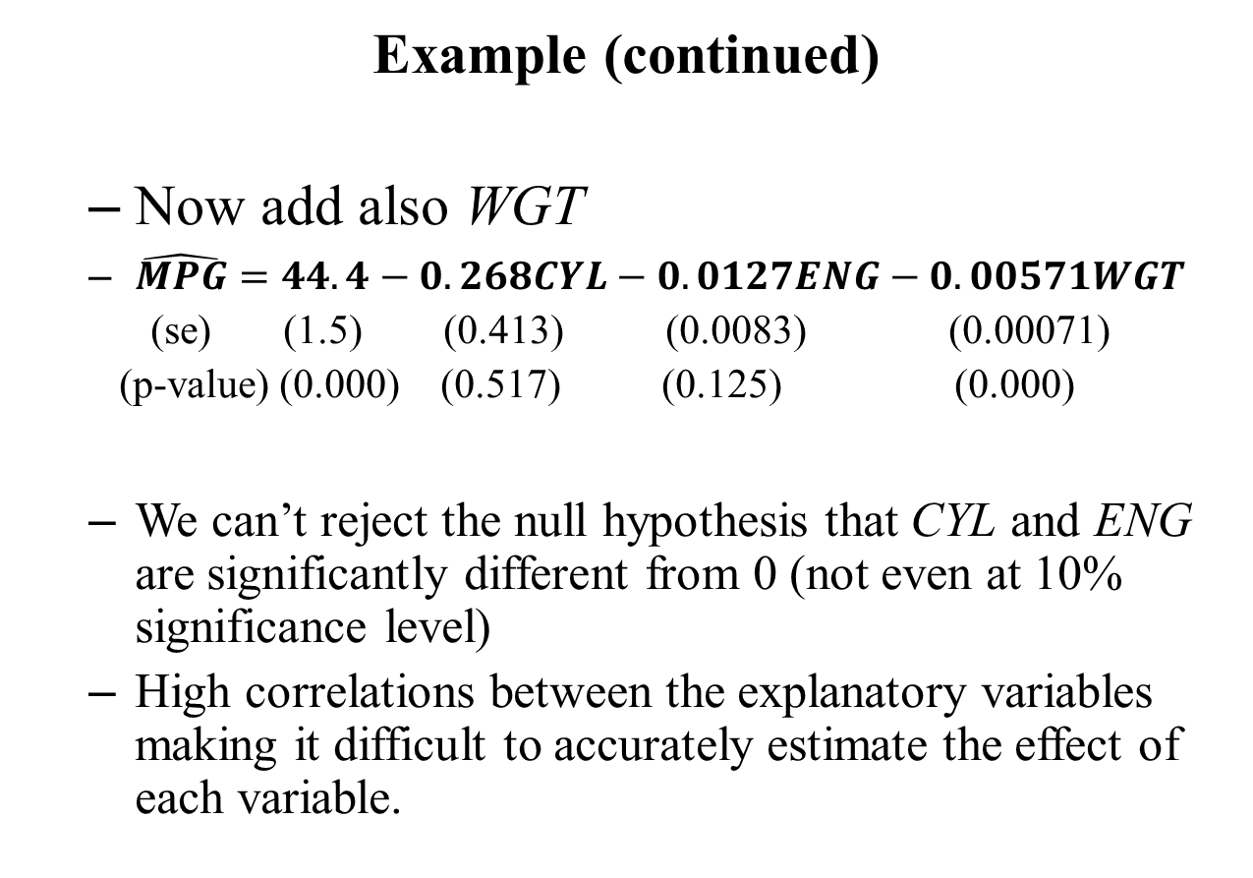
Poor Data Quality, Collinearity, and Insignificance
An Example
Example (continued)
Now add also WGT
$\hat{MPG}=44.4−0.268CYL−0.0127ENG−0.00571WGT$
(se) (1.5) (0.413) (0.0083) (0.00071)
(p-value) (0.000) (0.517) (0.125) (0.000)
We can’t reject the null hypothesis that CYL and ENG are significantly different from 0 (not even at 10% significance level)
High correlations between the explanatory variables making it difficult to accurately estimate the effect of each variable.

Slide 12
Poor Data Quality, Collinearity, and Insignificance
An Example
Example (continued)
When we test the null hypothesis:
H₀ : β₂ = 0, β₃ = 0
against the alternative hypothesis:
H₁ : β₂ ≠ 0 and/or β₃ ≠ 0
We obtain F-statistic 4.30 (p-value 0.014). Null hypothesis is rejected.(at significance level 0.05) Together these variables are influencing mileage but we can’t sort out the influence of each one of them.

Slide 13
Poor Data Quality, Collinearity, and Insignificance
An Example
Example (continued)
Dropping one of the variables is not a solution too, because given high correlation, it will introduce omitted-variable bias.

Slide 14
Poor Data Quality, Collinearity, and Insignificance
Identifying and Mitigating Collinearity
Then What is the solution?
Collinearity is a data problem! Not much we can do to solve this problem.
Consequently, one solution is to obtain more information (more data) and include it in the analysis, but this is often not available.

Slide 15
Poor Data Quality, Collinearity, and Insignificance
Identifying and Mitigating Collinearity
Non-exact colinearity is not a violation of the least squares assumptions. If your estimates are significant and have expected signs and magnitudes, you are fine even if your variables are highly correlated.
DO NOT LOOK FOR PROBLEMS WHEN THEY DO NOT EXIST
If you have unreasonably poor estimates check for collinearity.

Slide 16
Poor Data Quality, Collinearity, and Insignificance
Identifying and Mitigating Collinearity
One simple way to detect collinear relationships is to use sample correlation coefficients between pairs of explanatory variables
These sample correlations are descriptive measures of linear association
However, in some cases in which collinear relationships involve more than two of the explanatory variables, the collinearity may not be detected by examining pair-wise correlations

Slide 17
Poor Data Quality, Collinearity, and Insignificance
Identifying and Mitigating Collinearity
Try an auxiliary model:
If R² from this artificial model is high, above 0.80, say, the implication is that a large portion of the variation in x₂ is explained by variation in the other explanatory variables

