Slide 1
Introduction
BUAN / MECO 6312
Dr. Moran Blueshtein
University of Texas - Dallas

Slide 2
What Is Econometrics?
Why Study Econometrics?

Slide 3
What is Econometrics About
Econometrics is about how we can use theory and data from economics, business, and the social sciences, along with tools from statistics, to answer ‘‘how much’’ questions.

Slide 4
Why Study Econometrics
Every day, businesses and other decision-makers face ‘‘how much’’ questions:
Victoria’s secret wants to know what the effect of advertising on revenues is, in order to set the optimal level of advertising.
UTD must estimate by how much enrollment will fall if tuition is raised by 10%, and thus whether its revenue from tuition will rise or fall.
Toyota must estimate the effect that launching a new Tesla car is going to have on Toyota’s sales of hybrid cars in order to decide whether to invest in the development of an electric car ASAP.

Slide 5
The Econometric Model

Slide 6
The Econometrics Model
In economics we express our ideas about relationships between economic variables using the mathematical concept of a function:

Slide 7
The Econometric Model
An econometric model consists of a systematic part and a random and unpredictable component e that we will call a random error

Slide 8
The Econometric Model
The Systematic Part:
The systematic portion is the part we obtain from economic theory, and includes:
The explanatory variables of the model and the dependent variable.
The coefficients β₁, β₂, …, β₅ These are the unknown parameters of the model that we are trying to estimate using economic data and an econometric technique.
An assumption about the functional form (In any particular problem, one challenge is to determine a functional form that is compatible with economic theory and the data).

Slide 9
The Econometric Model
The Random Component:
The random component (“error term”) represents a ‘‘noise’’ component, which obscures our understanding of the relationship among variables, and which we represent using the random variable e

Slide 10
The Econometric Model
We use the econometric model as a basis for statistical inference
The ways in which statistical inference are carried out include:
Estimating economic parameters using econometric methods
Predicting economic outcomes (forecasting).
Testing economic hypotheses.

Slide 11
How are Data Generated?

Slide 12
How Are Data Generated?
We must have data
Where do data come from?
One way to acquire information about the unknown parameters of economic relationships is to conduct controlled experiment.
Problem: expensive and not always feasible.

Slide 13
How Are Data Generated?
Economists and other social scientists work in a complex world in which data on variables are ‘‘observed’’ and rarely obtained from a controlled experiment
This makes the task of learning about economic parameters more difficult.
Survey data is an example of nonexperimental data.
Data on all variables are collected simultaneously,
The values are neither fixed nor repeatable

Slide 14
Economic Data Types

Slide 15
Economic Data Types
3 Types of data:
Cross Section Data.
Time Series Data
Panel Data (Longitudinal)

Slide 16
Economic Data Types
Cross-Section Data
A cross-section of data is collected across sample units in a particular time period.
The ‘‘sample units’’ are individual entities and may be firms, persons, households, states, or countries.

Slide 17
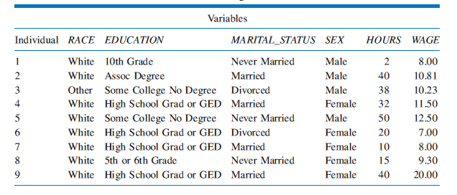
Economic Data Types
Cross Section Data
Cross-Section Data

Slide 18
Economic Data Types
Time-Series Data
A time-series is data collected on one individual entity (one firm or one person or one household or one country, etc.) over discrete intervals of time.
The key feature of time-series data is data on this entity is recorded at a regular time interval.

Slide 19
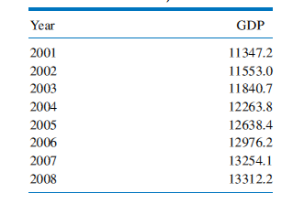
Economic Data Types
Real US GDP (Billion Dollars, 2005 Prices)
Time-Series Data

Slide 20
Economic Data Types
Panel or Longitudinal Data
A ‘‘panel’’ of data, also known as ‘‘longitudinal’’ data, has observations on individual micro-units who are followed over time.
The key aspect of panel data is that we observe each micro-unit for a number of time periods
Usually the number of time series observations is small relative to the number of micro-units, but not always.

Slide 21
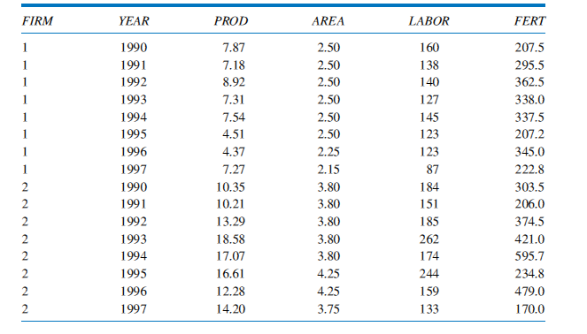
Economic Data Types
Panel Data from Two Rice Farms
Panel or Longitudinal Data

Slide 22
The Research Process

Slide 23
The Research Process
Econometrics is a research tool.
Steps in the research process:
Use economic theory to think about the problem
Develop a working economic model leading to an econometric model
Obtain sample data and choose a desirable method of statistical analysis based on initial assumptions and an understanding of how the data were collected
Estimate the unknown parameters with the help of a statistical software package, make predictions, and test hypotheses

Slide 24
The Research Process
Steps in the research process (Continued)
Perform model diagnostics to check the validity of the model (robustness check).
Summarize the empirical results and report your conclusions.

