Slide 1
CLASS 4
MECO 6312
Dr. Moran Blueshtein
University of Texas - Dallas

Slide 2
Goodness-of-fit
MECO 6312
Dr. Moran Blueshtein
University of Texas - Dallas

Slide 3
Measuring Goodness-of-fit

Slide 4
Measuring Goodness-of-fit
We call x_{i} the ‘‘explanatory’’ variable because we hope that its variation will ‘‘explain’’ the variation in y_{i}
But how well x_{i} indeed explains the variation in the dependent variable y_{i}?

Slide 5
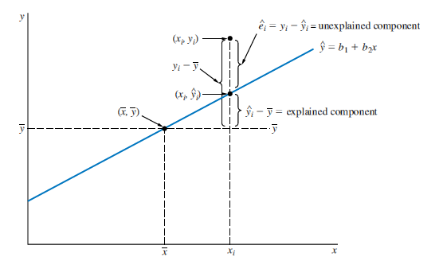
Measuring Goodness-of-fit
Explained and unexplained components of y_{i}

Slide 6
Measuring Goodness-of-fit
Subtracting the sample mean from both sides:
Squaring and summing both sides, using
“total sample variation” is divided into explained and unexplained components!

Slide 7
Measuring Goodness-of-fit
Specifically:
OR

Slide 8
Measuring Goodness-of-fit
Let’s define the coefficient of determination, or R² , as the proportion of variation in y explained by x within the regression model:

Slide 9
Measuring Goodness-of-fit
We can see that:
The closer R² is to 1, the closer the sample values y_{i} are to the fitted regression equation
If R² = 1, then all the sample data fall exactly on the fitted least squares line, so SSE = 0, and the model fits the data ‘‘perfectly’’
If the sample data for y and x are uncorrelated and show no linear association, then the least squares fitted line is ‘‘horizontal” so that SSR = 0 and R² = 0

Slide 10
Measuring Goodness-of-fit
When 0 < R² < 1 then R² is interpreted as ‘‘the proportion of the variation in y about its mean that is explained by the regression model’’

Slide 11
Measuring Goodness-of-fit
The Food Expenditure Example
For the food expenditure example, the sums of squares are:

Slide 12
Measuring Goodness-of-fit
The Food Expenditure Example
Therefore:
We conclude that 38.5% of the variation in food expenditure (around its sample mean) is explained by our regression model, which uses only income as an explanatory variable

Slide 13
Measuring Goodness-of-fit
The Food Expenditure Example

Slide 14
Measuring Goodness-of-fit
The Food Expenditure Example
Is this “large enough”?
Depends on the data set. Microeconomic household behavior is very difficult to explain.
For cross sectional data low values of R-squared (0.1-0.4) are common. For time series, it’s not uncommon to see values of 0.9 and higher.
Goodness of fit should not be the only criterion to evaluate the quality of the model! Always consider factors such as the signs and magnitudes of the estimates, their precision, statistical and economic significance etc.

Slide 15
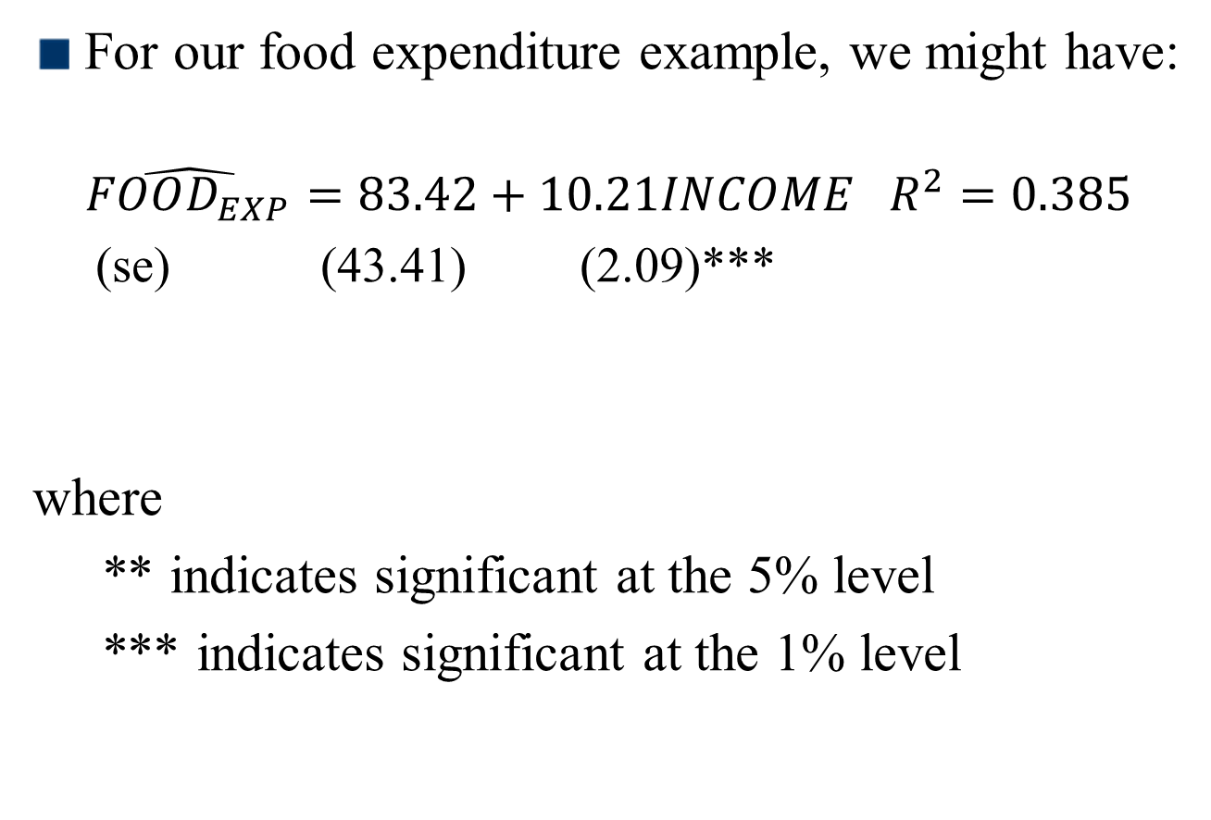
Measuring Goodness-of-fit
Reporting the Results
For our food expenditure example, we might have:
$$\hat{FOOD_{EXP}}=83.42+10.21INCOME R^{2}=0.385$$
(se) (43.41) (2.09)***
where
** indicates significant at the 5% level
*** indicates significant at the 1% level

