Slide 1
Random Variables and Probability Distributions
BUAN/MECO 6312
Dr. Moran Blueshtein
University of Texas - Dallas

Slide 2
Random Variables
A random variable is a variable whose value is unknown until it is observed; in other words it is a variable that is not perfectly predictable
Each random variable has a set of possible values it can take
A discrete random variable can take only a limited, or countable, number of values
A random variable that can have any value is treated as a continuous random variable

Slide 3
Probability Distributions
A probability density function (pdf ):
For a discrete random variable X, the value of the probability density function f(x) is the probability that the random variable X takes the value x, f(x) = P(X = x)
0 ≤ f(x) ≤ 1
f(x₁) + f(x₂) + … + f(x_{n}) = 1

Slide 4

Probability Distributions
Probability Density function
Assume that we have a population that is given by this table:
Let’s define a random variable X as the values that exist in that population.
X therefore can receive 4 values: 1,2,3 and 4.

Slide 5
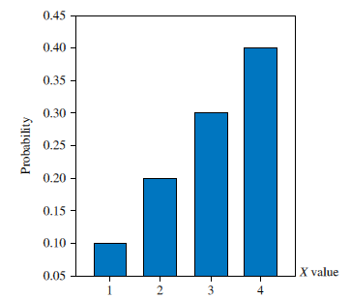
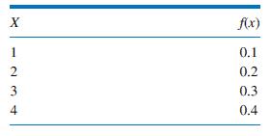
Probability Distributions
Probability density function for X
the probability of each possible value occurring in a random draw from the population is the probability density function (pdf )

Slide 6
Probability Distributions
The cumulative distribution function (cdf ) is an alternative way to represent probabilities.
The cdf of the random variable X, denoted F(x), gives the probability that X is less than or equal to a specific value x:

Slide 7
Probability Distributions

Slide 8
Joint and Conditional Probabilities

Slide 9
Joint and Conditional Probabilities
Working with more than one random variable requires a joint probability density function.
A joint probability is the probability of two events occurring simultaneously.

Slide 10
Joint and Conditional Probabilities
Joint Probability Density Function for X and Y
Let’s define a second random variable - Y
Y is a categorical random variable that can receive two values: blue (y=1) and white (y=0).

Slide 11
Joint and Conditional Probabilities
Joint Probability Density Function for X and Y
For example, the probability that we draw a blue cell with the value 2 is given by:

Slide 12
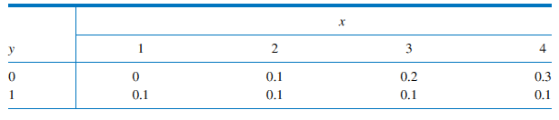
Joint and Conditional Probabilities
Joint Probability Density Function for X and Y
Make sure that you understand how we obtain the following table:

Slide 13
Joint and Conditional Probabilities
Conditional Probability
The conditional probability is the probability that the random variable X takes the value x given that Y takes the value y.
This conditional probability is given by the conditional pdf, f(x|y)
The effect of the conditioning is to reduce the set of possible outcomes

Slide 14

Joint and Conditional Probabilities
Conditional Probability of X given Y = 1
Conditional Probability

Slide 15
Joint and Conditional Probabilities
Conditional Probability
Example using the formula:

Slide 16
Joint and Conditional Probabilities
Statistical Independence
Two random variables are statistically independent if the conditional probability that X = x given that Y = y, is the same as the unconditional probability that X = x for every possible realizations of x and y.
This means, if X and Y are independent random variables, then:
Equivalently:

Slide 17
Joint and Conditional Probabilities
Statistical Independence
We can also say that X and Y are statistically independent if their joint pdf factors into the product of their marginal pdf ’s:
If this is true for each and every pair of values x and y, then X and Y are statistically independent.

Slide 18
Joint and Conditional Probabilities
Statistical Independence
Are X and Y statistically independent? NO

Slide 19
Properties of Probability Distributions

Slide 20
Properties of Probability Distributions
Two key features of a probability distribution are its center (location) and width (dispersion)
A key measure of the center is the mean, or expected value
Measures of dispersion are variance, and its square root, the standard deviation
We use Greek letters for population parameters: for the mean:
for standard deviation:

Slide 21
Properties of Probability Distributions
Expected Value of a Random Variable
The mean of a random variable is given by its mathematical expectation
If X is a discrete random variable, then the mathematical expectation, or expected value, of X is:

Slide 22
Properties of Probability Distributions
Expected Value of a Random Variable
For our example:

Slide 23
Properties of Probability Distributions
Expected Value of a Random Variable
The mean of a random variable is the population mean. The average value is our estimate of the mean.
The expected value of the random variable is the average value that occurs in many repeated trials of an experiment

Slide 24
Properties of Probability Distributions
Conditional Expectation
Many economic questions are formulated in terms of conditional expectation, or the conditional mean
Example: ‘‘What is the mean (expected value) wage of a person who has 16 years of education?’’
In expected value notation, what is E(WAGE|EDUCATION = 16)?

Slide 25
Properties of Probability Distributions
Conditional Expectation
For our problem:

Slide 26
Properties of Probability Distributions
Rules for Expected Values
If g(X) is a function of the random variable X, then g(X) is also random

Slide 27
Properties of Probability Distributions
Rules for Expected Values
If a is a constant, then
If a and b are constants, then:

Slide 28
Properties of Probability Distributions
Variance of a Random Variable
The variance of a random variable X is the expected value of:
Algebraically:

Slide 29
Properties of Probability Distributions
Variance of a Random Variable
For our problem, we know that E(X) = μ = 3
Now:
Then:
The square root of the variance is called the standard deviation

Slide 30
Properties of Probability Distributions
Variance of a Random Variable
A useful property of variances is the following
Let a and b be constants, then:
To see this, let Y = aX + b. Then:

Slide 31
Properties of Probability Distributions
Covariance Between Two Random Variables
The covariance between X and Y is a measure of linear association between them.
We define the covariance between two random variables as:
Note: unless X and Y are statistically independent:

Slide 32
Properties of Probability Distributions
Covariance Between Two Random Variables
Then:

Slide 33
Properties of Probability Distributions
Covariance Between Two Random Variables
Interpreting the actual value of σ_{XY} is difficult because X and Y may have different units of measurement
Scaling the covariance by the standard deviations of the variables eliminates the units of measurement, and defines the correlation between X and Y:

Slide 34
Properties of Probability Distributions
Covariance Between Two Random Variables
As with the covariance, the correlation ρ between two random variables measures the degree of linear association between them
Unlike the covariance, the correlation must lie between –1 and +1
The correlation between X and Y is +1 or –1 if X is a perfect positive or negative linear function of Y
If there is no linear association between X and Y, then cov(X, Y) = 0 and ρ = 0

Slide 35
Properties of Probability Distributions
Covariance Between Two Random Variables
Finally, the correlation is:

Slide 36
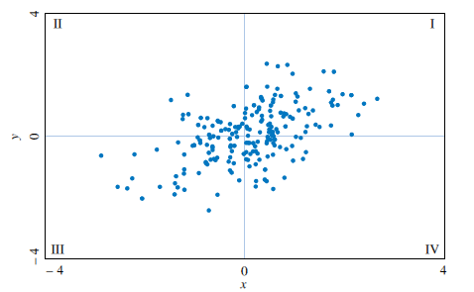
Properties of Probability Distributions
Example: Correlated data
Covariance Between Two Random Variables
In this example you see positive covariance and therefore also positive correlation between X and Y.

Slide 37
Properties of Probability Distributions
Covariance Between Two Random Variables
Here are some further results on variances:
If a and b are constants, then:
Special cases:

Slide 38
Properties of Probability Distributions
Covariance Between Two Random Variables
If X and Y are independent, or if cov(X, Y) = 0, then:
And:

Slide 39
The Normal Distribution

Slide 40
The Normal Distribution
If X is a normally distributed random variable with mean μ and variance σ² , it can be symbolized as X ~ N(μ, σ²)
The pdf of X is given by:

Slide 41
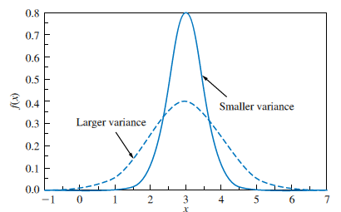
Properties of Probability Distributions
Distributions with different variances
Variance of a Random Variable

Slide 42
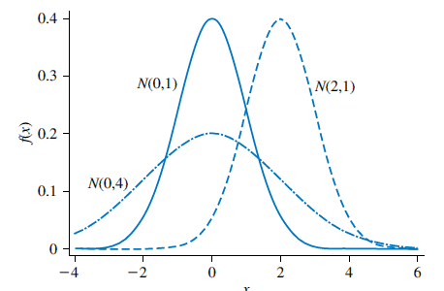
The Normal Distribution
Normal probability density functions N(μ, σ²)

Slide 43
The Normal Distribution
A standard normal random variable is one that has a normal probability density function with mean 0 and variance 1
If X ~ N(μ, σ²), then:

Slide 44
The Normal Distribution
If X ~ N(μ, σ²) and a and b are constants, then:

Slide 45
The Normal Distribution
For example, if X ~ N(3, 9),then:

