Slide 1
Object-Oriented Analysis and Design
Chapter 1: Introduction
Slides: By Dr. Semper

Slide 2
What will we learn?
We will learn the skills needed for good object-oriented analysis and design
We will utilize Unified Modeling Language (UML)
Be careful: Just knowing how to draw UML diagrams or create models does not imply good OOA/OOD!
UML is used mostly in this course as a diagraming method, a common notation
Responsibility-Driven Design
How should responsibilities be assigned to classes of objects?
How should objects collaborate?
What classes should do what?
For many common problems, these questions have been answered
Use existing best-practices, or patterns

Slide 3
What will we learn?
We will learn how to apply OOA/OOD to several case studies, which will be referred to throughout the course
We will learn how to do proper requirements analysis, and write use cases.
The first step in most projects, and the most important!
Not just for understanding the problem, but also to ensure common terminology, etc.
What is the development process? How does OOA/OOD fit in?
We will consider the agile development process, as part of the Unified Process (UP). This is an iterative development process that is very popular today
The OOA/OOD concepts we will learn can be applied to other development processes as well
We will also learn fundamental principles in object design and responsibility assignment: GRASP (General Responsibility Assignment Software Patterns)

Slide 4
We will:
Apply principles and patterns to create better object designs
Iteratively follow a set of common activities in analysis and design, based on the agile approach to the UP as an example
Create frequently used diagrams in the UML notation
Be able to skillfully assign responsibilities to software objects
Identify the objects that make up the system, or domain
Assign responsibilities to them – what do they do, how do they interact?
Apply the GRASP principles in OOA/OOD

Slide 5
Objects
From Merriam-Webster:
“something material that may be perceived by the senses”
Look around this room, and imagine having to explain to someone who has never taken a class what happens here …
You would explain the activity that occurs, and you would identify specific objects that play a role in that activity (Chairs, tables, projectors, students, professor, white board, etc.) to someone who has never seen these things …
Each of these objects is well defined, and plays a separate role in the story. There may be multiple copies of chairs, but a chair is very different from a projector – they have different responsibilities
You would not describe the action by saying “The classroom allows students to sit, and the classroom allows the professor to display slides, … “ etc. This would make the “classroom” too complex – almost magical
You would define the various objects in this domain, and use them to tell the story and describe the action

Slide 6

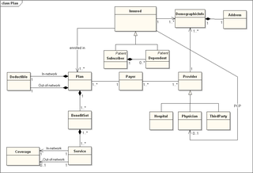
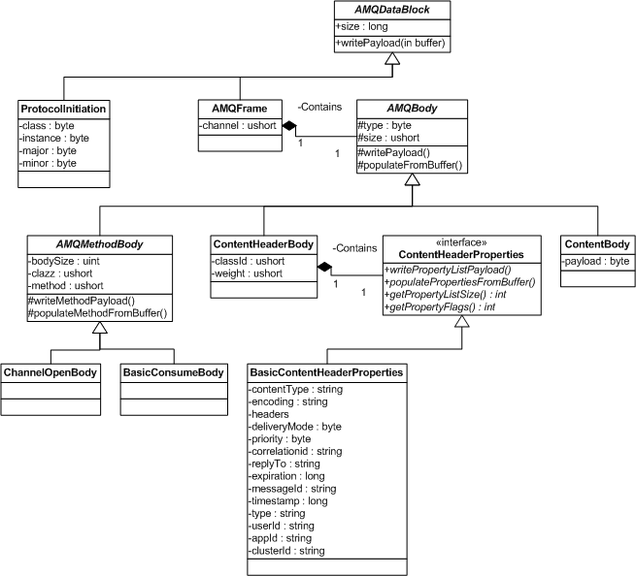
OOA/OOD
Analyze the system
Model the system
Design the software

Slide 7
Analysis and Design:
Analysis is the investigation of the problem - what are we trying to do?
Here is where use cases are created and requirements analysis are done
Design is a conceptual solution that meets the requirements – how can we solve the problem
Note: Design is not implementation
UML diagrams are not code (although some modeling software does allow code generation)
Object-oriented analysis: Investigate the problem, identify and describe the objects (or concepts) in the problem domain
Also, define the domain!
Object-oriented design: Considering the results of the analysis, define the software classes and how they relate to each other
Not every object in the problem domain corresponds to a class in the design model, and viceversa
Where do we assign responsibilities to the objects? Probably a little in both parts

Slide 8
UML
“The Unified Modeling Language is a visual language for specifying, constructing, and documenting the artifacts of systems.” - OMG, 2003
Standard for diagramming notation
We will use UML to sketch out our systems
UML can be used (by modeling packages) to auto-generate code directly from the model diagrams
Different perspectives:
Conceptual Perspective – defining the problem domain: Raw class diagrams, maybe mention some attributes (Domain Model)
Specification Perspective – defining the software classes: Design Class diagram, which shows the actual software classes and their methods, attributes

Slide 9
UML
We will explore the details of UML diagramming later in the course
For now, understand that UML is a language – it is used to communicate information
We will use UML to describe the problem domain, describe the activities that occur, and eventually describe the software classes
Since it is a language, UML has specific rules, and we will see these later in the course
You need to be able to read UML diagrams, as well as create them
Here are some examples (we will learn more about how to create these diagrams later …)

Slide 10
UML

Slide 11
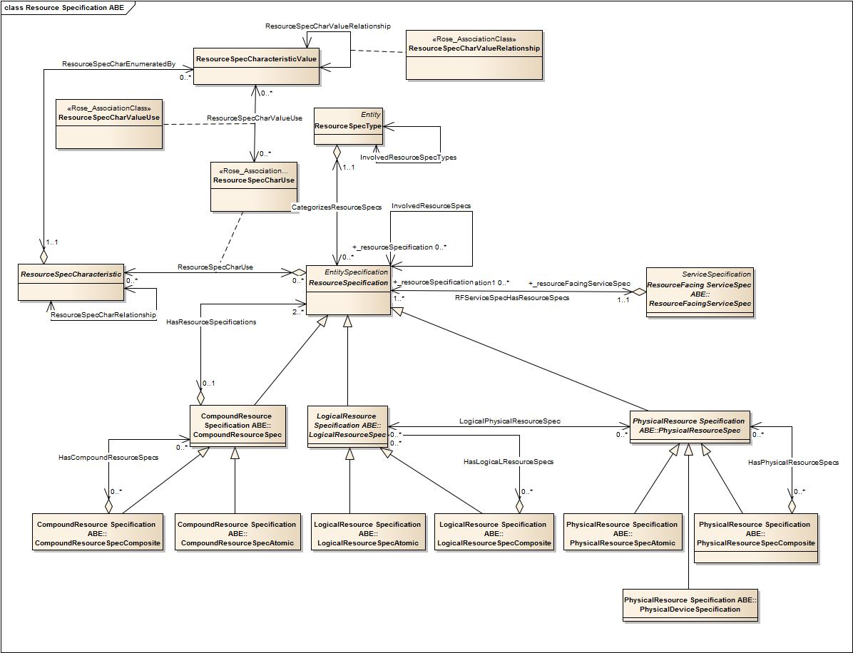

Slide 12
UML

Slide 13
UML

Slide 14
UML

Slide 15
UML

Slide 17
Example: The Dice Game
We will give an example of OOA/OOD for the following problem: We want to design an program that simulates a dice game. In the game, the player rolls two dice, and if the sum is seven, the player wins. Otherwise the player loses.
Step One: Define the Use Case.
In this case, the use case is very simple, and can be stated as this:
The Player plays the DiceGame. The DiceGame includes two Dice. The Player requests to roll the Dice. If the total of the two Dice is seven, the Player wins. Otherwise, the Player loses.
Step two: Define the Domain Model
In this step, we describe the domain of the problem in terms of objects, and try to identify the associations between those objects
We may add the noteworthy attributes of the objects
Note that this is a conceptual model – not a design class diagram

Slide 18
The Dice Game: Domain Model

Slide 19
The Dice Game: Object Responsibilities and Interactions
Step 3: We begin to define the software classes, and assign responsibilities
We can define “interaction diagrams” for software classes that will represent the objects we defined in Step 2
Note that at this step, we begin to deal with the real software classes (more specifically, instances of the real classes).
These will be based upon, but may not exactly match up with, the domain concepts or objects we identified in Step 2.
For example, there is no class for Player, since this is not part of the app we are developing

Slide 20
The Dice Game: Interaction Diagram

Slide 21
The Dice Game: Design Class Diagrams
Step 4: We are now ready to design the class diagrams
Using the interaction diagrams, we can define the classes, their attributes, and methods
Note: This is not coding. We do not specify how the methods will work, and we may not specify every attribute of the class.
We want to define the important methods and attributes that are needed to make the system work, so that a developer can take this model and build code from it

Slide 22
The Dice Game: Class Design Diagram

Slide 23
UML: Conceptual versus Specification Perspective

Slide 24
Chapter 1: Main Takeaways
We are learning the steps needed to do Object-Oriented Analysis and Design
Analysis: What
Design: How
We will use Universal Modeling Language (UML) to sketch our models – you should be familiar with the basics
UML can be used to create raw class diagrams (Conceptual), which are the domain models
UML is also used to create more detailed Design Class diagrams, which include more details on methods and attributes
The important activities in OOA/OOD: Define Use Cases (Requirements), Define Domain Model, Define Interaction Diagrams, Define Design Class Diagrams … we will study these in detail, and see how they relate to iterative development methods

Slide 25
Next …
Software Development Methodology: Iterative, Evolutionary, and Agile
Read Chapters 2-3

