Slide 1
Object-Oriented Analysis and Design
Chapters 8, 9: Basics, intro to domain models

Slide 2
What will we learn?
The basics of OOA/OOD – some key factors that are important in Inception and Elaboration
The Domain Model – what it is, how to start to build one from scratch

Slide 3
Inception Phase Produces …
A short requirements workshop, where most actors and goals are identified and use cases named
Brief descriptions of use cases, perhaps fully dressed versions for 10% of the critical ones
Identification of high risk requirements – “risk list”
First drafts of Vision and Supplementary Specification artifacts
Prototypes, if needed (e.g. UI)
High level candidate architecture
Recommendation on build/buy for some components
Agreement on first iteration plan

Slide 4
Elaboration
Core, risky architecture components are built and tested
Majority of requirements are discovered and stabilized
Major risks are mitigated or retired
Note, “risk” may mean critical business function
All code that is developed in this phase is production quality – it is added to in later iterations
“Architectural baseline” – early versions of the architecture, executable, production quality
Build the core architecture, resolve high-risk elements, define most requirements, and estimate the overall schedule and resources

Slide 5
Elaboration Artifacts
Domain Model – visualization of domain concepts
Design Model – Series of diagrams that describes the logical design
Class definition diagrams, object interaction diagrams, package diagrams, etc.
Software Architecture Document – Summary of outstanding design ideas and their motivation in the system, basically used as a learning tool
Data Model – may include database schema, mapping between object and non-object representations
Use-Case Model – details of high level use cases first begun in Inception

Slide 6
Case Study: NextGen POS Requirements (Inception)
Key Decisions made during Inception, plans for first iteration:
Implement basic, key scenario of Process Sale use case – entering items and receiving cash payment
Implement Start Up use case to initialize the system
No collaboration with external services at this point
No complex pricing rules
Notice that for the first iteration, the use case is limited – it will be expanded in later iterations

Slide 7
Case Study: Monopoly Requirements (Inception)
Implement basic, key scenario of Play Monopoly Game use case:
2-8 players
Play for 20 rounds. Each round, each player takes one turn. During a turn, the player advances his/her piece clockwise around the board a number of squares equal to the number rolled on two six-sided dice.
The results of each player’s roll is displayed: The display includes the name of the player and the value of the roll. When a player lands on a square, the player’s name and the name of the square are displayed
There is no money, winner, or loser, no properties to buy or rent, no special squares
There are 40 squares on the board: One is named “Go”, the others are simply numbered as “Square 1”, “Square 2”, … “Square 39”
The only user input required is the number of players

Slide 8
Domain Model - Introduction
Very important model in OOA … started after some key use cases have been developed
Illustrates the important concepts in the Domain, and will inspire the design of some software objects
Also provides input to other artifacts
Use-Case Model – operations contracts (TBD)
Glossary
Design Model (Sequence Diagrams)

Slide 9
This diagram shows an example of a an early Domain Model for the POS system.

Slide 10
Note …
We will be using the UML diagrams we saw earlier
The Domain Model appears to capture the important conceptual classes that make up the domain
We will see how to identify these shortly
The model also shows how these classes inter-relate to each other
Key aspect of OOA: Identifying a rich set of conceptual classes
Remember, this is an iterative approach – don’t need the entire Domain Model created at once!
The model is refined over the iterations in the Elaboration Phase

Slide 11
Domain Model: Definition
The Domain Model can be thought of as a visual representation of conceptual classes or real-situation objects in the domain (i.e. the real world).
In UP, the term Domain Model means a representation of real-situation conceptual classes, not software objects. The term does not mean a set of diagrams describing software classes, the domain layer of the software architecture, or software objects with responsibilities
This artifact is created in the Business Modeling discipline
Think of as a visual dictionary describing the domain: important abstractions, domain vocabulary, and information content

Slide 12
Observations …
Again, when building a Domain Model, avoid making it look like a class definition diagram
Leave off software entities, like databases and any known software objects
Use conceptual level UML diagrams (leave out methods and attribute details)
Conceptual Class
An idea, thing, object
Has a Symbol (i.e., a name or image)
Has Intention (the purpose in the domain – what it does, why it is there)
Has Extension (a set of examples to which the conceptual class applies)

Slide 13
Conceptual Class: Example

Slide 14
The difference between domain model and design model – UML used in two different ways.

Slide 15
Creating Domain Models
This is dependent upon which iteration cycle you are in, but in general there are three steps:
Find the conceptual classes
Draw the classes as UML diagrams (conceptual level)
Add associations and attributes
Finding Conceptual Classes
Use or modify existing models – we will see some of these later
Use a category list
Identify noun phrases in the use cases

Slide 16
Category Lists
This is a list of common conceptual class categories, generalized to apply to many situations
Can be used as a starting point; look for these conceptual classes in your domain
Book has good list …
Business transactions, transaction line items, where is the transaction recorded, physical objects, catalogs, other collaborating systems, ..
You can make a list of categories (or use a pre-existing list), and after reviewing use cases and requirements, list all conceptual classes you find that relate to a particular category

Slide 17
Noun Phrase Identification
Look at a textual description of the domain, and identify all the nouns and noun phrases
Try not to do this mechanically – not all nouns are conceptual classes!
Good place to start is the fully dressed use case
Go through the main success scenario, identify all important nouns, use these to name conceptual classes

Slide 18
Example: POS Use Case
Main Success Scenario (cash only):
Customer arrives at POS checkout with goods and/or services to purchases
Cashier starts new sale
Cashier enters item identifier
System records sale line item and presents item description, price, and running total
(repeat 2-3 until no more items)

Slide 19
Example: POS Use Case (identify key nouns)
Main Success Scenario (cash only):
Customer arrives at POS checkout with goods and/or services to purchases
Cashier starts new sale
Cashier enters item identifier
System records sale line item and presents item description, price, and running total
(repeat 2-3 until no more items)

Slide 20
Example – Initial Draft of Domain Model for POS

Slide 21
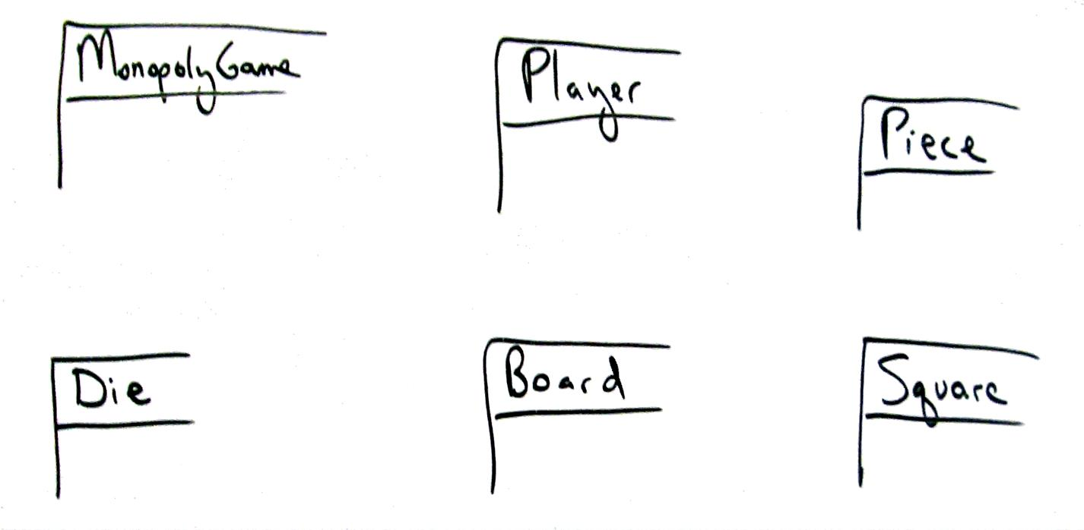
Example – Initial Draft of Domain Model for Monopoly

Slide 22
Observations
This model will evolve as the project goes through iterations
But aside from that, why save this model? Once it has served its purpose, it can be discarded
Once the more detailed class diagrams are created, there may not be a need for this model
It can be maintained in a UML CASE tool (there are many available)

Slide 23
Observations
Note not all conceptual classes need to be included – we are not going for a complete model in the beginning
Be careful with classes that simply report information derived from other classes – like Receipt.
If the reporting entity has some importance in the use case being considered (Receipt would be useful for Handle Returns, for example), then it should be included

Slide 24
Guidelines
Think like a mapmaker
Use existing names you find in the requirements/use cases, don’t invent new ones
Use terminology that is consistent with the business area
Exclude irrelevant or out of scope features
For example, in the Monopoly first iteration, we are not using “cards”, so they do not need to be modeled
Likewise, for the NextGen POS system, we do not need to include tax rules yet

Slide 25
Guidelines
Never add a conceptual class for something that is not there!
Always model the real system – don’t try to design ahead
Remember – think like a map-maker
Don’t be afraid of abstract conceptual classes
Virtual connection, etc.
If these are important to the real-world system, they should be modeled in the Domain model

Slide 26
Attributes and Conceptual Classes
Be careful not to turn conceptual classes into attributes
If X cannot be thought of as a number or text, it is probably a conceptual class
For example, in the POS case study, the Store is not a number or some text, so it should be modeled as a conceptual class (and not an attribute of Sale, for example)
In Monopoly, the Piece, Board, Square, and Dice are not numbers or text, so they will be conceptual classes
The number that each dice rolls, however, can be thought of as an attribute

Slide 27
Description Classes
Often it is a good idea to include the information that describes a class (conceptual or software) in a separate class, called a description class (also called a specification).
This is a more robust way to design the conceptual classes
Putting all information in each instance is wasteful because it duplicates information, and may be error-prone (what if something changes?)
Common in sales, product, and service domains.
These are separate objects (conceptual classes, or real software classes)

Slide 28
Descriptor Class – Store Item

Slide 29
Descriptor Class – Airline Flight

Slide 30
Associations
An association is a relationship between classes that indicates a meaningful and interesting connection.
When to add an association between conceptual classes to the domain model?
Ask “do we require some memory of the relationship between these classes?”
The knowledge of the relationship needs to be preserved for some duration
For example, we need to know that a SalesLineItem is associated with a Sale, because otherwise we would not be able to do much with the Sale (like compute the total amount, print receipt, etc.)
For the Monopoly example, the Square would not need to know the value of the Dice roll that landed a piece on that square – these classes are probably not associated

Slide 31
Associations
Avoid adding too many associations
A graph with n nodes can have (n x (n – 1)/2) associations, so 20 classes can generate 190 associations!
Realize that there may not be a direct association between software classes in the class definition model just because there is an association between conceptual classes in the domain model
Associations in the domain model show that the relationship is meaningful in a conceptual way
But many of these relationships do become paths of navigation in the software
Naming: Use ClassName – VerbPhrase – ClassName format
Can add a small arrow help to help explain the diagram to the reader

Slide 32
Associations

Slide 33
Takeaways from Chapters 8 and 9
Know which artifacts are initiated during the Inception and Elaboration phases
Understand what a Domain Model is and what role it plays
Know how to identify conceptual classes

Slide 34
Next …
More Domain Models – how to actually create the model (Chapter 9)
More details on Domain Models – how to enhance them (Chapter 31)

