Slide 1
How do you measure brand loyalty?
There is no single measure, but there are multiple indicators e.g.,
Share of purchases of that brand
Liking for the brand
Whether they would recommend the brand to others
How far are they willing to go to get their favorite brand
In fact, there are 300 definitions of brand loyalty

Slide 2
How do you measure service quality?
Multiple measures
Quality of service
Promptness
Knowledge
Courtesy
Reliability
Quality of office
Quality of people
What is the right measure and how do you create one useful measure of service quality

Slide 3
Issues in analyzing such data
There are many possible measures
One can ask multiple questions
Some of these measures may be correlated
How to create indices that are weighted scores of multiple measures?
Use PCA (Principal Components Analysis)
How many underlying constructs are needed say to measure service quality?
Use Factor Analysis

Slide 4
How can Factor Analysis Help?
Uncover underlying constructs: Factor analysis can summarize the information in many variables into a few underlying constructs/dimensions
Data Reduction: Reduces the number of variables that you have to deal with little loss of information

Slide 5
Why Reduce Data?
Typical customer survey on attitudes, lifestyles, opinions will probably have responses to more than 100 questions
Too much data can be hard to interpret and comprehend
Difficult to work with too much data
Many variables will be correlated with each other (known as multicollinearity problem in regression analysis).
We know that we may have many variables that are capturing the same or similar information? We can reduce redundancy.

Slide 6
What is Principal Components Analysis (PCA)?
What is PCA?
PCA is a technique for forming new variables, which are linear composites of original variables.
PCA also ensures that the new variables are uncorrelated among each other.
The new axes are called principal components and the values of the new variables are called PC scores.

Slide 7
Principal Components
PCA summarizes information in data by reducing original set of “items”/attributes to a smaller set of principal components (PC)
A PC can be viewed as an “Index”:
Dow Jones Index -- summarizes the movement of stock market
Consumer Price Index -- reflects prices of consumer products and indicator of inflation
How to create such an “index” that appropriately summarizes the data with the minimum loss of information?

Slide 8
How does Principal Components (PC) work?
Principal Components “constructs” factors/axes by including original attributes with different weights
The weights are estimated such that:
The first PC accounts for the maximum variance, then the second PC and so on
The sum of squares of the weights sum to 1.
The principal components are uncorrelated i.e., correlation (PC₁, PC₂) = 0.
P₁ = r₁₁X₁ + r₁₂X₂ + … + r_{1N}X_{N}
r₁₁ ² + r₁₂ ² + … + r_{1N} ² = 1

Slide 9
Example 1: Bank survey
Small banks charge less than large banks
Large banks are more likely to make mistakes than small banks.
Tellers do not need to be extremely courteous and friendly – its enough for them to be civil.
I want to be personally known at my bank and to be treated with special courtesy.
After being treated in an impersonal or uncaring way by a financial institution, I would never patronize that organization again

Slide 11
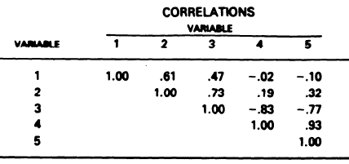
Correlation matrix

Slide 12
Factor Analysis output

Slide 13
Factor scores

Slide 14
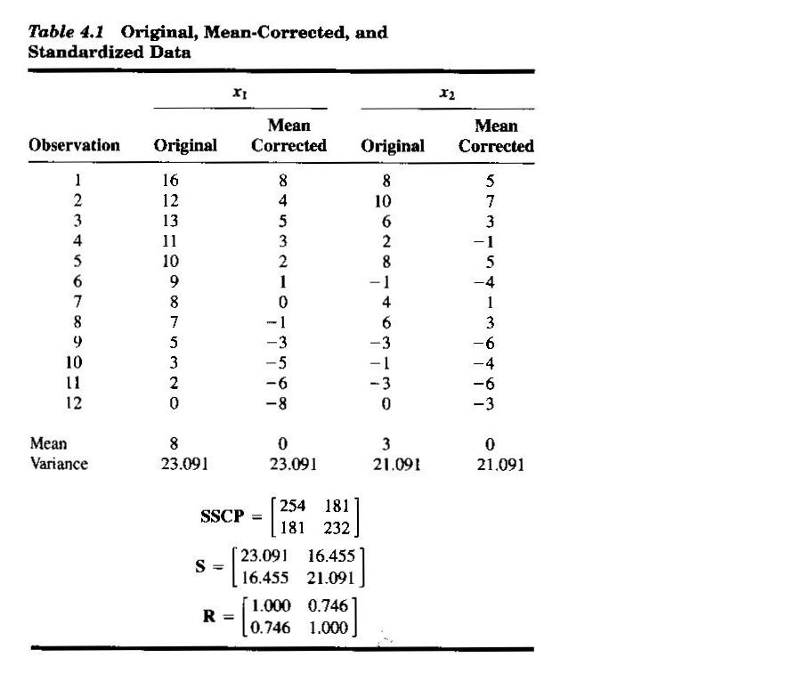

Slide 15
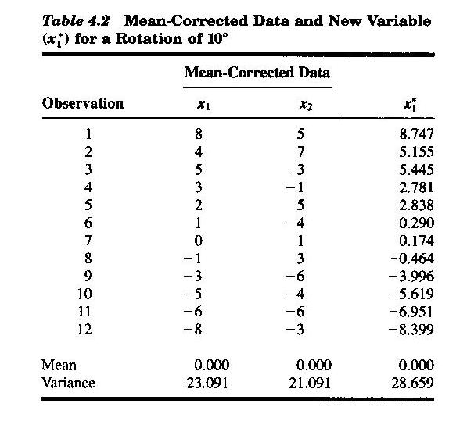
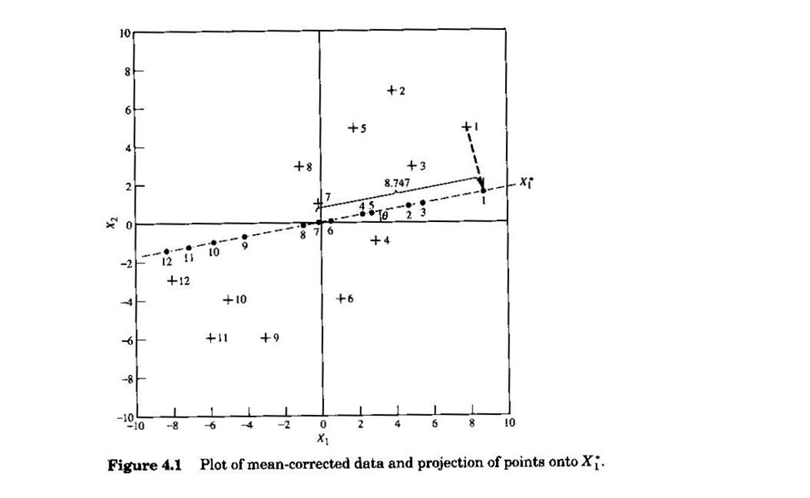
Rotate the x₁ axis by 10⁰ and find new values

Slide 16
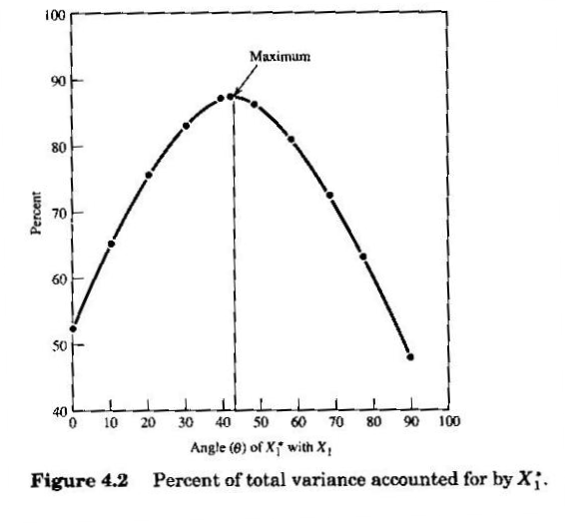
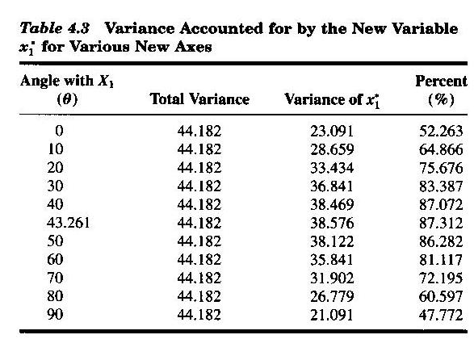
Find the angle at which PC₁ explains the maximum variance

Slide 17
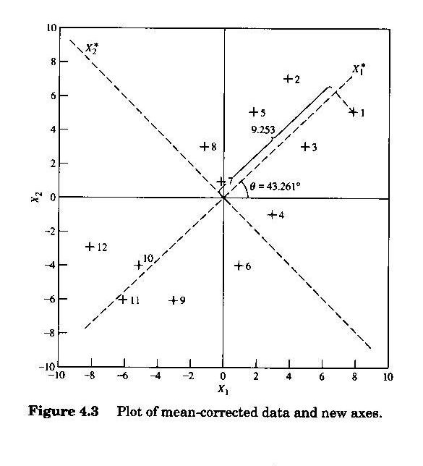
Graphical interpretation of PCA
PC₂
x₂
PC₁
x₁

Slide 18
Factor analysis
Unlike PCA, in Factor Analysis there is an additional error term U_{i} that captures the variance unique to X_{i}.
Unlike PCA, the factors need not be orthogonal or uncorrelated.
X₁ = a₁₁F₁ + a₁₂F₂ + a₁₃F₃ + … + a_{1m}F_{m} + a₁U₁
X₂ = a₂₁F₁ + a₂₂F₂ + a₂₃F₃ + … + a_{2m}F_{m} + a₂U₂

Slide 19
Example 2: College Admissions
Data: Students’ scores on different subjects – say Physics, Chemistry, Math, History, English and French
Task at hand: to make an assessment about the student’s ability to succeed in school given these scores
Do we need to look at the scores on all subjects or can we use a simplified heuristic?

Slide 20
Two-Factor Model
Suppose we get an output from Factor analysis:
M = 0.8 Q + 0.2 V +A_{m} P = 0.7 Q + 0.3 V + A_{p}
C = 0.6 Q + 0.3 V +A_{c} E = 0.2 Q + 0.8 V + A_{e}
H = 0.15 Q + 0.82 V +A_{h} F = 0.25 Q + 0.85 V + A_{f}
Q is an underlying factor that represents quant. ability
V is an underlying factor that represents verbal ability
A’s denote aptitude specific to the subject

Slide 21
Results: Raw factor loadings
Variable | Loadings Q | Loadings V | Variance Q | Variance V | Unique Variance
Math | 0.667 | -0.484 | 0.445 | 0.234 | 0.321
Physics | 0.680 | -0.343 | 0.462 | 0.118 | 0.420
Chem. | 0.615 | -0.267 | 0.378 | 0.071 | 0.551
English | 0.741 | 0.361 | 0.549 | 0.130 | 0.321
History | 0.725 | 0.412 | 0.526 | 0.170 | 0.304
French | 0.812 | 0.355 | 0.659 | 0.126 | 0.215
Total |  |  | 3.019 | 0.849 | 2.132
eigenvalue

Slide 22
Results: Rotated Factor Pattern
Variable | Loadings |  | Communality |  | Unique Variance
 | Q | V | Q | V
M | 0.800 | 0.200 | 0.640 | 0.040 | 0.321
P | 0.700 | 0.300 | 0.490 | 0.090 | 0.420
C | 0.600 | 0.300 | 0.360 | 0.090 | 0.551
E | 0.200 | 0.800 | 0.040 | 0.640 | 0.321
H | 0.150 | 0.820 | 0.023 | 0.672 | 0.304
F | 0.250 | 0.850 | 0.063 | 0.723 | 0.215
Total |  |  | 1.616 | 2.255 | 2.132

Slide 23
Factor Analysis: Key terms
Key Words
Factor Loading: Correlation of a factor with the original variable.
Communality: Variance of a variable summarized by the underlying factors
Eigenvalue (latent root): Sum of squares of loadings of each factor – just a measure of variance
e.g. the eigenvalue of factor 1, λ₁,
λ₁ = r₁₁² + r₁₂² + … + r_{1N}²

Slide 24
How many Factors do you Choose?
Look at the Eigen Values of the Factors
If K of P factors have an eigen value > 1 then K factors will do a pretty good job
Scree plot helpful

Slide 25
Scree Plot: Selection of # of Factors
eigenvalue
6
5
4
3
2
1
“elbow”
No. factors
2 4 6 8 10

