Slide 1
Automated system for forecasting and tracking of number of online search queries at scale using LSTM & Neural Prophet
12/15/2022
Manisha Gupta
(PhD Computer Science Student)
Advisor: Dr Kim

Slide 2
Overview – Goals of Forecasting
Forecasting Finance Goal
Set and track against finance goals: Revenue / Volume
Monitoring
Determine anomalous trends for Daily active user (DAU) & search queries volume based on expectations (seasonality)
Reporting and Updates
Inform short-term DAU and YoY trends (weekly, monthly)
Track against fiscal year targets

Slide 3
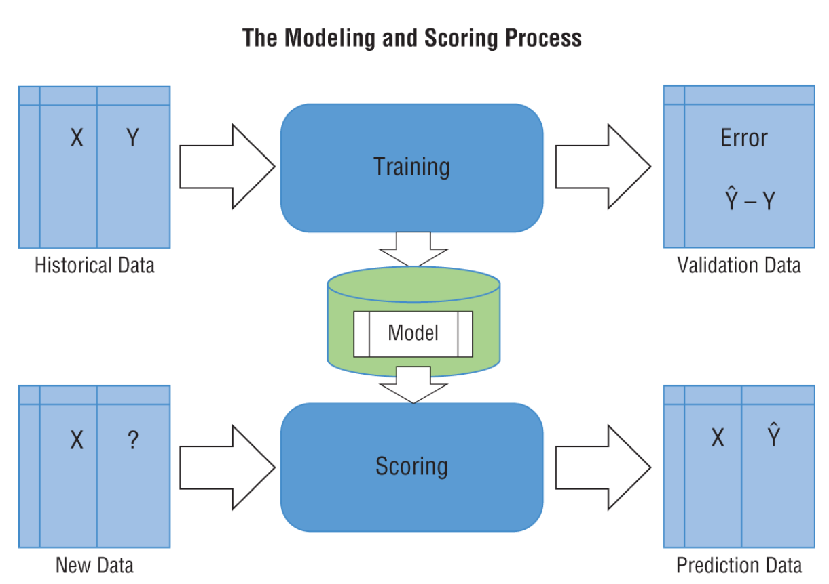
Performance Evaluation Metrics of our model
Performance Metrics
Coverage - Coverage is simply the percentage of actual values that lie between the predicted upper and lower uncertainty bounds
Root mean square error (RMSE) is a quadratic scoring rule that also measures the average magnitude of the error. It’s the square root of the average of squared differences between prediction and actual observation. The closer to zero the error is, the better the model.
Mean absolute percentage error (MAPE) is a statistical measure of how accurate a forecast system is. It is a measure in terms of percentage. It is mostly used for time-series forecasting. The closer to zero the error is, the better the model.

Slide 4
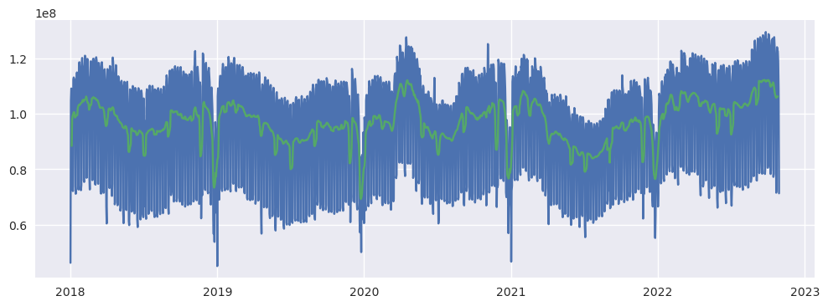
Data Exploration
US: Online Search Queries

Slide 5

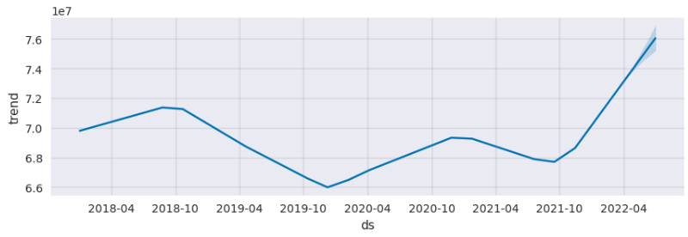
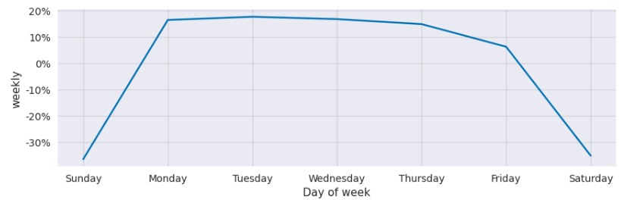
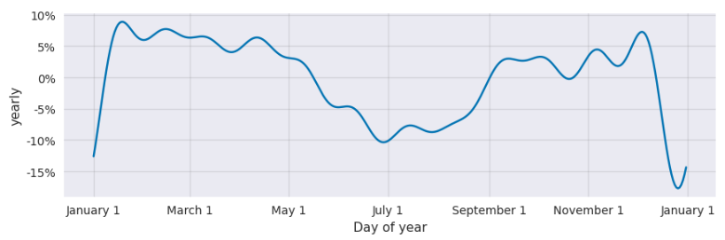
Interpret the model Component

Slide 6
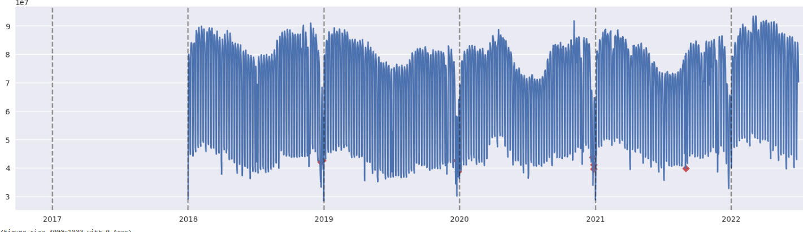
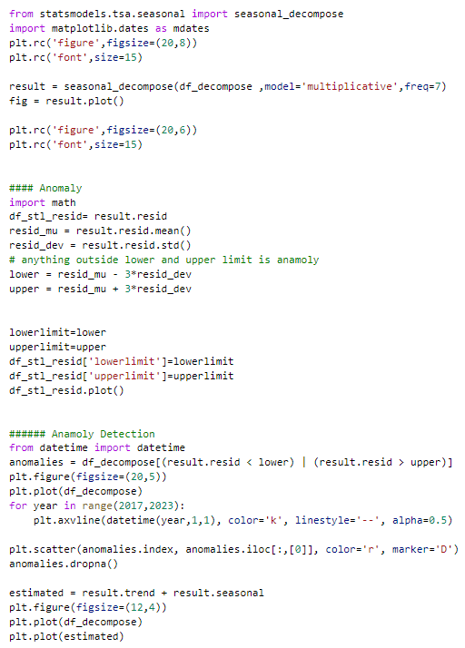
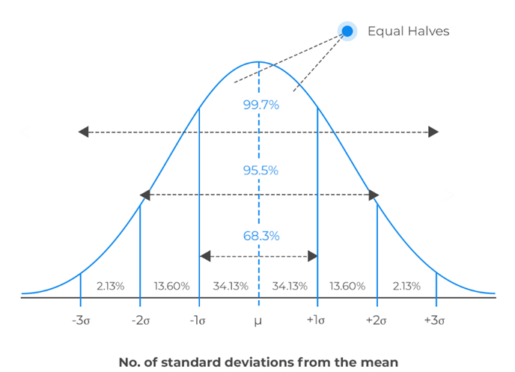
Anomaly detection and Treatment
Technique
Seasonal-Trend decomposition using LOESS (STL)
1) Decompose the time series using seasonal decomposition;
2) Remove trend and seasonality to generate a residual time series;
3) Detect points in the residual which are outside 3 times the interquartile range
Treatment
Forward Fill
Backward Fill
Moving Average- Rolling average
Interpolation
Imputation

Slide 7
Methodology
Baseline Model: Take last 4 days of moving average to forecast the next one
LSTM: Last 4 lag value is being used to predict the next value. The network architecture is 100 neuron with one output neuron along with Relu Activation function, optimizer is Adam and error metrics to optimized is mean squared error. Epoch is 50. The network also has one hidden layer. Min Max Scaler is used for Normalization
Neural Prophet: Run the default version of Neural prophet with Multiplicativity seasonality
Gradient Descent for optimization via using PyTorch as the backend.
Modelling Auto-Regression of time series using AR-Net
Modelling lagged regressors using a separate linear or Feed-Forward Neural Network.
Directly predict specific forecast horizons.
Train a single model on many related time-series (global modelling).

Slide 8
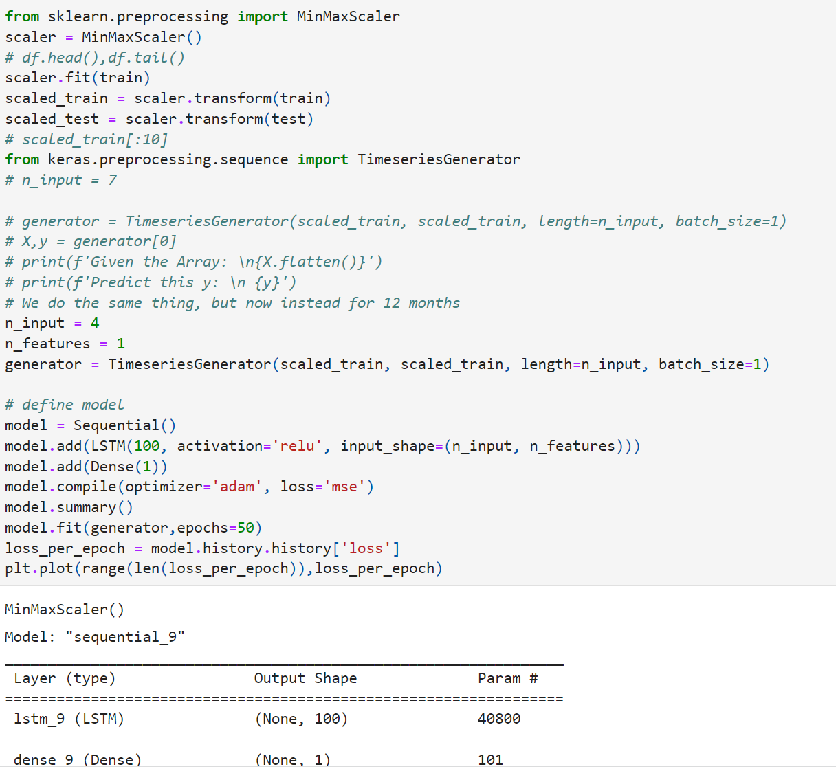
Methodology: LSTM

Slide 9
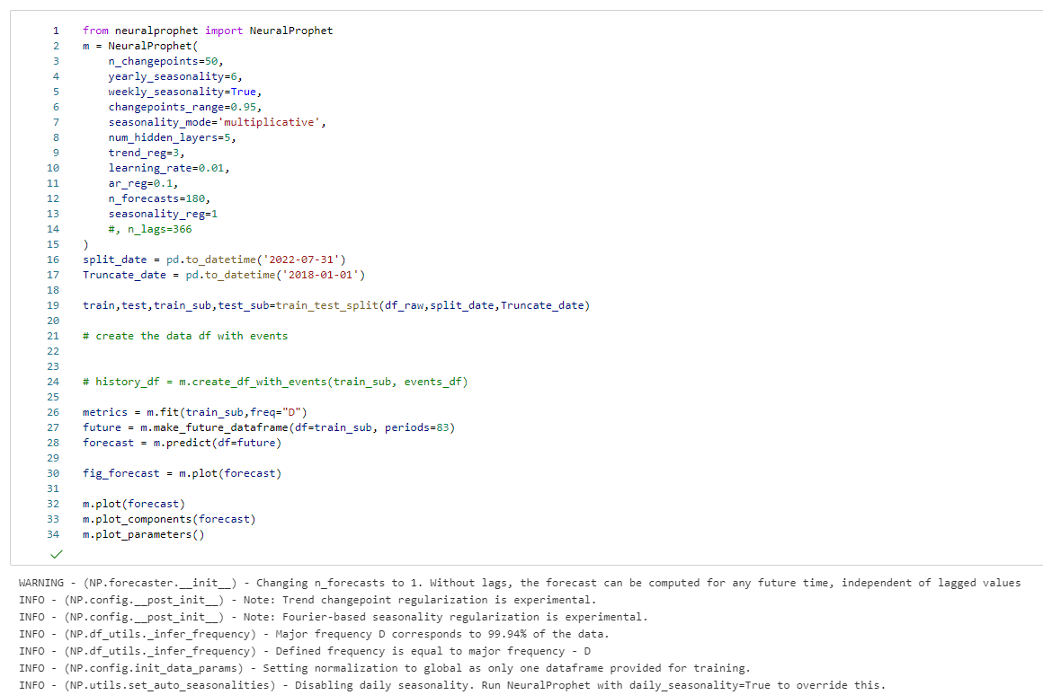
Methodology: Neural Prophet

Slide 10
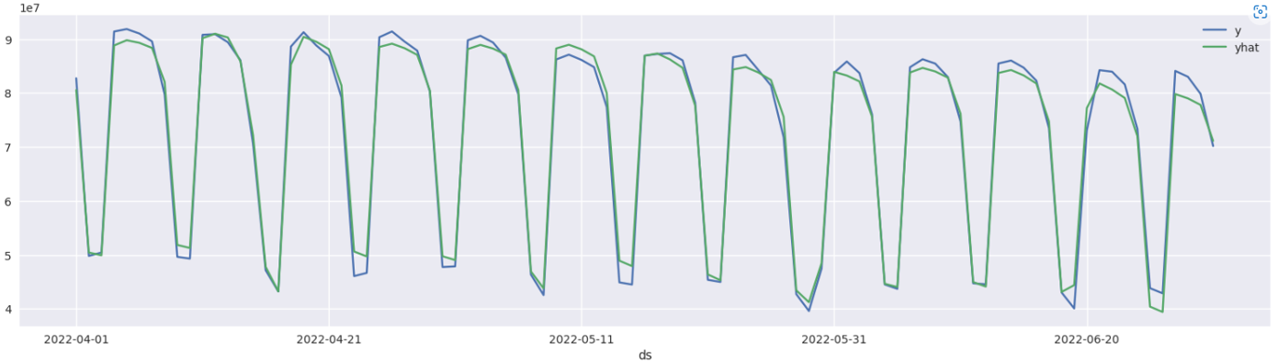
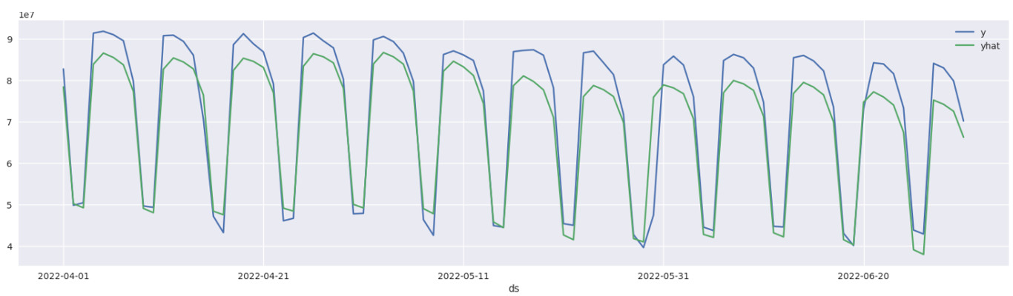
Decide seasonality mode
Understanding additive versus multiplicative seasonality
US: Daily Online search queries
Multiplicative
Additive
Notes:
What: Decide seasonality mode
How: Compared multiplicative vs additive for what?
Result: Multicaptive showed better MAPE by what?

Slide 11
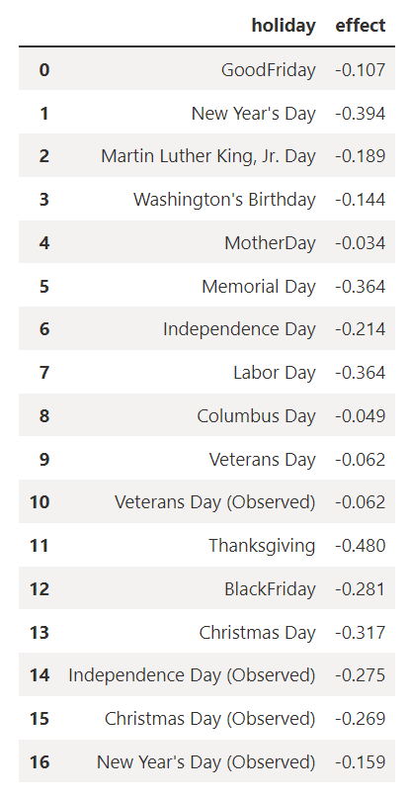
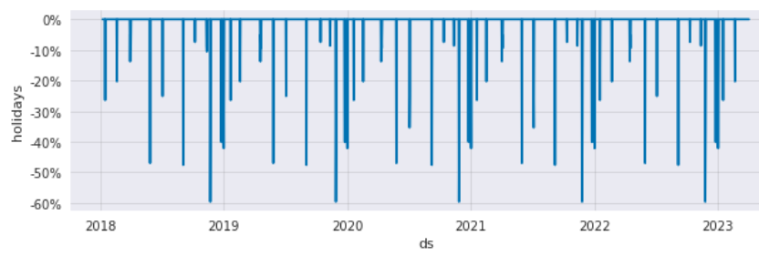
Capturing accurately holidays effect
Holidays
Adding default country holidays
Adding default state or province holidays & understand their effect
Creating custom holidays
Creating multi-day holidays
Regularizing holidays

Slide 12
Detecting Holidays and Growth Initiatives
Neural Prophet model detecting holidays
Martin
Luther
Good Friday/
Easter
Juneteenth
Thanksgiving
Spring Break
July 4
Columbus Day
Presidents' Day
Memorial
Day
Labor Day

Slide 13
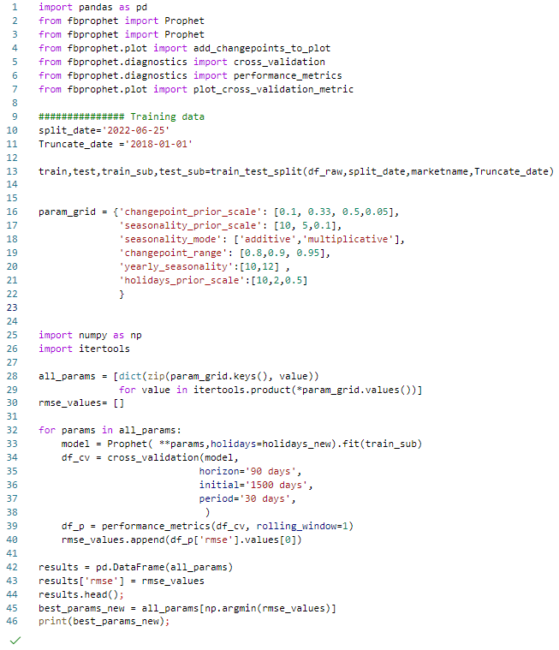
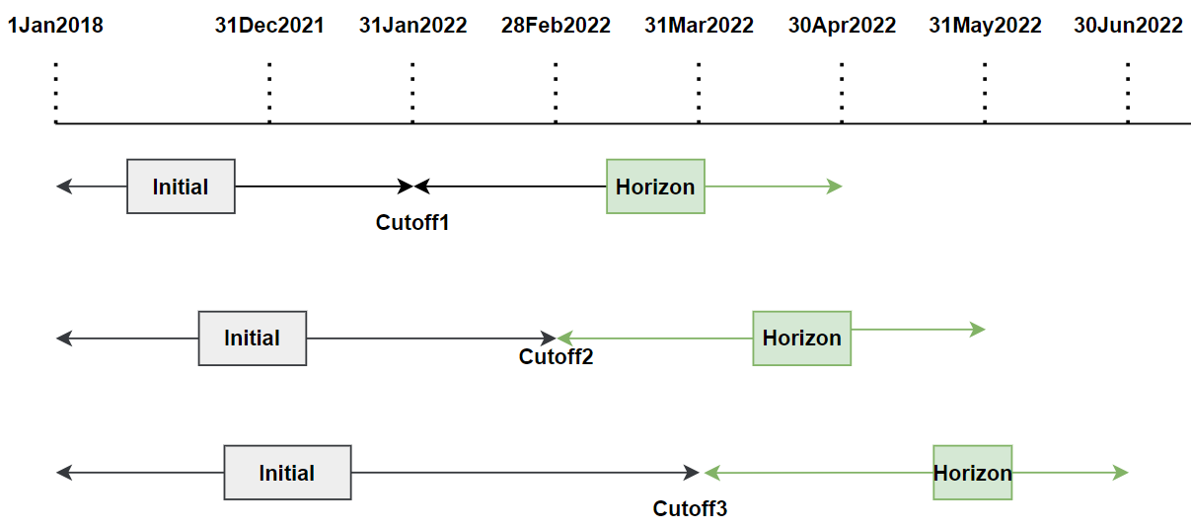
Hyper-parameter tuning using Grid Search Algo & Cross Validation

Slide 14
Result : Compare & Evaluate Forecasting Procedure
LSTM: Last 4 lag value is being used to predict the next value. The network architecture is 100 neuron with one output neuron along with Relu Activation function, optimizer is Adam and error metrics to optimized is mean squared error. Epoch is 50. The network also has one hidden layer. Min Max Scaler is used for Normalization
Neural Prophet: Run the default version of Neural prophet with Multiplicativity seasonality
Gradient Descent for optimization via using PyTorch as the backend.
Modelling Auto-Regression of time series using AR-Net
Modelling lagged regressors using a separate linear or Feed-Forward Neural Network.
Directly predict specific forecast horizons.
Train a single model on many related time-series (global modelling).

Slide 15
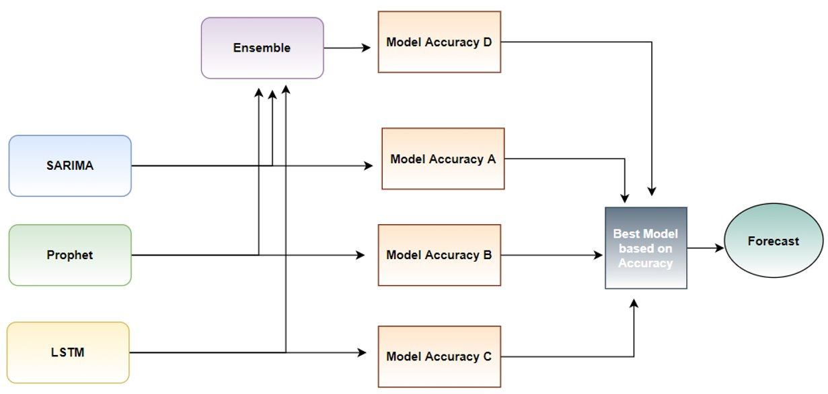
Next Steps
Research other models (Neural Prophet), LSTM and apply ensemble
Study correlation data with weather data, Market performance indicator (DJIA, NASDAQ)
Perform Hyper-parameter Tuning

