Slide 1
Survey-Neuro Computing LSTM & Neural Prophet for Time series forecasting
10/31/2022
Manisha Gupta (PhD Computer Science Student)
Advisor: Dr Kim

Slide 2
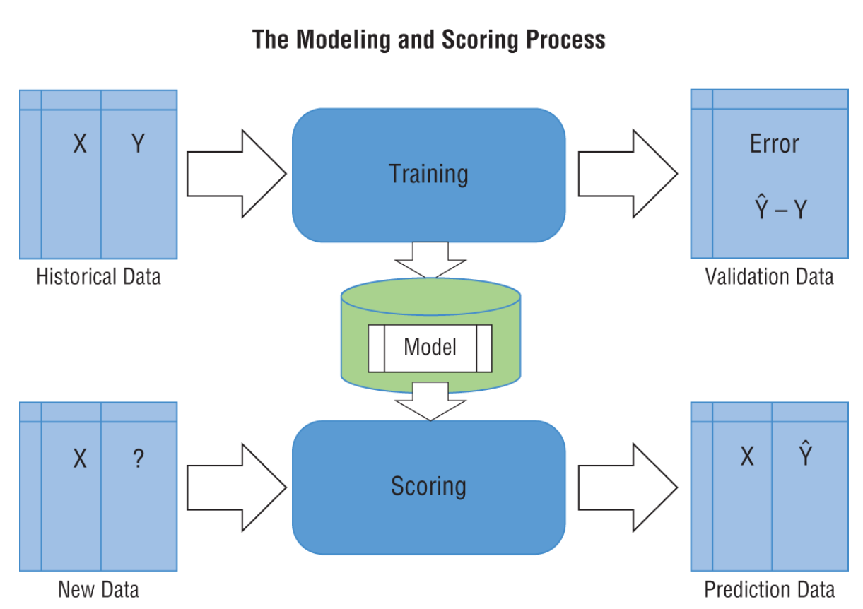
Performance Evaluation Metrics of our model
Performance Metrics
Mean Square Error: The average squared difference between the estimated values and the actual value
Root mean square error (RMSE) is a quadratic scoring rule that also measures the average magnitude of the error. It’s the square root of the average of squared differences between prediction and actual observation. The closer to zero the error is, the better the model.
Mean absolute percentage error (MAPE) is a statistical measure of how accurate a forecast system is. It is a measure in terms of percentage. It is mostly used for time-series forecasting. The closer to zero the error is, the better the model.

Slide 3
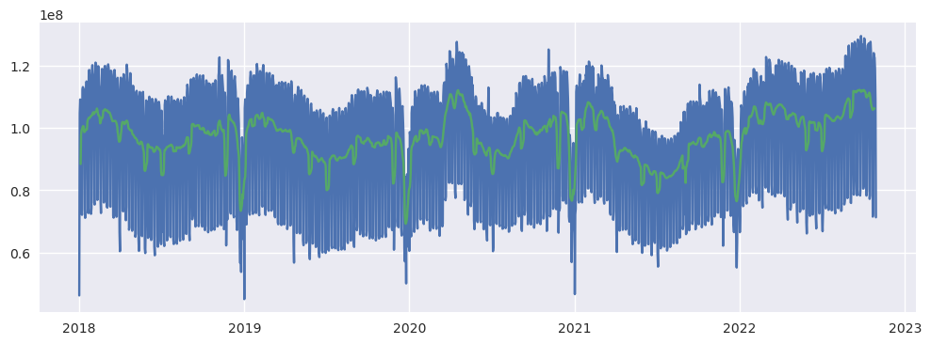
Data Exploration
Online Search Queries

Slide 4

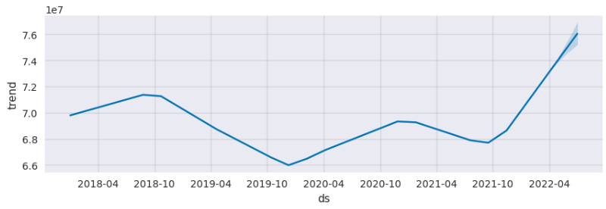
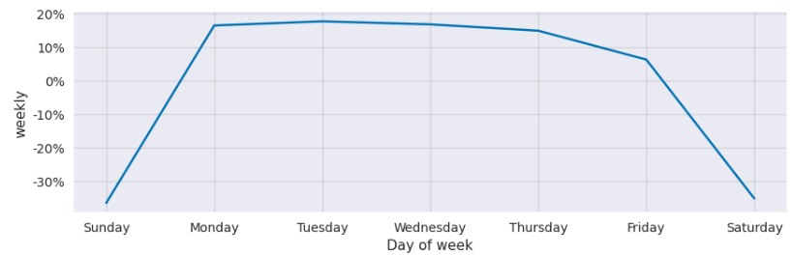
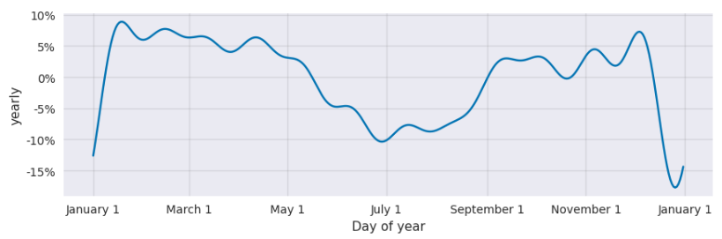
Interpret the model Component

Slide 5
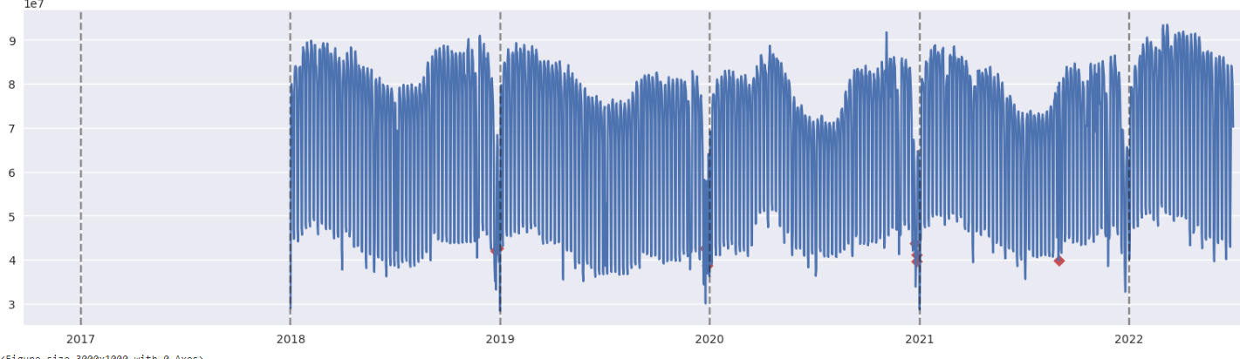
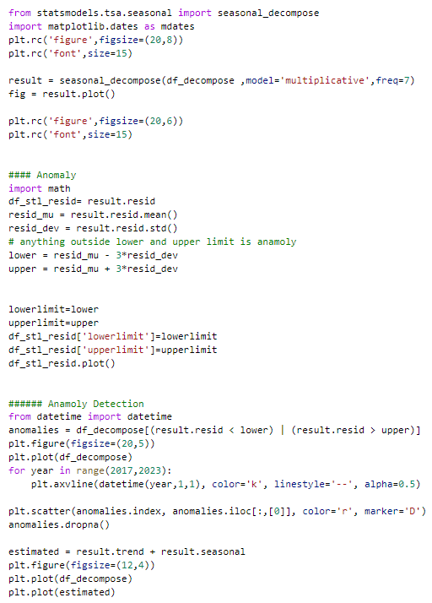
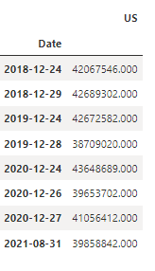
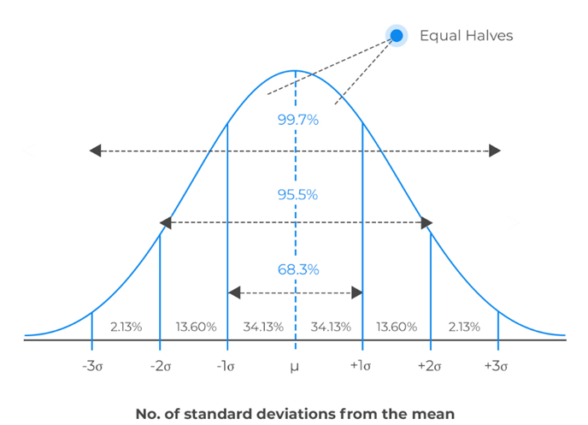
Anomaly detection and Treatment
Technique
Seasonal-Trend decomposition using LOESS (STL)
1) Decompose the time series using seasonal decomposition;
2) Remove trend and seasonality to generate a residual time series;
3) Detect points in the residual which are outside 3 times the interquartile range
Treatment
Forward Fill
Backward Fill
Moving Average- Rolling average
Interpolation
Imputation

Slide 6
Methodology
Baseline Model: Take last 4 days of moving average to forecast the next one
LSTM: Last 4 lag value is being used to predict the next value. The network architecture is 100 neuron with one output neuron along with Relu Activation function, optimizer is Adam and error metrics to optimized is mean squared error. Epoch is 50. The network also has one hidden layer. Min Max Scaler is used for Normalization
Neural Prophet: Run the default version of Neural prophet with Multiplicativity seasonality
Gradient Descent for optimization via using PyTorch as the backend.
Modelling Auto-Regression of time series using AR-Net
Modelling lagged regressors using a separate linear or Feed-Forward Neural Network.
Directly predict specific forecast horizons.
Train a single model on many related time-series (global modelling).

Slide 7
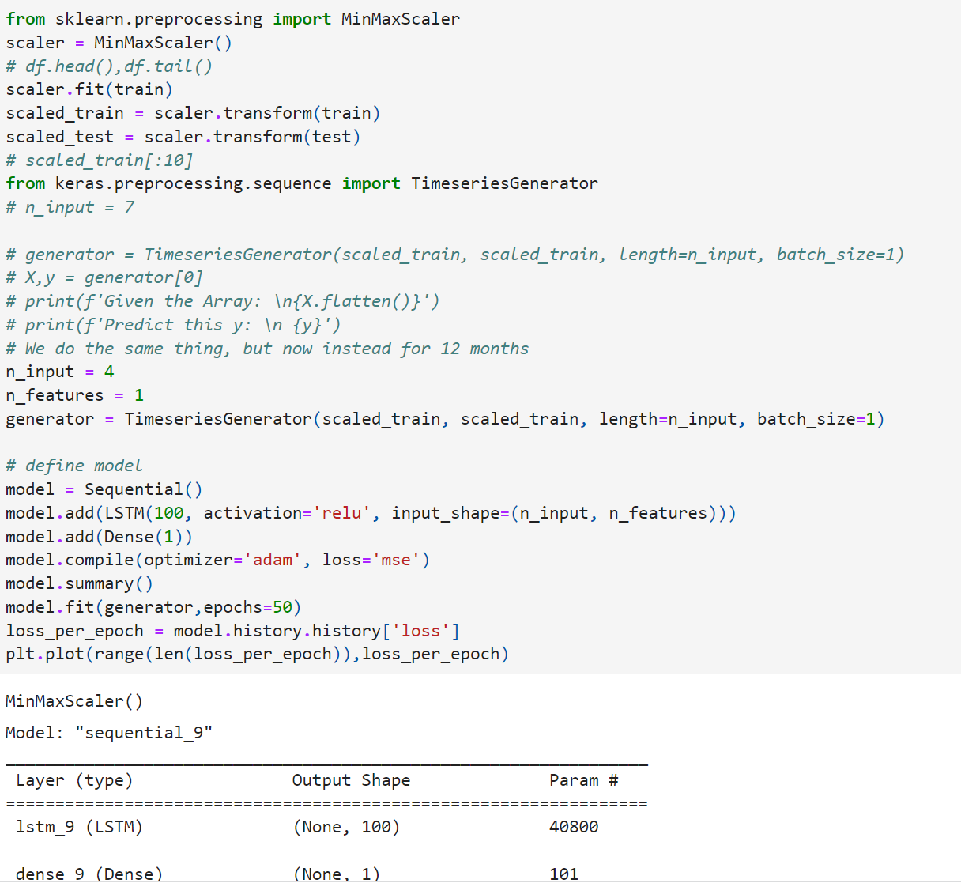
Methodology: LSTM

Slide 8
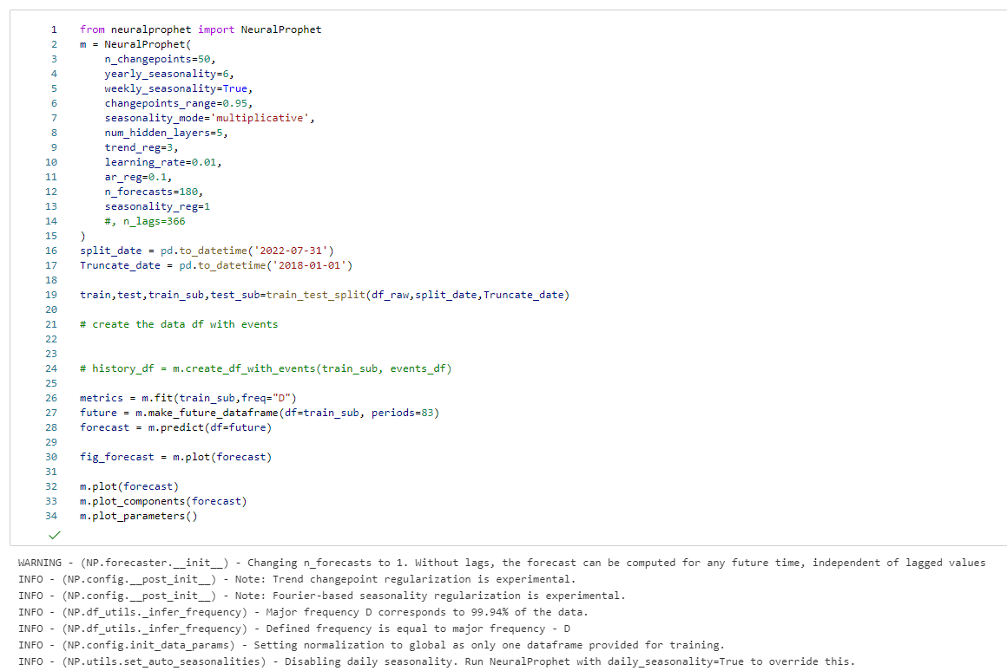
Methodology: Neural Prophet

Slide 9
Result : Compare & Evaluate Forecasting Procedure
LSTM: Last 4 lag value is being used to predict the next value. The network architecture is 100 neuron with one output neuron along with Relu Activation function, optimizer is Adam and error metrics to optimized is mean squared error. Epoch is 50. The network also has one hidden layer. Min Max Scaler is used for Normalization
Neural Prophet: Run the default version of Neural prophet with Multiplicativity seasonality
Gradient Descent for optimization via using PyTorch as the backend.
Modelling Auto-Regression of time series using AR-Net
Modelling lagged regressors using a separate linear or Feed-Forward Neural Network.
Directly predict specific forecast horizons.
Train a single model on many related time-series (global modelling).

Slide 10
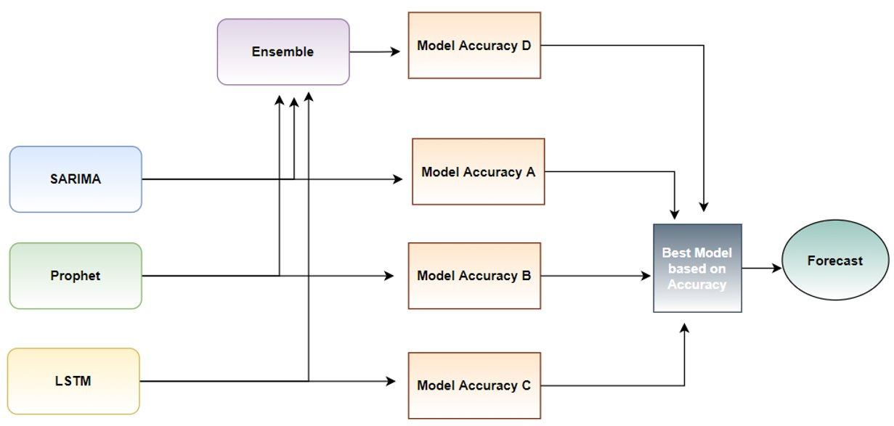
Next Steps
Research other models (Neural Prophet), LSTM and apply ensemble
Study correlation data with weather data, Market performance indicator (DJIA, NASDAQ)
Perform Hyper-parameter Tuning

