Slide 1
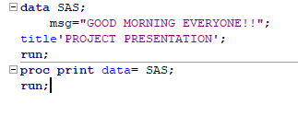
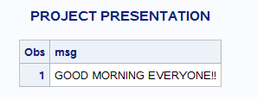

Slide 2

PROJECT 3
-Presented by Manisha Hyndavi

Slide 3
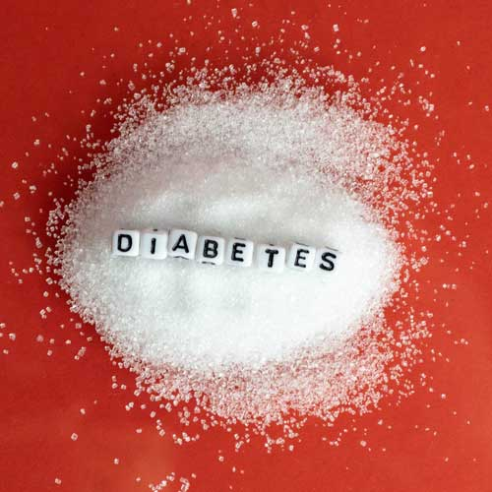
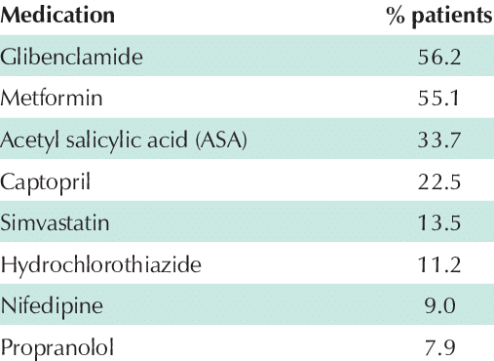
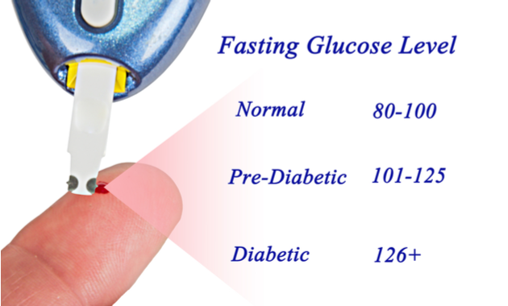
M MEDICATION
Stats according to 2022 reveals that about 422 million people worldwide have diabetes.
What is Diabetes?
Diabetes is a chronic, metabolic disease characterized by elevated levels of blood glucose (or blood sugar) .
2 Types: Type I Diabetes & Type II Diabetes
It is tested by blood test named Fasting Blood Sugar Test or Random Blood Sugar Test.

Slide 4
Objectives
A study was conducted to reduce the fasting blood sugar level by randomly giving three types of dosages( high, low, placebo) to subjects and they were placed in three different sites for 10 weeks and the readings were taken after 10 weeks.
My objectives are to know the how factors like age, site, Length of stay effects the fasting blood sugar level.
To Find whether there is any difference on the mean of test scores among different age groups, across different sites and to find the interactions between them.
How any other factor like age, group, site is correlated to FBS reading?
To know my hypothesized values matches with the actual outcome!

Slide 5

RESEARCH QUESTIONS
Research Question 1:
Is there any difference in the mean of FBS reading among the three groups across all three sites?
Research Question 2:
Is there any difference in the mean of FBS reading among three age groups?
Research Question 3:
Which state among two states outperform the other in terms of FBS reading?
Research Question 4:
Checking whether my hypothesised values fits with the actual outcome?
Research Question 5:
Is there any correlation between age and FBS reading?
This Photo by Unknown Author is licensed under CC BY

Slide 6
Data Cleaning Steps | File-I | File-II
Excel File comma delimited csv file text file imported into the SAS environment. | 3233 observations and 5 variables are seen | 3200 observations and 4 variables are seen
Run Proc frequency procedure to find any discrepancies in data. | Missing data Age - 16 Length of Stay - 2 Total Charge - 205 | Junk data Site - 1 (N/a) Group – 400 (n/a)
Deleted all the missing data rows and rows of observations with length of stay >10 weeks and test scores < 25 and >700. | 3010 observations are seen | 2786 observations are seen
Sorted files by Patient Id, Merged both the files (by Equijoint merge) and renamed few variable names for easy understanding. | After merging both the files 2592 observations and 7 variables are seen | Sampling done by SRS with sample size 1000
M
E T H O D O L O G Y

Slide 7
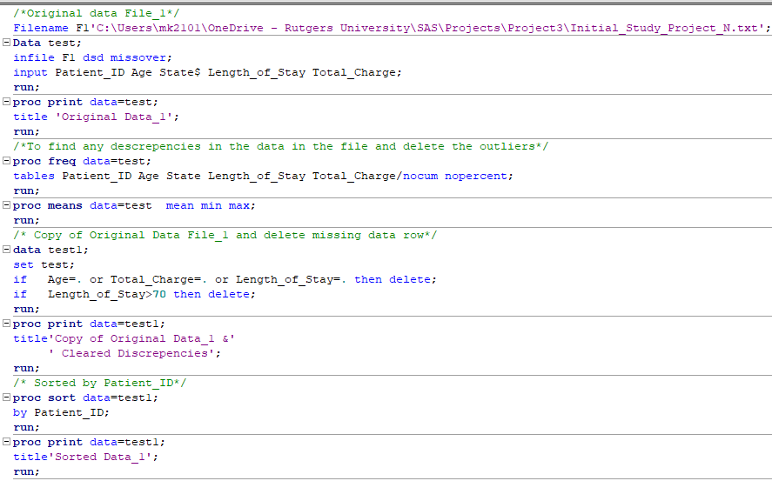


Slide 8
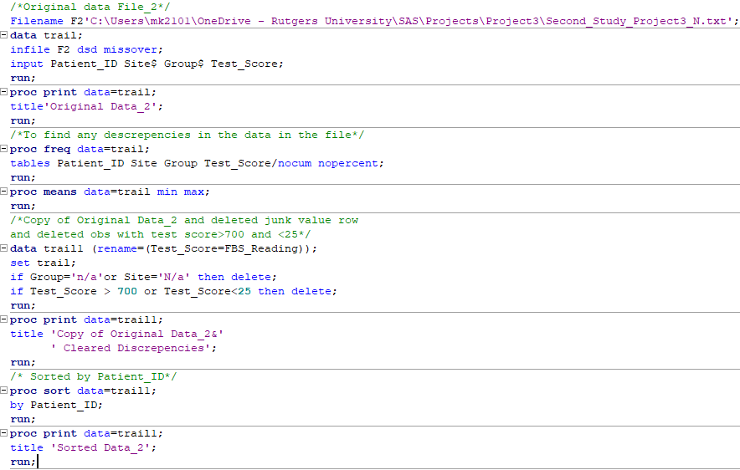


Slide 9
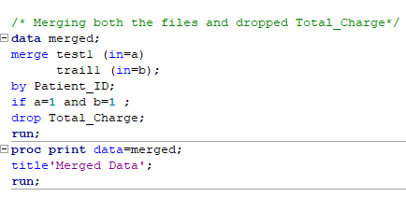
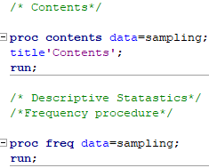
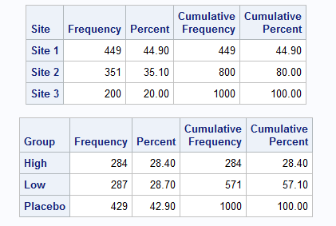
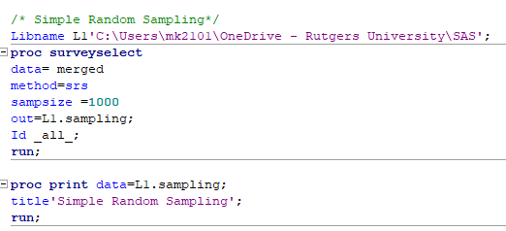
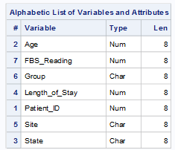
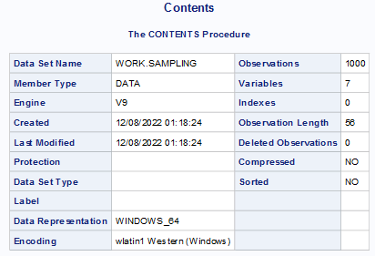

Slide 10
Research Question 1:
Is there any difference in the mean of FBS readings among the three groups (High Drug, Low drug, Placebo) across all three sites (Site 1, Site 2, Site3) ?
As we have to compare the means of FBS reading (Dependent variable) among three groups (Independent variable) across three sites ( Independent variable), we have to do “Two way Anova”.
Check whether the data is normally distributed or not and whether the data is balanced or not before making the test and assuming the data is normally distributed I performed the test.
Null Hypothesis (H0) | Alternative Hypothesis (H1)
There is no difference in the mean of FBS readings among the three groups across all three sites. | There is a difference in the mean of FBS readings among at least two groups across at least two sites.

Slide 11


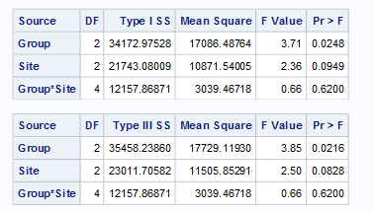
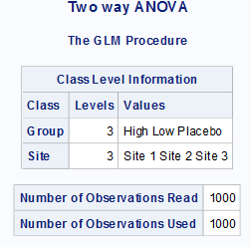
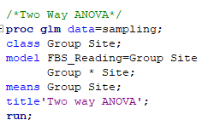
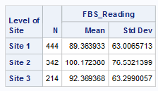
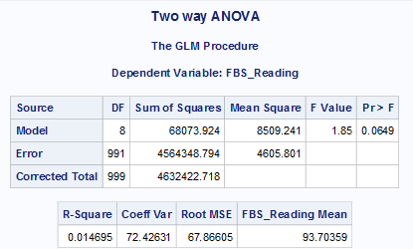
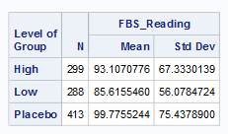


Since the P-Value is 0.0649, which is greater than 0.05, we can reject the alternative hypothesis which indicates that there is no difference in the mean of FBS reading among three groups across three sites.
* P-Value for group is 0.02 – effects the FBS reading
* P – Value for site is 0.08 – does not have any effect the FBS reading

Slide 12
Research Question 2:
Is there any difference in the mean of FBS readings among the three age groups (Young Age, Middle Age, old Age)?
As we have to compare the means of FBS reading (Dependent variable) among three age groups (Independent variable), we have to do “One way Anova”.
Check whether the data is normally distributed or not before making the test. Assuming the data is normally distributed I carried the test.
Null Hypothesis (H0) | Alternative Hypothesis (H1)
There is no difference in the mean of FBS reading among three age groups. | There is a difference in the mean of FBS reading among at least two age groups

Slide 13
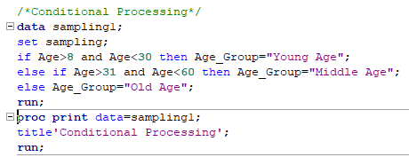
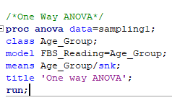
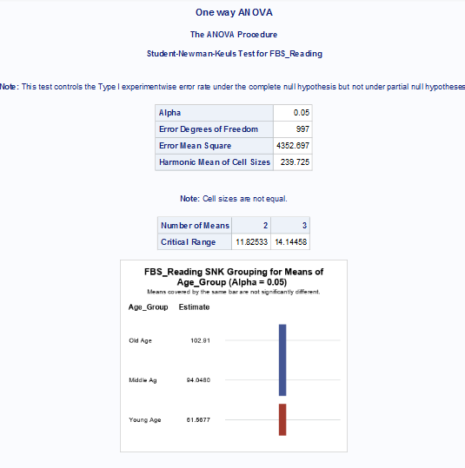
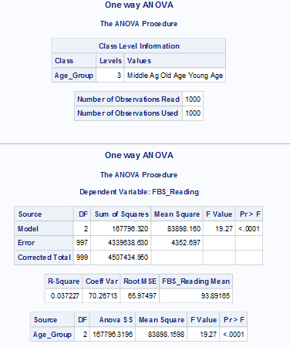
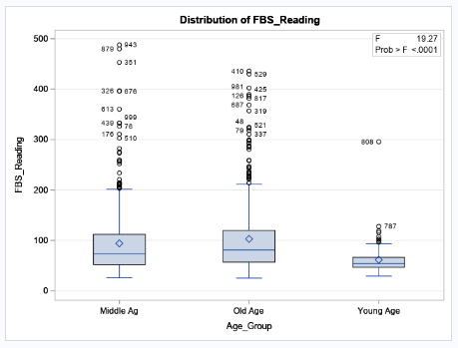

The P-Value is <0.0001, which is significantly less than 0.05. So, we can accept the alternative hypothesis, which indicates that there is a difference in mean of FBS reading among three age groups. SNK graph shows that old and middle age group shows higher FBS reading when compared to young age group.

Slide 14
Research Question 3:
Which state among two states outperform the other in terms of FBS reading?
As we have to compare the means of FBS reading (Dependent variable) among only two states (Independent variable), we have to do “Two sample t-test”.
Check whether the data is normally distributed or not and check for the equality of variance. Assuming the data is normally distributed I carried the test.
Null Hypothesis (H0) | Alternative Hypothesis (H1)
FBS readings remained the same among two states. | One of the state performed well than other state.

Slide 15
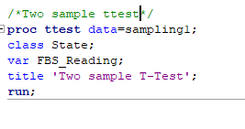
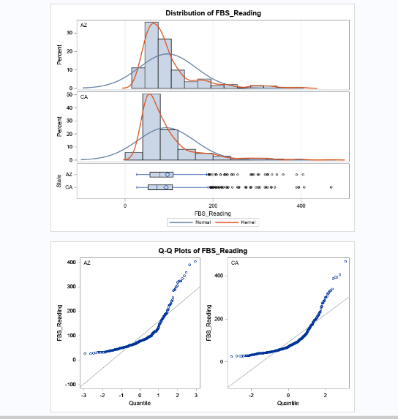
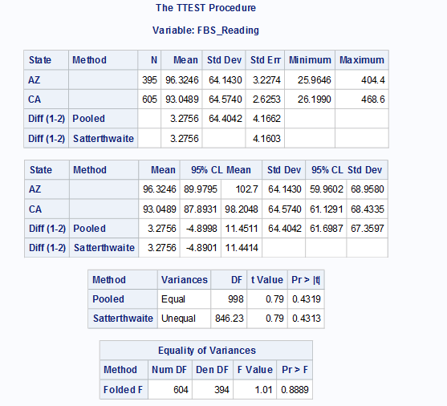


Assuming the data is normally distributed and check for the equality of variance, where the P value is 0.8889 which is greater than 0.05 which indicates that the null hypothesis is true for equality of variance.
In case of equal variances check pooled P value, which is 0.4319 which is >0.05 and hence we accept the null hypothesis which says that none of the states outperforms the other in terms of FBS reading.

Slide 16
Research Question 4:
I want to know whether my hypothesised values fit with the actual outcome?
As we are checking the actual outcome values with the hypothesised values we need to check “Goodness of fit test”.
Check whether the data is normally distributed or not. Assuming the data is normally distributed I carried the test.
Null Hypothesis (H0) | Alternative Hypothesis (H1)
Number of subjects whose sugar level will be high, Low, Normal, Prediabetic would be equal to 20%,30%,40%,10% respectively. | Number of subjects whose sugar level will be high, Low, Normal, Prediabetic would not be equal to 20%,30%,40%,10% respectively.

Slide 17
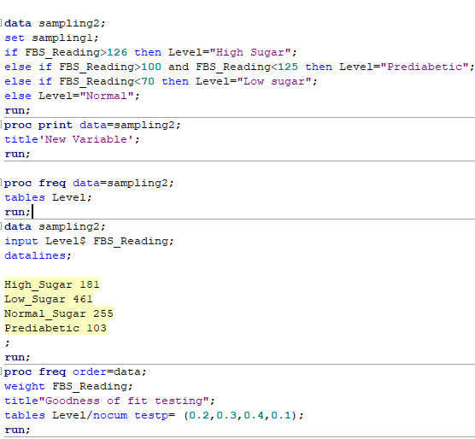
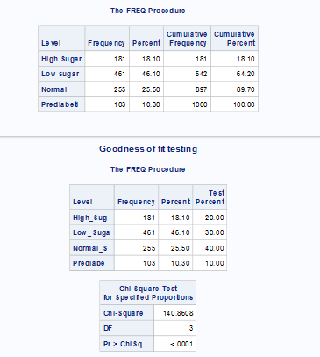

Since the P-value is <0.001 which is significantly less than 0.05, so we can reject the null hypothesis which means the actual outcome is different from the hypothesised values.

Slide 18
Research Question 5:
Is there any correlation between age and FBS reading?
As we have to check if there is any correlation between age and FBS reading we have to do “ Pearson’s Correlation Procedure”.
Check whether the data is normally distributed or not. Assuming the data is normally distributed I carried the test.
Null Hypothesis (H0) | Alternative Hypothesis (H0)
There is no correlation between age and FBS reading | There is a correlation between age and FBS reading

Slide 19
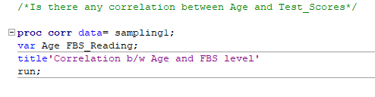
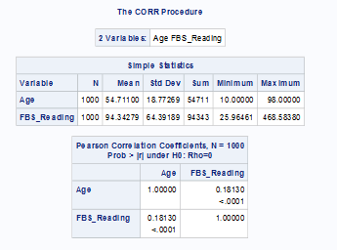

The R value is 0.18 which is positive but not perfect 1. Also, P-Value is <0.001which is greater than 0.05, which indicates that we can reject null hypothesis. That means there is a correlation.

Slide 20
Conclusion
Research Question 1:
Is there any difference in the mean of Fasting Blood Sugar Level reading among the three groups across all three sites?
“No, there is no difference in the mean of FBS readings among the three groups across all three sites”.
Research Question 2:
Is there any difference in the mean of Fasting Blood Sugar Level reading among three age groups?
“Yes, there is a difference in the means of FBS reading among three different age groups”.
Research Question 3:
Which state among two states outperform the other in terms of FBS reading?
“FBS readings remained the same in both the states”.
Research Question 4:
Checking whether my hypothesised values fits with the actual outcome?
“ No, the actual outcome is different from the hypothesised values ”.
Research Question 5:
Is there any correlation between age and FBS reading?
“ Yes, there is a slight positive correlation between age and FBS reading”.

Slide 21


