Slide 1
PROJECT
Project Title : Stock Market News Scraper &
Sentiment Analysis System
Name : Manisha Jangir (EC)
Institute Name : B.K. Birla Institute Of Engineering &
Technology, Pilani

Slide 2
Problems :
Stock market news is scattered across multiple websites
Manual sentiment analysis is time-consuming
Difficult to identify market mood quickly
Lack of automated sentiment tracking
Difficult to analyze large amounts of news data
No centralized dashboard for market sentiment
Solution:
Automated stock market news scraping
Sentiment analysis using NLP
Sector-wise classification
CSV dataset generation
Data visualization
Interactive dashboard

Slide 3
Objectives :
Collect stock market news automatically
Store news data in CSV format
Analyze market sentiment
Classify news as Positive, Negative, or Neutral
Visualize sentiment trends
Build an interactive dashboard

Slide 4
Technologies & Purpose :
Technology | Purpose
Python | Programming
BeautifulSoup | Web Scraping
Pandas | Data Analysis
Matplotlib | Visualization
TextBlob | Sentiment Analysis
Streamlit | Dashboard
Requests | Data Collection

Slide 5
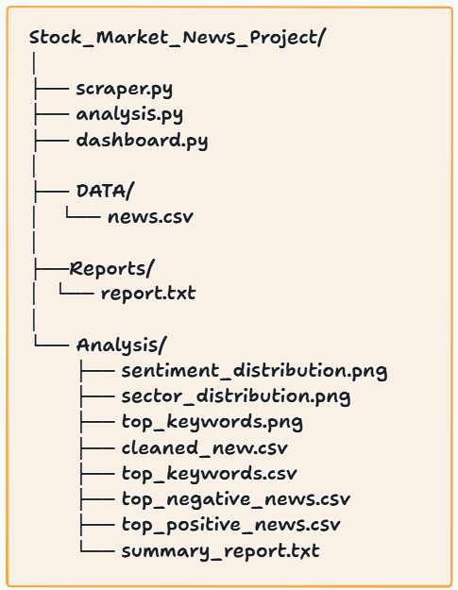
Project Workflow :
Website
Scraper.py
CSV Storage
Analysis.py
Sentiment.py
Dashboard.py
Browser

Slide 6
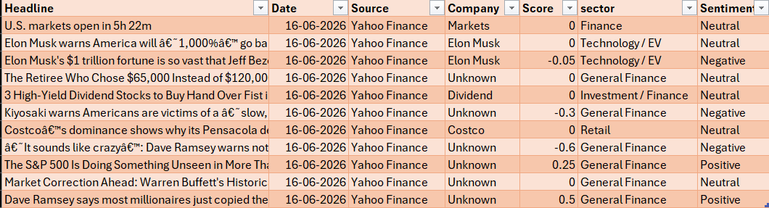
Data Collection :
Stock Market Data :

Slide 7
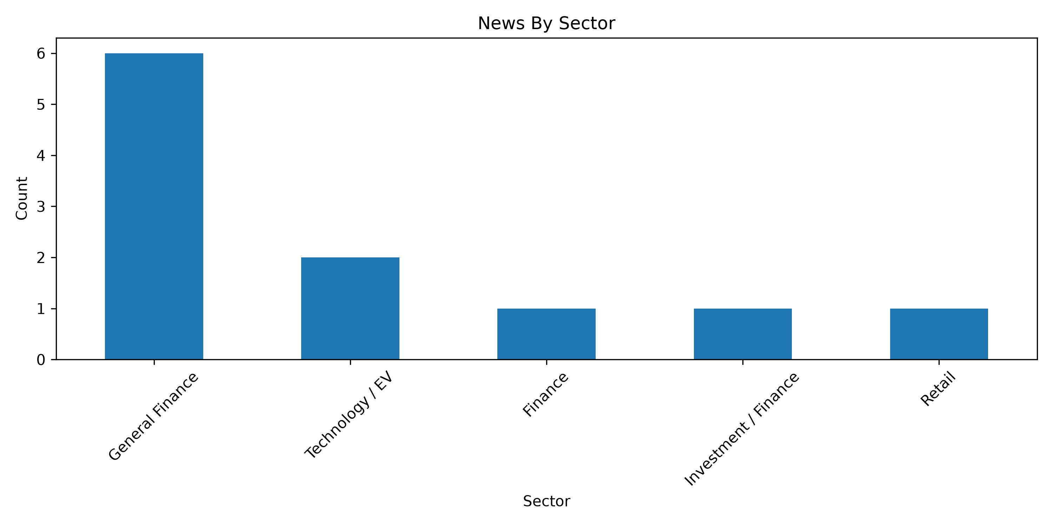
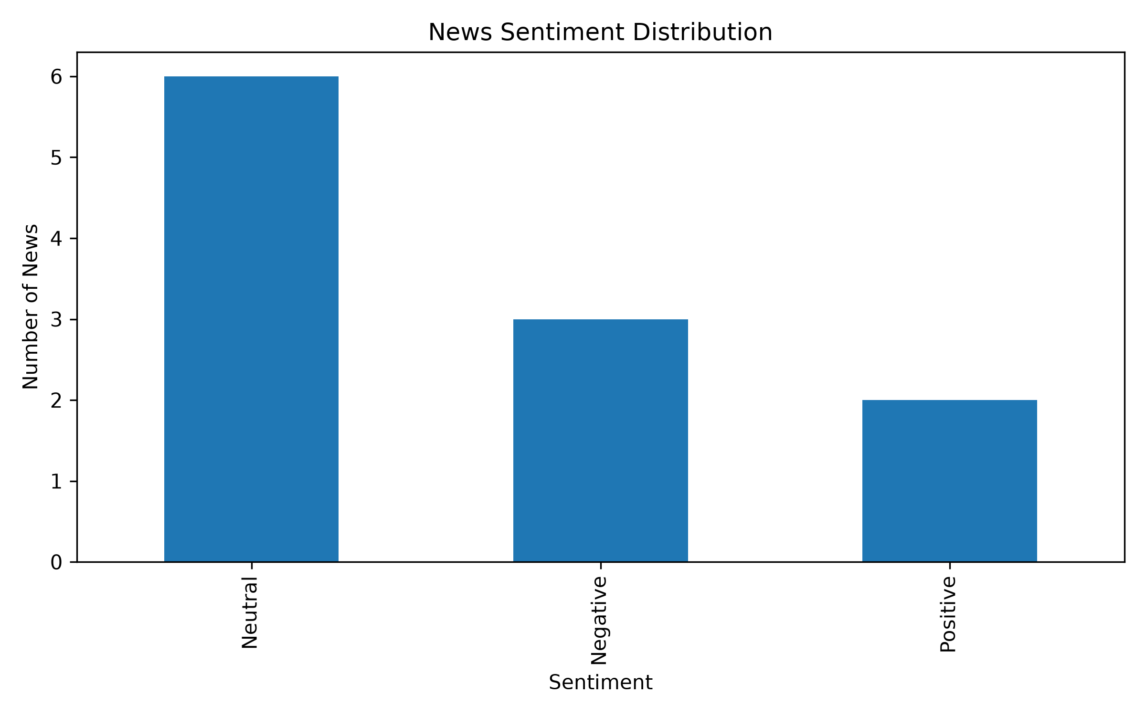
Analysis Results :

Slide 8
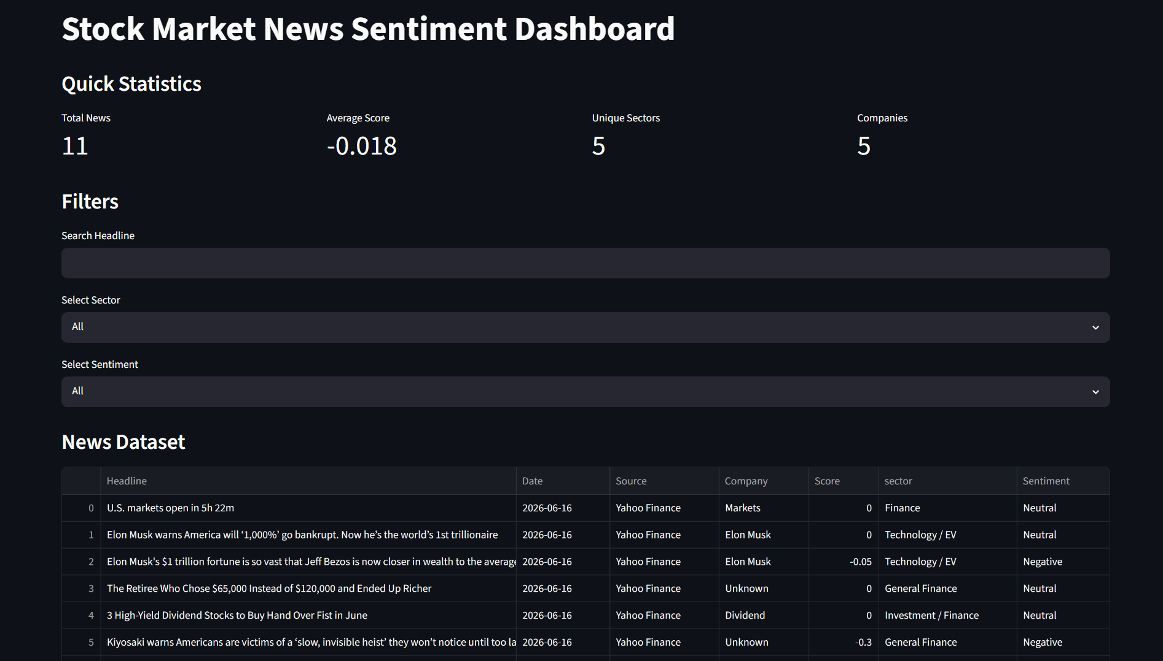
Dashboard :
Features:
Dataset View
Search Fund
Analysis Graphs
Forecast Results
Dashboard

Slide 9
Conclusion & Future Scope :
Conclusion :
Successfully scraped stock market news
Performed sentiment analysis
Generated visual insights
Built interactive dashboard
Organized news data automatically
Future Scope :
Real-time news updates
Multiple news sources
Company extraction
Market trend forecasting
Investment recommendation system

Slide 10
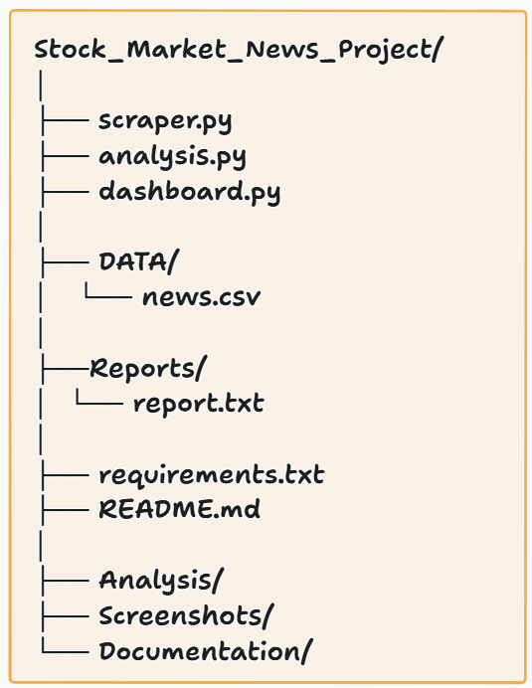
GitHub Repository :
Repository Contains:
Source Code
Dataset
Analysis Results
Dashboard
Documentation
Project Presentation
Repository Structure

Slide 11
Thank You

