Slide 1
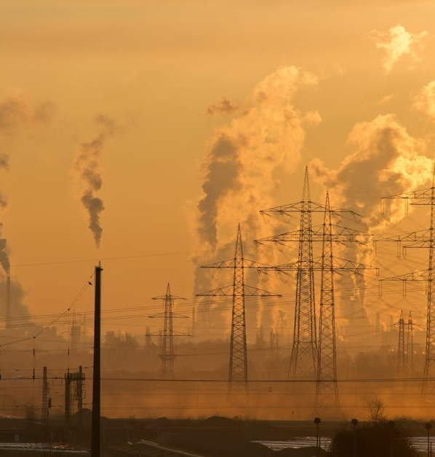
Air Quality Index Prediction and Analysis
Group – 4
Manisha Konda (Z2004588)
Nikhil Vishnu Teja Madasu (Z1980332)
Rohith Reddy Likki (z2004453)

Slide 2

Introduction
Importance of air quality monitoring:
Crucial for urban planning, public health management, and environmental policy-making.
Challenges of poor air quality:
Impacts businesses with reduced productivity, increased healthcare costs, and compliance expenses.
Need for accurate forecasting:
Enables informed decision-making for businesses and organizations.
Benefits of predictive models:
Provides lead time to adjust operations, protect employee health, and optimize energy usage.
Drives cost savings and enhances corporate social responsibility (csr).

Slide 3

Business Questions Q: Can we accurately predict the Air Quality Index (AQI) in urban areas 24-48 hours in advance? This involves understanding how various pollutants (PM2.5, PM10, NO2, SO2, etc.) and environmental factors interact to influence overall air quality, enabling proactive urban planning and public health measures.

Slide 4

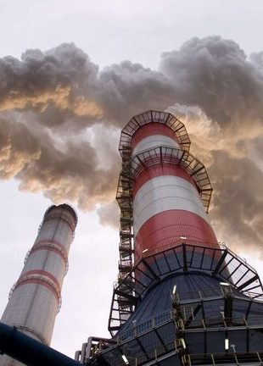
Project Objectives
Develop and compare multiple deep learning models for accurate AQI prediction
Analyze temporal patterns and pollutant contributions to air quality
Provide actionable insights for business decision-making and urban planning
Evaluate WHO (World health organization) guideline compliance and identify critical intervention periods

Slide 5

Methodology Initial Setup and Data Processing
Utilized essential libraries: pandas, numpy, matplotlib, seaborn, scikit-learn, and tensorflow.
Loaded data from 'city_day.csv'
Performed datetime conversion and mean imputation for missing values
Created temporal features from dates (year, month, day)

Slide 6

Model Architecture Development
Three distinct deep learning models implemented:
LSTM Model: Two LSTM layers (64 and 32 units) with dense layers
Hybrid CNN-LSTM Model: Combined convolutional layers with LSTM layers
Transformer Model: Multi-head attention mechanisms with 4 attention heads

Slide 7

Data Preparation and Training
Features scaled using MinMaxScaler
Created time series sequences with 30-day window
Dataset split: 80% training, 20% testing
Models trained using Adam optimizer and Mean Squared Error loss
Training conducted for 10 epochs with batch size of 50

Slide 8

Analysis

Slide 9
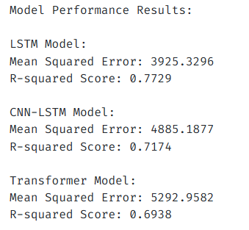
Model Performance Analysis
Performance metrics for each model:
LSTM Model: MSE of 3925.33, R² score of 0.773 (Best performer)
CNN-LSTM Hybrid: MSE of 4885.19, R² score of 0.717
Transformer Model: MSE of 5292.96, R² score of 0.694

Slide 10
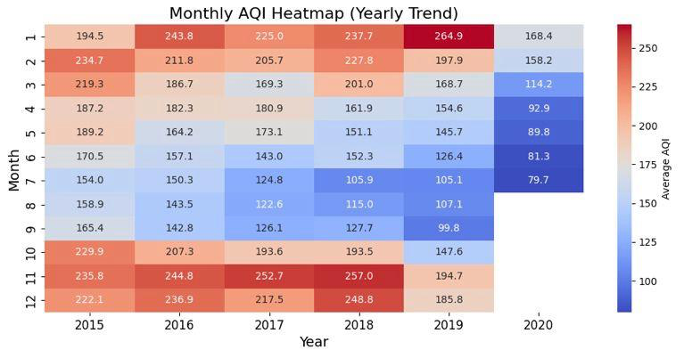
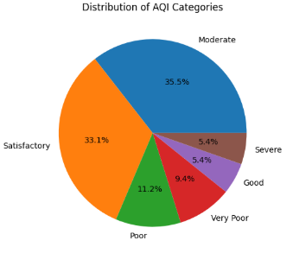
Temporal Pattern Analysis
November showed peak AQI levels
July recorded lowest AQI levels
Moderate conditions: 35.5% of observations
Satisfactory conditions: 33.1% of observations

Slide 11
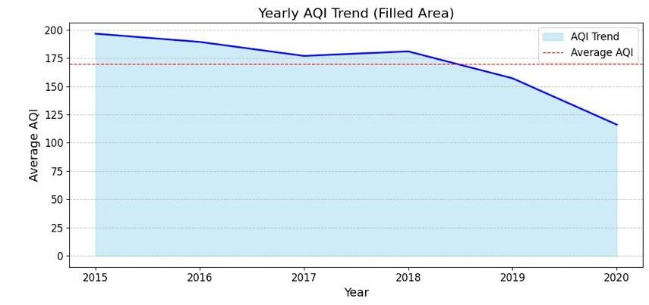
General improvement in air quality from 2015 to 2020
Air quality shows a consistent improvement trend from 2015 to 2020. This highlights the effectiveness of measures taken to reduce pollution during this period.

Slide 12
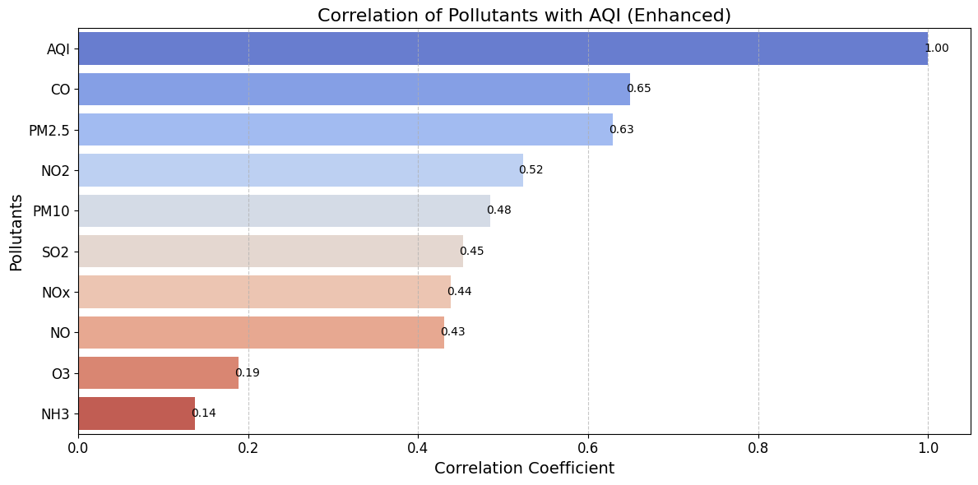
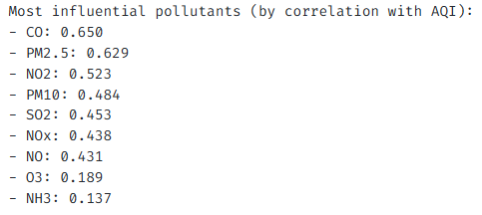
Pollutant Impact Assessment
Correlation with AQI:
Carbon Monoxide (CO): 0.650
PM2.5: 0.629
NO2: 0.523
WHO guideline exceedance:
PM10: 67.1% of days
PM2.5: 48.5% of days

Slide 13
Model Selection Justification

Slide 14
Models
LSTM: Selected for handling time series data and capturing long-term dependencies
CNN-LSTM Hybrid: Implemented for combined spatial feature extraction and temporal pattern recognition
Transformer: Included to test attention mechanisms in capturing complex relationships

Slide 15

Business Insights and Applications
Risk Management: Anticipate poor air quality days for operational adjustments
Healthcare Cost Reduction: Implement preventive measures during high-pollution periods
Regulatory Compliance: Proactive emissions management
Resource Optimization: Efficient HVAC and air purification management
Corporate Planning: Informed facility location and expansion decisions

Slide 16

Conclusion
LSTM model emerged as most reliable predictor
Significant air quality improvements from 2015 to 2020
Challenges remain with particulate matter and carbon monoxide levels
Project enables proactive approach to environmental challenges
Future enhancements: real-time prediction, weather data integration, business-specific risk metrics

Slide 17
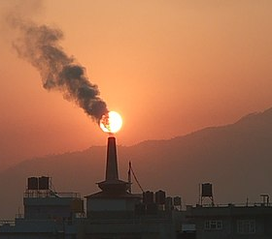
THANK YOU
Any Questions?

