Slide 1
Good Morning
Presented by:
Manish Khadka
Kusum Thapa Magar
Bishnu Maya Sunuwar
Shristi Gurung

Slide 2
ENTREPRENEURSHIP

Slide 3
FUNDING REQUIREMENT
Start-ups often have difficulty raising fund because they
are unknown and untested.

Slide 4
The fundamental financial building blocks of an entrepreneur are :
What assets are required to open the business,
What expenses will be required,
Which expenses cannot be changed and must be paid(fixed costs)and
Knowing how these costs will be financed.

Slide 5
Cash flow challenges
Reasons of Funding Requirements
Capital investments
Lengthy product development cycle

Slide 6
Cash flow challenges
The interval between spending to generate revenue
and earning income from the firm’s operations
create cashflow challenges.

Slide 7
Capital investments
Capital investments involves long term or fixed capital which is essential for establishment of a new venture.

Slide 8
Lengthy product development cycle
Sometime the product development cycles become long, in which firms need to invest upfront for a longer time. This slow and time taking process demand a regular pumping of finance towards the process before any revenue generation.

Slide 9
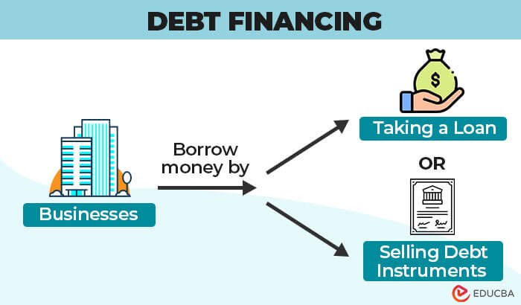

DEBT FINANCING

Slide 10
DEBT FINANCING
Debt financing is when a company raises money by borrowing from individuals, banks, or other financial institutions.
This type of financing involves taking on debt that must be repaid with interest over a specified period of time.
It includes bank loan, government backed loans, credit cards, mortgage and equipment loans.
Debt financing can offer a lower cost of capital, tax advantages through deductible interest payments, and the opportunity to maintain control and ownership of your business.

Slide 11


Slide 12
SOURCES OF DEBT FINANCING
Commercial bank
Bonds
Personal sources
Peer-to-Peer lending
Other sources

Slide 13
Sources of Equity Funding

Slide 14

Equity Funding
Equity funding entails businesses selling ownership stakes to investors in exchange for capital, bypassing the need for traditional loans and allowing for potential returns through dividends or share sales.

Slide 15
Angel investors
Common Sources of Equity Funding
Venture Capital
Initial Public Offering

Slide 16
ANGEL INVESTORS
Individual wealthy investors who provide early-stage capital to startups in exchange for equity.
Typically invest smaller amounts compared to venture capitalists.
Often have industry experience and can provide mentorship along with funding.

Slide 17
VENTURE CAPITAL
Investment firms that provide capital to high-potential startups in exchange for equity.
Usually invest larger sums than angel investors, targeting high-growth potential companies.
Venture capitalists often take an active role in guiding the strategic direction of the company.

Slide 18
Initial Public Offering (IPO)
Process by which a privately-held company becomes publicly traded by offering shares to the public on a stock exchange.
Provides a significant influx of capital to the company, enabling further growth and expansion.
Allows early investors, founders, and employees to realize gains by selling their shares on the public market.

Slide 19


