Slide 1
COURSE6_SPRINT4_HACKATHON
Title : Repaying The Credit Hackathon
Prepared By :
Manisha Mahapatro

Slide 2
Agendas of the presentation :
Problem Overview
Solution Process
Preventive Methods
Recommendation

Slide 3
Problem Overview
Gold Atlantis, a credit-providing firm, observed a rise in the number of defaulters.
Now, the firm is only interested in those consumers who have a lower probability of becoming a defaulter

Slide 4
However, there are two types of risks that are associated with the firm's decisions
If the applicant is likely to repay the loan, then disapproving the loan may result in a loss of business to the firm.
If the applicant is not likely to repay the loan, that is if the applicant is a defaulter, then approving the loan may lead to a financial loss to the firm

Slide 5
Solution Process
About knowing the type of dataset (rows(100000)&columns(24),datatypes) .
Analysing Data(missing value treatement,correlation between two columns,filter) .
Analytical Approach(PYTHON) because it has easy structure ,readable code ,portable and extensible programming language .

Slide 6
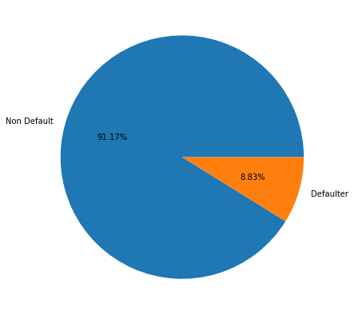
Based on the given data I segregated the clients who are paying on time and who are having difficulties in paying on time so that I can further do analyse on those clients who are having likely to be a defaulter .
Interpretation : from the above plot 91.91% are able to pay loan on time while
8.09% are facing difficulties in paying .

Slide 7
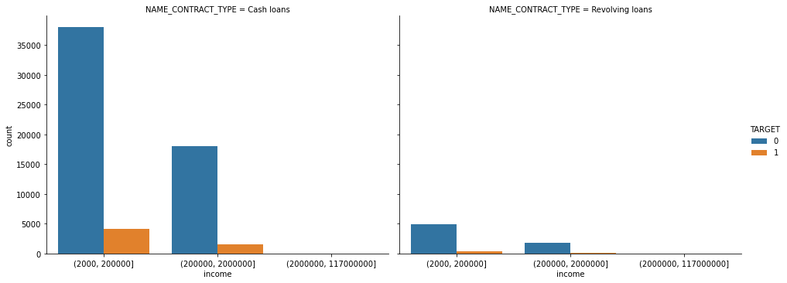
Maximum number of customers took loan in the range of (2000,200000)
There are more number of defaulters in the above graph

Slide 8
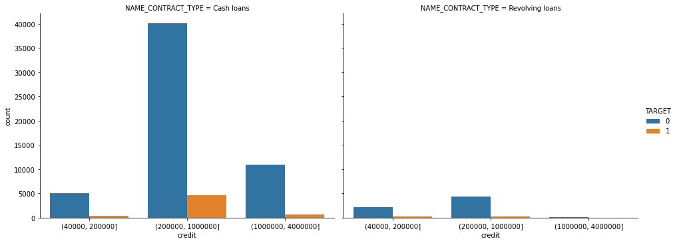
Maximum number of customers took loan in the range between 200000 and 1000000
Defaulters are more in the above graph

Slide 9
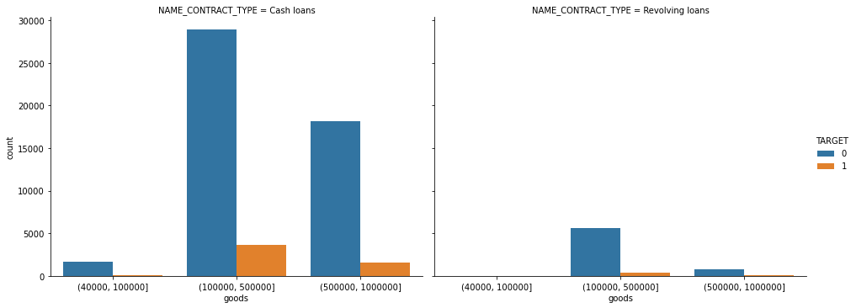
More customers took loan in the range between 100000 and 500000
Defaulters are more as compared to non-defaulters

Slide 10
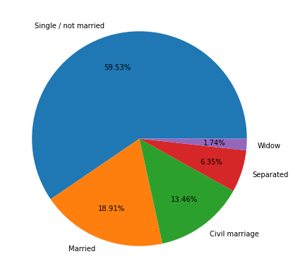
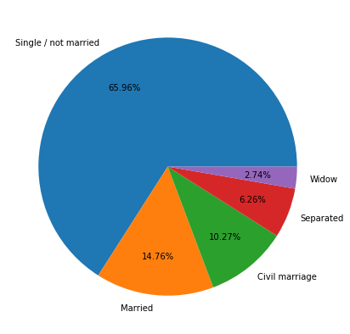
Customers marital-status of defaulters
Customers marital-status of non-defaulters

Slide 11
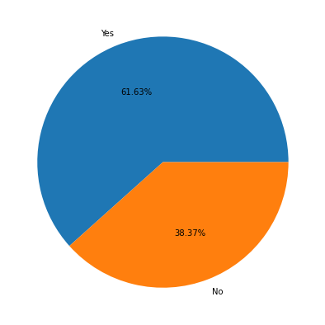
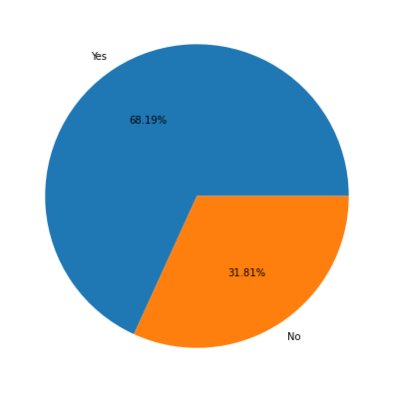
Non-default customers property analysis

Slide 12
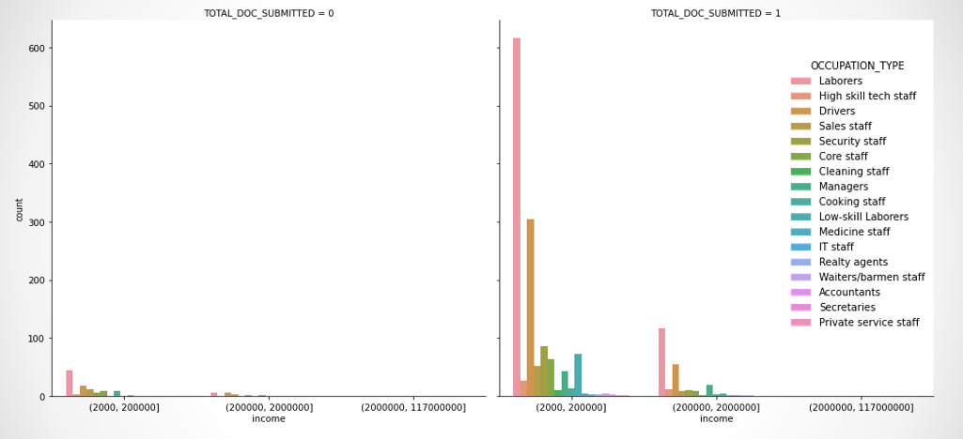
Document submission rate of non-default customers is more in the range of 2000 - 200000 for submission 1

Slide 13
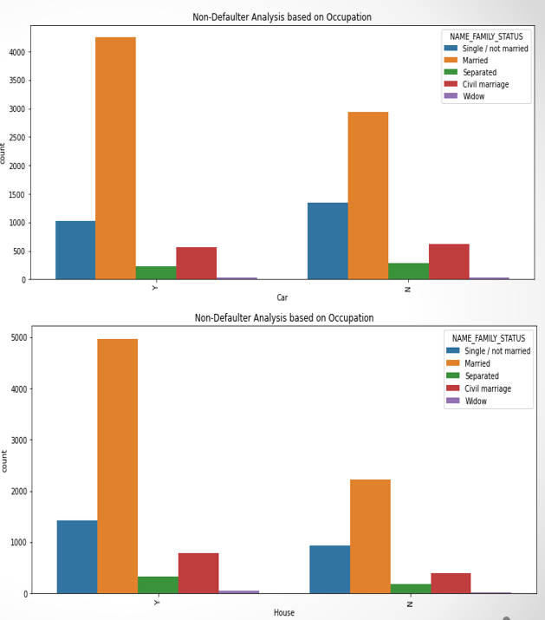
Occupation analysis of non-default customers based on properties

Slide 14
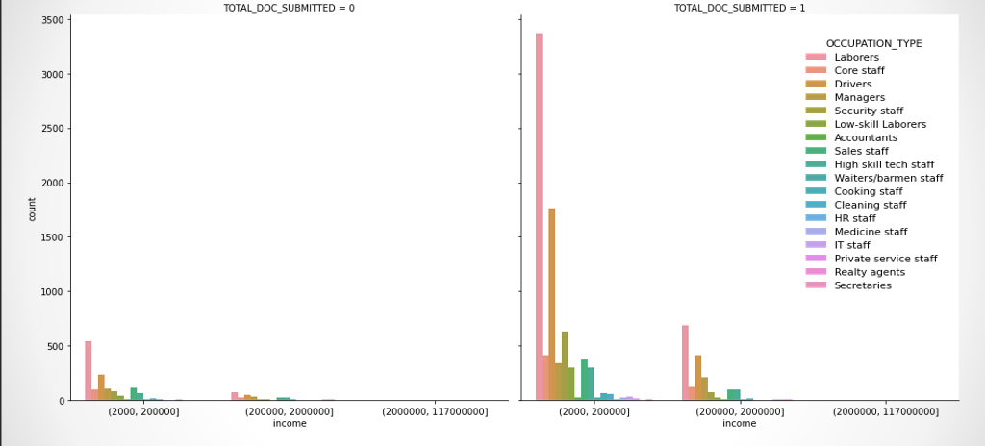
Document submission rate of default customers is more in the range of 2000 - 200000
For submission 1

Slide 15
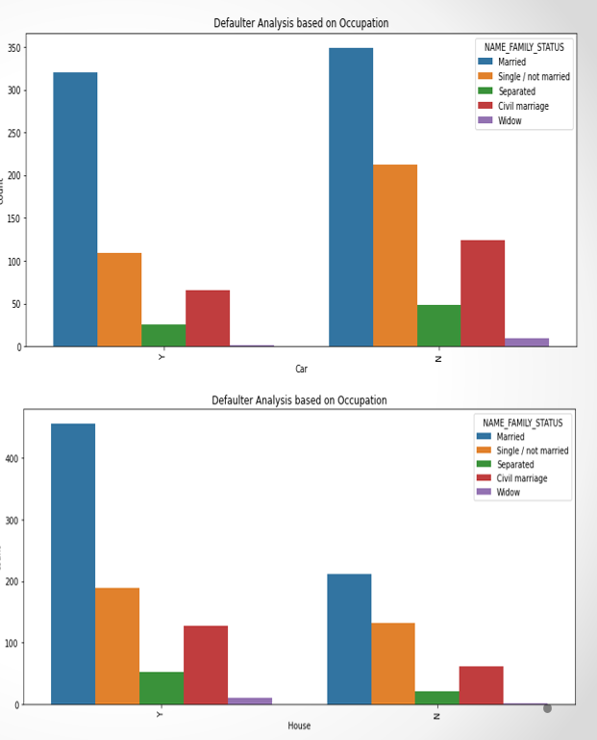
Occupation analysis of default customers based on properties

Slide 16
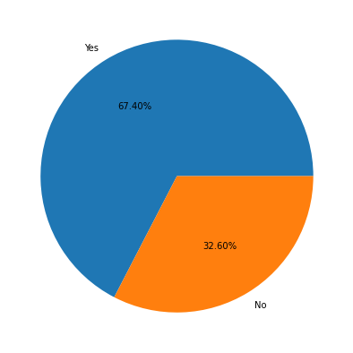

Default customers property analysis

Slide 17
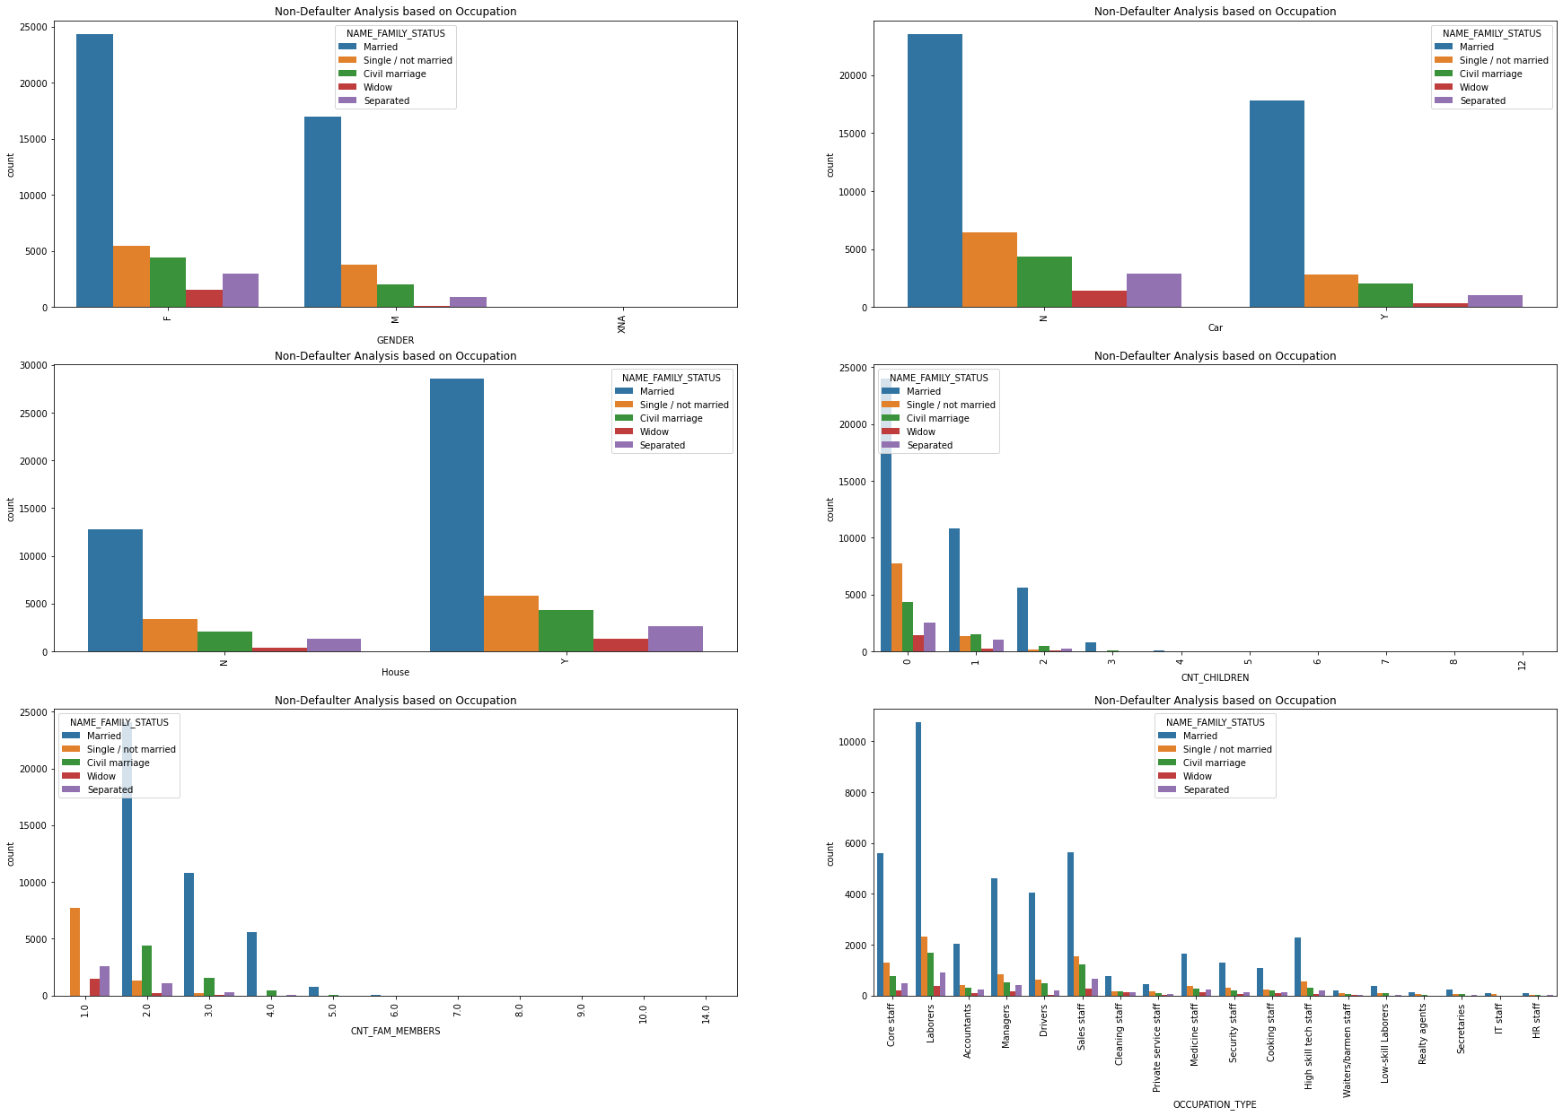

Slide 18
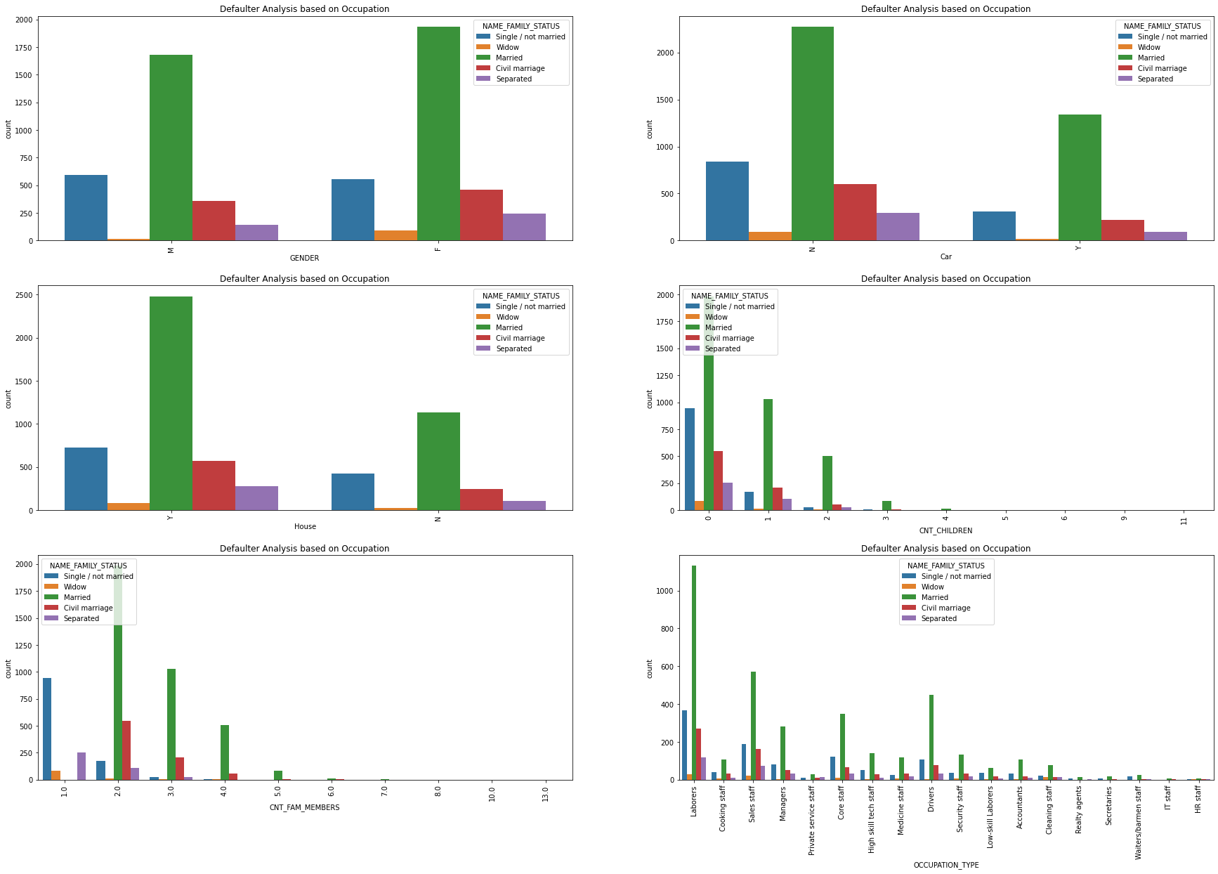

Slide 19
observations:
From the above observation we can say that whose income is less and who don’t have house and who have submitted less documents are more likely to be a defaulter.so we have to remove these type of customers from our entire dataset.
The customers who have more children and educational status is low has very less probability in paying loan so they might be the defaulters
Prescription:
We suggest Gold Atlantics to give loan those who have submitted documents and always give premium on time.
For that we have created an excel file as a suggestion to whom the gold atlantics give loan and those are the customers less likely to be a defaulter.

Slide 20


