Slide 1
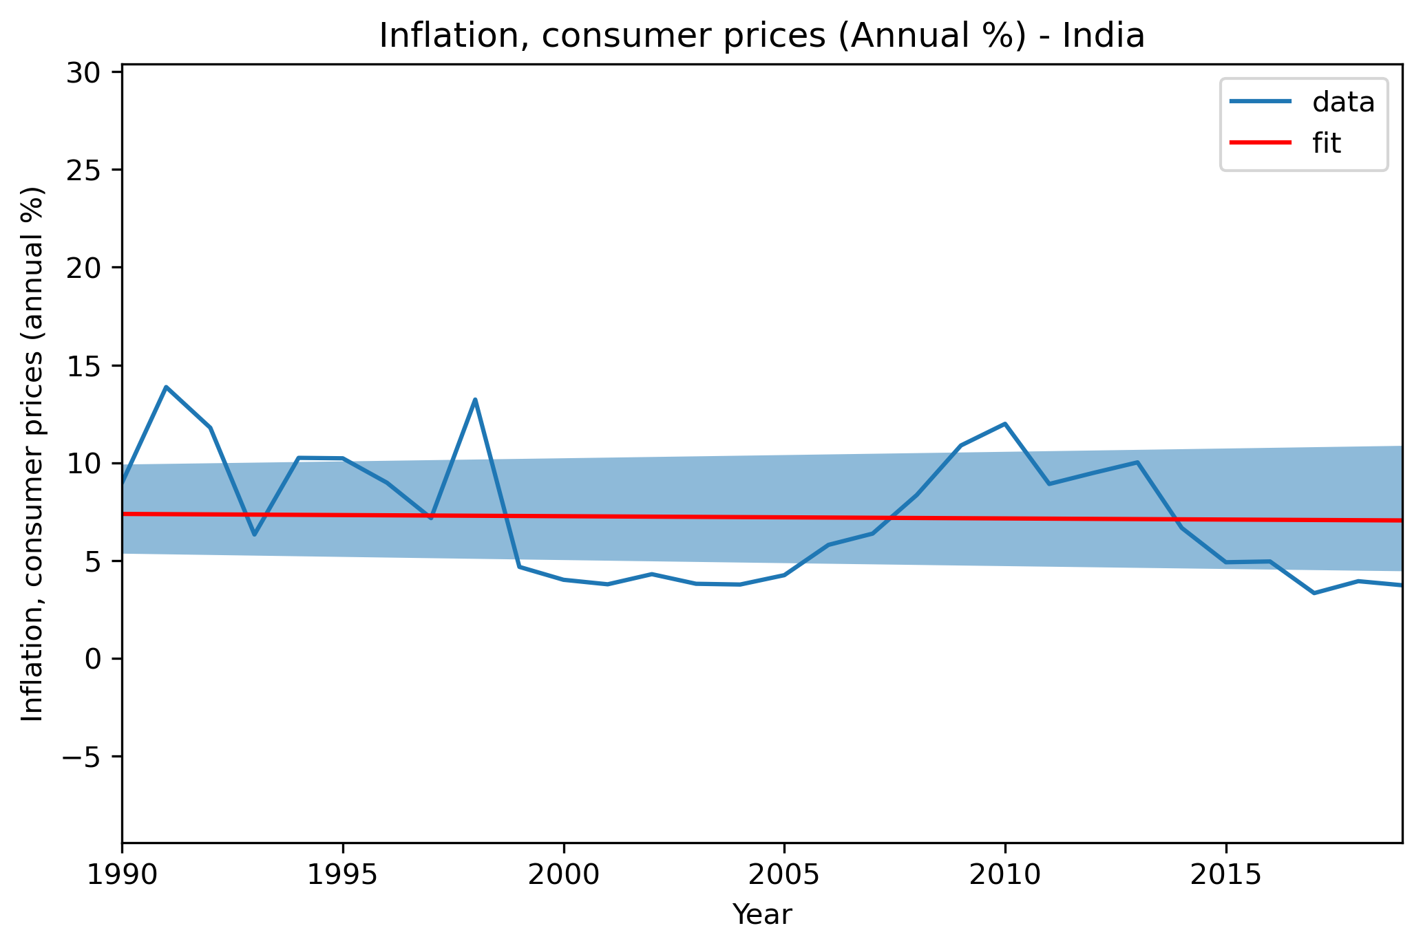
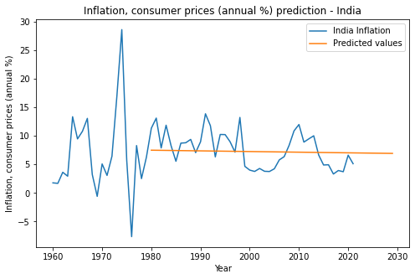
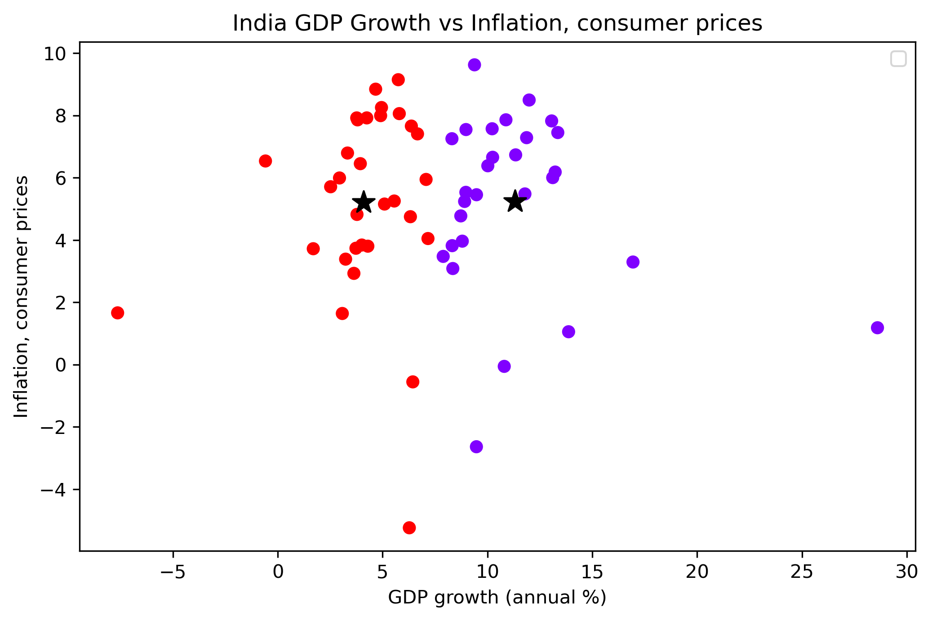
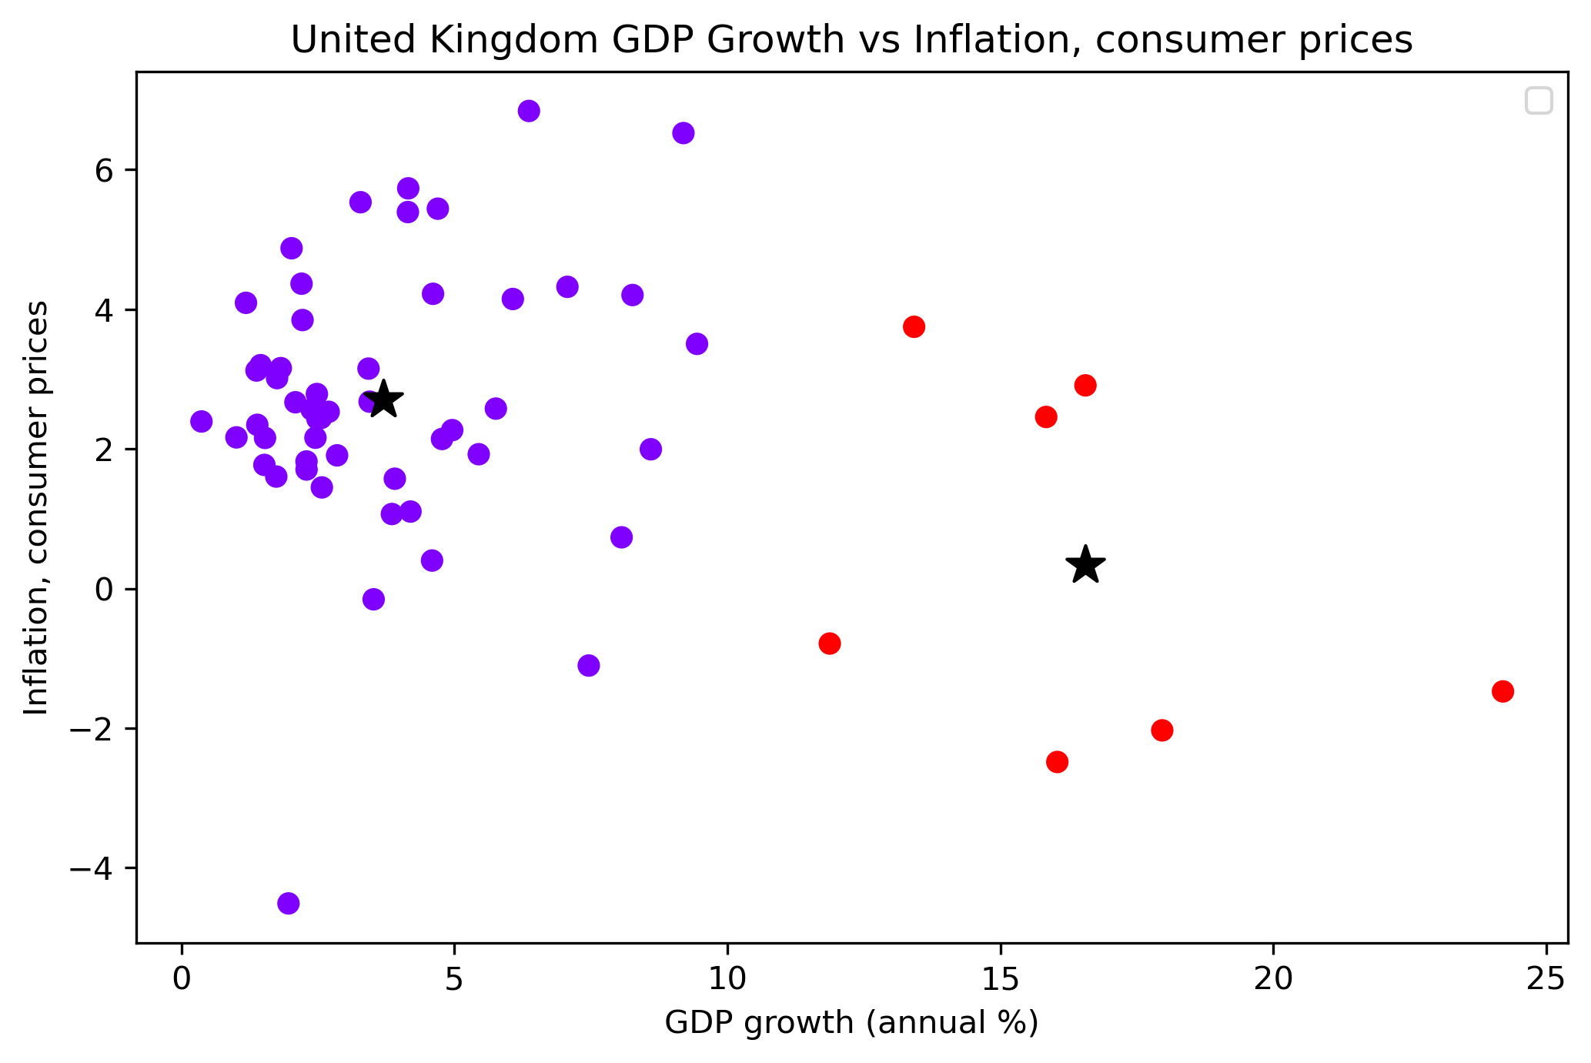
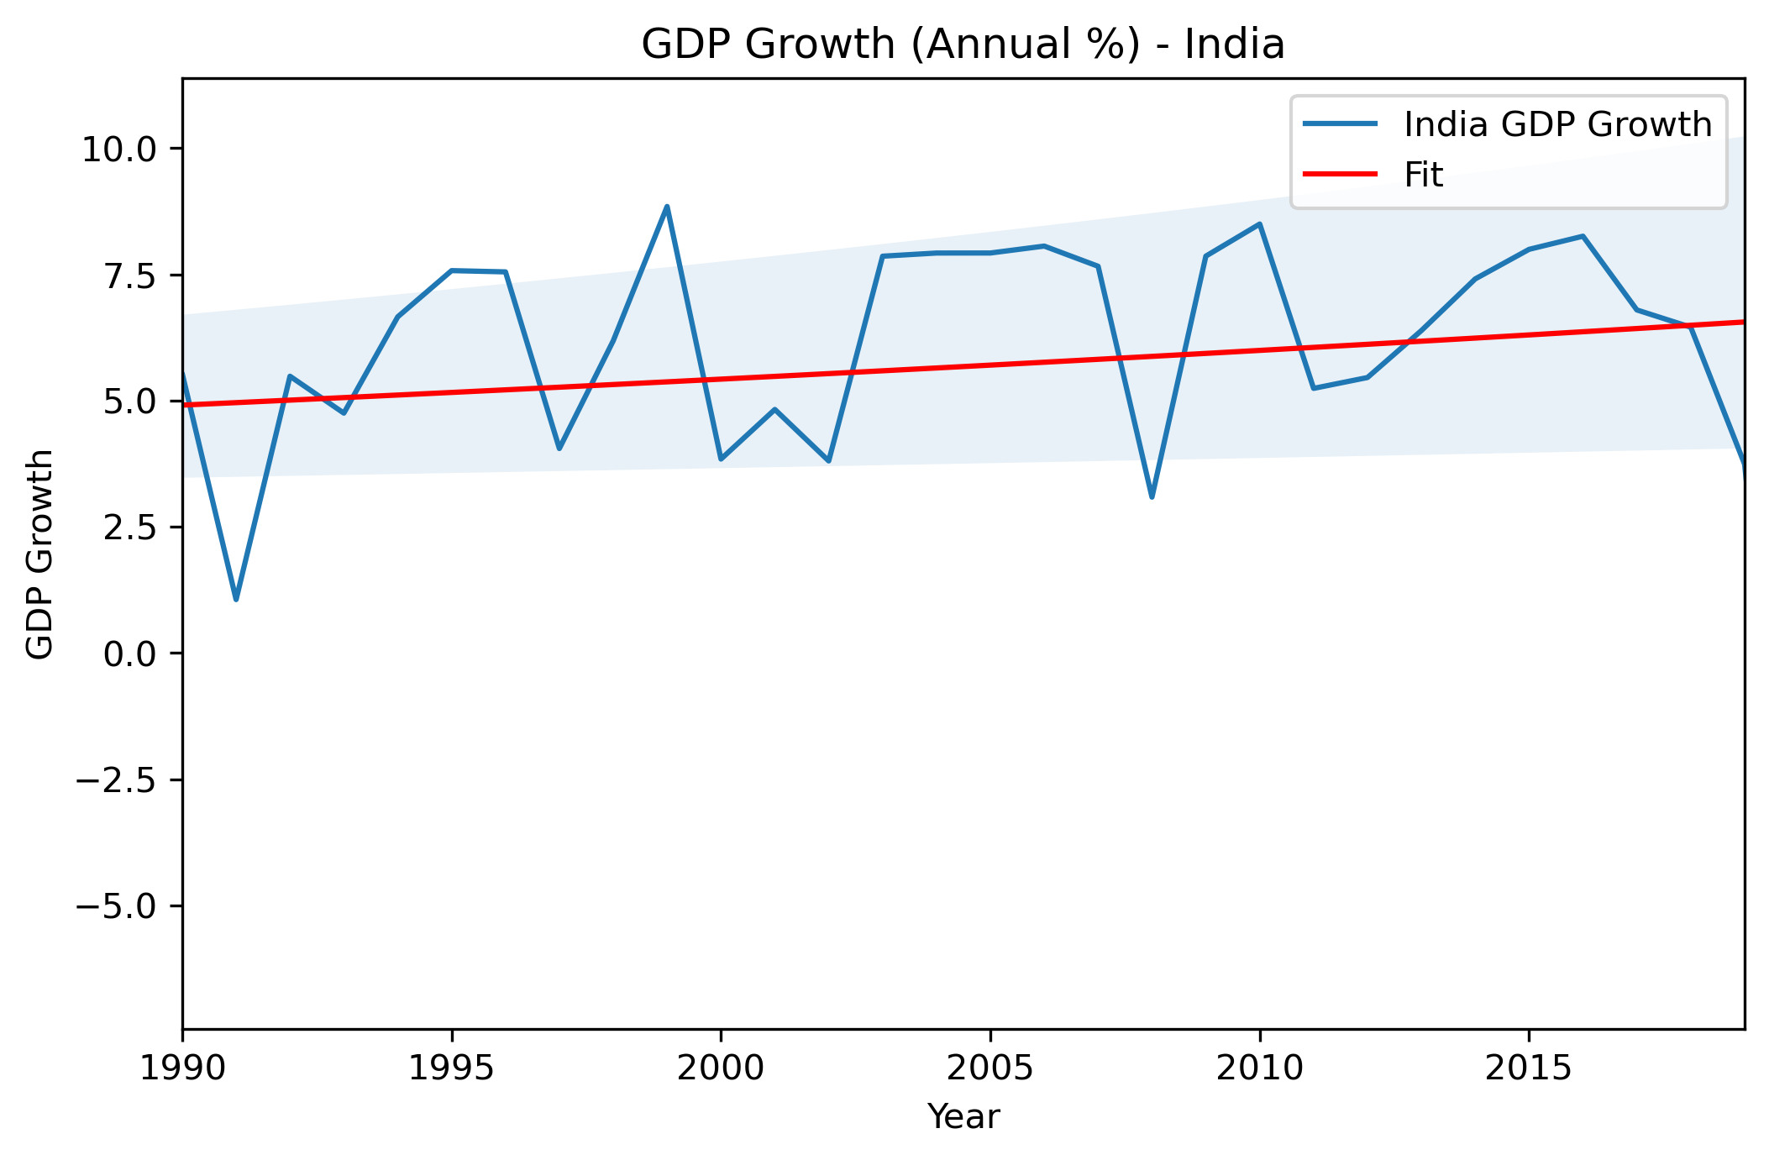
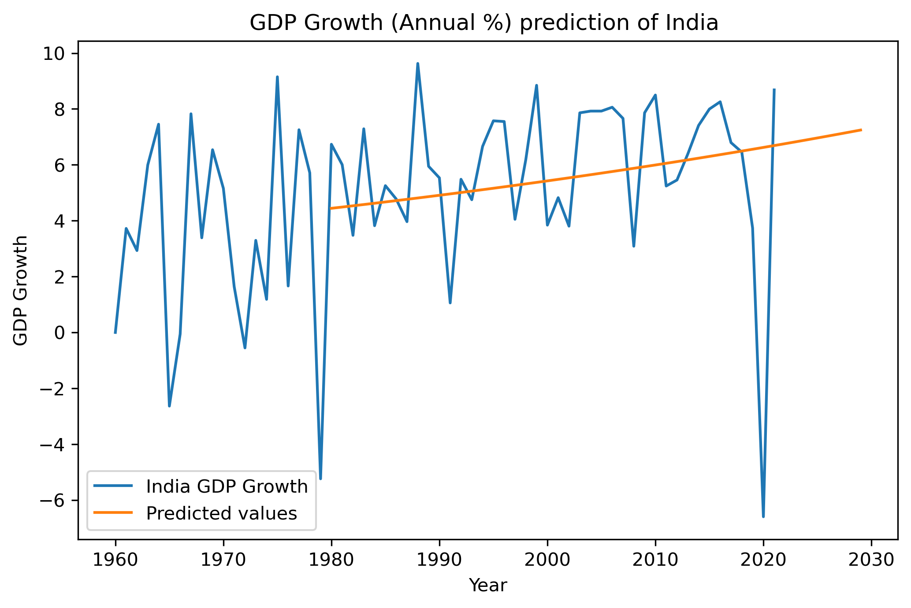
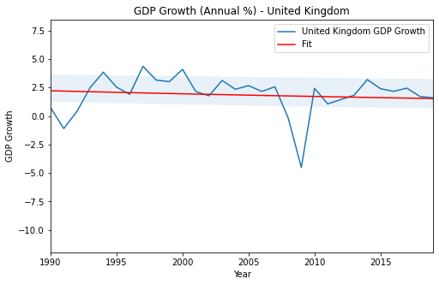
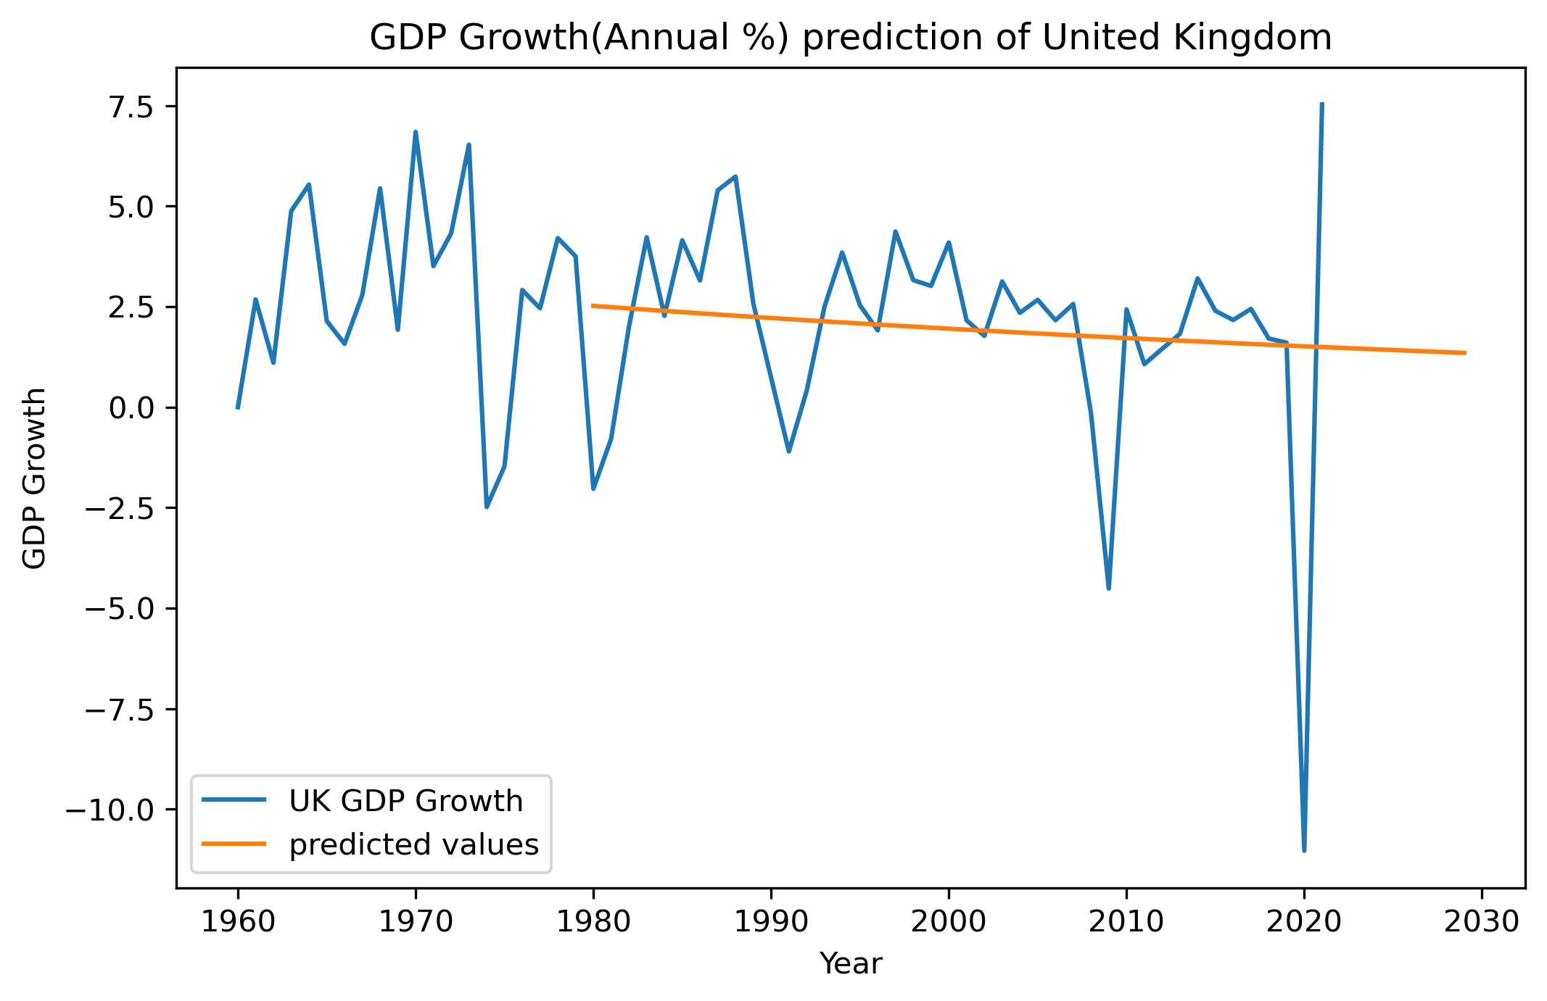
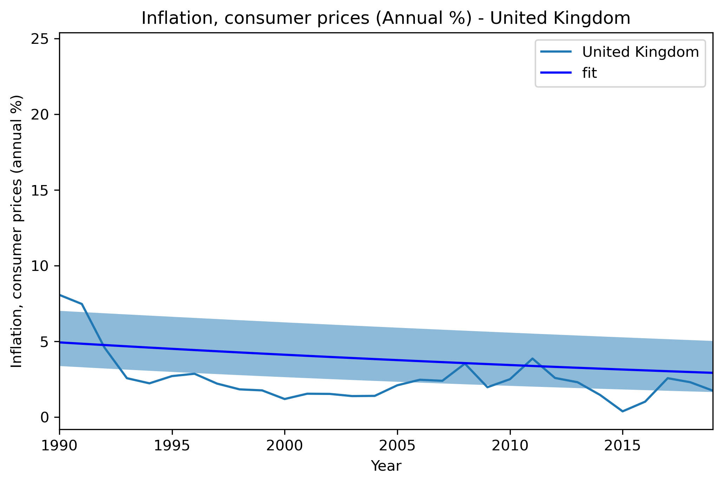
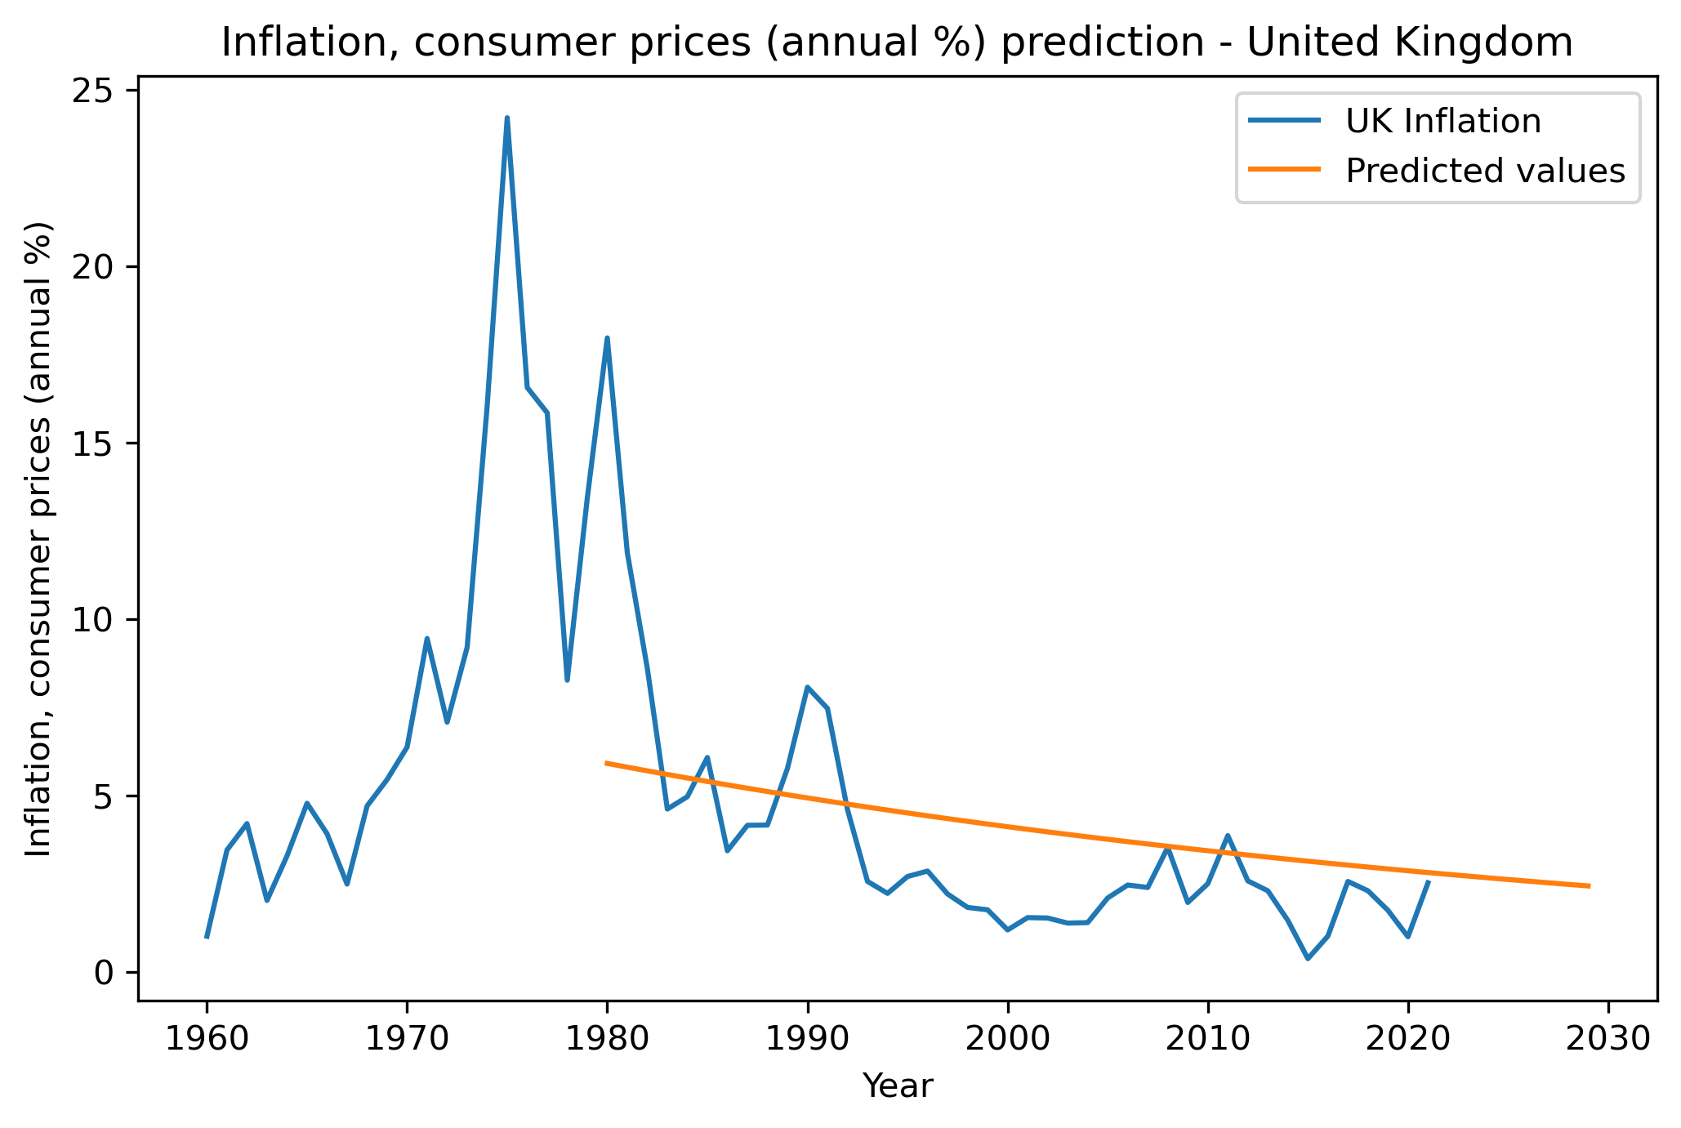
Applied Data Science 1
Assignment 3: Clustering and fitting
GDP GROWTH (ANNUAL %) AND INFLATION, CONSUMER PRICES (ANNUAL %)
Name : Manisha Motilal Yadav
Student ID: 22022080
Github : https://github.com/manishamyadav/AppliedDataScience1
Abstract: The objective of this project is to investigate and explore the relationships between GDP growth, inflation, and consumer prices in India and the United Kingdom. Using clustering techniques, we aim to identify any patterns or groups within the data, while analyzing the relationship between GDP growth and inflation to generate predictions based on previous data.
Introduction: The global economy today relies heavily on GDP growth, inflation, and consumer prices as key indicators of a country's economic performance. Two significant economies, India and the United Kingdom, have undergone notable changes in their economic landscapes in recent years.
To perform a curve fitting analysis on GDP growth data for India and the United Kingdom, a Python script is utilized, leveraging pandas, numpy, matplotlib, scipy.optimize, and sklearn libraries.
This script defines a function called curve_fun that models the curve for GDP growth as a function of time. The curve is then fitted to the data using the curve_fit function from the scipy.optimize library.
To ensure accuracy, the standard deviation of the parameter estimates is calculated.
Finally, the script generates plots to visualize the fitted curve and predicted values for GDP growth and , inflation, consumer prices in both countries.
Interpretation of results:
GDP Growth:
The India had a higher GDP growth rate than United Kingdom in recent years, indicating that its economy was growing at a faster pace.
However, in 2020, UK had a negative growth rate of -9.8% due to the impact of the COVID-19 pandemic, while India had a negative growth rate of -7.7%.
Inflation:
India had a higher inflation rate compared to the UK in recent years.
In 2020, India had an inflation rate of 4.6%, while the UK had an inflation rate of 0.9%.
Prediction:
The future are uncertain and subject to change based on various factors, such as changes in government policies, global economic conditions, natural disasters, and other unforeseen events.
However, based on the current trend and historical data, we can make some observations and predictions about the GDP growth and inflation rates for India and the UK.
India's economy is expected to continue growing at a faster pace than the UK's economy
India will continue to have a higher inflation rate than the UK due to a number of factors, including the high demand for goods and services, currency fluctuations, and supply chain disruptions.
However, both countries have independent central banks that may implement policies to control inflation, such as adjusting interest rates or implementing monetary policies.
Conclusion:
In summary, this study utilized clustering techniques and curve fitting analysis to examine the links between GDP growth, inflation, and consumer prices in India and the United Kingdom. The findings demonstrated that India had a higher GDP growth rate and inflation rate than the UK in recent years. Additionally, the analysis predicted that India's economy will continue to expand at a quicker pace than the UK's and that India's inflation rate will be greater than the UK's due to various factors.

