Slide 1
NextHikes IT Solutions
Job Market Analysis and Recommendation System
Manisha Nagda
October 2026
Notes:
Hello, I am Manisha Nagda. This is my project for NextHikes IT Solutions: a job market analysis and a job recommendation system. I use about 245,000 Upwork job posts to answer eight questions about pay, demand and remote work, and I build working tools on top of the answers.

Slide 2








244,828 job posts. What do they tell us?
Eight questions, answered from one dataset
Task 1
Task 2
Task 3
Task 4
Which title words go with higher pay?
Which kinds of work are emerging?
Which roles will be in high demand?
How do hourly rates differ by country?
Task 5
Task 6
Task 7
Task 8
Can I recommend jobs from skills?
How can the market be tracked monthly?
What is changing in remote hiring?
What do the next weeks look like?
Notes:
The assignment asks eight questions. Some are about the past: pay, emerging work, country rates and remote work. Some are about the future: demand and the next weeks. Two ask me to build tools: a job recommender and a monthly dashboard. I answer all eight from the same 244,828 job posts.

Slide 3
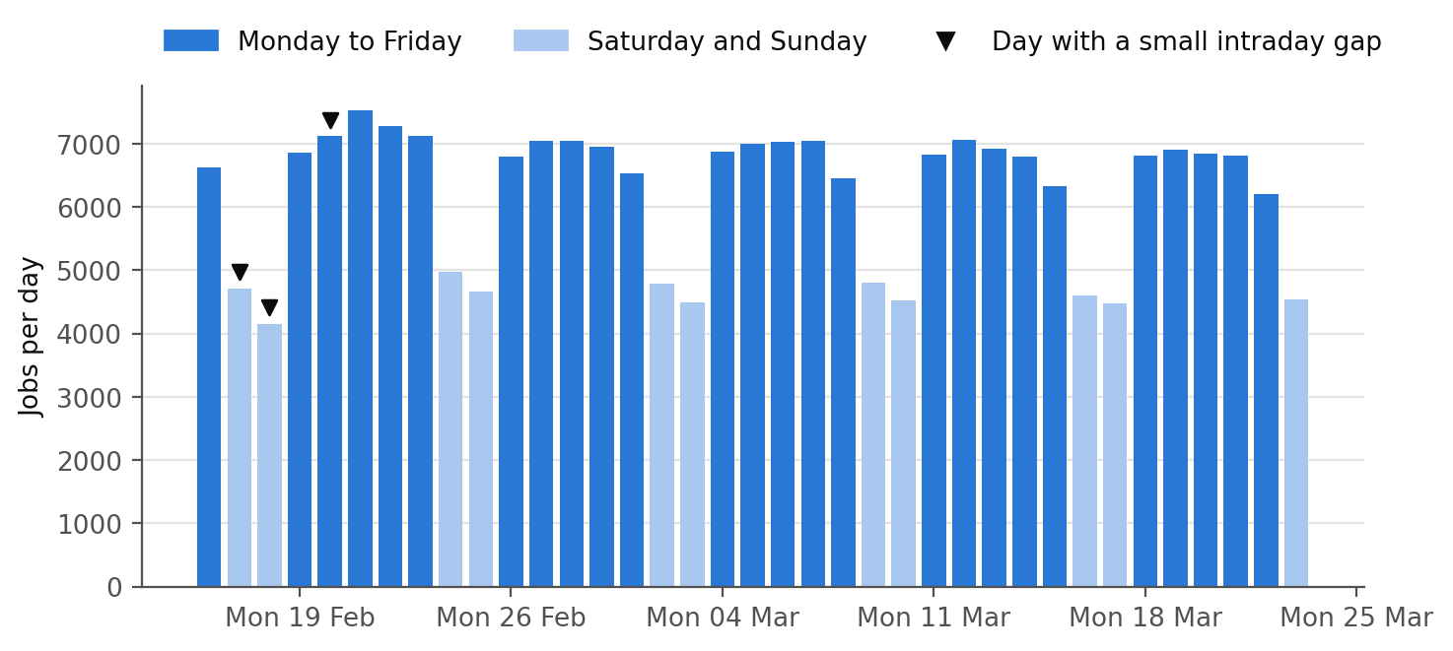
First: what the data can and cannot answer
In the data
Job title
Hourly range or fixed budget
Client country
Posting time
Not in the data
Job descriptions
A remote / on-site field
What freelancers finally earn
37 days
reliable window, 16 Feb to 23 Mar 2024
229,520 jobs
inside that window
Notes:
Before any analysis, I check what the data can and cannot answer. It has job titles, contract types, offered rates or budgets, client countries and posting times. It has no job descriptions and no remote or on-site field, so the categories, title-word results and recommendations depend on short titles. The reliable window covers 37 days, from 16 February to 23 March 2024. Three days still have small collection gaps, so I check whether these gaps affect the results. All time-based analysis uses this window. The chart shows a strong weekly rhythm, so I compare periods using averages per day.

Slide 4



How I work: one pipeline, rules fixed before evaluation
Raw CSV
244,828 rows
Clean
flags, never deletes
Categorise
22 job functions
Analyse
pay, trends, forecasts
Deliver
app, dashboard, SQL
Docker
Nginx + Flask
Rules fixed before final evaluation
Blind human tests
Selected figures checked by code
I use development data to choose the rules and settings, then keep them fixed for the final evaluation.
I label job categories and recommendations without seeing what the system predicts.
Each notebook ends with a claims check; tests check the README and report too.
Notes:
I use one pipeline to clean the data, assign job categories, run the analysis and prepare the results for the app, the dashboard and SQL. I develop the rules using development data, then fix them before the final evaluation. I test the categories and the recommender with blind human labels, and code checks selected figures against the saved outputs.

Slide 5
Giving every job a category
22 job functions
plus Other / Unclear, one category per job
68.9%
agreement with my blind labels
241 of 350 titles · 95% interval 63.8% to 73.5%
86.6% decided by rules
transparent keyword rules; a guarded classifier adds 1.2%
77.2% when named
agreement when the system names a category instead of Other
50%
90%
Software & IT, AI & Machine Learning, Engineering & Architecture and Admin & Virtual Assistance are likely undercounted, so I show the Other share next to category results.
Notes:
The data has no category field, so I build one: 22 job functions plus Other / Unclear. Keyword rules assign 86.6% of jobs, and a guarded classifier adds another 1.2%. I compare the system's predictions with my own labels for 350 titles. I label these titles without seeing the system's predictions, and I keep the category rules fixed before the final evaluation. The system agrees with my label for 68.9% of titles, with a 95% interval from 63.8% to 73.5%. Some categories, such as Software & IT and AI & Machine Learning, are likely undercounted, because many of their titles fall into Other / Unclear.

Slide 6
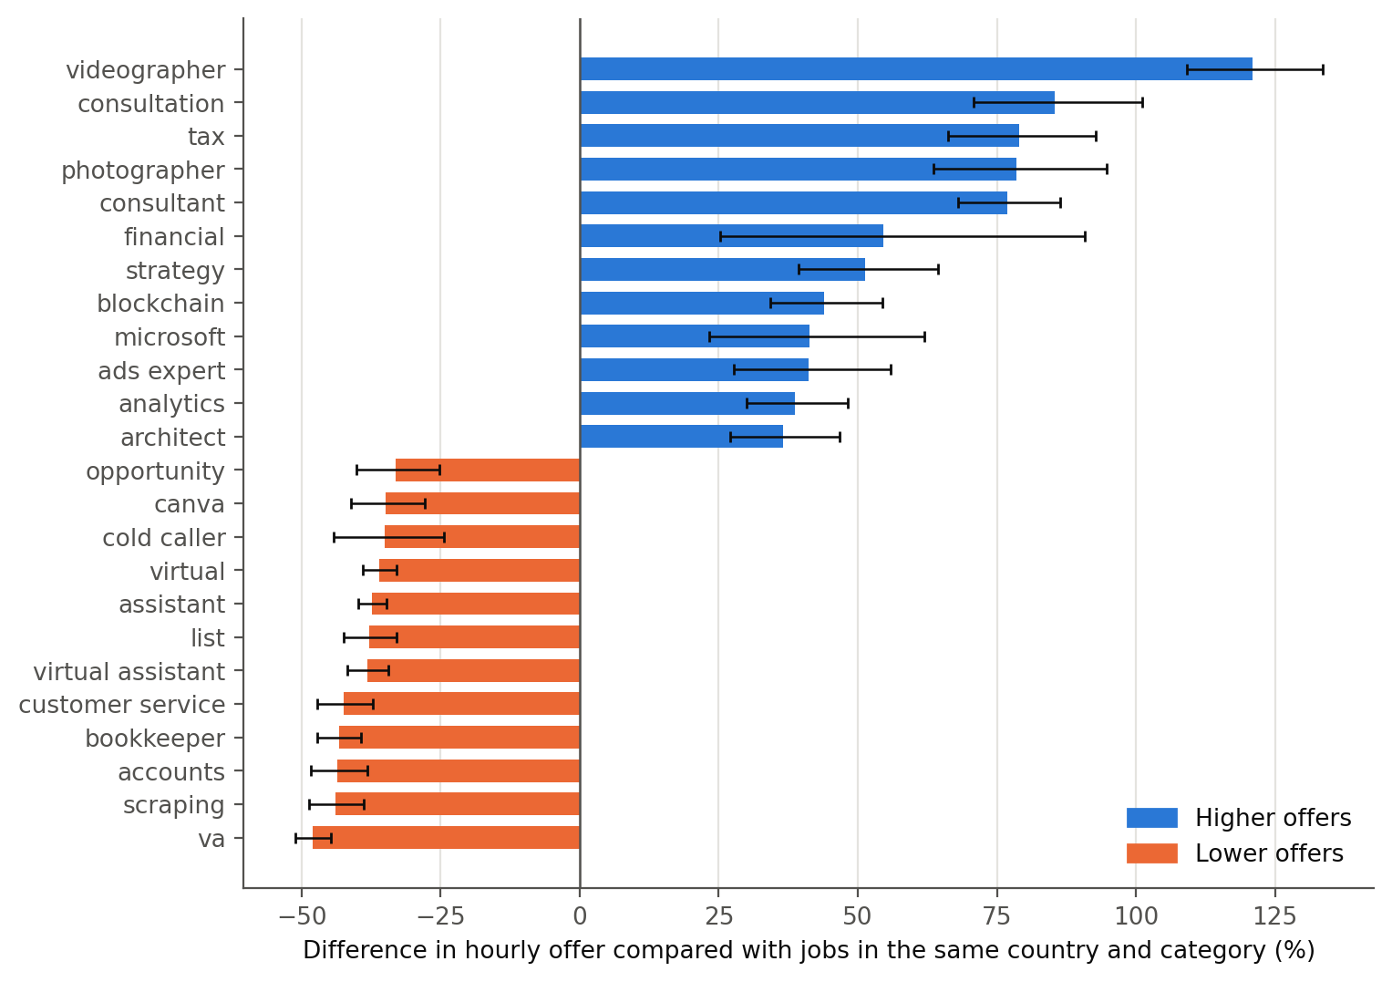
Title words that go with higher or lower pay
TASK 1
+77% consultant
higher hourly offers than similar jobs in the same country and category
−38% virtual assistant
lower than similar jobs
11% → 26%
explained variation when title words are added
“Python” is +10% in the raw comparison but −7.5% after adjustment: the job mix matters.
Difference in hourly offer compared with jobs in the same client country and category; black lines are 95% intervals.
Notes:
For Task 1, I compare each title word with similar jobs: the same client country and the same category. Titles with consultant offer about 77 percent more; virtual assistant about 38 percent less. Title words raise the explained variation from 11 to 26 percent, so titles matter, but most of pay depends on things the title does not show. These are associations, not causes.

Slide 7
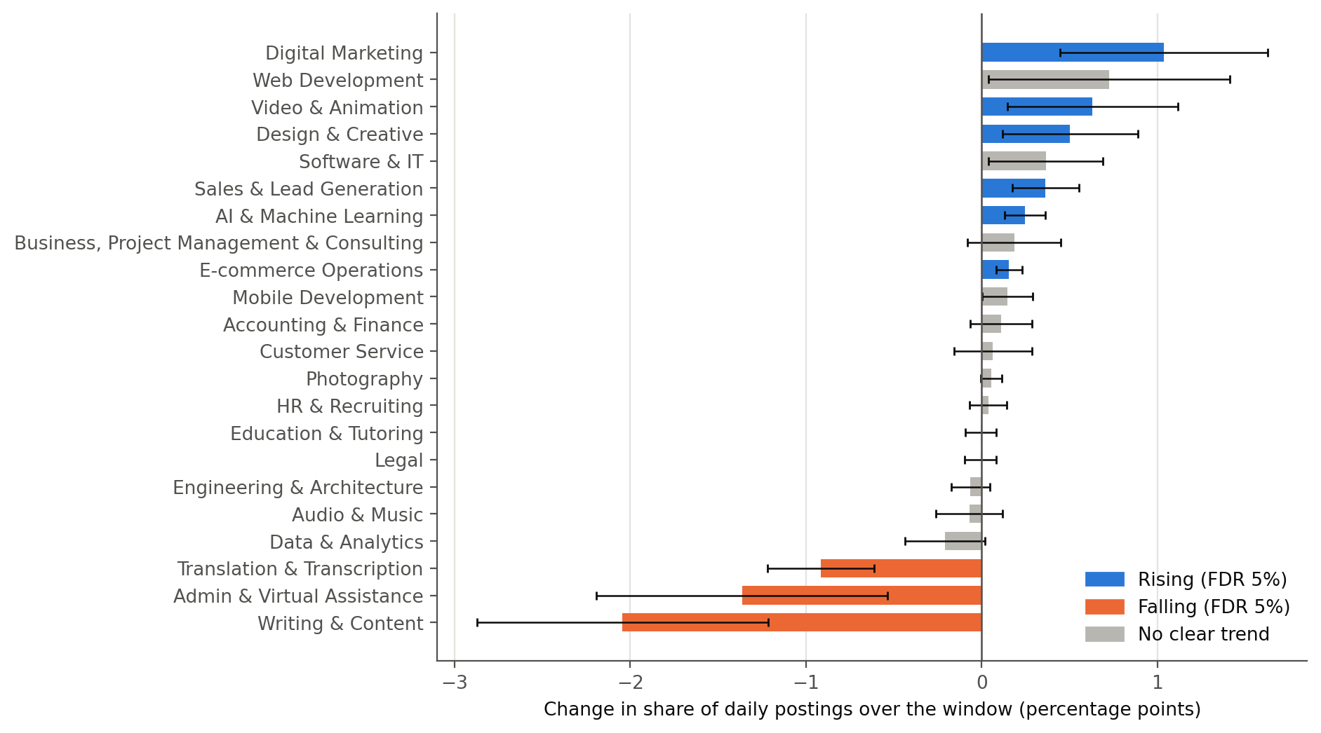
Which kinds of work are rising and falling
TASK 2
Rising
Digital Marketing +1.0 point (+10%)
Video & Animation, Design & Creative, Sales & Lead Generation, E-commerce Operations
AI & Machine Learning +19%
Falling
Writing & Content 5.8% → 3.7% of posts
Admin & Virtual Assistance −1.4 points
Translation & Transcription −0.9 points
Part of the change is one step around 26 February, not a smooth trend.
9 of 22 functions change significantly (FDR 5%) within the 37-day window.
Notes:
For Task 2, I measure each job function's share of daily posts across the five weeks. Nine of 22 functions change significantly. Digital Marketing, Video & Animation, Design & Creative, Sales & Lead Generation, E-commerce Operations and AI & Machine Learning gain share; Writing & Content, Admin & Virtual Assistance and Translation & Transcription lose it. All nine directions hold without possible reposts, without days with collection gaps and in a complete-week comparison, although the sizes vary. Part of the change is one step around 26 February. After that step, four categories keep changing clearly: Writing & Content falls, while AI & Machine Learning, Sales & Lead Generation and E-commerce Operations rise. These are short-term shifts, not long-run trends.

Slide 8
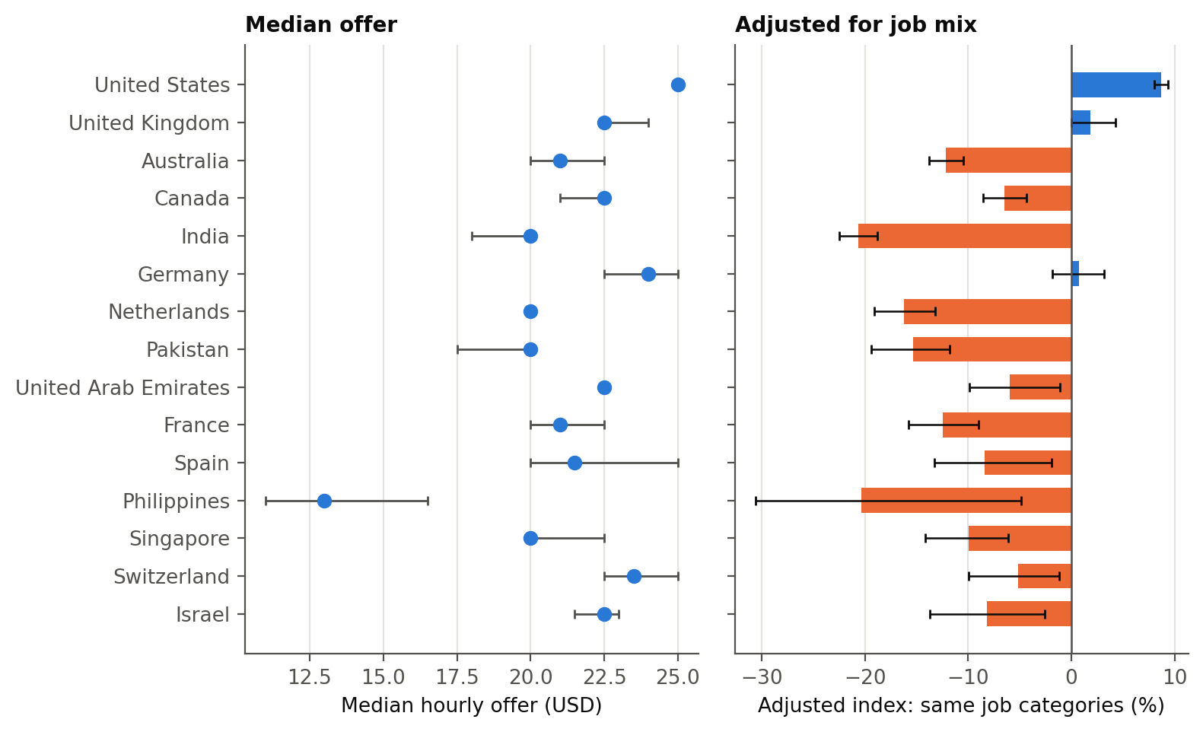
Pay depends on the client's country, and on the job mix
TASK 4
91 countries
with at least 30 rated hourly jobs
USD 25 per hour
US median; mean USD 32.6; adjusted index +9%
−12%
Australia: near-average median, but less for the same work
Left: median hourly offer. Right: index adjusted for job categories. Interactive map in Notebook 04 and the dashboard.
Notes:
For Task 4, I compare 91 client countries. I show the median offer, the mean offer and an index for the same kinds of jobs. Among countries with at least 2,000 rated jobs, US clients have the highest median, USD 25 per hour, and their mean is USD 32.6. The mean is above the median in 89 of the 91 countries, because a small number of high offers pulls the averages up. After adjusting for job categories, the US index is about 9% above the reference level. The job mix changes the picture: Australia's median is near average, but its adjusted index is about 12% below. These are offers in postings, not what freelancers earn.

Slide 9
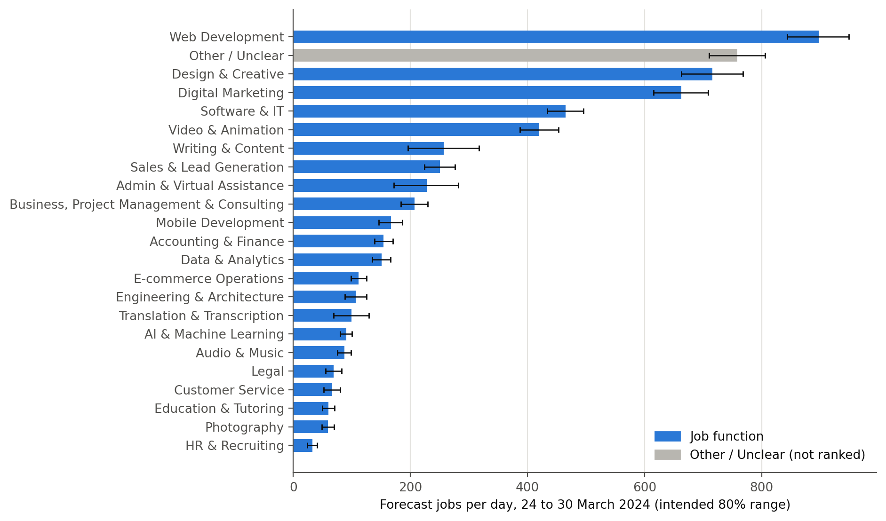
The next two weeks: who leads, and how sure I am
TASKS 3 & 8
about 900 · 720 · 660
jobs a day: Web Development, Design & Creative, Digital Marketing
Central outlook
about 6,100 jobs a day in total
Intended 80% range
5,930 to 6,300 a day (days 1 to 7)
Possible directions
small rises for 4 categories, not established trends
Final week: better than the baseline for 20 of 23 categories, not for total jobs; ranges built the same way contain 75.0% of values.
Forecast jobs per day, 24 to 30 March 2024, with intended 80% ranges; overlapping ranges mean similar demand.
Notes:
For Tasks 3 and 8, I forecast 14 days ahead. I compare four simple models and select the weekday mean because it has the lowest average seasonal MASE in the development backtests. Seasonal MASE compares a model's error with the usual week-to-week change. The weekday mean is not better on every measure: for total jobs, the simple seasonal baseline forecasts better in both the development backtests and the final week. Web Development, Design & Creative and Digital Marketing lead the next week with about 900, 720 and 660 jobs a day, and the last two have overlapping ranges. The ranges come from past forecast errors. When I build ranges the same way from the development period and test them on the reserved final week, they contain 75.0% of the demand values, below the intended 80%. This tests the method, not the future ranges themselves. A separate damped-trend model suggests small rises for four categories, but the trend after 26 February does not clearly support three of them, so these are possible directions, not established trends.

Slide 10
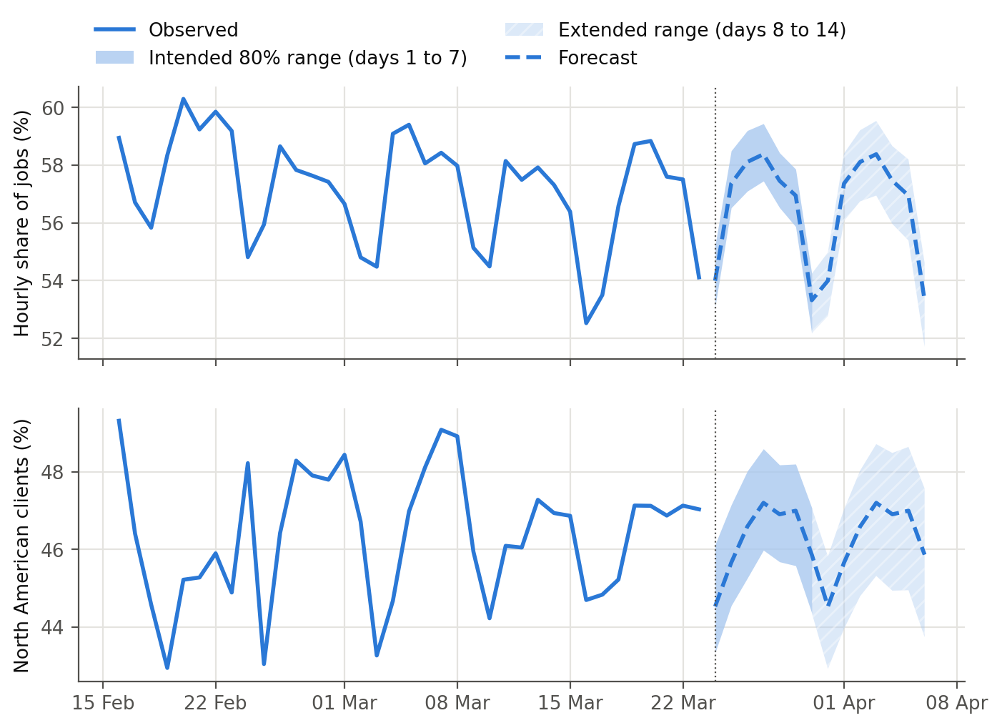
What the data can measure about remote work
TASK 7
The data has no remote or on-site field, so it cannot show the actual percentage of remote jobs.
about 46%
of jobs with a known client country come from North America; stable
58.3% → 56.1%
hourly share: fixed-price work gains slightly
0.55%
of postings have remote or home wording in the title; the audit finds 91% of matches correct
Daily hourly share and North American client share, then the 14-day forecast with its two ranges.
Notes:
For Task 7, I first state what the data cannot measure: there is no remote or on-site field, so I do not estimate a remote-work percentage. Instead, I measure what is there. About 46% of jobs with a known client country come from North America, and this stays stable. The hourly share falls from 58.3% to 56.1%, so fixed-price work gains slightly. Explicit wording is rare: 1,260 of 229,520 postings have remote or home wording in the title, 199 mention a time-zone requirement and 171 mention on-site or in-person work. I also check how well the wording rules work. I use a separate sample and exclude titles identified as seen during rule development, although earlier records do not prove complete separation. About 91% of remote or home matches are correct, with a 95% interval from 85% to 95%. This measures the wording rule, not the percentage of jobs that allow remote work. The forecasts place the hourly share and the North American share close to their recent levels.

Slide 11
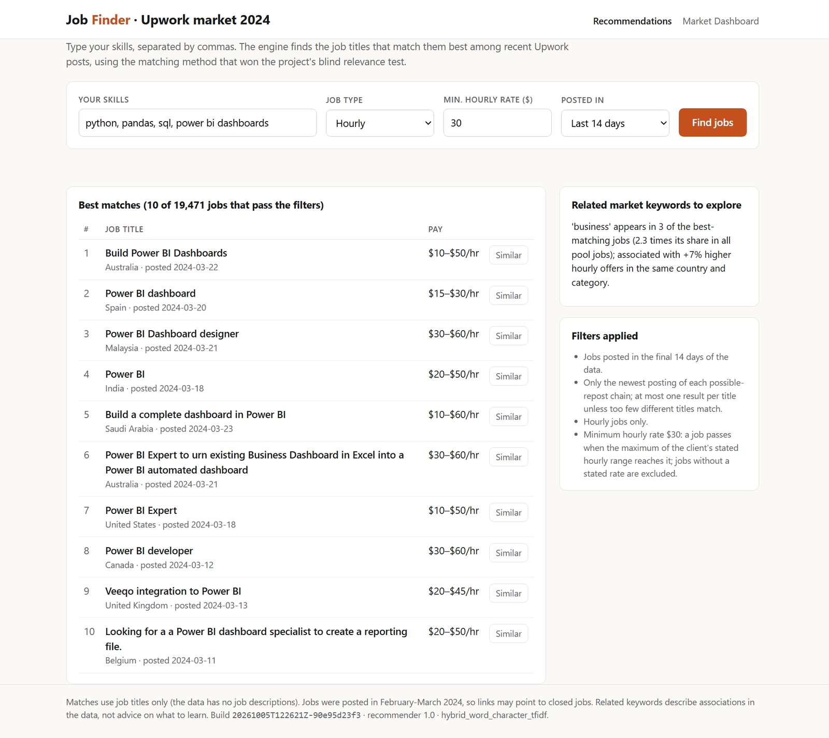
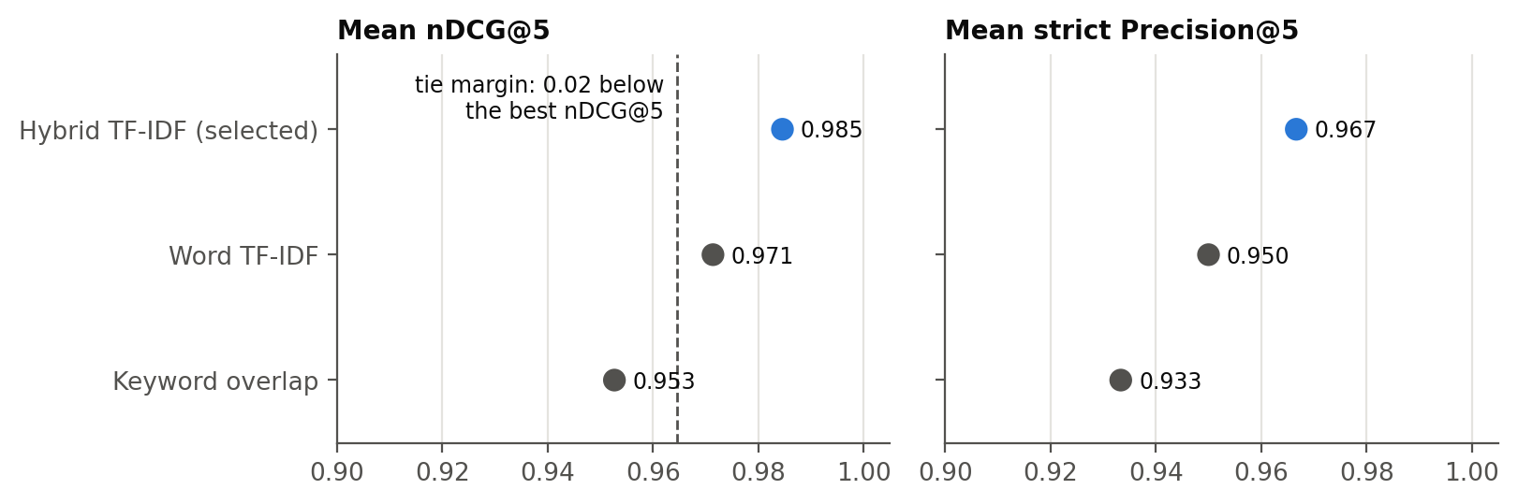
A job recommender that matches skills to jobs
TASK 5
1
Type skills
for example python, sql, power bi
2
Match job titles
hybrid word + character TF-IDF
3
Strict filters
pay, contract type, recency
12 profiles: nDCG@5 0.985 · Precision@5 0.967 · one-result margin
Notes:
For Task 5, I build a working recommender with a web page and an API. A freelancer types skills, the engine matches them to recent job titles and applies strict pay and contract filters. I compare three matching methods. I label the pooled results myself, without knowing which method returns each job. Under a scoring rule fixed before labelling, the hybrid word-and-character TF-IDF method is selected, with nDCG@5 of 0.985 and strict Precision@5 of 0.967. nDCG@5 gives more credit when relevant jobs appear near the top of the list. The hybrid method has only one more relevant result than word TF-IDF in 60 evaluated slots, so I do not claim that it is better in general. The app serves this method only while its recorded approval remains valid. If the recommender code or settings change, the app stops until the result is reviewed again.

Slide 12
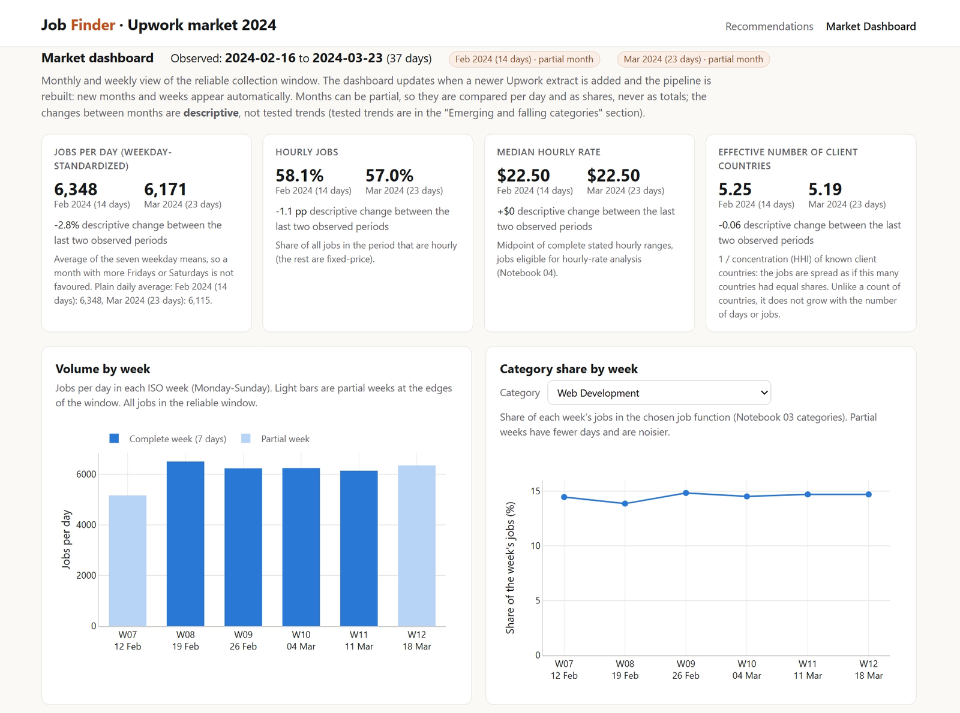
A dashboard that updates with every new month
TASK 6
New monthly extract
Pipeline rebuild
Updated monthly tables
Updated dashboard
An automated test adds a synthetic April and checks that the new month appears.
Notes:
For Task 6, I build a dashboard in the same app. It shows each month's headline numbers, weekly trends, pay, the country map and the forecasts. It computes nothing itself: it draws the verified tables. When a new monthly extract arrives, one rebuild updates the tables and the dashboard. An automated test checks that a new month appears without any code change.

Slide 13
How the results are checked
500+
automated tests
Official build
20261011T132714Z-e537465460
6 input fingerprints raw data, settings, code, environment, SQL and label inputs
54 of 54 analytical files identical across two rebuilds from the same inputs
0 errors, 0 warnings strict project check; all 9 notebooks rerun on this build
1,358 values SQL recomputes selected results and every compared value matches
Approval
the app serves only the approved recommender method
Claims checks
notebooks and report tests compare selected figures with the outputs
The official Windows and Linux builds use the same recorded inputs. Of 54 analytical files, 49 are byte-identical. The other five differ only in compression or small numerical values, without changing the main findings.
Git tags
record the frozen label-based evaluations
Notes:
On every push, GitHub runs more than 500 automated tests, checks the committed notebooks and builds the Docker images. The official build is recorded with six input fingerprints, and two rebuilds from the same inputs give identical copies of all 54 analytical output files. All nine notebooks run in strict mode, and the project check reports 0 errors and 0 warnings. SQL recomputes selected results from the row-level data, and all 1,358 compared values match. The app serves only the approved recommender method. Git tags record the frozen category, recommender and work-arrangement evaluations. I also rebuild the official outputs in Linux and compare them with Windows. All six input fingerprints match. Two files contain identical data with different compression, while three have small numerical differences. The categories, rankings, forecasts and reported findings remain unchanged. The forecast model and selection rule are fixed before the reserved final week is scored.

Slide 14
Deployment with Docker
Browser
localhost:8080
Nginx
web server, the only public port
Gunicorn + Flask
1 worker, 4 threads
Verified data
mounted read-only
Run it
docker compose up -d
then open http://localhost:8080
Rebuild inside Linux
An on-demand pipeline service rebuilds every output from the raw file. The app starts only after its health check passes.
Notes:
The whole system runs in Docker with two images. Nginx is the web server and the only public port. Behind it, Gunicorn runs the Flask app with one worker and four threads, because each worker would load its own copy of the search index. The verified data is mounted read-only, so the website cannot change it. One command starts everything.

Slide 15
Limits, and what more data would allow
Limits today
No job descriptions or skills lists
Five weeks of reliable history
One annotator for all labels
Offers, not what freelancers earn
Associations, not causes
Forecast ranges cover fewer values than intended
Recommender margin of one result
With more data
Job descriptions: better categories and skill-level pay
A year of history: real seasons, longer forecasts
A remote / on-site field: a direct remote answer
Click data: a recommender that learns
Notes:
Every result has limits, and I state them. The data has no job descriptions and only five reliable weeks. I am the only annotator for all labels. Pay means offers, not earnings, and the results are associations, not causes. The forecast ranges contain fewer final-week values than intended, and the recommender is selected by a margin of one result. More complete job information, a longer history and user activity data could help improve the categories, forecasts and recommendations.

Slide 16
Thank you
Manisha Nagda
Notes:
Thank you for your time.

