Slide 1
NEXTHIKES IT SOLUTIONS
LLM News Research Tool
Company news for equity research: ranked articles and a summary checked against its sources
Manisha Nagda · November 2026

Slide 2
What an equity analyst needs from company news
THE PROBLEM
01
Recent company news
From many publishers, in one place
The tool
Type a company name.
Get its recent news, ranked, and a short summary in which every point cites its articles and every number is checked against them.
02
A concise summary
The main developments, not every article
03
Source-linked findings
Each point tied to the articles it rests on
04
Checks on reported numbers
Each figure compared with its cited articles

Slide 3
From a company name to a checked summary
OVERVIEW
Search
Clean
Rank
Summarize
Two NewsAPI searches: the company name and its subsidiaries' names
Duplicates, stock-listing pages and unrelated pages removed; full article read where allowed
O1M5 + S1: company in the title, or named 5+ times in the text, first. No model call
gpt-oss-120b on Groq writes the summary; numbers and sources checked, failures repaired or removed
SEVEN STAGES
1
Finding and cleaning
2
Relevance check
3
Ranking
4
Summaries
5
Analyst pipeline
6
Streamlit app
7
Second company and fresh weeks

Slide 4
How each stage is tested
METHOD
Development data
Fresh tests
Ranking baseline
104
4
3
Tata Motors articles from three search days, labelled by hand: 47 relevant, grouped into 24 events
weeks, two per company. Each tests the ranking and one summary, labelled blind and frozen before any model runs
fresh weeks compare the ranking with the plain retrieval order: the order articles arrive in
Every test plan is tagged in Git before its data is fetched. Blind re-check of 40 labels by the same labeller: agreement 0.825, Cohen's kappa 0.723.

Slide 5
Reading the full article keeps more relevant news
STAGE 1 · FINDING AND CLEANING
16 of 16
relevant articles in the 24 October pool found by searches A + B (A alone: 12)
0.868 → 0.714
precision: the cost of reading the full text, 13 more articles that are not relevant
Stock-listing pages: 22 removed, no relevant article lost

Slide 6
A language model is not safe as a filter
STAGE 2 · RELEVANCE CHECK
3 relevant articles removed
All indirect industry news (India as a car-making hub, a used-truck market report). The model answers "not", each marked sure.
Decision
The model never removes an article. Its answers are tested as a ranking signal instead.

Slide 7
Model-based ranking is too slow on the free plans
STAGE 3 · RANKING
Model configuration | Answered | Slowest day | Days passing
gpt-oss-120b | 100% | 274 s | 1 of 3
gpt-oss-20b | 100% | 274 s | 1 of 3
qwen3.8-27b | 91% | 908 s | 0 of 3
gemini-3.8-flash (two attempts) | 9% / 31% | 188 / 327 s | 0 of 3
Fresh week, 24–30 October
No model order passes: all exceed 180 seconds.
O2 also loses a direct event, the Q2 results.
The default stays O1 + S1, with no model call.
Rule: a model order must pass on two of three days and answer within 180 seconds.

Slide 8
O1M5 + S1: the only variant passing on all three days
STAGE 3 · SECOND CYCLE
Trigger: in the Reliance test, a relevant article whose headline does not name the company falls to place 47 of 53.
Four variants of O1, tested on Tata Motors development data only.
Conditions on each day at k = 10: no direct event lost, event recall not lower, precision not lower.
O1M5: an article naming the company 5+ times in its text joins the headline group
Pooled precision 0.83 → 0.87. Development result only.

Slide 9
The direct design, with three automatic checks
STAGE 4 · SUMMARIES
 | Direct | Brief-first
Items supported | 68.9% | 60.0%
Events covered | 11 of 11 | 10 of 11
Model calls per summary | 2.33 | 7.0
Structure
Valid answer, every section, every article accounted for
Numbers
Every number appears in the articles the point cites
Judged blind, three development days. Direct leads on all three, so direct is chosen.
Source naming
Sources named only through citations
A failing point is repaired up to twice; if it still fails, it is removed and its reason shown.

Slide 10
Errors found in saved runs, and their fixes
STAGE 4 · ERROR ANALYSIS
1
2
3
Answers cut off
Correct amounts flagged
A figure ten times too large
Answers stop mid-way at 3,072 tokens.
"14.40 euro" in the article, "€14.40" in the point: flagged as wrong.
1,35,114 units (1.35 lakh) written as "about 1.35 million".
Fix: an explicit output limit of 4,096 tokens.
Fix: number check version 2 reads both forms.
Caught by the number check; the repair restores 1,35,114.

Slide 11
Industry rule, five articles, and the freeze
STAGE 4 · DESIGN DECISIONS
Prompt 4
No unsupported industry point; misses one real sector fact in three runs
k = 5
Ten articles reach about 7,451 tokens, above the 7,200 safe limit of the free plan
Frozen
Direct, k = 5, prompt 4, fixed in Git (freeze-summary) before any fresh test
Prompt 4 adds an industry rule; prompt 5 also asks for sector facts but adds weak points.

Slide 12
Prompt 6 scores higher, but the fixed rule keeps prompt 4
STAGE 4 · THIRD PROMPT TEST
Three matched runs per prompt | Prompt 4 | Prompt 6
Expectation-and-outcome pairs | 8 of 12 | 9 of 12
Industry points stretched to the sector | 2 of 7 | 0 of 4
Events covered | 31 of 33 | 33 of 33
Key points and briefs supported | 33 of 40 | 34 of 41
Contradicted items | 1 | 0
Why prompt 4 stays
One guardrail fails for prompt 6: an industry point on a day with no industry evidence. Prompt 4 has the same fault, but the rule, fixed before the runs, requires every guardrail to hold.
16 of 17
items get the same judgement in a second blind pass

Slide 13
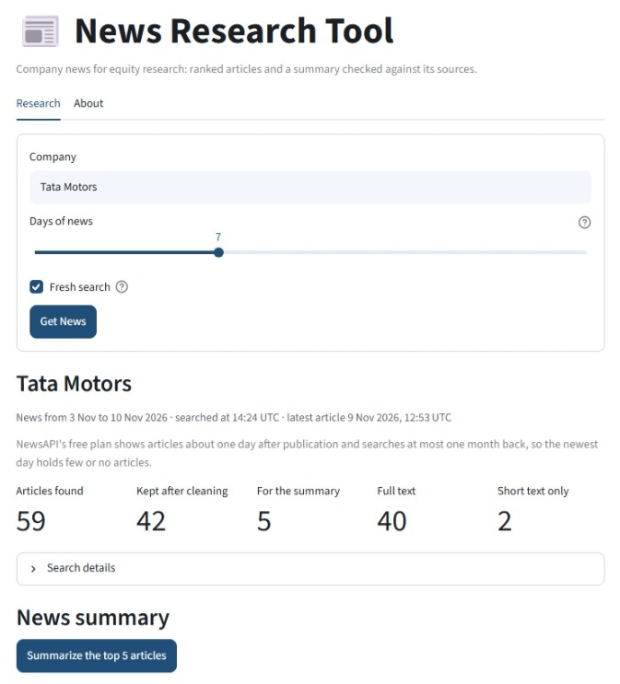
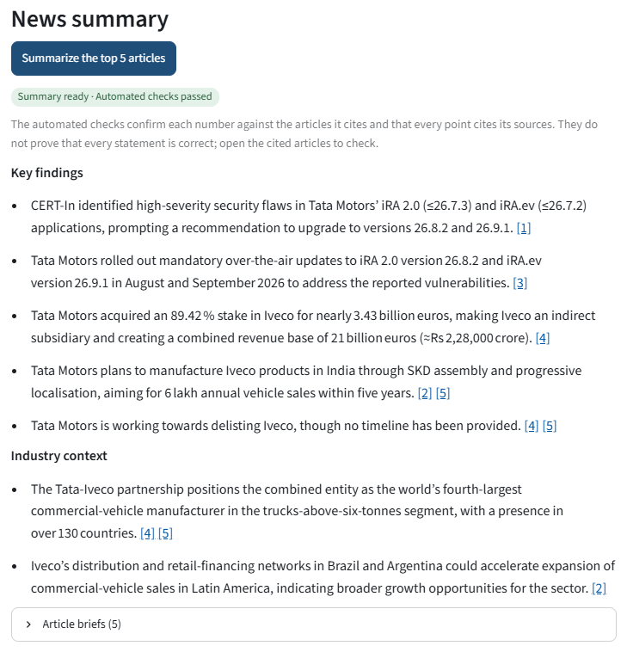
The analyst pipeline and the Streamlit app
STAGES 5 AND 6 · THE TOOL
Provisional list first, final list after the full text
Evidence badges on every article
Summary with linked citations and a check status
Optional model review and an experimental order

Slide 14
Reliance Industries: the summary transfers
STAGE 7 · SECOND COMPANY
Summary
Ranking against the retrieval order (k = 10)
Passes every level
One direct event lost
11 items: 8 supported, 3 partly supported
0 contradicted
3 of 3 events covered
Precision 1.00 against 0.90; 5 events each
The lost article's headline does not name the company: place 1 in retrieval order, 47 of 53 under O1
One industry point adds a claim the articles do not make.
This finding starts the second ranking cycle.

Slide 15
Week 2: O1M5 + S1 beats O1 + S1, not the retrieval order
FRESH WEEKS
Precision is the same for all three lists: 1.00 for Tata Motors, 0.80 for Reliance Industries.
Summaries on the four fresh weeks: 0 contradicted items in all four. Events covered: Tata Motors 3 of 4 in both weeks (below 0.80); Reliance 3 of 3 and 2 of 2.

Slide 16
Key findings
1
Full text
Keeps 45 of 47 relevant articles instead of 33, and all 24 events instead of 16
2
No model filter
A model removes relevant articles, even with sure answers; the tool never lets it remove one
3
Ranking
O1M5 + S1 beats the earlier default on both fresh weeks, but not the plain retrieval order
4
Summaries
No contradicted item in any fresh test; Tata Motors weeks cover 3 of 4 events, below 0.80
5
Second company
The summary passes on Reliance in both weeks; the ranking shows a name-matching weakness ("Jio")

Slide 17
Future work and limitations
NEXT
Future work
Limitations
Group articles about the same news in the top 10 (S2)
Count a short name such as "Jio" only when no other company can share it, checked against labels
Keep an outlook article's main point when a later article reports the outcome
Test each change on development data, then on a new fresh week
Small samples: three development days and four fresh weeks, one summary each
One judge for labels and summaries
Free plans: NewsAPI one day late, one month back, 100 requests a day; Groq 8,000 tokens a minute
Two companies, a few weeks of news

Slide 18
Thank you
LLM News Research Tool
Manisha Nagda · November 2026

