Slide 1
TEEN-AGE
PHONE ADDICTION

Slide 2

Introduction
Teenage phone addiction is the excessive and uncontrollable use of smartphones by teens, often leading to negative effects on their mental health, academics, sleep, and social life. Constant engagement with social media, games, and notifications can cause anxiety, poor focus, and reduced real-life interactions. Addressing this issue is important to promote healthier digital habits among teenagers.

Slide 3
Objective
To understand the causes behind excessive smartphone use among teenagers.
To analyze the psychological and physical impacts of phone addiction.
To identify the signs and symptoms of smartphone dependency in teens.
To explore the influence of social media and gaming on teenage behavior.
To assess how phone addiction affects academic performance and sleep patterns.
To suggest preventive measures and strategies for healthy phone usage.
To raise awareness among parents, teachers, and teens about digital balance.

Slide 4
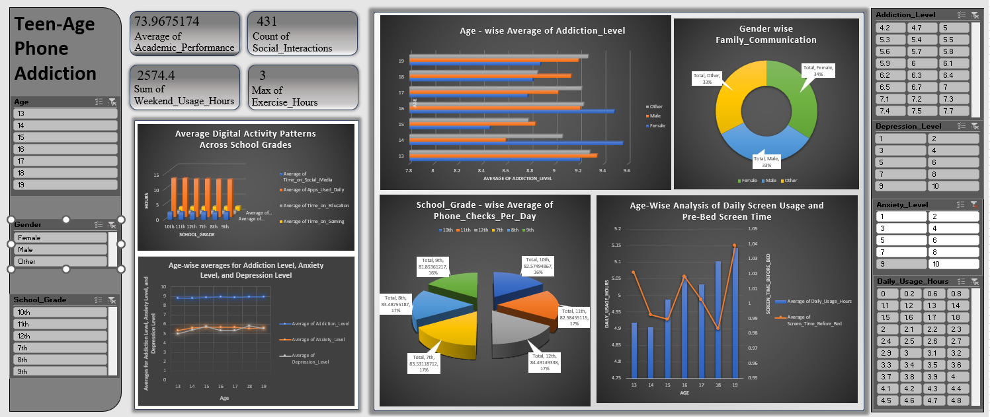
Dashboard

Slide 5
Problem Statement
Analyze how digital activity (social media, education, gaming, and app usage) varies across school grades to identify its impact on students focus and well-being.
Analyze the relationship between daily screen usage and pre-bed screen time across different age groups to understand its potential impact on health and sleep quality.
Analyze how addiction, anxiety, and depression levels vary across different age groups to understand the mental health impact of digital usage.
To analyze the distribution of family communication practices across different gender identities in order to understand the gender-wise involvement in family-related interactions
To examine the average number of phone checks per day across different school grades to identify patterns in mobile usage behavior among students from 7th to 12th grade.

Slide 6
Result
Students use about 14 apps daily across all grades.
Social media usage is around 3–4 hours per day.
Educational use is the lowest among digital activities.
Gaming time is 1–2 hours daily.
Digital activity is similar across grades 7th to 12th.
Data shows signs of possible phone overuse among teens.

Slide 7
Result
Teenagers spend around 5 hours daily on screens across all age groups.
Pre-bed screen time averages about 1 hour, showing consistent usage at night.
Age 19 has the highest overall screen and bedtime usage.
Slight increase in screen time with age indicates growing digital dependence.

Slide 8
Result
Females show the highest percentage in family communication at 34%.
Males and individuals identifying as Other each account for 33%.
The distribution is fairly balanced across all gender groups.
Slightly higher communication among females may indicate stronger family engagement.

Slide 9
Result
Addiction levels remain consistently high (around 8.8 to 9) across all age groups.
Anxiety levels stay moderate, ranging between 5.4 and 5.9 across ages 13–19.
Depression levels show slight fluctuation, with a small peak at age 18.
The consistently high addiction scores suggest a strong link between age and smartphone dependency.

Slide 10
Result
Students in 12th grade have the highest average phone checks per day at 84.49 times.
Grades 7th, 8th, and 11th also show high phone check rates, all above 82 times/day.
Grades 9th and 10th have slightly lower averages, around 81–82 checks/day.
Overall, all grades show frequent phone usage, indicating a high level of digital engagement across school levels.

Slide 11
Result
Females at age 19 show the highest addiction level, slightly above 9.1.
Males at age 16 and 18 also show high addiction levels, close to 9.1.
All genders across all ages have addiction levels above 8.5, indicating widespread usage.
The "Other" gender group shows relatively stable but slightly lower addiction levels compared to males and females

Slide 12
Conclusion
Teenage phone addiction is a growing concern in today’s digital world, with data showing consistently high screen time, frequent phone checks, and elevated addiction levels across age and school grades. The overuse of smartphones, particularly for social media and entertainment, is linked to issues like poor sleep, increased anxiety, and reduced real-life social interactions. The charts also highlight a gender balance in usage patterns but show a trend of rising addiction with age. Immediate awareness and intervention are essential to promote healthier digital habits and ensure the overall well-being of teenagers.

Slide 13
Future Scope
Digital Wellness Apps: Tools to monitor and control screen time for teens.
Digital Literacy in Schools: Educating students on healthy tech use and its effects.
Parent-Teacher Involvement: Joint efforts to guide and monitor teen phone habits.
Mental Health Research: Long-term studies on the impact of phone addiction on teen well-being

Slide 14
THANK YOU

