Slide 1

🎵 Music Clustering
By
Manisha Priyadharshini M

Slide 2
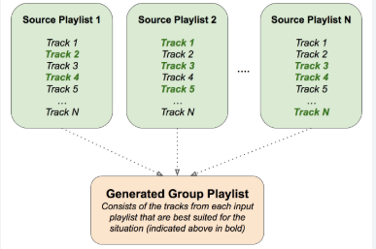
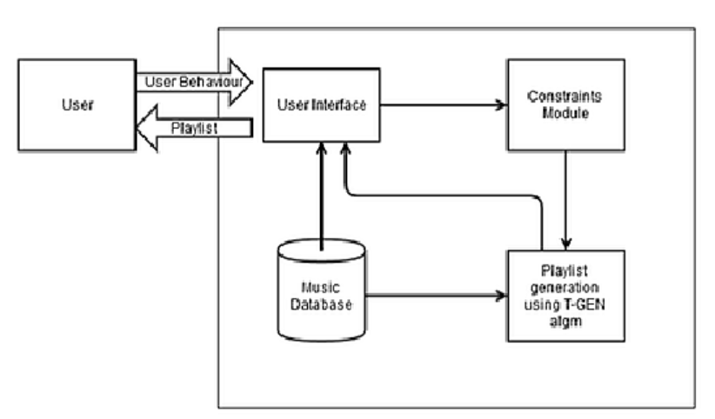
Playlist Curation

Slide 3

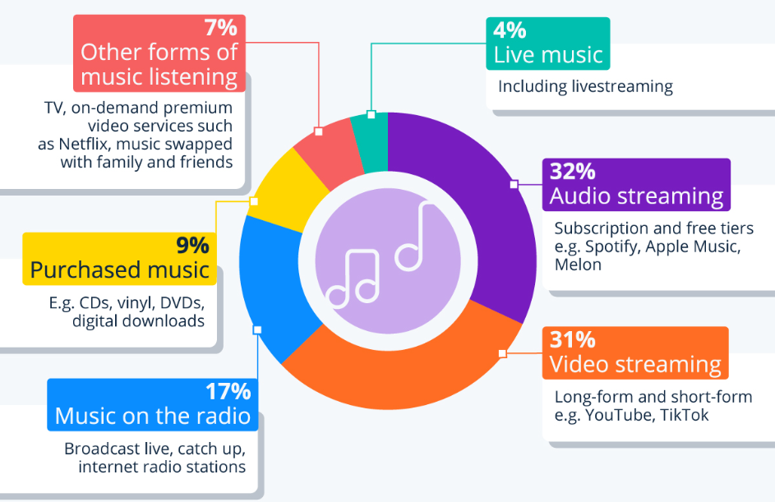
Song discovery

Slide 4
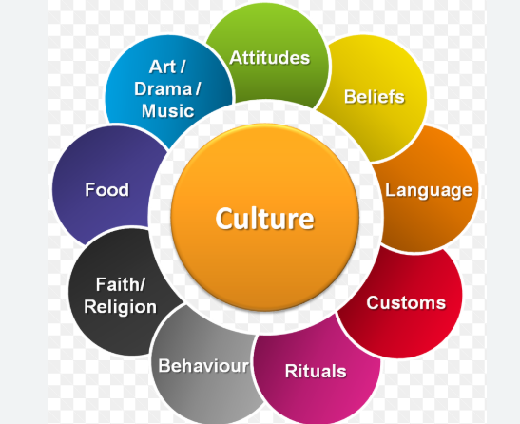
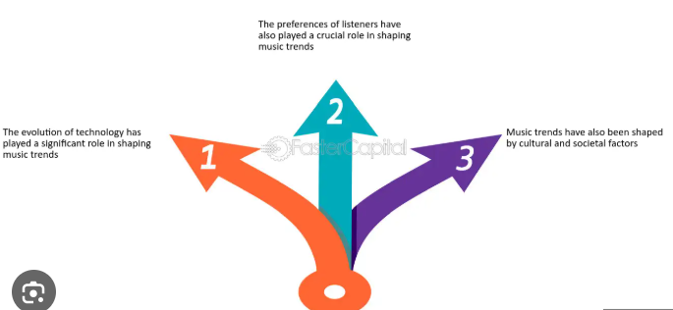
Artist analysis

Slide 5

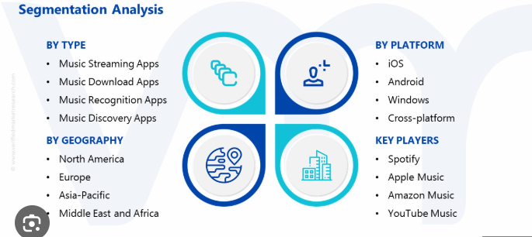
Market segmentation

Slide 6
Thank you ALL

