Slide 1

🎵 Music Clustering
By
Manisha Priyadharshini M

Slide 2
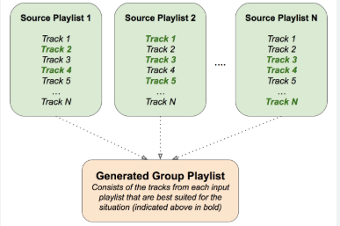
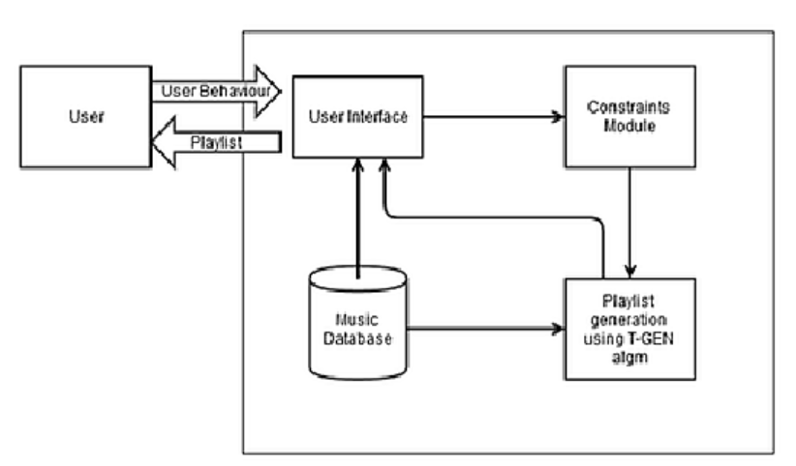
Playlist Curation

Slide 3

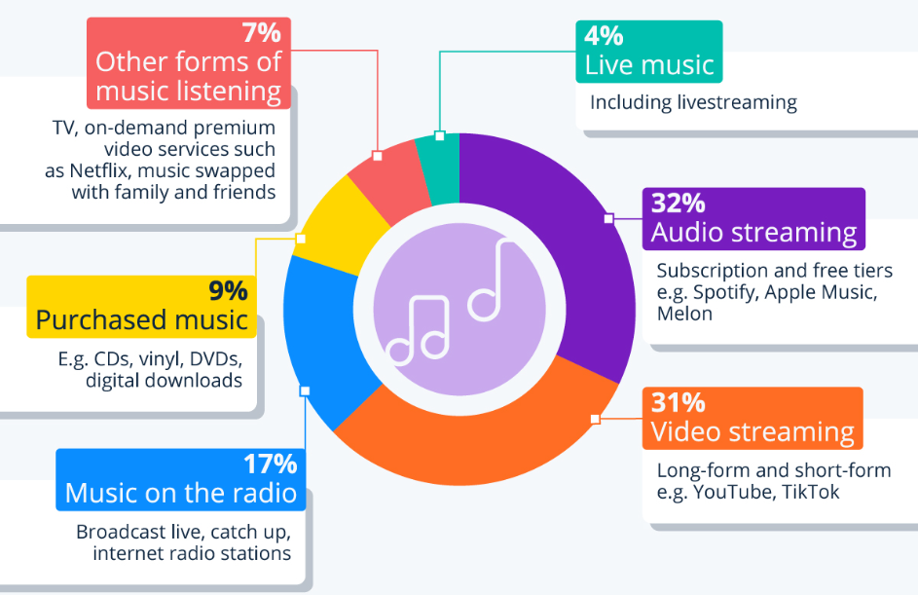
Song discovery

Slide 4
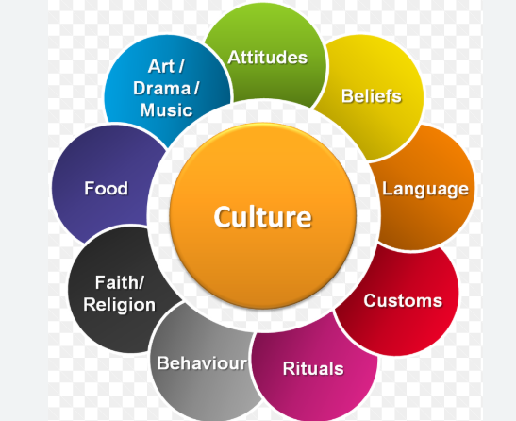
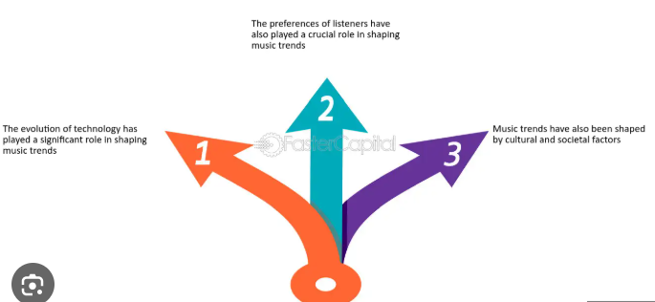
Artist analysis

Slide 5

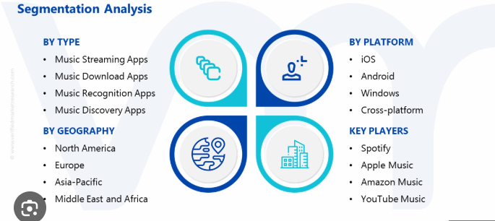
Market segmentation

Slide 6
Speaking engagement metrics
Impact factor | Measurement | Target | Achieved
Audience | Percentage (%) | 85 | 88
Knowledge retention | Percentage (%) | 75 | 80
Post-presentation surveys | Average rating | 4.2 | 4.5
Referral rate | Percentage (%) | 10 | 12
Collaboration opportunities | # of opportunities | 8 | 10

Slide 7
Thank you ALL

