Slide 1
MULTI CLASS IMAGE CLASSIFY
Presented By
Manisha
Priyadharshini M

Slide 2
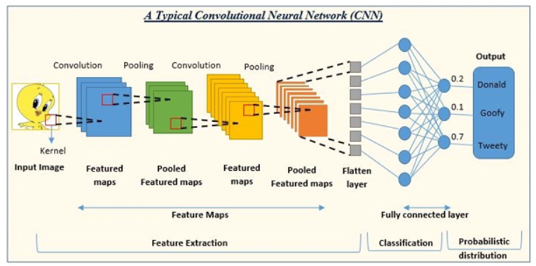
CNN Architecture

Slide 3
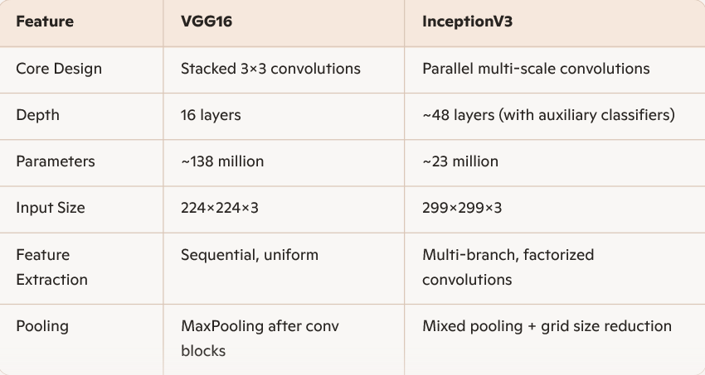
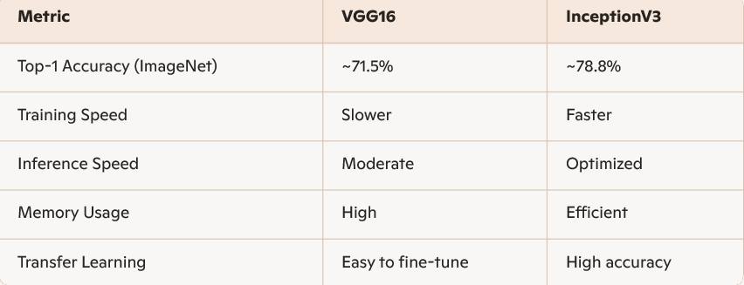
VGG16 VS InceptionV3

Slide 4
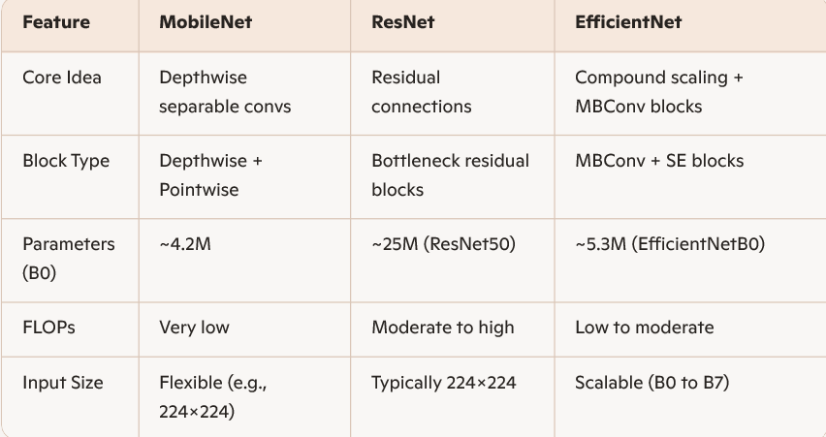
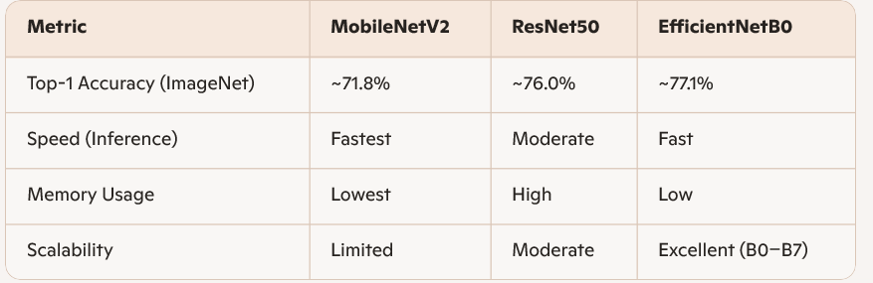
Compare models

Slide 5
Optimizers Validation Loss Metric
SGD Accuracy Category Crossentropy
Adam Precision & Recall MSE
RMSProp F1 Score
AUC

Slide 6


