Slide 1



Final year project
BCA 694
Bachelor of Computer Application
Submitted by
BCA_PROJ_2024_1
Student Name | University Roll No. | Registration Number
Yojana Adhikari | 211532381208060 | 2382105030046
Manish Aryal | 211532381108048 | 2382105030058
Ruben Shankar | 212432381108121 | 2382105030057
Subramanyam Pradhan | 212232381108184 | 2382105030062
Darius Prakash Khakha | 211532381108066 | 2382105030075

Slide 2

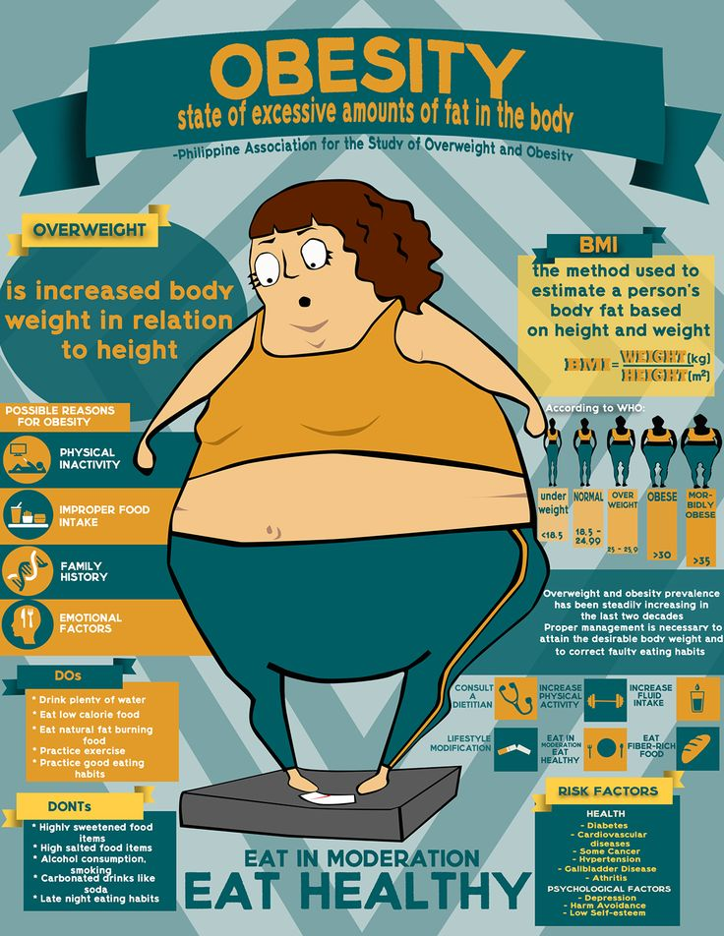
PREDICTING
OBESITY USING MACHINE LEARNING

Slide 3
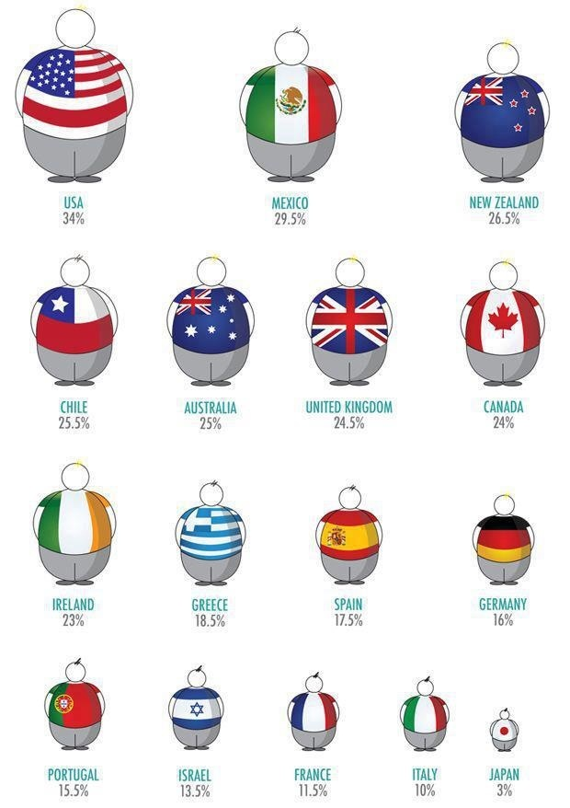
Problem Statement
1
Identify Risk Factors
Uncover the key factors that contribute to obesity, such as diet, physical activity, demographics, and lifestyle habits.
2
Predict Obesity Prevalence
Develop a machine learning model that can accurately predict the likelihood of an individual becoming obese.
3
Inform Prevention Strategies
Leverage the insights gained to design targeted interventions and public health initiatives to combat the obesity epidemic.

Slide 4

Dataset Overview
Data Source
Features
Target Variable
Future Recommendations
and Improvement
The dataset, sourced from a kaggle website, furnishe comprehensive information regarding individual health and lifestyle factors.
The dataset comprises variables such as age, gender, height, weight, level of physical activity, dietary habits, and socioeconomic status.
The primary objective is to accurately forecast an individual's obesity level outcome.
Future enhancements will provide personalized dietary plans and guidance for healthy weight, including obesity, through individual assessment.

Slide 5

Data Preprocessing
1
Data Cleaning
Identify and handle missing values, outliers, and inconsistencies to ensure data integrity.
2
Feature Scaling
Apply appropriate scaling techniques, such as standardization or normalization, to ensure all features are on a similar scale.
3
Encoding Categorical Variables
Convert categorical variables into a format suitable for machine learning algorithms, such as one-hot encoding.

Slide 6
Feature Engineering
Derived Features
Dimensionality Reduction
Apply techniques like PCA or feature selection to identify the most informative features and reduce complexity.
Create new features by combining or transforming existing variables, such as BMI or waist-to-hip ratio.
Domain Knowledge
Feature Importance
Leverage subject matter expertise to engineer features that capture important biological, behavioral, and environmental factors.
Analyze the relative importance of each feature to understand the key drivers of obesity and guide model interpretation.

Slide 7



Model Selection and Training
Classification Models
Ensemble Methods
Model Validation
Explore a variety of supervised learning algorithms, such as logistic regression, decision trees, and random forests.
Analyzing obesity dataset with individual factors using machine learning. Aim is trained model sense
Employ techniques like cross-validation to ensure the models generalize well to unseen data.

Slide 8
Model Evaluation
Accuracy
Measures the overall correctness of the model's predictions.
Precision
Evaluates the model's ability to correctly identify positive instances.
Recall
Assesses the model's ability to detect all positive instances.
Combines precision and recall to provide a balanced performance metric.
F1-Score

Slide 9




Insights and Recommendations
Key Risk Factors
Targeted Interventions
Policy Implications
Identify the most significant contributors to obesity, such as sedentary lifestyle, unhealthy diet, and socioeconomic status.
Develop tailored prevention and treatment strategies based on the identified risk factors.
Inform public health policies and initiatives to address the systemic drivers of the obesity epidemic.

Slide 10


