Slide 1



Department of Computer Science and Engineering
EMOTION-DRIVEN ADAPTIVE LEARNING SYSTEM FOR REAL-TIME VOICE AND FACIAL EXPRESSION-BASED USER MOTIVATION AND SUPPORT
Mrs. K. Mahesmeena
Assistant Professor
Department of Computer Science
TEAM ID: B21A2425C03
Lavanya A 210701132
Manisha Sharmi M 210701063

Slide 2
Introduction
The e-learning platform leverages voice and facial recognition to create a personalized learning experience. It detects emotions like happiness, sadness, and stress through tone, pitch, and expressions, adapting content and feedback accordingly. Positive emotions prompt challenging tasks, while stress triggers calming suggestions, enhancing engagement and well-being. By integrating emotional intelligence, the system fosters a supportive, inclusive environment that improves focus, confidence, and comprehension. This approach makes learning more dynamic and holistic. It demonstrates how technology can transform education by addressing emotional and intellectual needs.
Second Review
Department of Computer Science and
Engineering

Slide 3
Problem Statement
Lack of Emotional Intelligence: Current e-learning platforms do not effectively detect or respond to users' emotions, resulting in generic, non-personalized learning experiences.
Limited Input and Feedback: These systems primarily rely on textual or visual inputs, failing to capture real-time emotional nuances, which diminishes engagement and motivation.
Suboptimal Learning Outcomes: The inability to adapt to users' emotional states reduces user satisfaction, retention, and the overall effectiveness of the learning process.
Second Review
Department of Computer Science and Engineering

Slide 4
Abstract
This project proposes an adaptive e-learning platform that uses voice and facial recognition to analyze emotions like happiness, sadness, and stress. By detecting emotional states in real time, the system personalizes learning content and provides motivational feedback tailored to user needs. Stress triggers calming suggestions, while positive emotions lead to more challenging tasks, ensuring continuous engagement. Unlike traditional systems, it integrates emotional intelligence to enhance retention, comprehension, and user well-being. The platform creates a supportive, human-centered learning environment, addressing both intellectual and emotional needs. This approach fosters motivation, confidence, and improved academic outcomes. It exemplifies how technology can revolutionize education with emotional awareness
First Review
Department of Computer Science and Engineering

Slide 5
Literature Review
PAPER 1: Audio and Text Sentiment Analysis of Radio Broadcasts
Authors: NAMAN DHARIWAL , SRI CHANDER AKUNURI , SHIVAMA , K. SHARMILA BANU
Brief about problem statement, implementation and Solution:
Problem Statement: The rapid increase in radio broadcast data has created challenges in analyzing public opinion and emotions efficiently. Traditional sentiment analysis methods lack the ability to handle audio-centric data effectively. There is a need for a real-time, comprehensive sentiment analysis model tailored to audio broadcasts.
Approach: Develop a "Bifurcate and Mix" method that separates audio into emotional (via Vokaturi) and linguistic components (via AssemblyAI transcription). Use VADER to analyze textual sentiment and merge insights for holistic analysis. Leverage advanced NLP techniques for real-time sentiment extraction and categorization.
Implementation: Audio data from All India Radio is processed using Vokaturi for emotion detection and Assembly AI for transcription. Transcribed text undergoes sentiment analysis using VADER to extract trends and patterns. Combined results are fed into a model designed for real-time sentiment visualization and reporting.
Solution: The proposed model identifies sentiments and emotions expressed in radio broadcasts with high efficiency and accuracy. It uncovers patterns in public opinion, providing actionable insights for media and policymaking. This innovative approach advances sentiment analysis in audio-driven domains.
Second Review
Department of Computer Science and Engineering

Slide 6
Literature Review
Advantages of the Method Used: The "Bifurcate and Mix" method offers a comprehensive approach by combining audio and text analysis, capturing both emotional tones and linguistic sentiments for a well-rounded understanding. Its real-time capability makes it highly suitable for live broadcasts, providing immediate insights. The method is scalable and can be extended to analyze various audio sources, from radio shows to podcasts. By integrating specialized tools like Vokaturi, AssemblyAI, and VADER, it ensures accuracy and efficiency in sentiment analysis. Additionally, the actionable insights derived from patterns and trends in public opinion make it valuable for media strategies and policymaking.
Disadvantages of the Method Used: The approach depends heavily on third-party tools, which could lead to licensing costs, reliability concerns, or dependency issues. Real-time analysis may face processing delays due to the sequential nature of audio transcription and sentiment computation. The accuracy of the results may vary, as emotional subtleties might not always be captured due to tool limitations. Language constraints also pose a challenge, as the method is limited to languages supported by the transcription and sentiment analysis tools. Lastly, integrating multiple tools and frameworks increases development complexity and can lead to higher implementation costs.
Second Review
Department of Computer Science and Engineering
6

Slide 7
Literature Review
PAPER 2: The Analysis of Music Emotion and Visualization Fusing Long Short-Term Memory Networks Under the Internet of Things
Authors: YUJING CAO ,JINWAN PARK
Brief about problem statement, implementation and Solution:
Problem Statement: Traditional music emotion analysis methods often fail to capture the nuanced emotional content in music due to their limited capability to model temporal and contextual dynamics. There is a need for an advanced, accurate approach to analyze music emotions intuitively. The challenge lies in integrating innovative technologies like IoT and machine learning to bridge these gaps.
Approach: The research employs Long Short-Term Memory (LSTM) networks to effectively model time-series data in music, capturing its dynamic emotional aspects. By integrating LSTM with the Sequence-to-Sequence (STS) framework, an advanced model for music emotion analysis is developed. Machine learning algorithms are utilized to train and evaluate the system for precision in emotion prediction.
Implementation: The model processes musical data using LSTM for temporal analysis, combining it with the STS framework for enhanced sequence learning. Metrics such as Arousal and Valence are predicted, with evaluation metrics including absolute error, RMSE, and R square. IoT technology supports data acquisition and enhances real-time application potential.
Solution: The integrated LSTM and STS model demonstrates high accuracy in predicting music emotions, outperforming traditional methods. With an Arousal average absolute error of 0.921 and Valence error of 0.902, the system sets a new benchmark. This approach deepens the understanding of music emotions
Second Review
Department of Computer Science and Engineering
7

Slide 8
Literature Review
Advantages of the Method Used: The method provides a precise and nuanced analysis of music emotions by leveraging LSTM’s strength in modeling temporal data. Integration with the STS framework enhances sequence learning, resulting in superior accuracy. The approach bridges the gap between traditional methods and advanced IoT-enabled systems, enabling real-time applications. It also holds potential for personalized music recommendations and innovative music composition tools, revolutionizing user interaction with music.
Disadvantages of the Method Used: The method relies heavily on computational resources, making it challenging to implement in resource-constrained environments. Training the LSTM and STS models requires extensive data, which may not always be accessible. The integration of IoT adds complexity and potential reliability concerns. Metrics like RMSE and R square indicate room for improvement in precision. Additionally, the model may need adaptation for diverse musical genres and cultural contexts.
Second Review
Department of Computer Science and Engineering
8

Slide 9
Objectives
Personalized Learning: To create a smart e-learning platform that adapts to users' emotions through real-time voice and facial recognition, providing tailored content and feedback.
Enhanced Engagement: To improve user motivation and focus by dynamically responding to emotional states such as happiness, sadness, or stress, ensuring a supportive learning experience.
Improved Outcomes: To optimize learning processes by fostering confidence, reducing stress, and increasing retention through emotionally intelligent interactions and personalized guidance.
Second Review
Department of Computer Science and Engineering
9

Slide 10
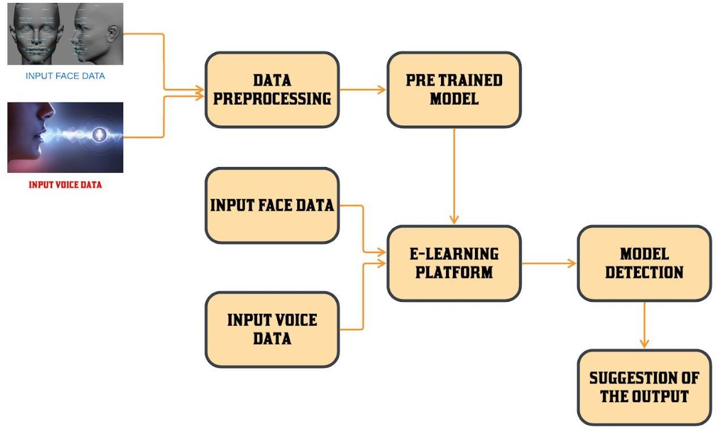
ARCHITECTURE DIAGRAM
Second Review
Department of Computer Science and Engineering

Slide 11
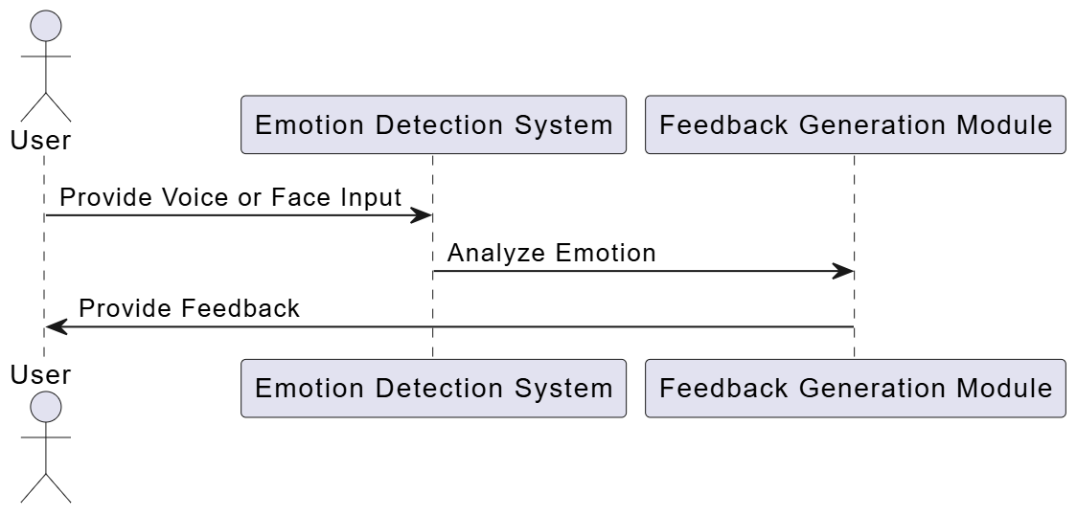
SEQUENCE DIAGRAM
Second Review
Department of Computer Science and Engineering

Slide 12
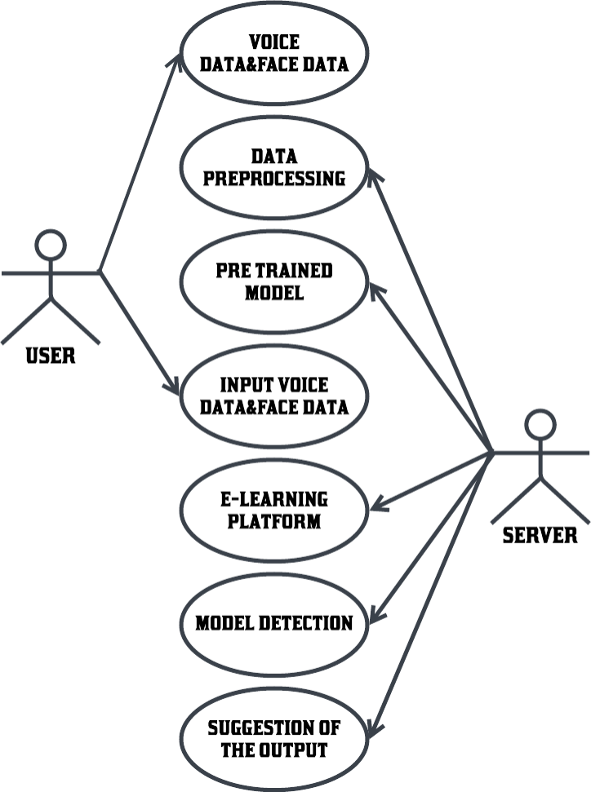
USE CASE DIAGRAM
Second Review
Department of Computer Science and Engineering

Slide 13
MODULE DESCRIPTION
Data Preprocessing
Feature Extraction
Voice Analysis
Facial Recognition and Analysis
Emotion Recognition Algorithms (CNN & LSTM)
Real-Time Interaction and Feedback
Adaptive Learning Content
User Interface (UI) and Experience (UX) Design
Data Security and Privacy Management
System Evaluation and Continuous Improvement
Second Review
Department of Computer Science and Engineering

Slide 14
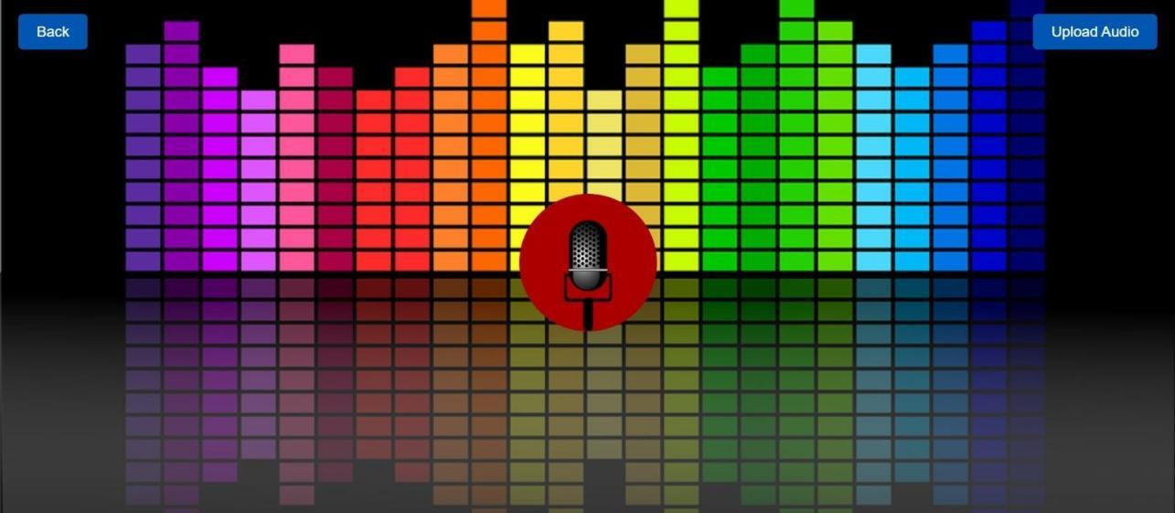
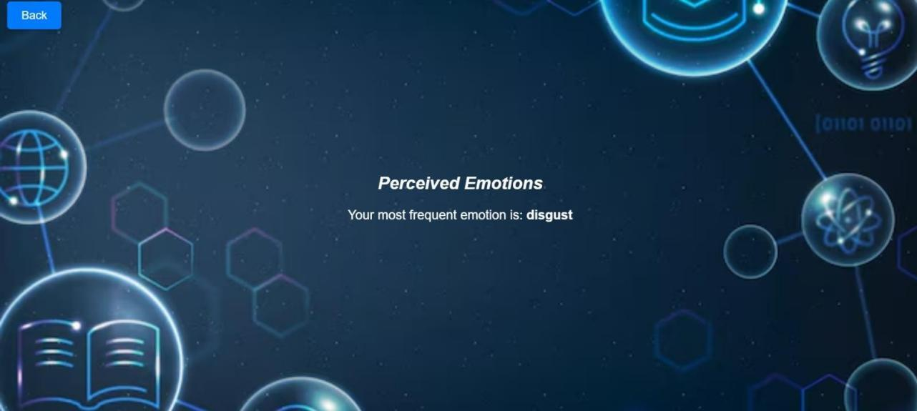
OUTPUT SCREENSHOTS
Second Review
Department of Computer Science and Engineering

Slide 15
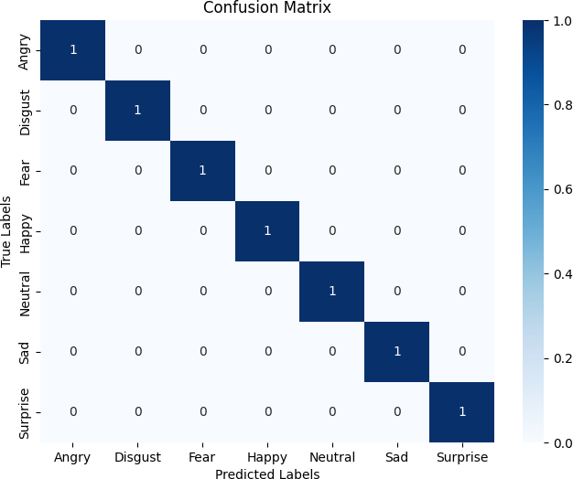
CONFUSION MATRIX
Second Review
Department of Computer Science and Engineering

Slide 16
REFERENCES
[1] N. Dhariwal, S. C. Akunuri, Shivama and K. S. Banu, "Audio and Text Sentiment Analysis of Radio Broadcasts," in IEEE Access, vol. 11, pp. 126900- 126916, 2023, doi: 10.1109/ACCESS.2023.3331226.
[2 ] The Analysis of Music Emotion and Visualization Fusing Long Short-Term Memory Networks Under the Internet of Things
[3] K. Zaman, M. Sah, C. Direkoglu and M. Unoki, "A Survey of Audio Classification Using Deep Learning," in IEEE Access, vol. 11, pp. 106620- 106649, 2023, doi: 10.1109/ACCESS.2023.3318015
[4 ] A. Dutt and P. Gader, "Wavelet Multiresolution Analysis Based Speech Emotion Recognition System Using 1D CNN LSTM Networks," in IEEE/ACM Transactions on Audio, Speech, and Language Processing, vol. 31, pp. 2043- 2054,2023, doi: 10.1109/TASLP.2023.3277291.
Second Review
Department of Computer Science and Engineering

Slide 17
REFERENCES
[5] H. -D. Le, G. -S. Lee, S. -H. Kim, S. Kim and H. -J. Yang, "Multi-Label Multimodal Emotion Recognition With Transformer-Based Fusion and EmotionLevel Representation Learning," in IEEE Access, vol. 11, pp. 14742-14751, 2023, doi: 10.1109/ACCESS.2023.3244390.
[6] M. Xu, F. Zhang, X. Cui, and W. Zhang, ‘‘Speech emotion recognition with multiscale area attention and data augmentation,’’ in Proc. IEEE Int. Conf. Acoust., Speech Signal Process. (ICASSP), Jun. 2021, pp. 6319–6323.
[7] C. Gong, D. Wang, M. Li, V. Chandra, and Q. Liu, ‘‘KeepAugment: A simple information-preserving data augmentation approach,’’ in Proc. IEEE/CVFConf. Comput. Vis. Pattern Recognit. (CVPR), Jun. 2021, pp. 1055–1064.
[8] E. D. Cubuk, B. Zoph, J. Shlens, and Q. V. Le, ‘‘Randaugment: Practical automated data augmentation with a reduced search space,’’ in Proc. IEEE/CVF Conf. Comput. Vis. Pattern Recognit. Workshops (CVPRW), Jun. 2020, pp. 3008–3017
Second Review
Department of Computer Science and Engineering

Slide 18
REFERENCES
[9] B. T. Atmaja and A. Sasou, ‘‘Effects of data augmentations on speech emotion recognition,’’ Sensors, vol. 22, no. 16, p. 5941, Aug. 2022.non_x0002_intrusive assessment methods (literature survey).
[10] Kumar P; Salman Latheef T A; Santhosh R(2023), "Face Recognition Attendance System Using Local Binary Pattern Algorithm," 2023 2nd International Conference on Vision Towards Emerging Trends in Communication and Networking Technologies (ViTECoN), Vellore, India, 2023, pp.1-6, doi:10.1109/ViTECoN58111.2023.10157843.
[11] P. Kumar, S. Senthil Pandi, T. Kumaragurubaran and V. Rahul Chiranjeevi (2024), "Human Activity Recognitions in Handheld Devices Using Random Forest Algorithm," 2024 International Conference on Automation Computation (AUTOCOM), Dehradun, India,2024, pp. 159-163, doi:10.1109/AUTOCOM60220.202
Second Review
Department of Computer Science and Engineering

Slide 19
PAPER STATUS
Status : Paper submitted.
Conference name: Internation Conference on Emerging research in computational Science 2024
Paper ID: 1405
Authors: Mrs. K. Mahesmeena, A Lavanya, M Manisha Sharmi
Second Review
Department of Computer Science and Engineering

Slide 20
Thank You
Second Review
Department of Computer Science and Engineering
20

