Slide 1
Online Examination system Project

Slide 2
KEY WORDS
HTML : Hypertext Markup Language
CSS: Cascading Style Sheets
SQL : Structured Query Language
PHP: Hypertext Pre-processor
ERD: Entity Relationship Diagram

Slide 3
WHY ONLINE EXAMINATION SYSTEM?
Result calculated in less time
Time Saving
Clarity
Instantly
Access to new-data
User –friendly

Slide 4
INTRODUCTION
Online examination is fast developing method
It is also needed less manpower handle examination
Organizations can also easily monitor
Requirement is significantly
Saving the time and effort
Prepare the results report

Slide 5
OBJECTIVES
Main objectives of our project are:
To provide an interface through which student can appear for examination online for objective type questions.
To provide registration for students done by themselves.
When the student starts the exam the timer will start automatically and show the student how much time is left
To provided user name and password facility.

Slide 6
PROBLEM
The main problem statement of the our project is “to design and implement the online examination system using PHP language”.

Slide 7
PROCESS
STUDENT ASPECT
Requesting registration
Logging into the system
Selecting the test
Appearing for the examination
Printing the result at the end of examination
Reviewing the given response

Slide 8
ADMINSTRATOR ASPECT
Editing/deleting/creating the database
Accepting registration of candidates
Changing the password
Logging into the system
Time limit of the test if any
Marking correct answer with in the given option
Set negative marks for wrong response

Slide 9
Software/Tools Requirements
Designing Tool :HTML,CSS,php,java script
Front End Tool :XAMPP Server
Database Tool :SQL Server
Documenting Tool: MS-Word

Slide 10
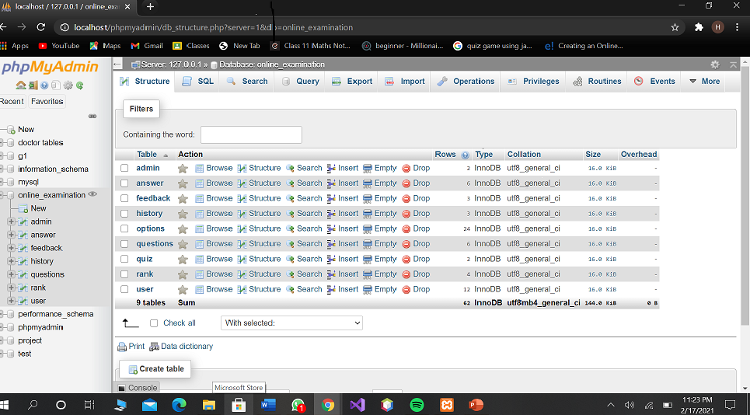

Slide 11
Functional Requirements
Sign Up:
Login:
Create User:
Create Question:.
Create Exam:
Answer Question:.

Slide 12
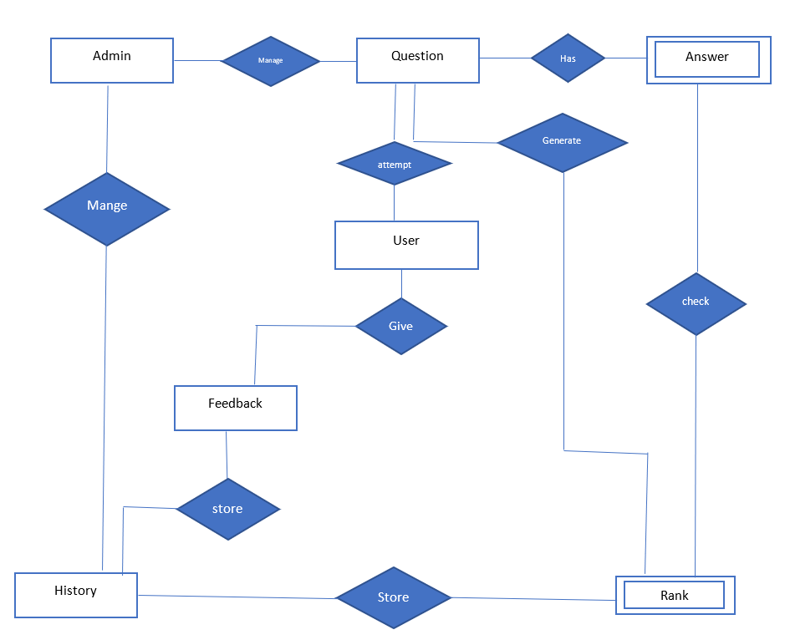
ERD DIAGRAM

Slide 13
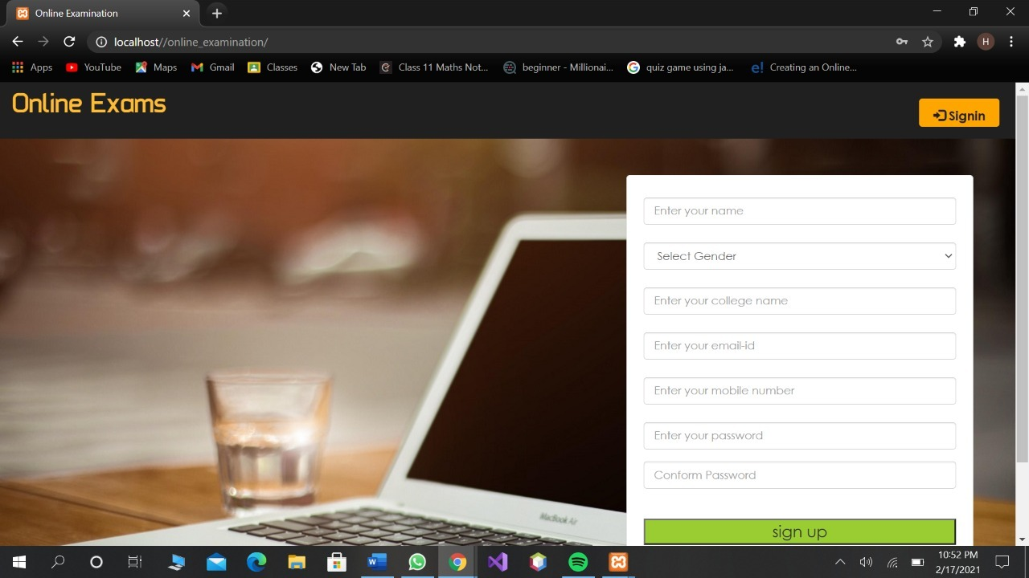

Slide 14
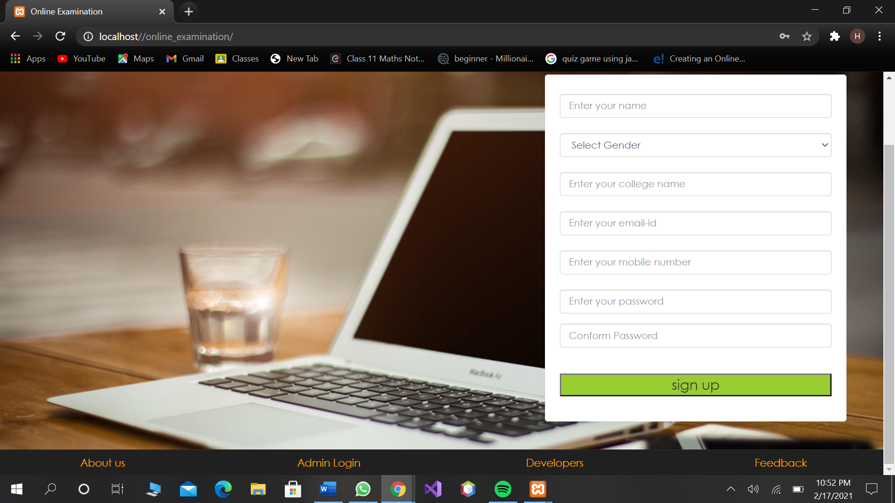

Slide 15
Thanks you so much for your attention

