Slide 1

ReactJS, Redux
and unit testing
with Jest & Enzyme

Slide 2

Name: Manish Kumar
Professional Experience: 12+ years in Web Development
Specialization: React.js, Redux, and TDD (Test-Driven Development)
Mentorship: Trained over 100 candidates, ensuring they are adept in modern web development techniques and best practices.
Objective: Leveraging extensive industry experience and a deep passion for imparting knowledge, I aim to bridge the gap between education and real-world application, fostering innovation and excellence in the next generation of web developers.
Quote: "Education is not just about the information but about transformation. Let's code, learn, and transform together!"

Slide 3
Day 1:
Introduction to ReactJS with Hooks
1. What is React and why use it?
2. Setting up a new React project with
Create React App (CRA)
3. Understanding JSX syntax
4. Functional Components
5. State with useState
6. Effects with useEffect
7. Assignment: Create a simple counter application using functional components and hooks

Slide 4
What is React?
A JavaScript Library for Building User Interfaces.
Components

Slide 5
1. What is React and why use it?
React, often referred to as React.js or ReactJS, is an open-source JavaScript library developed by Facebook for building user interfaces or UI components.
Initially released in 2013, React focuses on enabling developers to build reusable UI components using a declarative syntax.

Slide 6
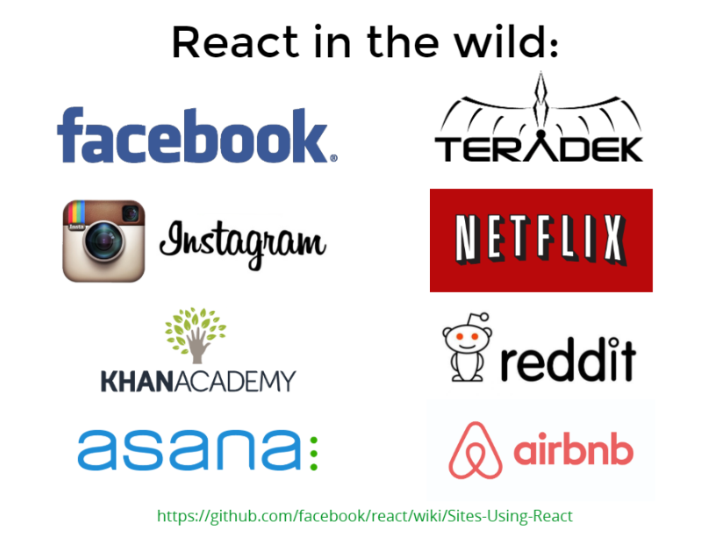
Who?
Who uses React?

Slide 7
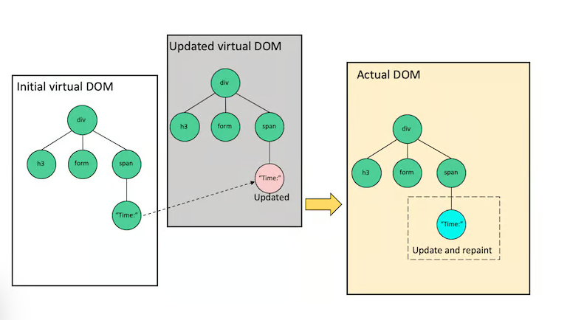
What is the virtual DOM in React?
A unique feature of React is the virtual DOM (Document Object Model). The virtual DOM is a programming concept where an ideal or "virtual" representation of a UI is stored in memory and synced with the "real" DOM through a process called reconciliation. This approach allows React to achieve optimal update performance and ensures that the user interface stays consistent throughout the application.

Slide 8
Why Use React?
There are several reasons why developers and companies choose to use React:
1. Component-Based Architecture
2. Virtual DOM
3. Flexibility
4. Strong Community & Ecosystem
5. Backed by Facebook
6. Adaptable for Mobile Development
7. Easy to Learn
8. SEO Friendly
9. Use of JSX

Slide 9
2. Setting up a new React project with Vite
Prerequisites:
Node.js: Ensure that you have Node.js and npm (Node Package Manager) installed. If not, download and install it from Node.js official website.
https://nodejs.org/en

Slide 10
It’s time to create our first React App ☺

Slide 11
2. Setting up a new React project with Vite
Setting Up a React Project:
Official Documentation:
https://react.dev/learn/start-a-new-react-project
1. Open Terminal/Command Prompt: Start your terminal or command prompt.
2. Create a new React project with Vite:
Vite is a build tool that aims to provide a faster and leaner development experience for modern web projects. It leverages JavaScript's native ES modules. Starting a React project with Vite is simple.

Slide 12
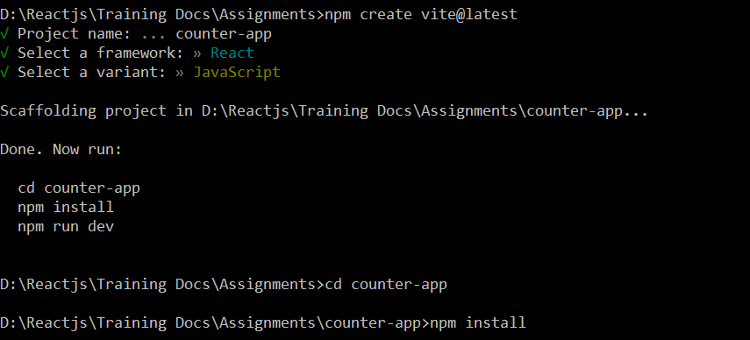
2. Setting up a new React project with Vite
Create a new React project with Vite:
Use the following commands to create a new Vite project with the React:
Replace counter-app with the name you want for your project directory.

Slide 13
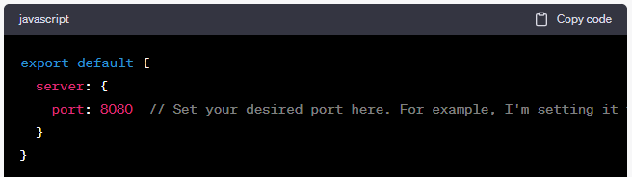

2. Setting up a new React project with Vite
Set the Server Port:
Inside vite.config.js, export your configuration with the desired port:
Start the development server:
Visit http://localhost:8080/ in your browser, and you should see your Counter App.

Slide 14

3. Understanding JSX syntax
JSX, or JavaScript XML, is a syntax extension for JavaScript, commonly used with React to describe what the UI should look like. JSX may remind you of a template language, but it has the full power of JavaScript. It allows you to write HTML-like syntax directly in your JavaScript code, resulting in a more intuitive and cleaner way to define React components.
Here are some essential concepts and features of JSX:
1. Basic Syntax:
In its simplest form, JSX looks a lot like HTML:

Slide 15
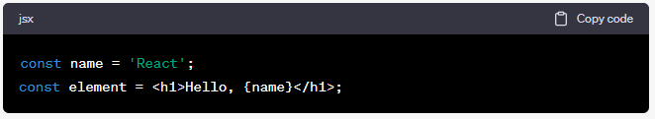
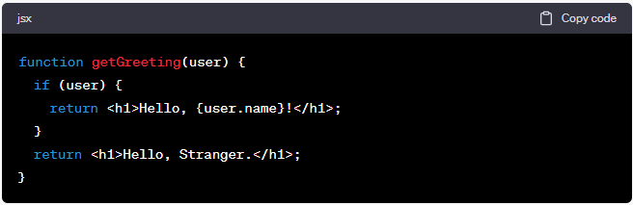
3. Understanding JSX syntax
2. Embedding Expressions:
JSX allows you to embed any valid JavaScript expression inside {}. For example:
3. JSX is an Expression:
After being transpiled, JSX expressions become regular JavaScript function calls and evaluate to JavaScript objects.
This means you can use JSX inside if statements, for loops, assign it to variables, accept it as arguments, and return it from functions.

Slide 16
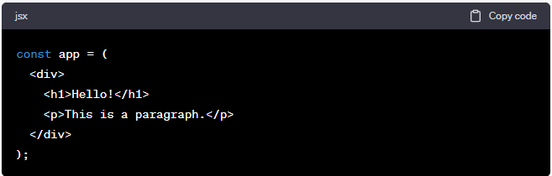
3. Understanding JSX syntax
4. Children in JSX:
JSX tags can contain children:

Slide 17
3. Understanding JSX syntax
Conclusion:
JSX offers a concise and readable syntax for defining tree structures with attributes. It provides a set of tools that make it easier to visualize and work with UI components in JavaScript. While it might seem a bit unfamiliar at first, especially if you're coming from a strict HTML/JavaScript background, many developers find it incredibly helpful and efficient once they get used to it.

Slide 18
Components?
Header
Headline
Sidebar
Blog Post Content

Slide 19
4. Functional Components
1. Functional components are a simpler way to write React components.
2. They're just JavaScript functions that return JSX.
3. Unlike the older class-based components, functional components don't involve the complexities of this context, lifecycle methods, or the constructor method. Instead, they're straightforward and often easier to read and write.
4. With the introduction of React Hooks in React 16.8, functional components can now manage state and side-effects, which were previously exclusive to class components.

Slide 20
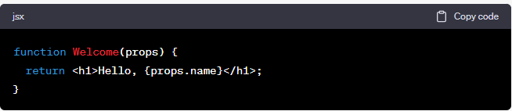
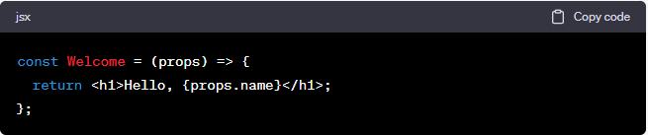
4. Functional Components
Basic Syntax
A simple functional component looks like this:
Or using an arrow function:

Slide 21
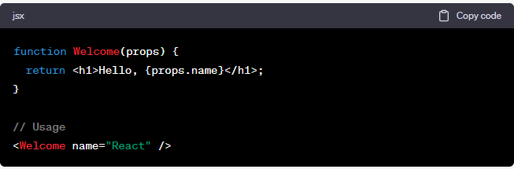
4. Functional Components
Props
Functional components receive props as their first argument. Props are a way of passing data from parent to child. They are read-only and help to keep your UI consistent:

Slide 22
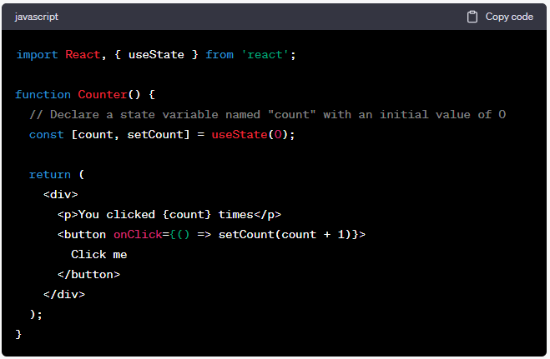
4. Functional Components
State with useState Hook In the past, functional components couldn't have their own state. But with the useState hook, they can:
In the above example, useState(0) means the initial state is 0. The setCount function is used to update the state.

Slide 23
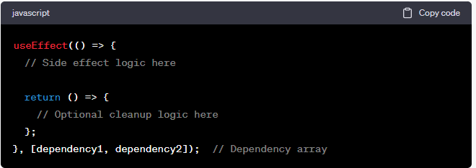
4. Functional Components
Lifecycle and Side Effects with useEffect Hook The useEffect hook can replicate lifecycle behaviors in functional components:

Slide 24
4. Functional Components
The useEffect hook can be thought of as componentDidMount, componentDidUpdate, and componentWillUnmount combined.
Advantages of Functional Components:
Simpler Syntax: Without the need to use this, the code often looks cleaner.
Hooks: With hooks, you can use state and other React features without writing a class.
Performance: While there are ongoing discussions and tests about performance, functional components combined with hooks can lead to reduced code size in some scenarios, which can positively impact performance.
Conclusion:
Functional components, especially with hooks, have become the preferred way to write React components for many developers. They lead to more readable and maintainable codebases and provide all the capabilities that were once exclusive to class components.

Slide 25

5. State with useState
The useState hook is a significant addition to React, introduced in version 16.8. It allows functional components to manage local state without needing to convert the component to a class.
Basic Usage:
Here's the basic syntax of the useState hook:
`useState` returns a pair: the current state value and a function to update it.
The only argument to useState is the initial state.
The initial state can be any type: number, string, array, object, boolean, etc.
The setState function is used to update the state. When you call this function, the component will re-render with the new state.

Slide 26
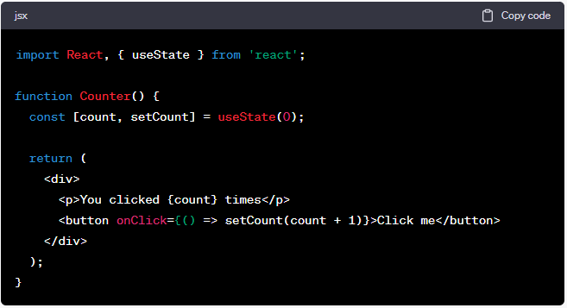
5. State with useState
Example:
Here's a simple counter component using the useState hook:
In this example:
We initialize count state to 0 using useState(0).
We display the current value of count in the component.
When the button is clicked, the setCount function is called with the new value, and the component re-renders.

Slide 27
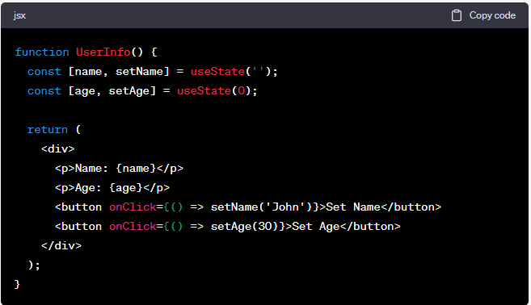
5. State with useState
Using Multiple State Variables:
You can use the useState hook multiple times in a single component for different state variables:

Slide 28
5. State with useState
Conclusion:
The `useState` hook provides a simpler and more intuitive way to manage local state in functional components. It's a cornerstone of the React Hooks API, allowing developers to write more concise and readable components.

Slide 29
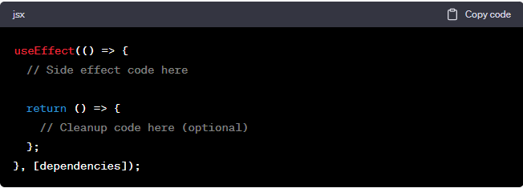
6. Effects with useEffect
The useEffect hook is part of React's Hooks API, allowing you to perform side effects in functional components. It serves as a replacement and unification of several lifecycle methods from class components, such as componentDidMount, componentDidUpdate, and componentWillUnmount.
Basic Usage:
The useEffect hook takes two arguments:
A function that contains the code to run the effect.
A dependency array which determines when the effect runs.
Here's the basic syntax:

Slide 30
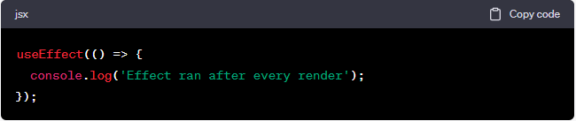
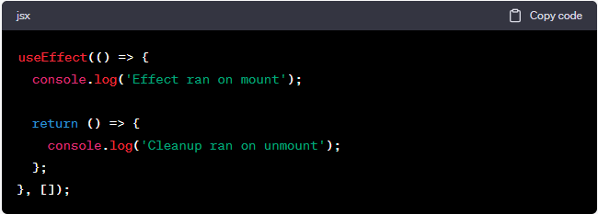
6. Effects with useEffect
Running Effects:
1. After Every Render (by not providing a dependency array):
2. Once (on mount and unmount) (by providing an empty dependency array):

Slide 31
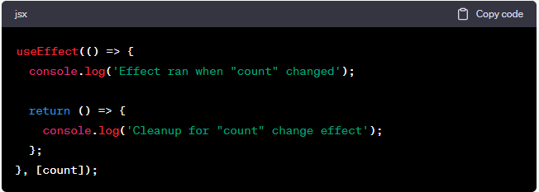
6. Effects with useEffect
Running Effects:
3. When Certain Values Change (by providing values in the dependency array):

Slide 32
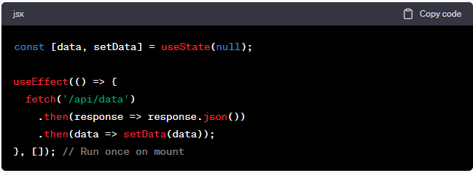
6. Effects with useEffect
Fetching Data:

Slide 33
7. Assignment:
Create a simple counter application
using functional components and hooks

Slide 34
Day 2:
Introduction to ReactJS with Hooks
1. Context with useContext
2. Ref with useRef
3. Callback with useCallback
4. Memoization with useMemo
5. Assignment: Enhance the counter application, add a feature to store counter history.

Slide 35

1. Context with useContext
The `useContext` hook is a part of the React Hooks API that allows functional components to easily access the value of a context without having to use the `Context.Consumer` component, which can lead to less nested and cleaner code.
Basics of `useContext`:
The `useContext` hook takes a context object (the value returned from React.createContext) and returns the current context value for that context.
How to use `useContext`:
Let's walk through the process of creating a context and using it with the `useContext` hook.
1. Creating the Context:
First, you need to create a context using `React.createContext`.

Slide 36
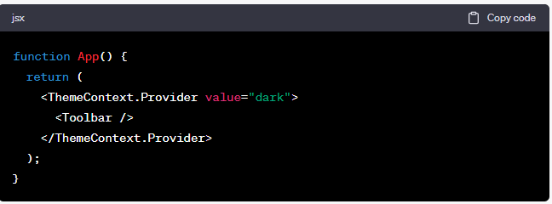
1. Context with useContext
2. Providing the Context Value:
Wrap your component tree with the context provider and give it a value.
In this example, any component within `App` can access the` ThemeContext` value, which is "dark".

Slide 37
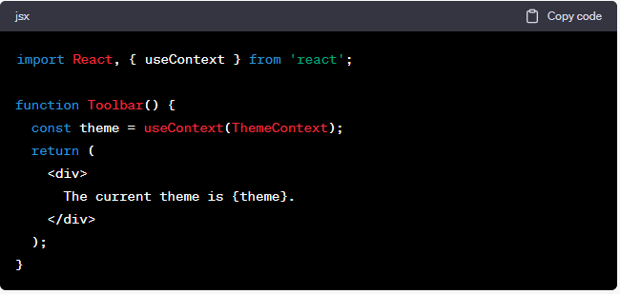
1. Context with useContext
3. Consuming the Context Value using useContext:
Within any functional component, you can now use the `useContext` hook to consume the context value.
Here, the `Toolbar` component directly accesses the theme without requiring a `Context.Consumer` component or a render prop.

Slide 38
1. Context with useContext
Important Notes:
Context is designed to share data that can be considered "global" for a tree of React components, such as authenticated user, theme, or preferred language.
The value argument passed to `useContext` must exactly match the context object you used when creating the context. If not, you'll receive an error.
Remember, due to the way React works, when the value of a context changes, all components that consume that context will re-render. If performance is a concern, you might need to optimize components with `React.memo` or `useMemo` hooks.
Conclusion:
`useContext` is a powerful tool that simplifies the consumption of context values in functional components, leading to more readable and concise code. When combined with other hooks and features, it offers a seamless way to manage and pass down "global" values through your React application.

Slide 39
2. Ref with useRef
The `useRef` hook is part of the React Hooks API and provides a way to access the DOM elements or keep a mutable reference to a value without causing re-renders. It returns a mutable object called a `ref` object, and this object will persist for the full lifetime of the component.
Here's how you can use `useRef`:
Accessing DOM Elements:
One of the primary use cases for `useRef` is to get a reference to a DOM element. This allows direct manipulation of the element, similar to using `document.getElementById` or other DOM querying functions.
1. Setting the Ref on the Element:

Slide 40
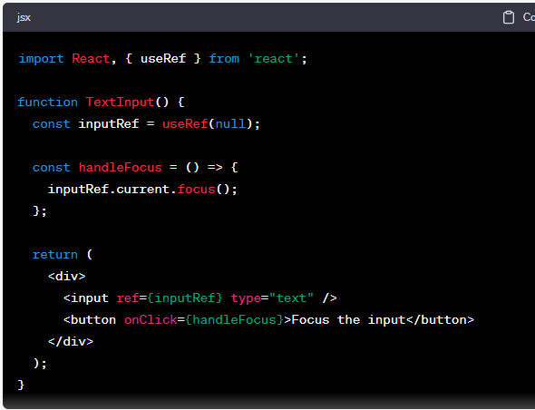
2. Ref with useRef
Setting the Ref on the Element:
In the above example, when the button is clicked, the input field will receive focus.

Slide 41
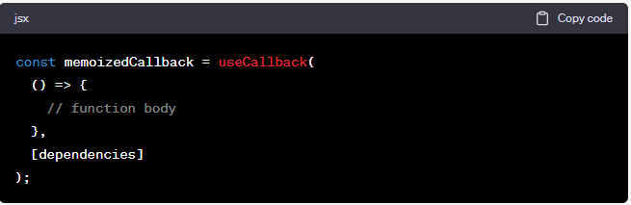
3. Callback with useCallback
The `useCallback` hook, part of the React Hooks API, is used to memorize functions. It's especially beneficial in contexts where we pass callback functions to optimized child components that rely on reference equality to prevent unnecessary renders, such as when using `React.memo`.
Basic Usage:
The `useCallback` hook returns a memorized version of the callback function that only changes if one of the dependencies has changed.
Here's the basic syntax:

Slide 42
3. Callback with useCallback
The `dependencies` array works similarly to the one in the `useEffect` hook. The callback function will only be recreated if any value in the dependencies array changes between renders.

Slide 43
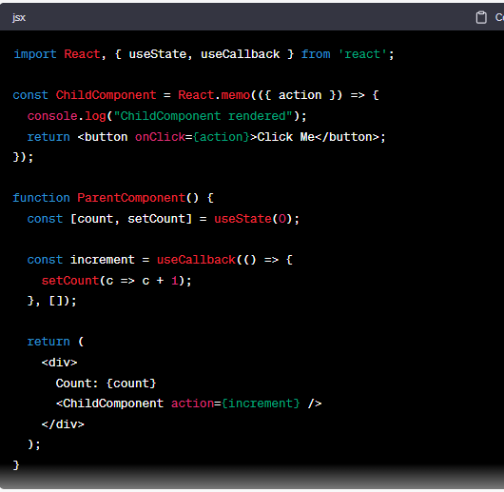
3. Callback with useCallback
Example:
Let's look at an example using a parent component that renders a child component. We want to ensure the child doesn't re-render unnecessarily:

Slide 44
3. Callback with useCallback
In this example, `ChildComponent` uses `React.memo`, which makes it only re-render if its props change. The `increment` function is wrapped with `useCallback` to ensure that it keeps a consistent reference across renders unless specific dependencies change (in this case, there are no dependencies since setCount doesn't change).
Without `useCallback`, the `increment` function would be redefined every time `ParentComponent` re-renders, causing `ChildComponent` to re-render as well, even though the actual logic of the function hasn't changed.

Slide 45
3. Callback with useCallback
When to use useCallback:
Performance Optimization: When passing callbacks to highly reusable components or components with a large subtree. If the child component is expensive to re-render or re-renders often, `useCallback` can be beneficial.
Reference Equality: In situations where reference equality matters, for instance, when passing callbacks to components that rely on `React.memo` or when working with certain libraries.
Event Listeners: If you're adding and removing event listeners often and need a stable reference to a callback function.
Caution:
While `useCallback` can help in optimizing performance in specific scenarios, it's not a silver bullet. Overuse can lead to more complex code and can sometimes even introduce performance issues due to the overhead of maintaining the memorized function. Use it judiciously and profile your application's performance to ensure it's having a positive impact.

Slide 46
3. Callback with useCallback
Conclusion:
The `useCallback` hook provides a way to optimize performance by retaining a stable reference to functions across component renders. However, like all optimization tools, it should be used when necessary and not by default.

Slide 47

4. Memoization with useMemo
`useMemo` is a React hook that memorizes the result of a computation. This can be beneficial when you have expensive computations that you don't want to execute on every render, especially if the inputs to those computations haven't changed.
Basic Usage:
The `useMemo` hook is called with a function and a dependencies array. The function will only be re-computed when one of its dependencies has changed:
When to use useMemo:
Performance Optimization: If there's an expensive calculation that doesn't need to be recomputed on every render unless certain values change, you can use `useMemo` to avoid unnecessary recalculations.
Reference Equality: Sometimes, you want to ensure that an array, object, or function doesn't get re-created on every render to prevent unnecessary re-renders of child components or recomputation of derived data.

Slide 48
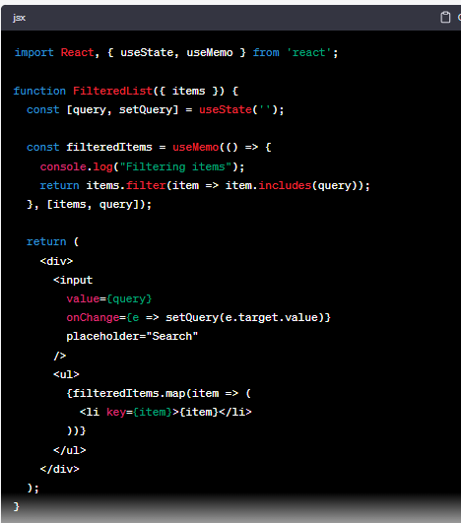
4. Memoization with useMemo
Example:
Let's consider a simple example where a list of items is filtered based on a query, and this filtered list is used in a component:

Slide 49
4. Memoization with useMemo
In the example above, the `filteredItems` are recalculated only when `items` or `query` changes. If the `FilteredList` component re-renders for any other reason, the `useMemo` hook ensures that the filtering logic doesn't run again unless necessary.
Caveats and Considerations:
1. Overuse: Just like `useCallback`, it's essential not to overuse `useMemo`. Not every calculation needs to be memorized. Sometimes, the overhead of memorization might even exceed the benefits.
2. Memory vs. CPU: Memoization is a trade-off. You're opting to use more memory to store computed values to save CPU cycles in the future. It's essential to strike the right balance and not to over-optimize prematurely.
3. Shallow Equality Check: The dependencies array in `useMemo` does a shallow equality check, similar to `useEffect` and `useCallback`. This means that if you're passing objects or arrays, they should remain the same across renders unless their data changes.

Slide 50
4. Memoization with useMemo
Conclusion:
`useMemo` is a powerful tool in React's optimization toolkit. It allows for fine-grained control over when certain computations should be carried out. However, like all optimizations, it's best used judiciously and in situations where performance gains are noticeable and necessary.

Slide 51
6. Assignment:
Enhance the counter application, add a feature to store counter history.

Slide 52
Day 3:
React Router with Hooks
1. What is React Router?
2. Setting up React Router in a project
3. useParams, useHistory, and useLocation hooks
4. Assignment: Add routes to the counter app. Each counter has its own route.
Official Documentations:
https://reactrouter.com/en/main/start/tutorial
https://github.com/remix-run/react-router

Slide 53
1. What is React Router?
1. React Router is a popular library for adding navigation into your React application.
2. It allows you to create single-page applications (SPAs) with navigation capabilities, without doing full-page refreshes when moving between views or routes.
3. This provides a smoother user experience, akin to native mobile or desktop applications.
Key Concepts:
1. Router: The main component that keeps your UI in sync with the URL.
2. Route: Renders the right UI components based on the current URL.
3. Link: Navigation component that, when clicked, navigates to a new route.
4. Switch: Renders the first child <Route> or <Redirect> that matches the current location.
5. History: An object that allows you to manage session history in JavaScript, navigate between routes, and view the current location.

Slide 54
1. What is React Router?
Main Components:
1. BrowserRouter: Uses the HTML5 history API to sync your UI with the URL. It's the router to use for browser-based applications.
2. HashRouter: Uses the hash portion of the URL (e.g., window.location.hash) to keep your UI in sync with the URL. It's useful for older browsers without support for the HTML5 history API.
3. Route: Determines which component to render based on the current URL.
4. Link and NavLink: Allows you to create links to navigate through your application. While both generate links, NavLink can be styled based on whether the path it links to is active.

Slide 55
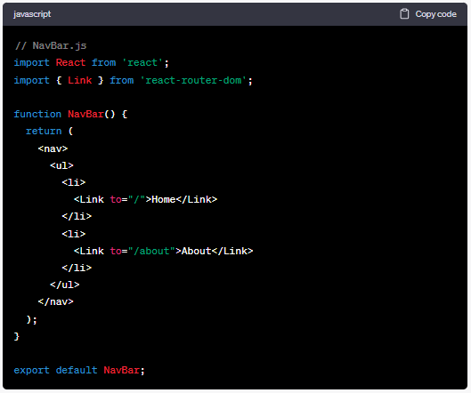
1. What is React Router?
Basic Example:
1. `NavBar` Component: This component will render the navigation links.

Slide 56
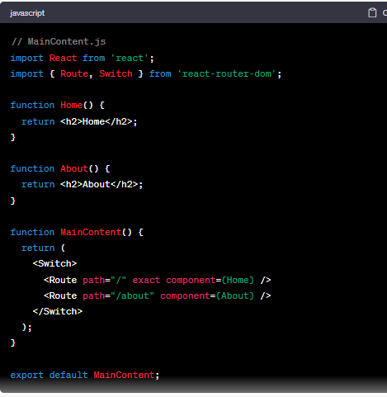
1. What is React Router?
2. `MainContent` Component: This component will be responsible for displaying the content based on the current route.

Slide 57
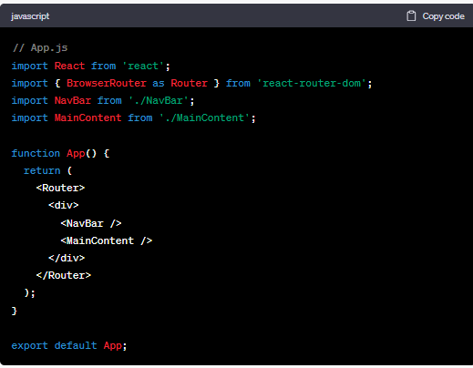
1. What is React Router?
3. `App` Component: Now, let's use the NavBar and MainContent components within the main App component.

Slide 58
1. What is React Router?
Advanced Features:
1. Nested Routes: Allows for more complex UIs where components have sub-routes.
2. Dynamic Route Matching: Allows for parameterized routes, such as `/users/:id` where `:id` is a dynamic part of the URL.
3. Programmatic Navigation: Navigate between routes using the `history` object without a link.
4. Redirects: Redirect from one route to another.
5. Route Config: Centralized route configuration for more complex applications.
6. Lazy Loading: Load parts of your application lazily using React's `Suspense` and `React.lazy()` to improve initial load performance.
Conclusion:
React Router provides a comprehensive solution to add navigation capabilities to your React application. It integrates seamlessly with React's component model, allowing for fine-grained control over your navigation experience. With a variety of components and features, React Router can cater to both simple and complex application routing needs.

Slide 59

2. Setting up React Router in a project
Setting up React Router in a React project involves a series of steps to ensure that your application can navigate and render components based on different URL paths. Here's a step-by-step guide to help you set up React Router:
1. Install React Router:
You can add React Router to your project using npm:

Slide 60
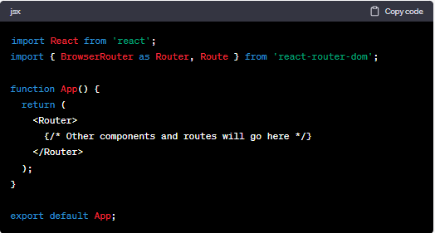
2. Setting up React Router in a project
2. Set Up the Router:
To set up routing, you'll need to wrap your main `App` component with the `BrowserRouter` component (from `react-router-dom`). This sets up the context needed for routing and provides the underlying mechanisms to change routes.
In your main application file (`App.js` or similar):

Slide 61
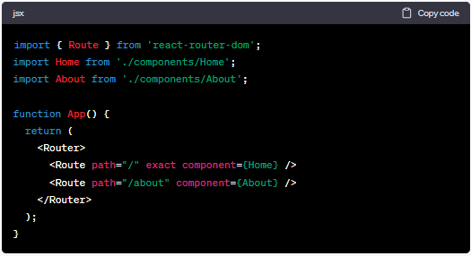
2. Setting up React Router in a project
3. Define Routes: Using the `Route` component, you can define which component should be rendered for specific paths:

Slide 62
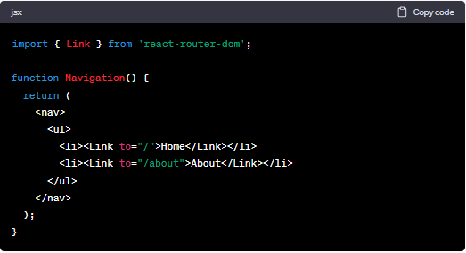
2. Setting up React Router in a project
4. Add Navigation Links:
For navigation, use the `Link` component from `react-router-dom`. This component will change the URL when clicked, triggering the relevant route:
You can then incorporate the `Navigation` component into your main `App` component or any other component where you'd like navigation links to appear.

Slide 63
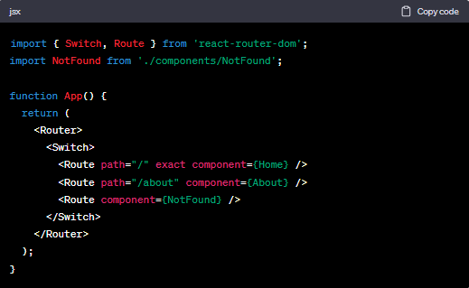
2. Setting up React Router in a project
5. Add 404 or Fallback Route (Optional):
Using the `Switch` component, you can ensure that only one route is rendered. By placing a route at the bottom without a `path` prop, you can render a fallback or 404 component:

Slide 64
2. Setting up React Router in a project
6. Additional Configurations:
React Router comes with many other features, such as:
Protected routes and authentication: Conditionally render routes based on authentication status.
Nested routes: Define routes within other routes for more complex applications.
Dynamic routes: Use URL parameters to render specific content based on dynamic paths.
7. Test Your Routes:
Ensure that everything works as expected:
Navigate using the `Link` components.
Manually enter URLs to ensure routes render correctly.
Check for any console errors or warnings related to routing.
Once you've followed these steps, you will have React Router set up in your project, providing the foundation for a navigable single-page application.

Slide 65
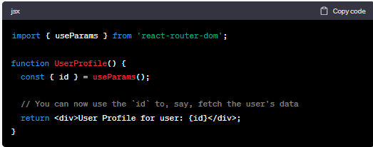
3. useParams, useHistory, and useLocation hooks
React Router v5 introduced several hooks to help simplify navigation and routing in functional components. These hooks make it easier to access various parts of the routing context without needing to wrap your components in higher-order components or render props.
Let's dive into useParams, useHistory, and useLocation:
1. useParams
The `useParams` hook allows you to access the dynamic parts of the URL (the parameters). It's useful when you have routes like `/users/:id` and you want to grab the `id` from the path.
Example:

Slide 66
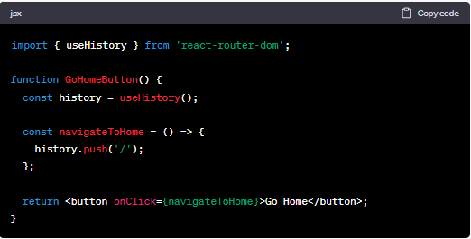
3. useParams, useHistory, and useLocation hooks
2. useHistory
The `useHistory` hook gives you access to the `history` instance. You can use it to navigate programmatically.
Example:
With `history`, you have methods like:
push(newPath): Navigates to a new path.
replace(newPath): Replaces the current entry in the history stack with a new one.
goBack(): Goes back one step in the history.

Slide 67
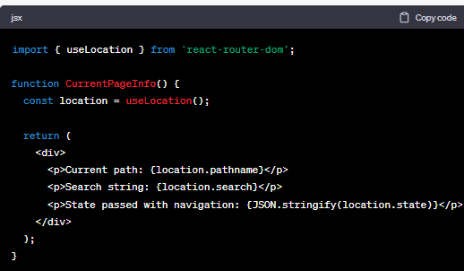
3. useParams, useHistory, and useLocation hooks
3. useLocation The `useLocation` hook returns the current location object, which contains information about the current URL. It's useful for getting details about the current path, query parameters, and more.
Example:
Here's a quick breakdown of the location object's properties:
pathname: A string representing the current path.
search: A string representing a query string, including the leading "?".
state: Any state that was passed with the Link or history.push/replace methods.
hash: The hash fragment of the URL, including the leading "#“.

Slide 68
3. useParams, useHistory, and useLocation hooks
In Conclusion:
These hooks (useParams, useHistory, and useLocation) simplify the process of accessing routing-related details and functionalities in functional components. They're more intuitive and lead to cleaner code, making them a preferred method for many developers working with React Router in functional components.

Slide 69
5. Assignment:
Add routes to the counter app. Each counter has its own route.

Slide 70
Day 4:
Introduction to Redux with Hooks
1. Why use Redux?
2. Core concepts: Actions, Reducers, Store
3. Setting up Redux Toolkit
4. Redux Hooks: useSelector, useDispatch, useStore
5. Assignment: Create a simple to-do app using
React and Redux with hooks.

Slide 71
Day 4:
Introduction to Redux with Hooks
Official Documentations:
https://redux.js.org/
https://react-redux.js.org/
https://redux-toolkit.js.org/
Redux: One way data flow
https://d33wubrfki0l68.cloudfront.net/73bb62ebc338fcd64ee95bde18684ffe3b3bb379/dac4f/assets/images/one-way-data-flow-04fe46332c1ccb3497ecb04b94e55b97.png
Redux Data Flow Diagram
https://d33wubrfki0l68.cloudfront.net/01cc198232551a7e180f4e9e327b5ab22d9d14e7/b33f4/assets/images/reduxdataflowdiagram-49fa8c3968371d9ef6f2a1486bd40a26.gif
Redux Async Data Flow Diagram
https://redux.js.org/assets/images/ReduxAsyncDataFlowDiagram-d97ff38a0f4da0f327163170ccc13e80.gif

Slide 72
1. Why use Redux?

Slide 73
Is switching to React easy?
Don’t worry… We are here to help you!
☺

