Slide 1
BLOGGER’S HOUSE
Submitted by:
Manish Chauhan
Rashmi Pal
Submitted To:
Nishant Singh

Slide 2
INTRODUCTION
BLOGGER HOUSE IS A BLOGGING SITE IN WHICH PEOPLE CAN EASILY INTERSACT WITH THE DIFFERENT PEOPLE AROUND THE WORLD AND CAN SHARE THEIR EXPERIENCES AND VIEWS.

Slide 3
Why you choose this project?
As the trend of social networking sites had become so much that people have forget to or stop expressing their views to everyone.
They are busy in chatting and making stupid kind of videos.
Due to all these thing it has led me to chose this project.

Slide 4
Literature Survey
For animation:
https://getbootstrap.com/docs/4.3/getting-started/introduction/
https://www.w3schools.com/html/
https://www.fullstackpython.com/django.html
https://www.w3schools.com/css/

Slide 5
Existing System
Criminal activities.
Social platform
Making nonsense and ill mannered video.
Religious fight, now mainly used for dirty politics

Slide 6
PROPOSED SYSTEM
Blogger house will help the people to get connect with each other and help each other.
This System will be most usefull in searching the best healthy content.
This will help in sharing the knowledgeable content which can children easily use.
PROPOSED
SYSTEM

Slide 7
TECHNOLOGY USED
FRONT-END
HTML
CSS
BOOTSTRAP
PYTHON
BACK-END
PYHTON
DJANGO
PYMYSQL
JASON

Slide 8
NEED OF PROJECT
The need of this kind of project is increasing day by day.
As our youth is getting involved in nonsense type activity and making country’s future insecure .
This kind of site help us to get more connected to the people easily and person can easily convey their emotions .

Slide 9
ADVANTAGES
EASY CONNECTIVITY:- People can easily connect with each other and can convey their feelings and good knowledge content.
Free from adult: This site will be free from adult content so that kid can also excess it easily.
Free from graphical content: this site will have no graphical content and plus will be away from business promotion.
Online Information:- A good automated information gathering site the best one stop of everything.

Slide 10
DISADVANTAGE
When server is down, accessibility is may not be possible.
Not possible to communicate with each other physically.
We can only know the person through this mean we cant know what phase that person is going.

Slide 11
MODULES
USER
ADMIN

Slide 12
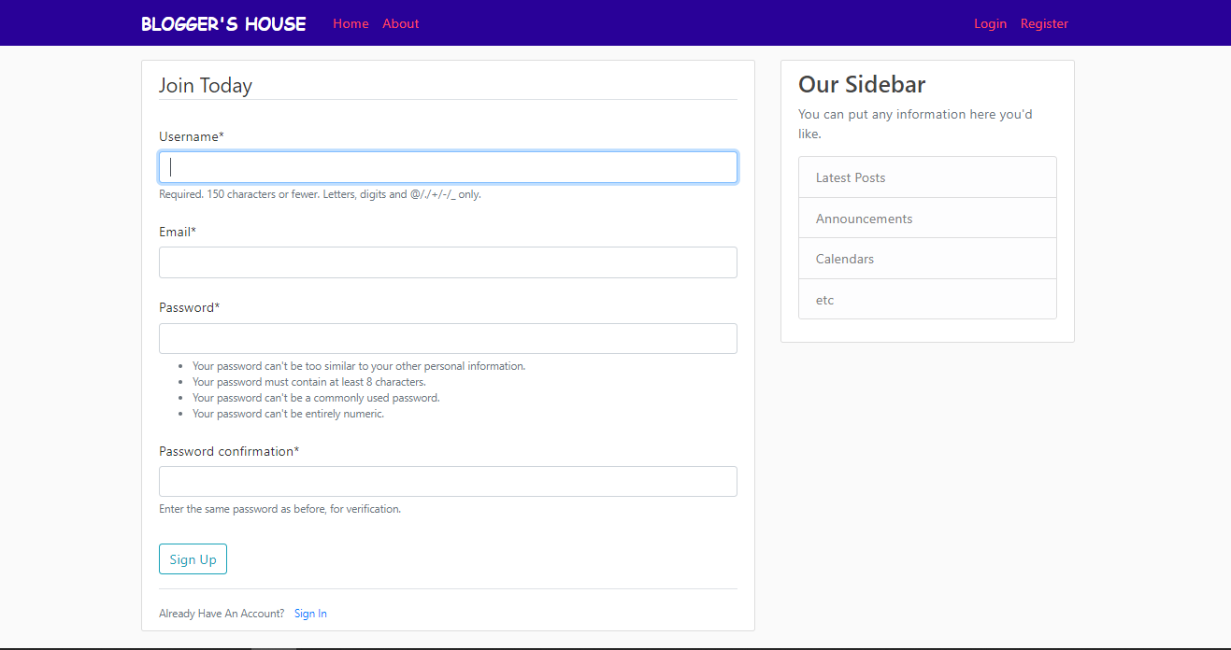
USER REGISTRATION

Slide 13
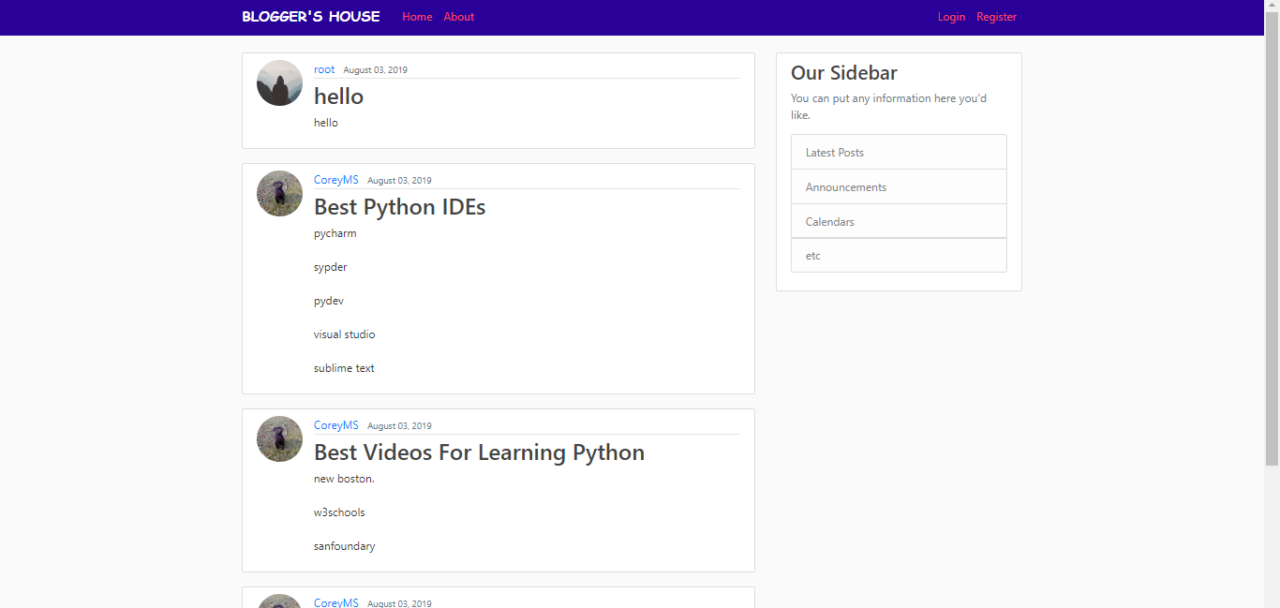
HOME PAGE

Slide 14
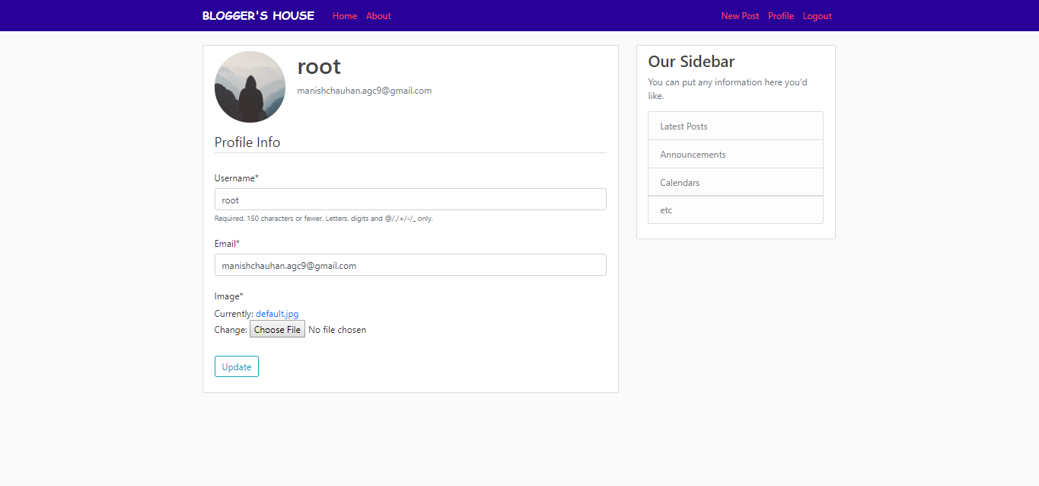
PROFILE VIEWER

Slide 15
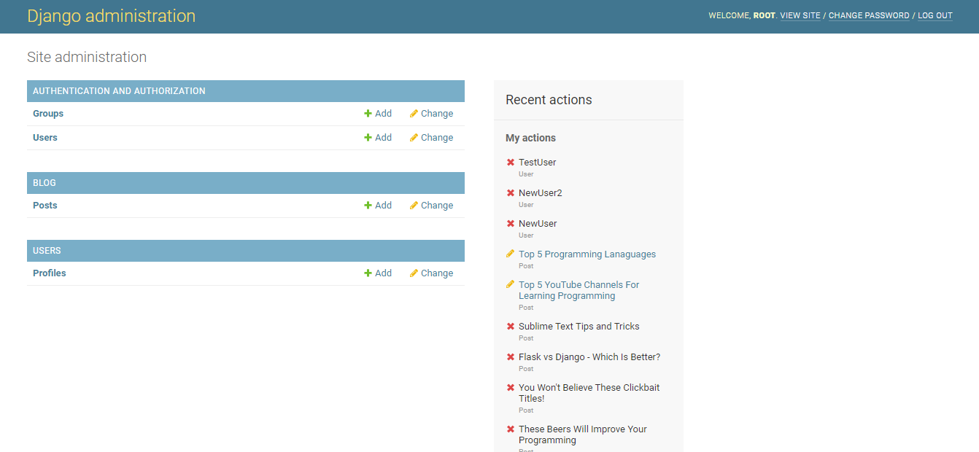
ADMIN PANNEL

Slide 16
FUTURE SCOPE
THE SCOPE OF THIS KIND OF SITE WILL BE KEEP INCREASING DAY BY DAY.
Blogs are informal articles written for the purpose of showing thought leadership and expertise on a topic. They are a great way to generate fresh content on a website and provide a catalyst for email marketing, social media promotion to drive search traffic to your website.
THESE KIND OF WEBITE WILL
HELP THE COUNTRY TO UNITE AND STAY AWAY FROM WAKE NEWS.

Slide 17
THANK YOU

