Slide 1
SleepStageNet: Deep Learning for Automated Sleep Stage Classification
CSEP 590A Deep Learning | Group Project
• Manish Das • Nithin Balachandran • Regith Lingesh • Shrinivas Acharya • Thangakumar Dhanasekaran

Slide 2
Problem & Motivation
• Sleep disorders affect millions worldwide
• Diagnosis requires overnight polysomnography (PSG) — expensive, manual, expert-dependent
– A trained technician takes 2–4 hours to score one night (800–1000 epochs)
• Goal: Automate 5-class sleep stage classification from raw EEG signals
• Clinical impact: Reduce cost, enable scalable sleep monitoring

Slide 3
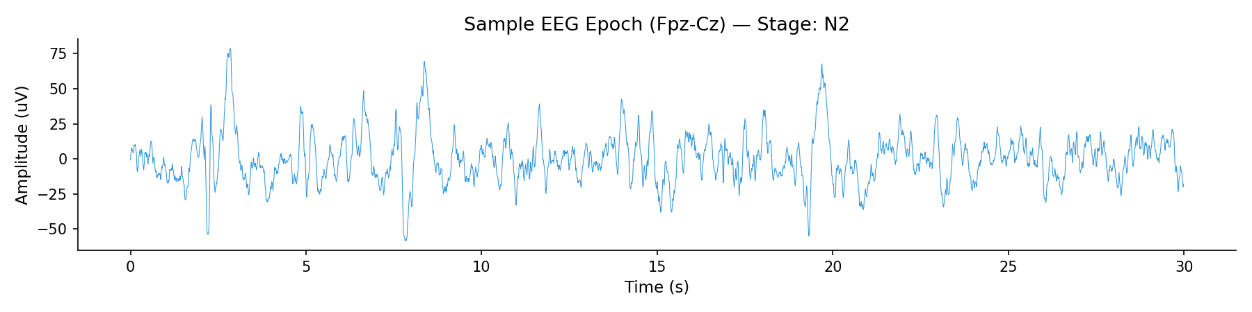
Sleep Stages
• 5 classes per AASM guidelines:
– Wake (W) — alert / drowsy
– N1 — light sleep, transition stage
– N2 — intermediate sleep, sleep spindles
– N3 — deep / slow-wave sleep, delta waves
– REM — Rapid Eye Movement, dreaming
• Each 30-second epoch is classified independently
100 Hz, 30 s epoch (3000 samples), Fpz-Cz channel

Slide 4
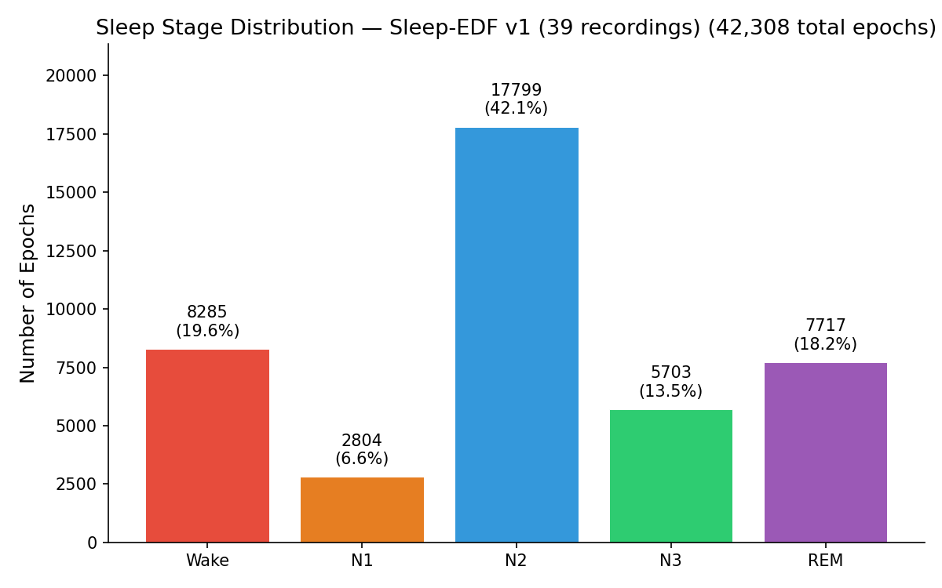
Dataset
• Sleep-EDF v1 from PhysioNet (public benchmark)
– 39 whole-night PSG recordings from 20 healthy subjects
– EEG channel: Fpz-Cz at 100 Hz → 3000 samples per 30 s epoch
– 42,230 total epochs across all recordings
Note: The dataset is heavily imbalanced: N2 alone makes up 42.1% of all epochs while N1 is only 6.6%.
This imbalance is why we need multiple metrics — accuracy alone would be misleading (a model predicting all N2 gets 42%)

Slide 5
Evaluation
Overall Accuracy
What: Fraction of correctly classified epochs out of all epochs.
Why it matters: Simple to understand, but misleading with imbalanced data.
Limitation: Doesn't reflect poor N1 performance (only 6.6% of data).
Macro F1 Score
What: Unweighted average of per-class F1 scores. Treats all 5 classes equally regardless of size.
Why it matters: This is our primary metric. It penalizes the model for doing poorly on rare classes (N1).
3. Weighted F1 Score
What: Average of per-class F1 scores, weighted by class support (number of samples).
Why it matters: Reflects performance proportional to how often each stage appears.

Slide 6
Evaluation
4. Cohen's Kappa
What: Agreement between predictions and ground truth, corrected for chance agreement. Ranges from -1 to 1 (0 = random, 1 = perfect).
Why it matters: Standard metric in clinical sleep staging. For reference, interscorer agreement between human experts is typically kappa ~0.75-0.85. Clinical threshold: Kappa > 0.60
Evaluation Protocol
20-fold Leave-One-Subject-Out Cross-Validation (LOSO-CV)
– Each fold: train on 19 subjects, test on 1 held-out subject
– Ensures model generalizes to unseen subjects (no data leakage)

Slide 7
Approach Overview
Start from a strong CNN baseline, then improve systematically:
• Model 1→ Baseline: CNN Only
– Multi-scale dual-path CNN: small filters (~0.5s) capture spindles, large filters (~4s) capture slow waves
• Model 2 → Temporal: CNN + BiLSTM
– Same CNN extracts per-epoch features → 2-layer BiLSTM learns sleep stage transitions across epochs
• Model 3 → Conformer: CNN + Transformer
– Replaces BiLSTM with Conformer blocks: self-attention (global patterns) + depthwise conv (local transitions)
• All experiments compared via the same 20-fold LOSO-CV protocol
Model | Architecture | Params
CNN Only | Dual-path multi-scale CNN | ~191K
CNN+BiLSTM | Multi-scale CNN + 2-layer BiLSTM | ~851K
Conformer | Multi-scale CNN + Conformer blocks | ~1.34M

Slide 8
Baseline

Slide 9
Baseline Architecture — DeepSleepNet-Lite
• Input: 90-second window (3 × 30 s epochs) = 9,000 samples
• Dual parallel CNN paths:
– Path 1: Small filters (~50 samples) — fine-grained, high-frequency features
– Path 2: Large filters (~400 samples) — coarse, low-frequency features
• Concatenated features → Fully Connected → Softmax (5 classes)
• Training: Adam optimizer, lr = 1e-4, 100 epochs, batch size 100
• Oversampling applied to handle class imbalance during training

Slide 10
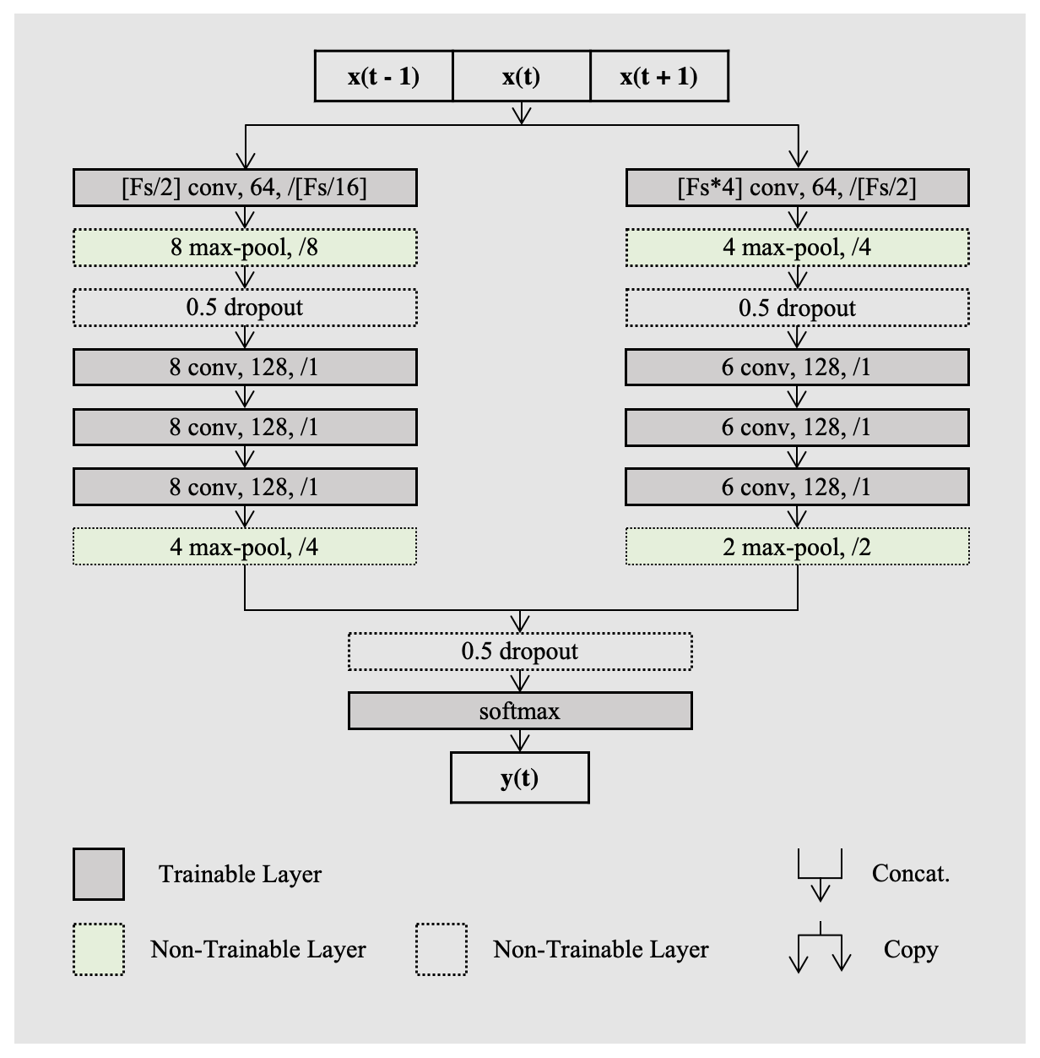
Baseline - Architecture of DeepSleepNet-Lite

Slide 11
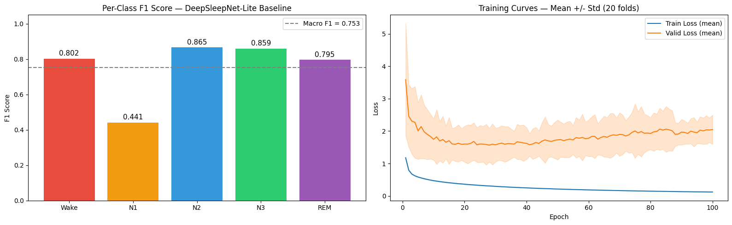
Baseline Results: Per-Class F1 and Training Curves
Baseline Model Achieves 0.753 Macro F1 Across 5 Sleep Stages

Slide 12
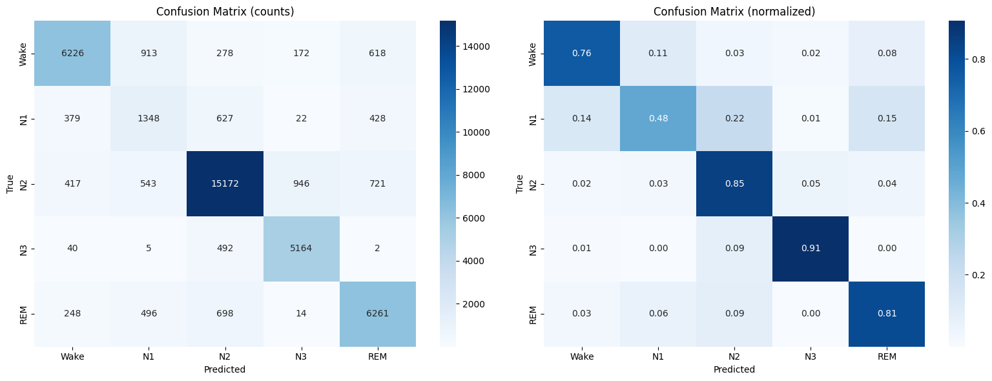
Confusion Matrix
N3 and N2 Classified Well; N1 Confusion Persists Model Excels at N2/N3, Struggles Most with N1 (48% Recall)

Slide 13
Temporal Model

Slide 14
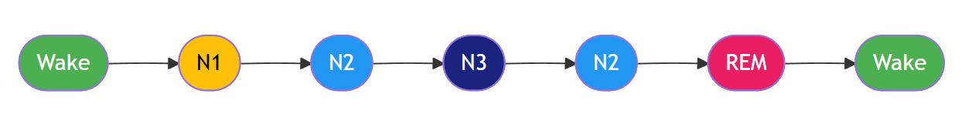
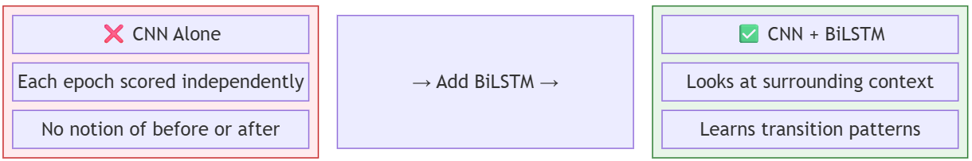
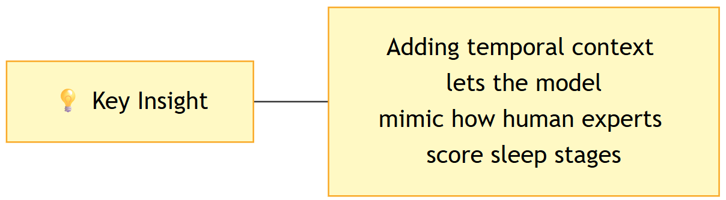
Why Temporal Modeling?
Sleep stages are not independent — they follow a biological sequence.
CNN + BiLSTM

Slide 15
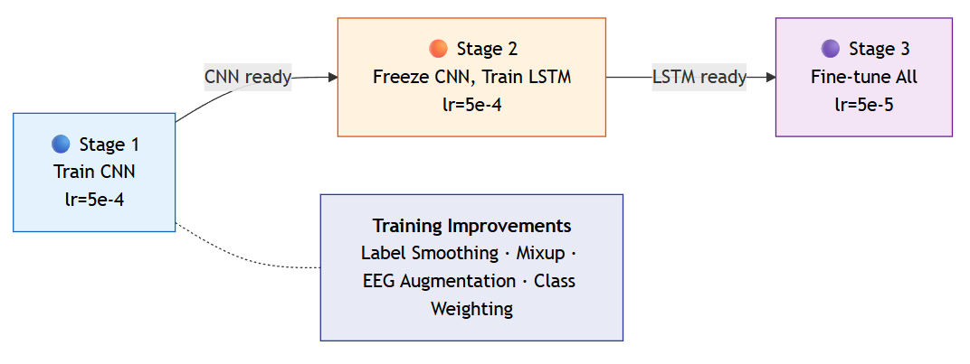
Improvement — Temporal Context Modeling
• Problem: CNN classifies each epoch mostly independently
– Ignores natural temporal progression of sleep stages
• Solution: BiLSTM over a sequence of CNN epoch features
• 3-stage training

Slide 16
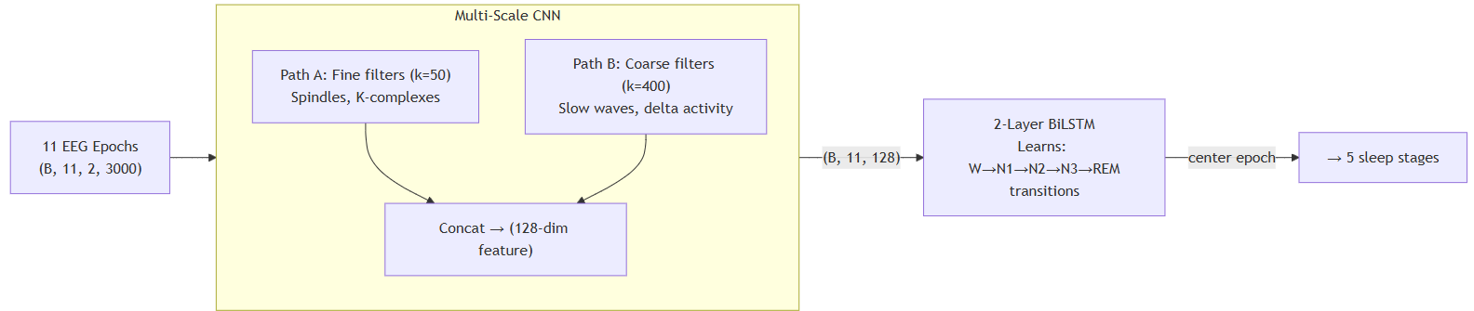
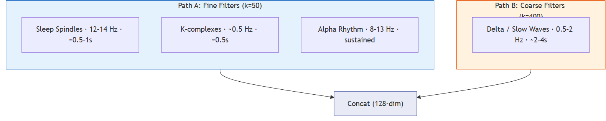
Temporal Model Architecture

Slide 17
Conformer Model

Slide 18
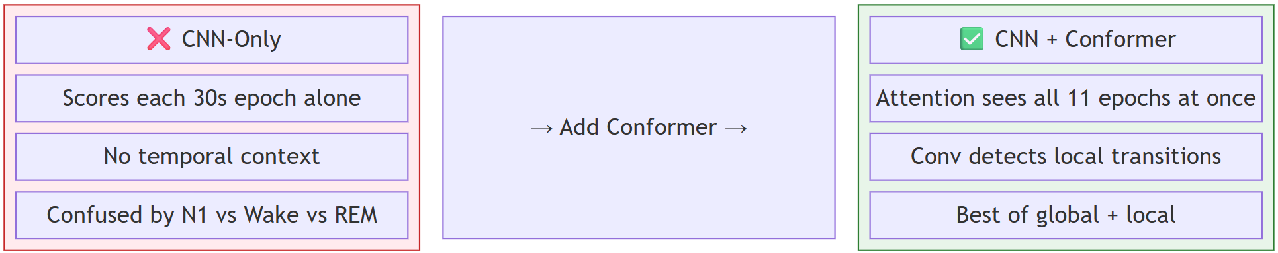
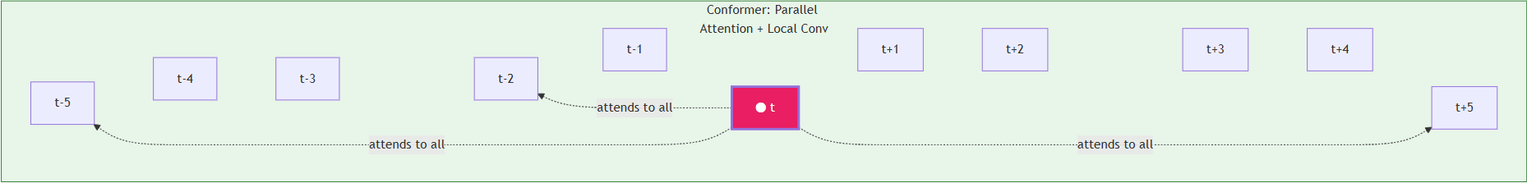
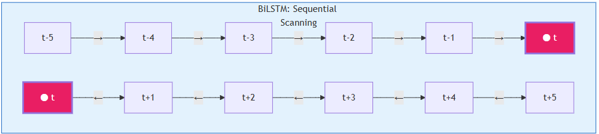
Why Conformer Model?
Attention captures global sleep cycles, convolution captures local N2 -> N3 transitions. Together: Best of both worlds!
Conformer vs BiLSTM — How They See Context:

Slide 19
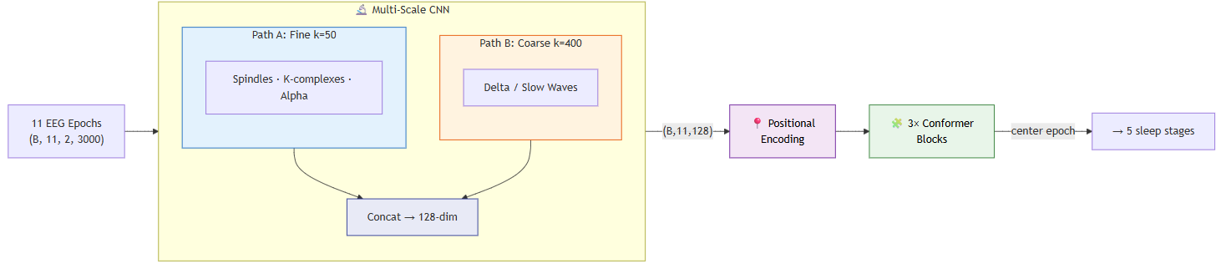
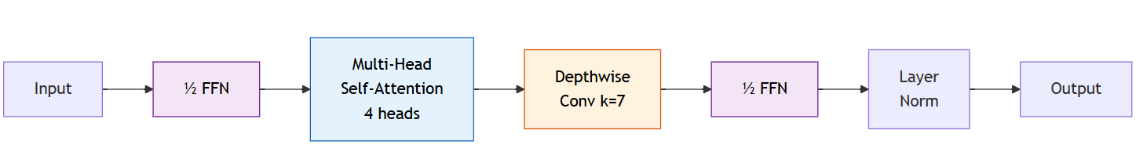
Conformer Model Architecture
Originally from speech recognition (Gulati et al., 2020), the Conformer combines the best of Transformers and CNNs in a single block
Each Conformer block uses the Macaron structure (half-step FFN sandwich):

Slide 20
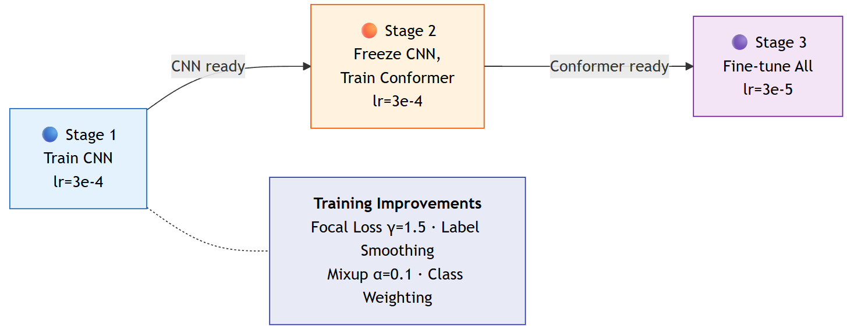
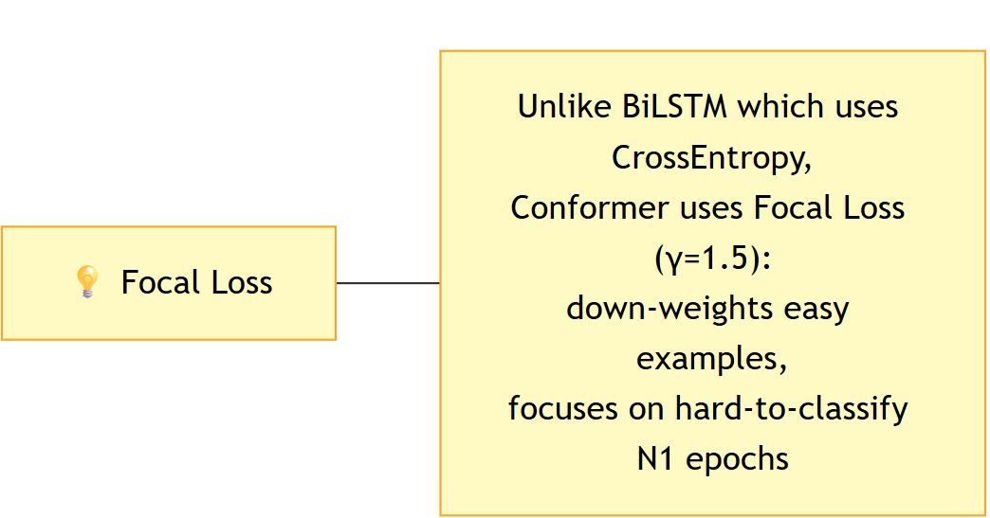
Training
Multi-Stage Training

Slide 21
Results

Slide 22
Results Comparison
Model | Accuracy | Macro F1 | Cohen's κ | N1 F1
Baseline (DeepSleepNet-Lite) | 80.9% | 0.753 | 0.740 | 0.441
Temporal (CNN + BiLSTM) ★ | 83.9% ± 6.5% | 0.79 ± 0.067 | 0.778 ± 0.091 | 0.519
Conformer (CNN + Transformer) | 83.0% ± 7.3% | 0.78 ± 0.07 | 0.768 ± 0.1 | 0.500
Per-Class F1 (Temporal CNN+BiLSTM vs Baseline)
Stage → | Wake | N1 (bottleneck) | N2 | N3 | REM
Baseline | 0.802 | 0.441 | 0.865 | 0.859 | 0.795
Temporal ★ | 0.881 | 0.519 | 0.869 | 0.877 | 0.856
Conformer | 0.870 | 0.500 | 0.869 | 0.874 | 0.834

Slide 23
Key Takeaways
1 Temporal context is the single biggest lever
Both CNN + BiLSTM and CNN + Conformer beat the baseline on every metric, confirming that modelling transitions between consecutive sleep epochs — not just individual 30-second windows — is critical for accurate staging.
2 CNN + BiLSTM is the best model overall ★
83.9% accuracy (+3 pp), Macro F1 = 0.79 (+0.037), Cohen's κ = 0.778. It outperforms the more complex Conformer on every metric, showing that recurrent temporal modelling fits EEG sequences better than pure attention.
3 N1 (light sleep) remains the hardest class — but improved
BiLSTM raises N1 F1 from 0.441 → 0.519 (+17.7% relative). N1 is a brief transitional stage whose EEG overlaps Wake and REM; temporal context helps the model use neighbouring epochs as disambiguating cues.
4 Cohen's κ = 0.778 — approaching human-expert agreement
Inter-scorer κ among human sleep technicians is typically 0.75 – 0.85. The BiLSTM model now sits at the lower bound of that range, suggesting clinical-grade reliability is within reach.

Slide 24
Limitations & Future Work
⚠ Limitations (evidence from results)
→ Future Work (grounded in findings)
• N1 detection remains bottleneck across all models
– Baseline 0.441 → Temporal 0.477: only +3.6% after full retraining
– Intrinsic spectral overlap of N1 with Wake & REM limits ceiling
• Single EEG channel (Fpz-Cz) — all models share this constraint
– EOG/EMG channels used by human scorers are absent
• High subject-to-subject variance (std ≈ 0.07–0.10)
– Temporal fold 8: only 60.9% acc — single-subject outlier drags mean
– Conformer std (0.076) > Enhanced CNN+BiLSTM std (0.069)
• Conformer underperforms Enhanced CNN+BiLSTM (82.9% vs 84.1%)
– Self-attention needs larger datasets to surpass recurrent biases
• Small dataset: 20 subjects — limits generalisation claims
– No external validation set (SHHS, MASS) tested
• Improve N1: targeted augmentation & loss shaping
– Stage-conditional focal loss with higher α for N1 specifically
– Synthetic N1 generation via EEG-GAN / sleep-spindle injection
• Multi-modal input to break Fpz-Cz ceiling
– Add EOG + EMG channels — directly mirrors clinical scoring
• Subject-adaptive fine-tuning to reduce fold variance
– Few-shot personalisation layer on top of frozen backbone
– Meta-learning (MAML) for fast subject adaptation
• Scale Conformer with pre-training (larger corpus)
– Pre-train on SHHS (5,000+ subjects), fine-tune on Sleep-EDF
– Expected: attention > recurrence advantage realised
• Deployment-ready pipeline
– Real-time inference for wearable EEG (OpenBCI, Muse)
– Uncertainty output (MC-Dropout) for low-confidence flagging

Slide 25
Thank You
Q & A

Slide 26
Key Takeaways
• 1. All three approaches improve on the same 20-fold LOSO-CV benchmark (Sleep-EDF v1, 39 recordings)
– Baseline 80.9% → Temporal (CNN+BiLSTM) 84.1% → Conformer (CNN + Transformer) 83.1%
• 2. Temporal context is the single biggest lever — adding BiLSTM over L=5 epochs gained +2.2% accuracy and +3.6% N1 F1
– Sleep stage transitions (W→N1→N2→N3→REM) give the sequence model a structural advantage over epoch-wise CNN
• 3. Enhanced training (focal loss γ=2, mixup, cosine warmup, longer context L=11) adds another +1.0% accuracy
– Multi-scale CNN backbone captures both fine (spindles) and coarse (delta) EEG features simultaneously
• 4. Conformer (82.9%) slightly underperforms Enhanced CNN+BiLSTM (84.1%) on this dataset size
– Attention mechanisms may need more data to outshine recurrent inductive biases for temporal EEG
• 5. N1 remains the persistent bottleneck across all models (0.441 → 0.477 in Temporal; enhanced similar)
– N1 is intrinsically ambiguous — only 6.6% of data, overlaps spectrally with both Wake and REM
• 6. High fold-to-fold variance (std ≈ 0.07–0.09) confirms subject-level variability dominates model choice
– Larger datasets (SHHS, MASS) or subject-adaptive fine-tuning needed for robust clinical deployment
• 7. All enhanced models approach human inter-scorer Kappa range (0.75–0.85); Enhanced CNN+BiLSTM κ = 0.783

Slide 27
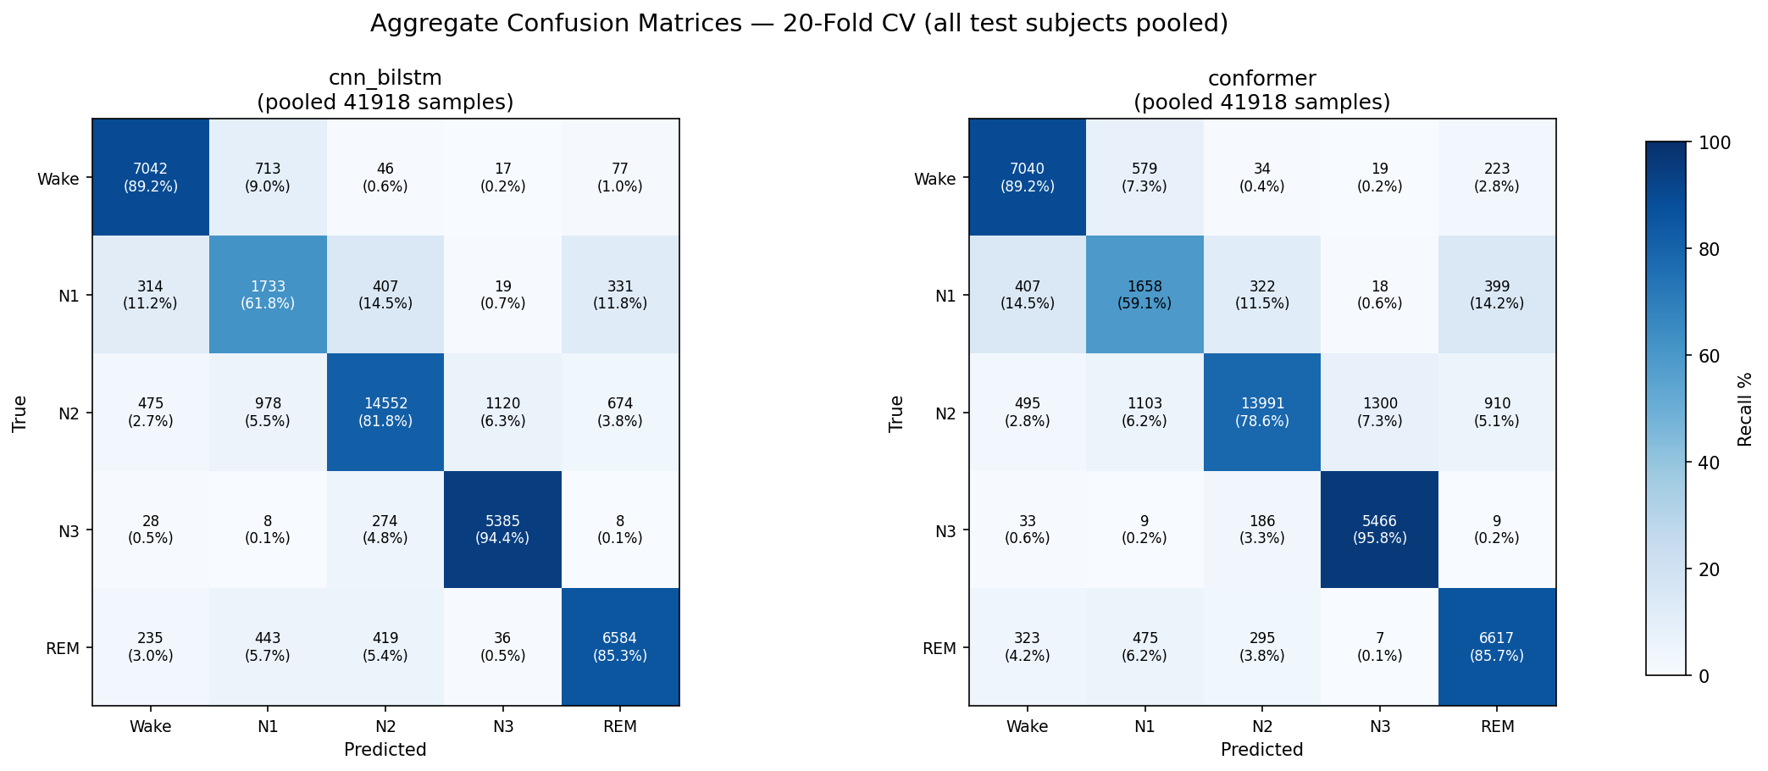
Aggregate Test Set Performance (20-Fold CV)
Combined predictions across all 20 folds for both models
Able to achieve N1 improvements (61.8%)

Slide 28
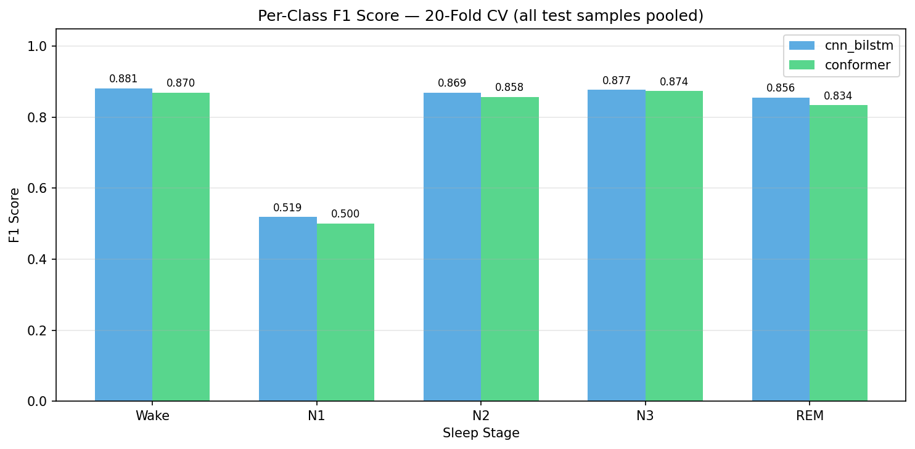
Per-Class F1 Scores: CNN+BiLSTM vs Conformer
Conformer improves N1 and REM detection relative to BiLSTM

