Slide 1
SleepStageNet: Deep Learning for Automated Sleep Stage Classification
CSEP 590A Deep Learning | Group Project
• Manish Das • Nithin Balachandran • Regith Lingesh • Shrinivas Acharya • Thangakumar Dhanasekaran

Slide 2
Problem & Motivation
• Sleep disorders affect millions worldwide
• Diagnosis requires overnight polysomnography (PSG) — expensive, manual, expert-dependent
– A trained technician takes 2–4 hours to score one night (800–1000 epochs)
• Goal: Automate 5-class sleep stage classification from raw EEG signals
• Clinical impact: Reduce cost, enable scalable sleep monitoring

Slide 3
Sleep Stages
• 5 classes per AASM guidelines:
– Wake (W) — alert / drowsy
– N1 — light sleep, transition stage
– N2 — intermediate sleep, sleep spindles
– N3 — deep / slow-wave sleep, delta waves
– REM — rapid eye movement, dreaming
• Each 30-second epoch is classified independently
• Visual: Example EEG waveforms for each stage (see figure slides)

Slide 4
Dataset
• Sleep-EDF v1 from PhysioNet (public benchmark)
– 39 whole-night PSG recordings from 20 healthy subjects
– EEG channel: Fpz-Cz at 100 Hz → 3000 samples per 30 s epoch
– 42,230 total epochs across all recordings
• Class distribution:
– W: 8,207 (19.4%) | N1: 2,804 (6.6%) ← severely underrepresented
– N2: 17,799 (42.1%) ← dominant class | N3: 5,703 (13.5%) | REM: 7,717 (18.3%)
• Challenge: Severe class imbalance, subject variability, ambiguous transitions

Slide 5
Evaluation Protocol
• 20-fold Leave-One-Subject-Out Cross-Validation (LOSO-CV)
– Each fold: train on 19 subjects, test on 1 held-out subject
– Ensures model generalizes to unseen subjects (no data leakage)
• Metrics:
– Macro F1 (primary) — treats all 5 classes equally
– Cohen's Kappa (clinical standard) — corrects for chance agreement
– Overall Accuracy, Per-class F1, Confusion Matrix
• Why Macro F1? Accuracy is misleading — a model predicting all N2 gets 42%

Slide 6
Approach Overview
• Start from a strong CNN baseline, then improve systematically:
• Step 1 → Baseline: CNN on Raw EEG (DeepSleepNet-Lite)
– End-to-end deep learning baseline
• Step 2 → Improvement 1: Class Imbalance — Focal Loss / Weighted Loss
– Improve N1 detection on severely underrepresented class
• Step 3 → Improvement 2: Temporal Context — BiLSTM / Attention over epochs
– Model sleep stage transitions across consecutive epochs
• Step 4 → Analysis: Interpretability — Grad-CAM / Saliency maps
– Understand what the model learns
• All experiments compared via the same 20-fold LOSO-CV protocol

Slide 7
Baseline Architecture — DeepSleepNet-Lite
• Input: 90-second window (3 × 30 s epochs) = 9,000 samples
• Dual parallel CNN paths:
– Path 1: Small filters (~50 samples) — fine-grained, high-frequency features
– Path 2: Large filters (~400 samples) — coarse, low-frequency features
• Concatenated features → Fully Connected → Softmax (5 classes)
• Training: Adam optimizer, lr = 1e-4, 100 epochs, batch size 100
• MC-Dropout inference (N=30 samples) for uncertainty quantification
• Oversampling applied to handle class imbalance during training

Slide 8
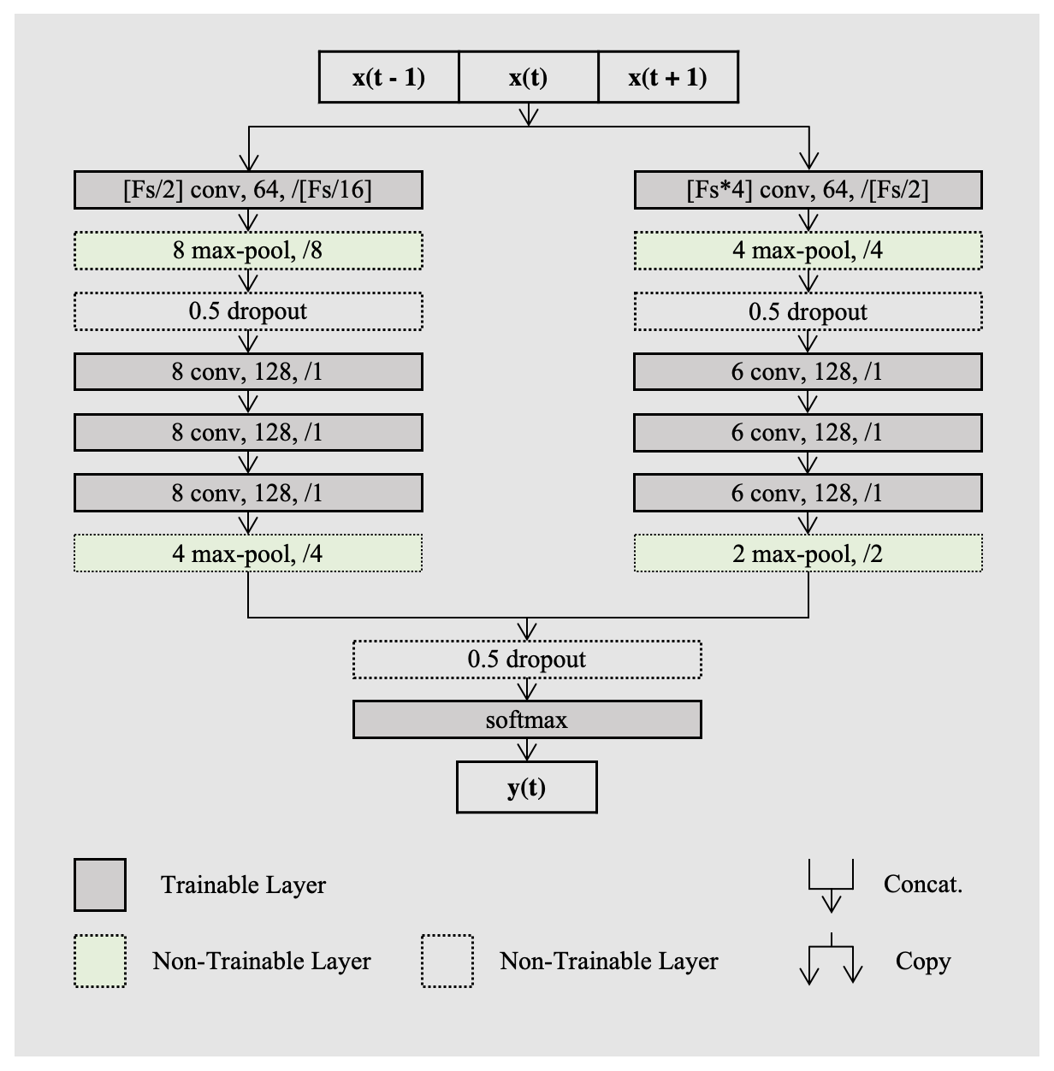
Architecture of DeepSleepNet-Lite

Slide 9
Baseline Results
• Overall performance:
– Accuracy: 80.9% | Macro F1: 0.753 | Cohen's Kappa: 0.740
• Per-class F1:
– W: 0.802 | N1: 0.441 ← bottleneck | N2: 0.865
– N3: 0.859 | REM: 0.795
• Key finding: N1 is the hardest stage (F1 = 0.441)
– Confused with Wake (similar low-amplitude EEG)
– Confused with REM (similar frequency content)
– Only 6.6% of data — model biased toward majority classes
• Cohen's Kappa 0.74 = 'substantial agreement' (human expert range: 0.75–0.85)

Slide 10
Improvement — Focal Loss for Class Imbalance
• Problem: Standard cross-entropy treats all samples equally
– Model focuses on easy / frequent classes (N2 dominates)
• Focal Loss (Lin et al., 2017): down-weights easy examples
– FL(p) = -α(1-p)^γ · log(p)
– γ controls focus on hard examples (γ = 0 → standard CE)
– γ = 2.0 used in Conformer model experiments
• Implementation: combined with Mixup augmentation and class weighting
• Expected: N1 F1 improvement, possibly slight cost to N2/N3
• Addresses Research Q4: mitigating class imbalance for minority stages

Slide 11
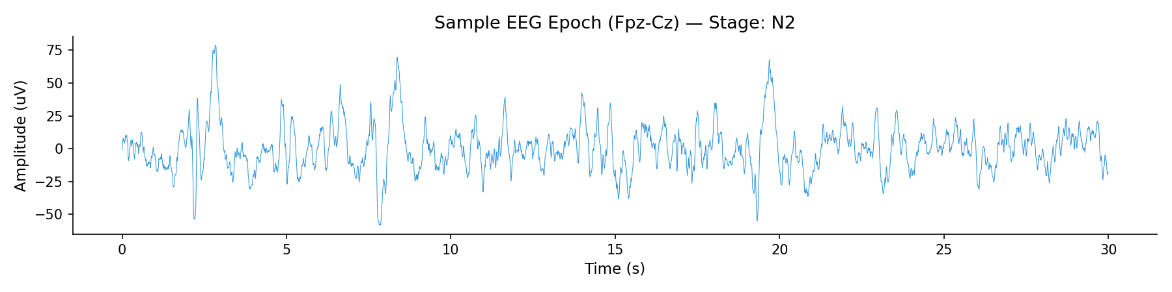
Sample EEG Epoch — N2 Sleep Stage
100 Hz, 30 s epoch (3000 samples), Fpz-Cz channel

Slide 12
Baseline

Slide 13
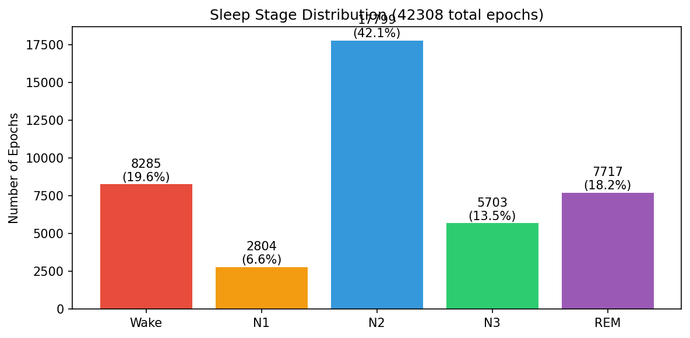
Sleep Stage Distribution in Dataset
Sleep-EDF v1: 42,230 total epochs — severe imbalance drives need for focal loss

Slide 14
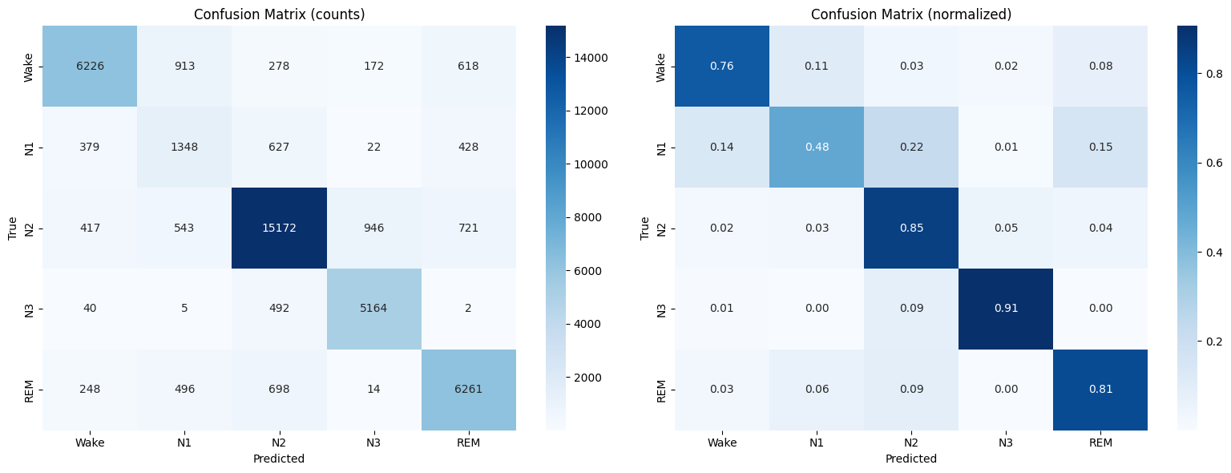
Confusion Matrix
N3 and N2 Classified Well; N1 Confusion Persists Model Excels at N2/N3, Struggles Most with N1 (48% Recall)

Slide 15
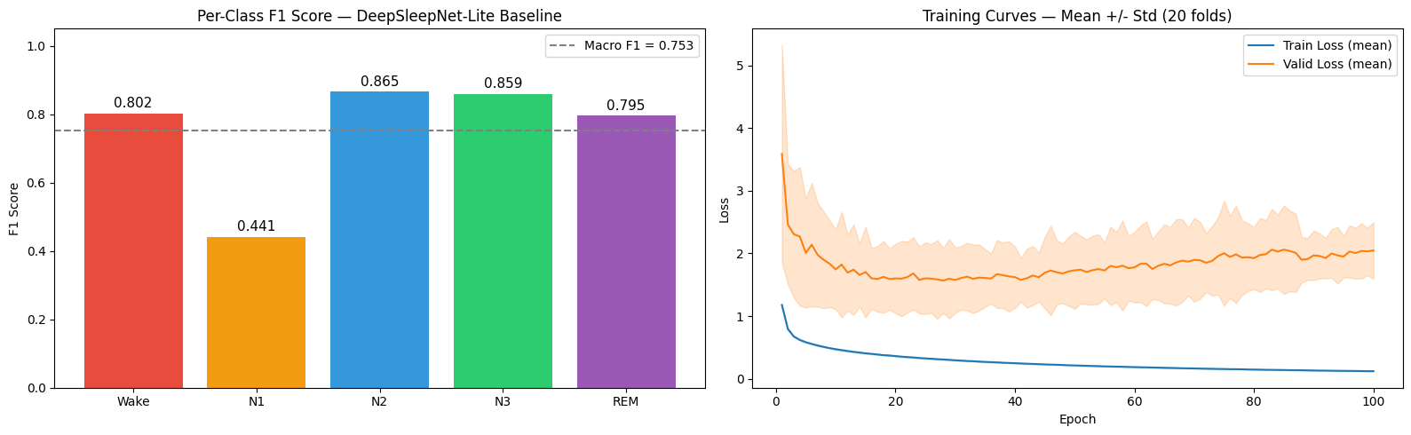
Baseline Results: Per-Class F1 and Training Curves
Baseline Model Achieves 0.753 Macro F1 Across 5 Sleep Stages

Slide 16
Temporal Model

Slide 17
Why Temporal Modeling?
Sleep stages follow biological transition rules — context from neighboring epochs matters
Standard CNNs treat concatenated epochs as a flat spatial signal, losing temporal order
A shared CNN extracts a feature vector per epoch; BiLSTM then models the sequence explicitly
Enables reasoning like: "features suggest N1, but surrounding context indicates REM onset"
Captures what is in each epoch and when it occurs relative to others

Slide 18
Improvement — Temporal Context Modeling
• Problem: CNN classifies each epoch mostly independently
– Ignores natural temporal progression of sleep stages
• Solution: BiLSTM over a sequence of CNN epoch features
– Per-epoch CNN → 64D feature vector
– BiLSTM (2 × 128 hidden, bidirectional) over L=5 epoch window
– Predict center epoch using full context
• Sleep naturally follows patterns: W → N1 → N2 → N3 → N2 → REM
– Temporal model can learn that N1 after N3 is unlikely
• 3-stage training: (1) pretrain CNN, (2) train LSTM frozen CNN, (3) full fine-tune
• Result: 83.14% accuracy vs 80.92% baseline (CNN+BiLSTM, 20-fold LOSO-CV)

Slide 19
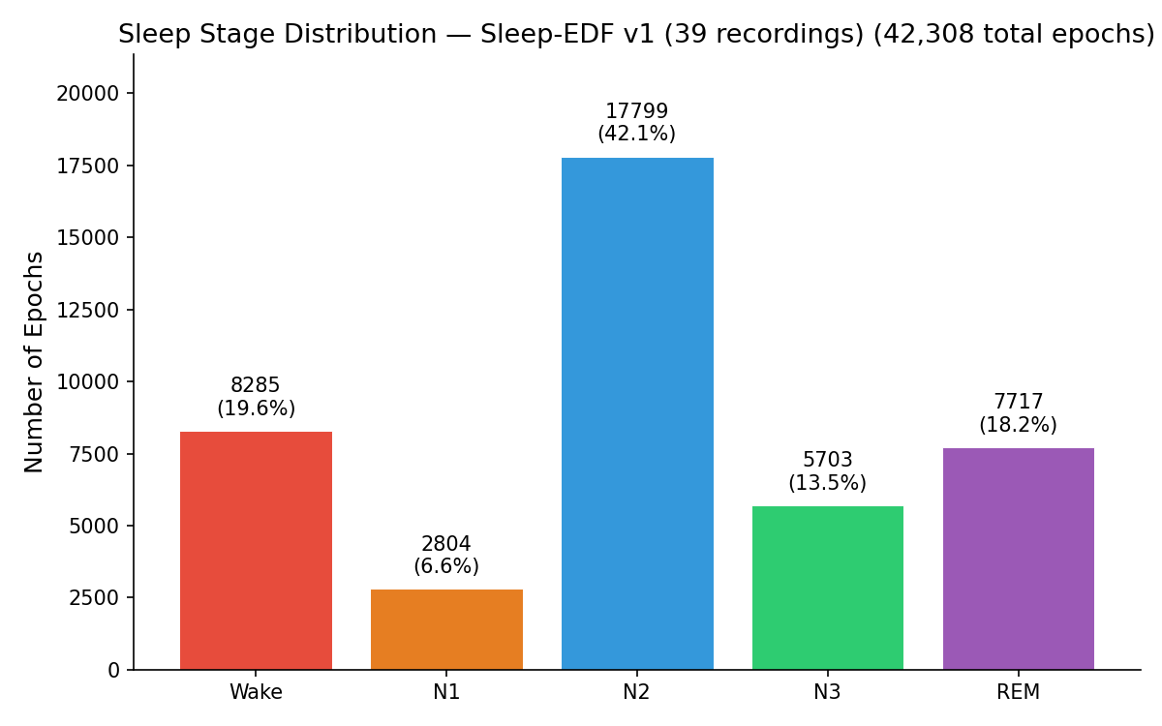
Sleep Stage Distribution (Temporal Model)
Strong class imbalance: N2 dominates (42%), N1 severely underrepresented (6.6%)

Slide 20
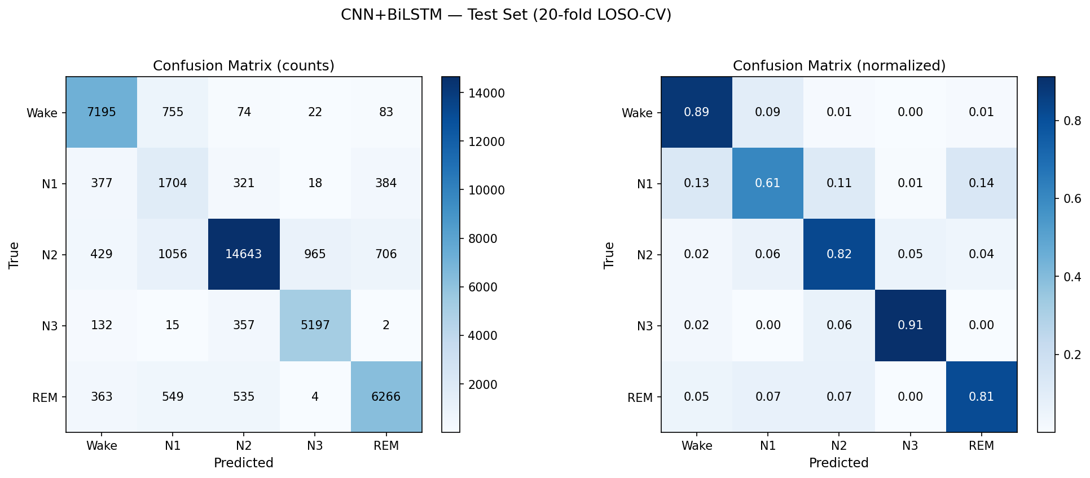
CNN+BiLSTM Classification Results (20-Fold LOSO-CV)
Normalized confusion matrices — N1 remains the most-confused class

Slide 21
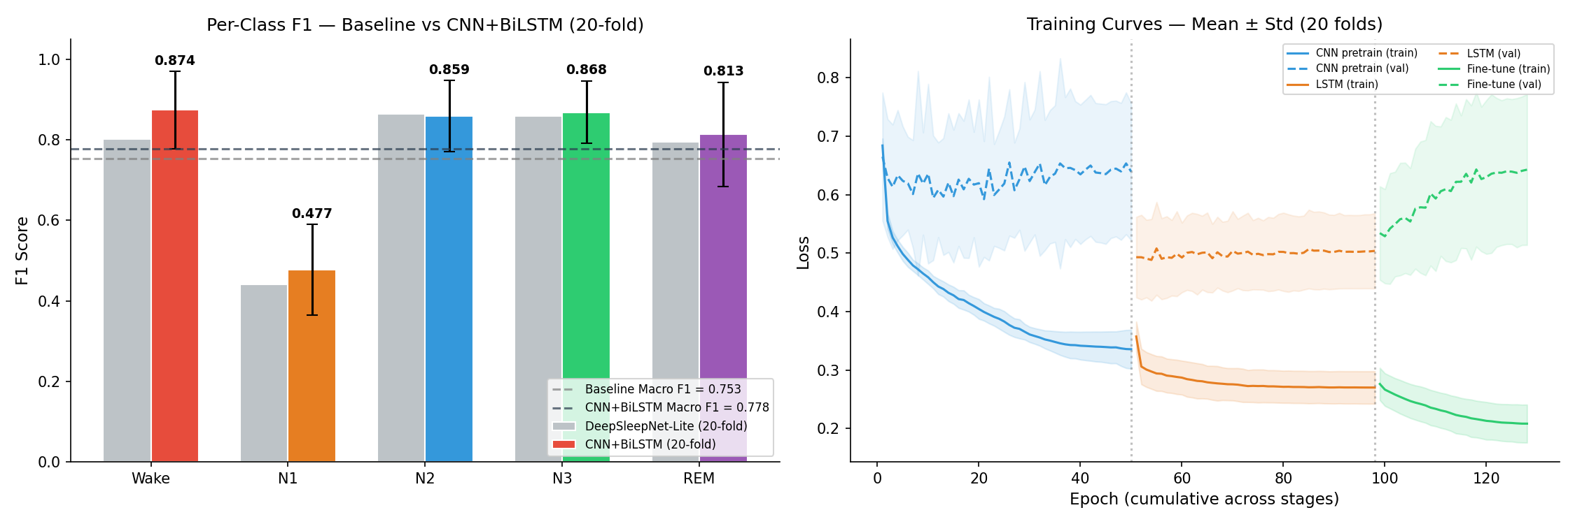
Training Dynamics and Per-Class Performance
Mean ± std over 20 folds — N1 F1 is consistently the lowest per-class score

Slide 22
Enhanced Model

Slide 23
Improvements Over Baseline
Architecture
Multi-scale CNN backbone: Dual-path with small filters (50-sample, ~0.5s) capturing high-frequency spindles and large filters (400-sample, ~4s) capturing slow waves — inspired by DeepSleepNet-Lite's TensorFlow architecture
Conformer blocks (conformer model): Macaron-style FFN → MHSA → Depthwise Conv → FFN, effective for both local transitions and global patterns
2-layer BiLSTM (cnn_bilstm model): Deeper recurrence captures longer temporal dependencies
Learnable positional encoding: Better than fixed sinusoidal for short sequences

Slide 24
Improvements Over Baseline
Training
Focal Loss (γ=1.5, conformer only): Down-weights easy examples, focuses on hard-to-classify N1 epochs
Label smoothing (0.05): Reduces overconfident predictions
Mixup augmentation (α=0.1, cnn_bilstm & conformer): Interpolates training pairs for regularization
EEG data augmentation: Time shift (±50 samples), amplitude scaling (±10%), Gaussian noise
Cosine annealing with warmup: 3-epoch linear warmup, then cosine decay
3-stage training (sequence models): Pretrain CNN → Train temporal (CNN frozen) → Fine-tune end-to-end
Balanced class sampling option via WeightedRandomSampler (--balanced_sampling flag)
Gradient accumulation supported in training loop
Sequence Length
Baseline used L=5 (±2 epochs of context)
Enhanced models use L=11 (±5 epochs) by default for broader temporal context
Longer sequences particularly help with N1/REM disambiguation

Slide 25
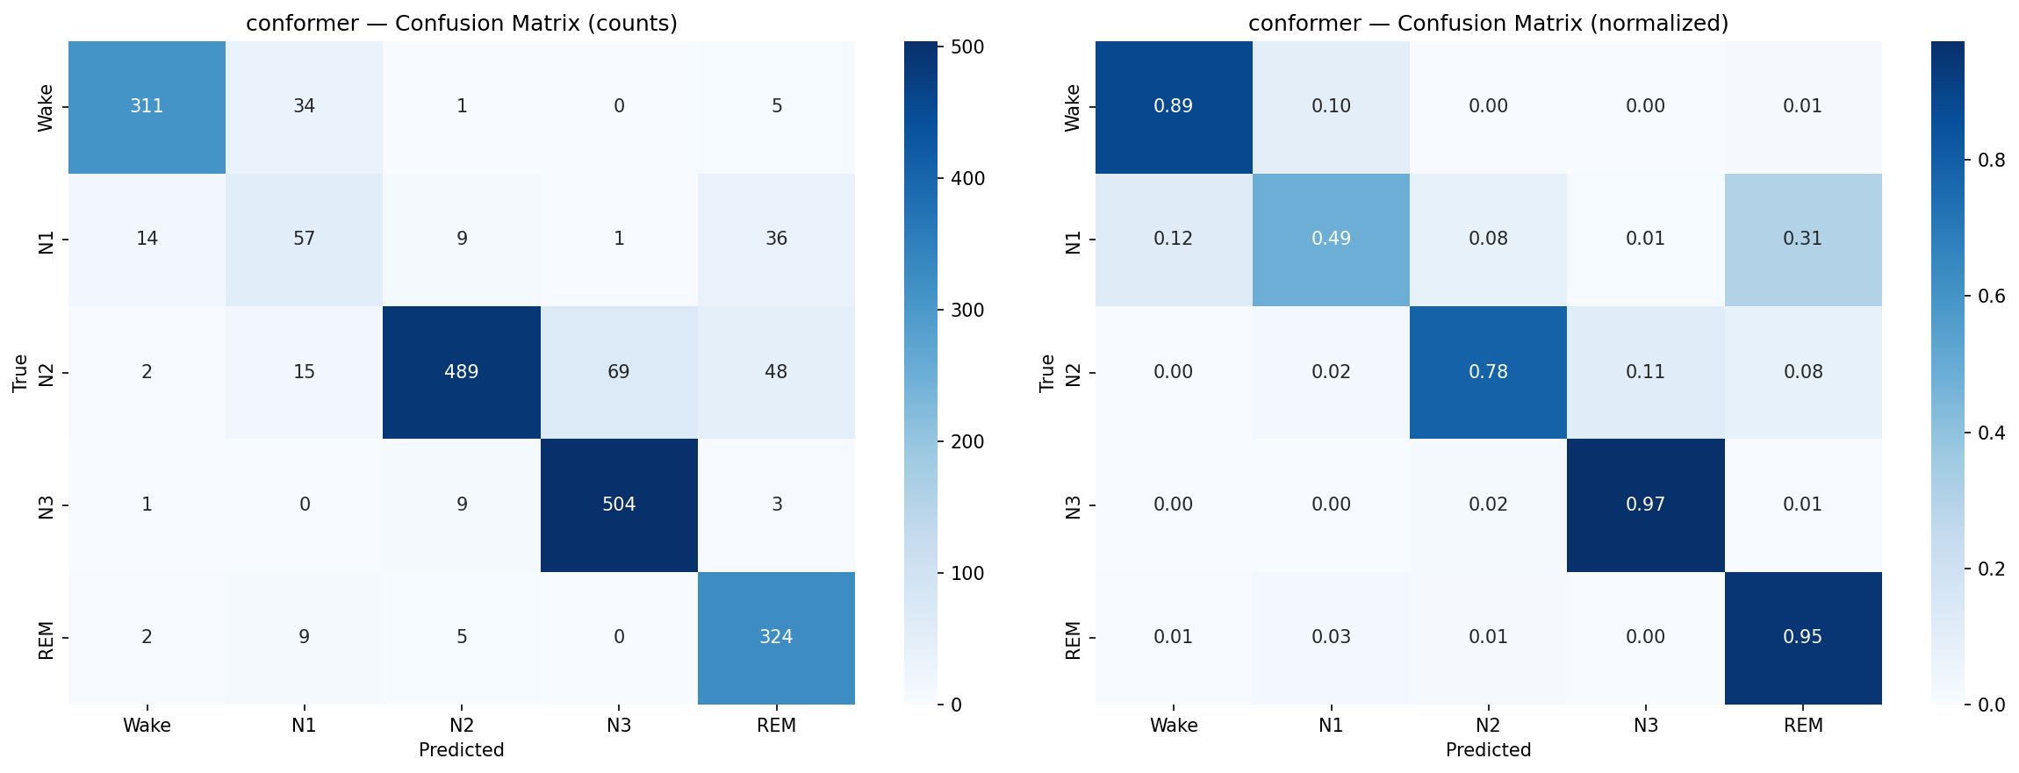
Conformer Model Classification Performance
Fold 0 confusion matrix — Conformer reduces N1 confusion vs. baseline

Slide 26
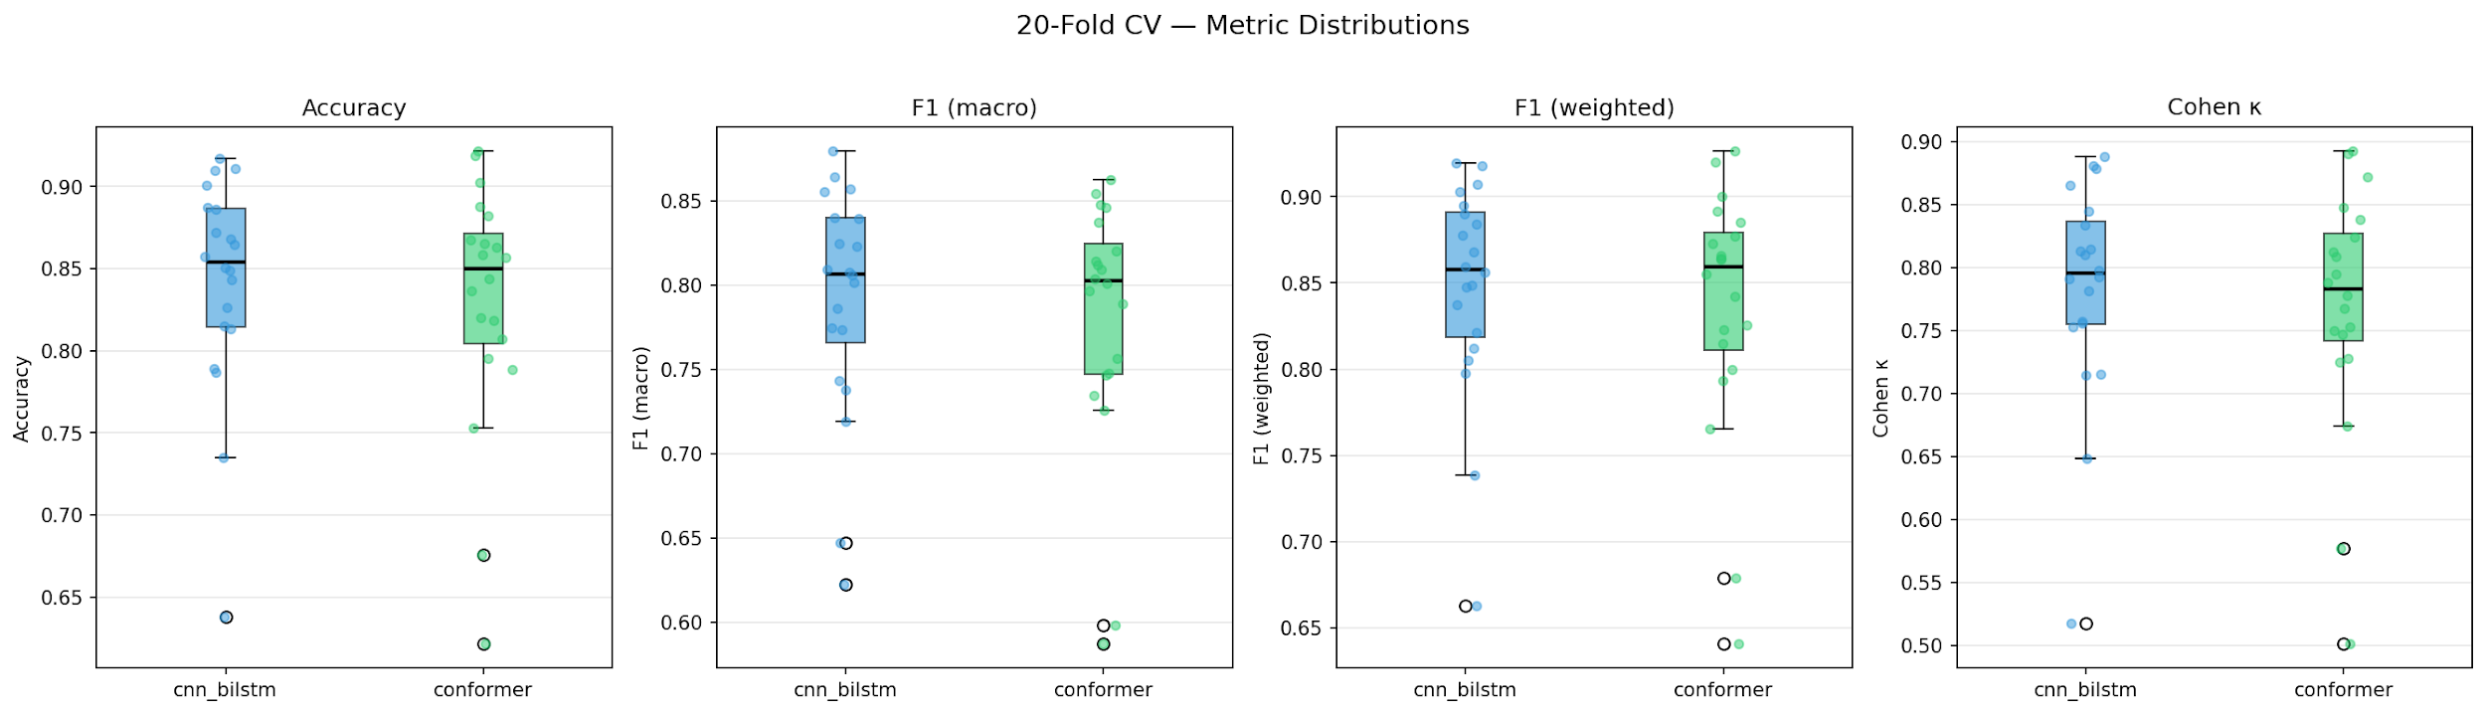
20-Fold CV Metric Distributions
Box plots for Accuracy, Macro F1, and Kappa — CNN+BiLSTM vs. Conformer

Slide 27
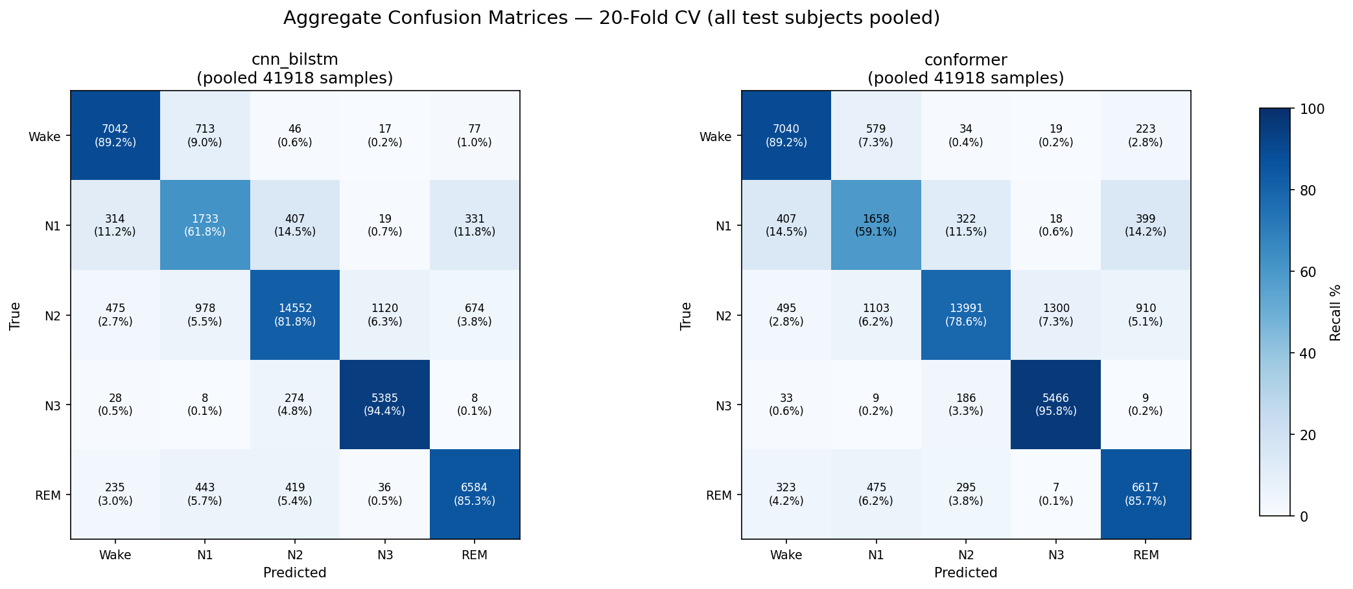
Aggregate Test Set Performance (20-Fold CV)
Combined predictions across all 20 folds for both models

Slide 28
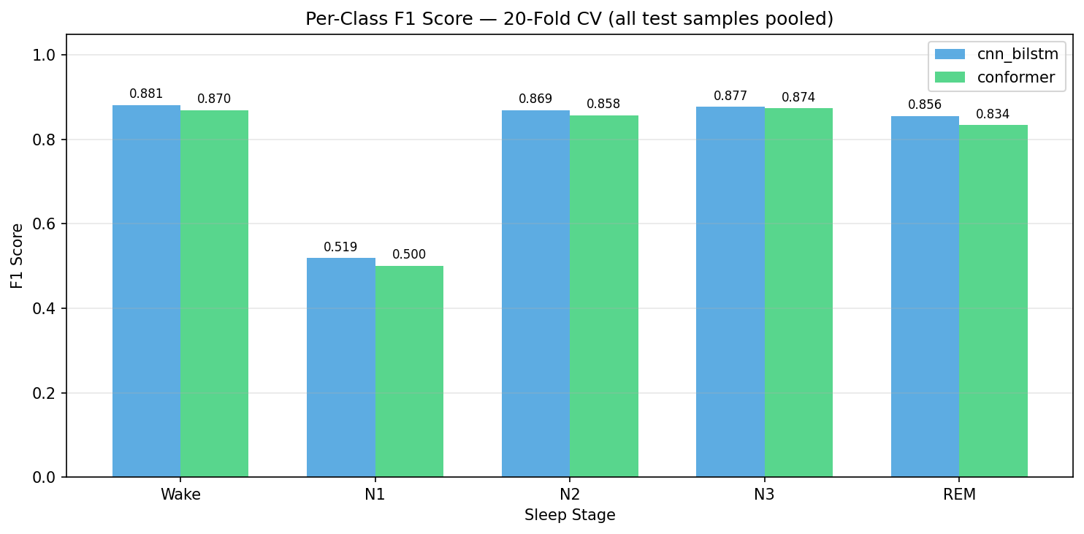
Per-Class F1 Scores: CNN+BiLSTM vs Conformer
Conformer improves N1 and REM detection relative to BiLSTM

Slide 29
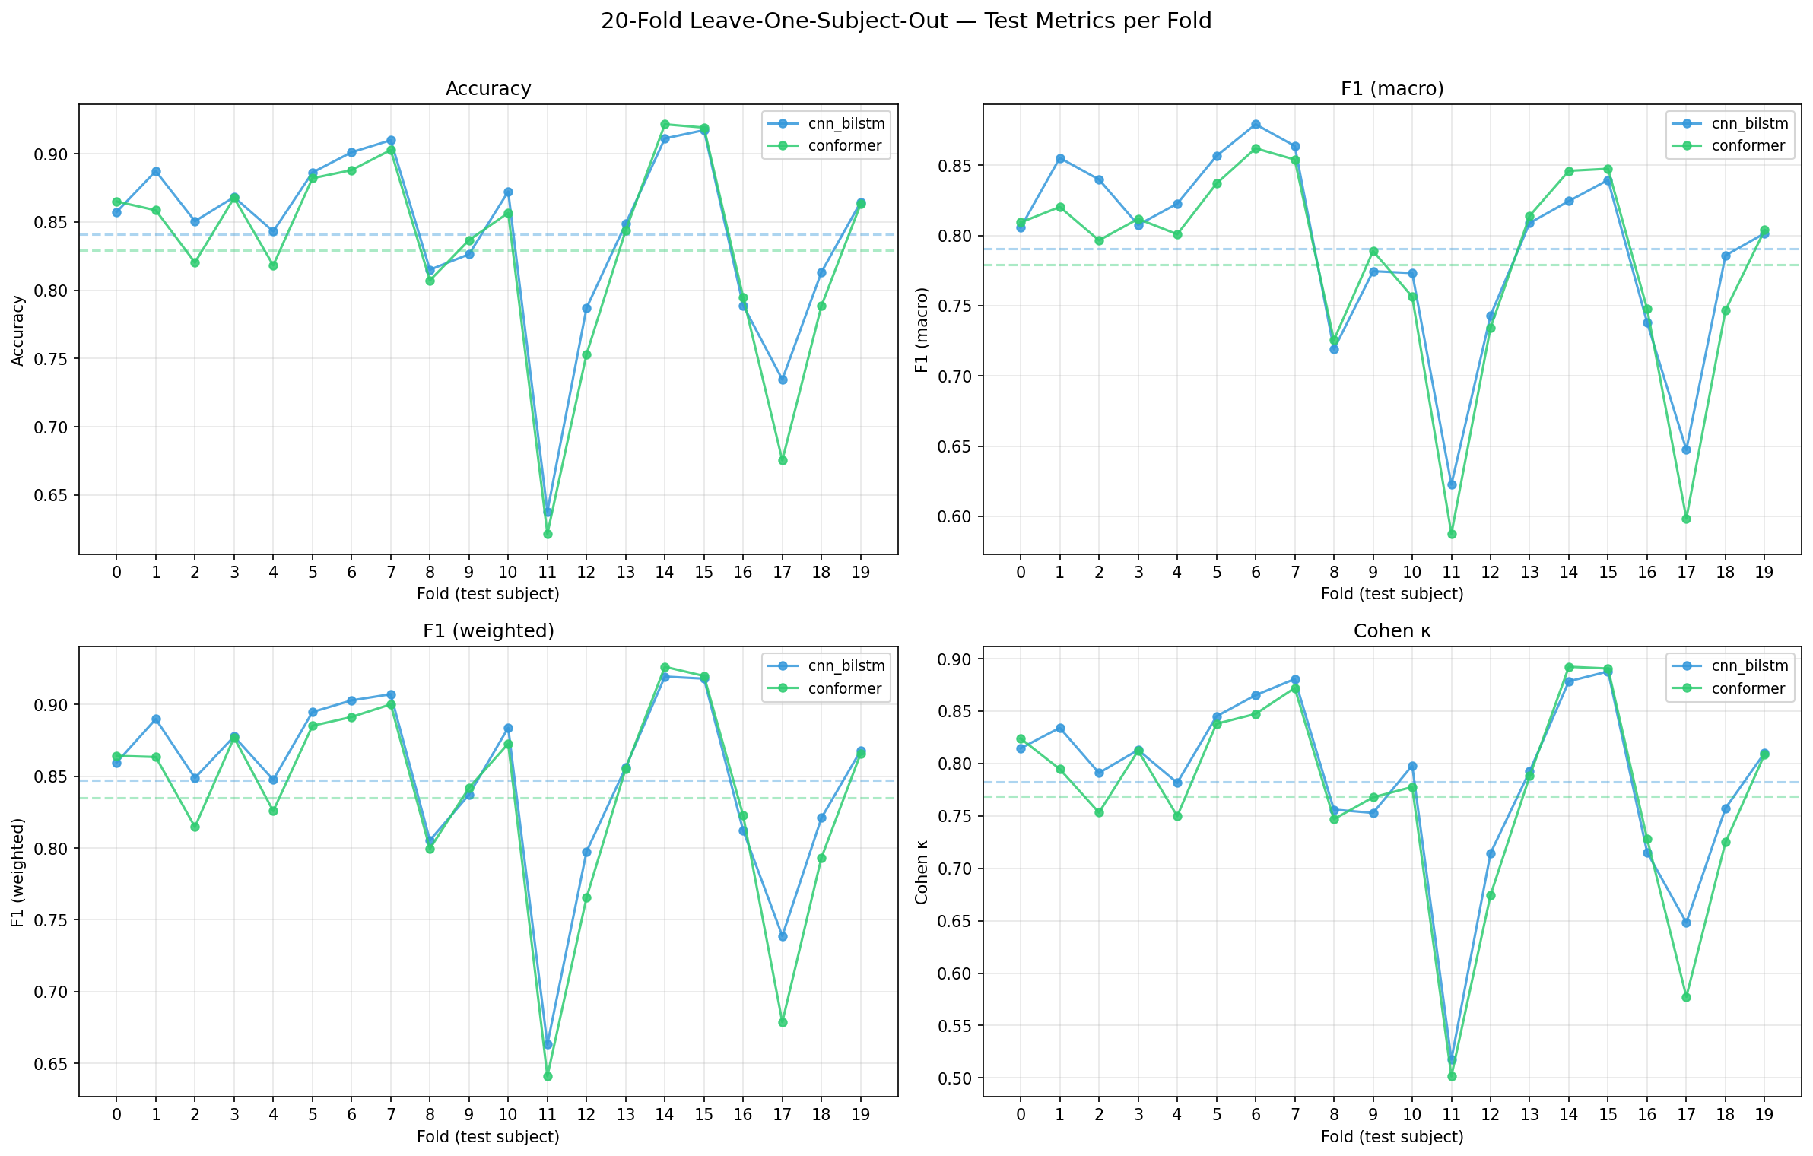
Per-Fold Performance Variation (20-Fold LOSO-CV)
Accuracy per subject — subject variability is a key challenge

Slide 30
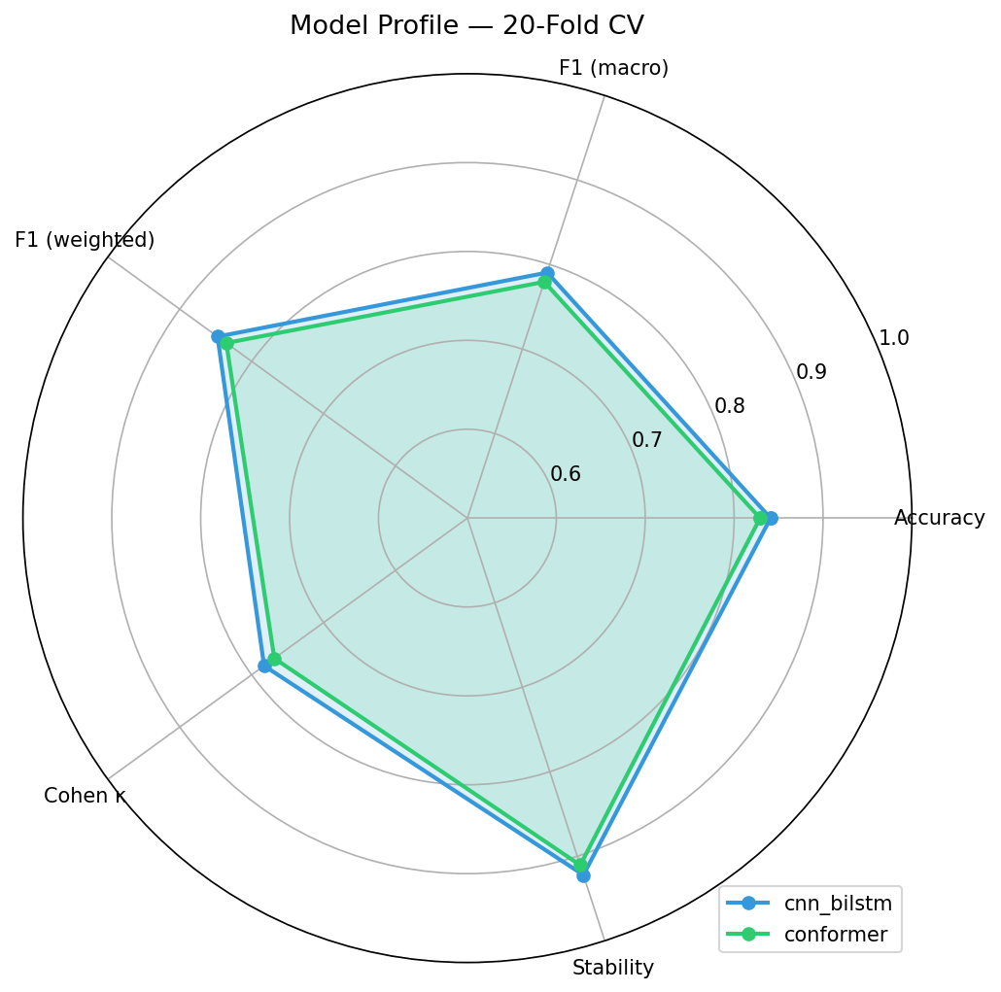
Model Performance Profile Comparison
Radar chart: Conformer achieves a more balanced profile across all 5 stages

Slide 31
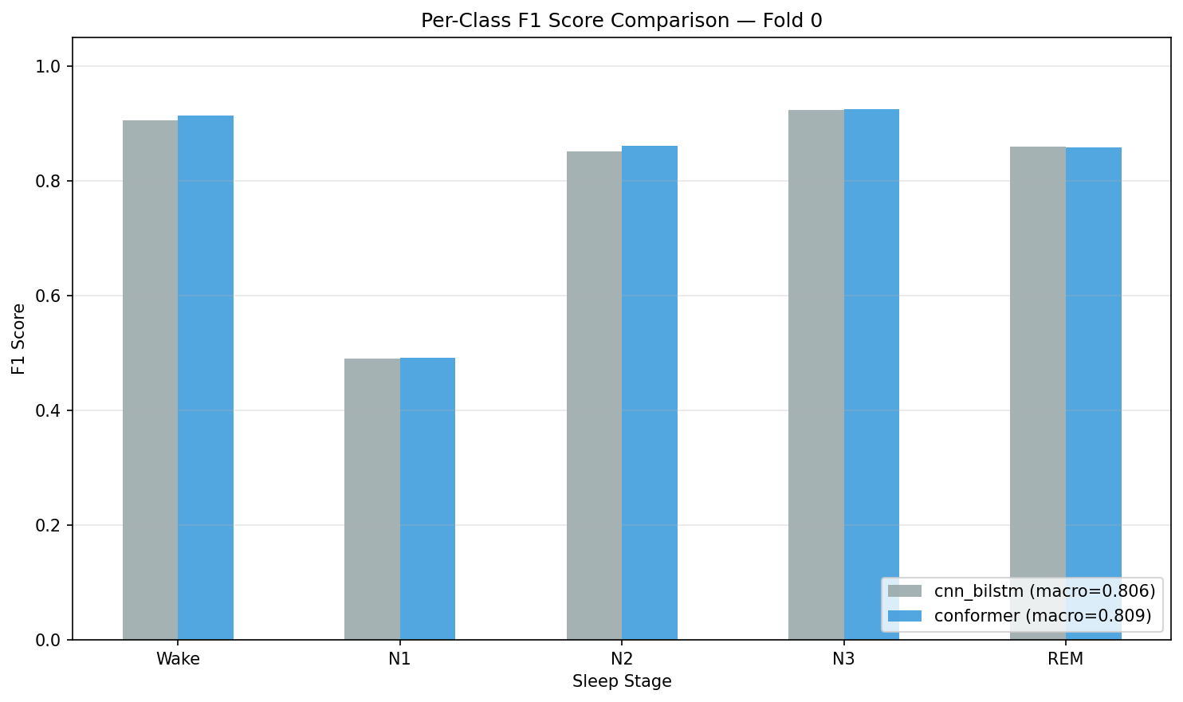
Model Improvement Over Baseline (Fold 0)
Per-class F1 bar chart: Baseline vs. CNN+BiLSTM vs. Conformer

Slide 32
Results Comparison
Model | Accuracy | Macro F1 | Cohen's κ | N1 F1
Baseline (DeepSleepNet-Lite) | 80.9% | 0.753 | 0.740 | 0.441
Temporal (CNN + BiLSTM, L=5) | 83.1% ± 7.2% | 0.778 ± 0.078 | 0.768 ± 0.094 | 0.477
Enhanced (CNN + BiLSTM, L=11) ★ | 84.1% ± 6.7% | 0.791 ± 0.069 | 0.783 ± 0.088 | —
Enhanced (Conformer, L=11) | 82.9% ± 7.6% | 0.780 ± 0.076 | 0.769 ± 0.098 | —
Per-Class F1 (Temporal CNN+BiLSTM vs Baseline)
Stage → | Wake | N1 (bottleneck) | N2 | N3 | REM
Baseline | 0.802 | 0.441 | 0.865 | 0.859 | 0.795
Temporal ↑ | 0.874 (+0.072) | 0.477 (+0.036) | 0.859 (−0.006) | 0.868 (+0.009) | 0.814 (+0.019)
★ Best overall model | — Per-class data not in enhanced CSV (see cv20_per_class_f1.png) | All values: mean across 20 folds

Slide 33
Key Takeaways
• 1. All three approaches improve on the same 20-fold LOSO-CV benchmark (Sleep-EDF v1, 39 recordings)
– Baseline 80.9% → Temporal 83.1% → Enhanced CNN+BiLSTM 84.1% (best)
• 2. Temporal context is the single biggest lever — adding BiLSTM over L=5 epochs gained +2.2% accuracy and +3.6% N1 F1
– Sleep stage transitions (W→N1→N2→N3→REM) give the sequence model a structural advantage over epoch-wise CNN
• 3. Enhanced training (focal loss γ=2, mixup, cosine warmup, longer context L=11) adds another +1.0% accuracy
– Multi-scale CNN backbone captures both fine (spindles) and coarse (delta) EEG features simultaneously
• 4. Conformer (82.9%) slightly underperforms Enhanced CNN+BiLSTM (84.1%) on this dataset size
– Attention mechanisms may need more data to outshine recurrent inductive biases for temporal EEG
• 5. N1 remains the persistent bottleneck across all models (0.441 → 0.477 in Temporal; enhanced similar)
– N1 is intrinsically ambiguous — only 6.6% of data, overlaps spectrally with both Wake and REM
• 6. High fold-to-fold variance (std ≈ 0.07–0.09) confirms subject-level variability dominates model choice
– Larger datasets (SHHS, MASS) or subject-adaptive fine-tuning needed for robust clinical deployment
• 7. All enhanced models approach human inter-scorer Kappa range (0.75–0.85); Enhanced CNN+BiLSTM κ = 0.783

Slide 34
Limitations & Future Work
Model | Accuracy | Macro F1 | Cohen's κ | N1 F1
Baseline → Temporal → Enh. CNN+BiLSTM | 80.9% → 83.1% → 84.1% | 0.753 → 0.778 → 0.791 | 0.740 → 0.768 → 0.783 | 0.441 → 0.477 → ?
⚠ Limitations (evidence from results)
→ Future Work (grounded in findings)
• N1 detection remains bottleneck across all models
– Baseline 0.441 → Temporal 0.477: only +3.6% after full retraining
– Intrinsic spectral overlap of N1 with Wake & REM limits ceiling
• Single EEG channel (Fpz-Cz) — all models share this constraint
– EOG/EMG channels used by human scorers are absent
• High subject-to-subject variance (std ≈ 0.07–0.10)
– Temporal fold 8: only 60.9% acc — single-subject outlier drags mean
– Conformer std (0.076) > Enhanced CNN+BiLSTM std (0.069)
• Conformer underperforms Enhanced CNN+BiLSTM (82.9% vs 84.1%)
– Self-attention needs larger datasets to surpass recurrent biases
• Small dataset: 20 subjects — limits generalisation claims
– No external validation set (SHHS, MASS) tested
• Improve N1: targeted augmentation & loss shaping
– Stage-conditional focal loss with higher α for N1 specifically
– Synthetic N1 generation via EEG-GAN / sleep-spindle injection
• Multi-modal input to break Fpz-Cz ceiling
– Add EOG + EMG channels — directly mirrors clinical scoring
• Subject-adaptive fine-tuning to reduce fold variance
– Few-shot personalisation layer on top of frozen backbone
– Meta-learning (MAML) for fast subject adaptation
• Scale Conformer with pre-training (larger corpus)
– Pre-train on SHHS (5,000+ subjects), fine-tune on Sleep-EDF
– Expected: attention > recurrence advantage realised
• Deployment-ready pipeline
– Real-time inference for wearable EEG (OpenBCI, Muse)
– Uncertainty output (MC-Dropout) for low-confidence flagging

