Slide 1
Name : Rangiya Poojan j. Regi no : 250130380029 Department : BSC Microbiology Assignment topic :Famous instruments of india-sitar and veena

Slide 2
The Soulful Strings: Sitar and Veena
Two magnificent instruments that have shaped the soul of Indian classical music for centuries

Slide 3
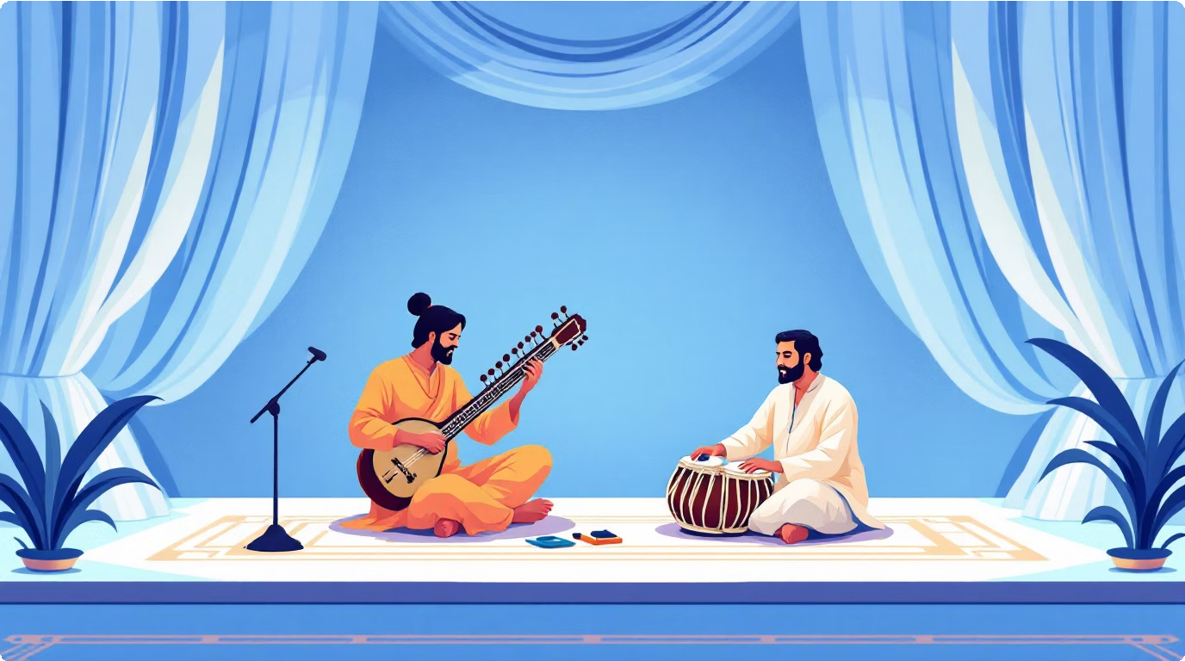
Guardians of Musical Heritage
Indian classical music is a treasure trove of melodic expression, and the sitar and veena stand as two of its most celebrated instruments. Each possesses a unique voice, yet both share the common purpose of bringing ragas to life with emotional depth and technical brilliance.
Their strings have echoed through royal courts, temples, and concert halls, carrying forward centuries of musical tradition.

Slide 4
Journey Through Time
Vedic Era
Ancient roots in the veena's predecessor mentioned
in sacred texts
1
2
Medieval Period
Sitar emerges, influenced by Persian instruments brought by Islamic rulers
Mughal Courts
Both instruments flourish under royal patronage,
reaching artistic heights
3
4
Modern Era
Clobal recognition through legendary maestros and cross-cultural collaborations

Slide 5
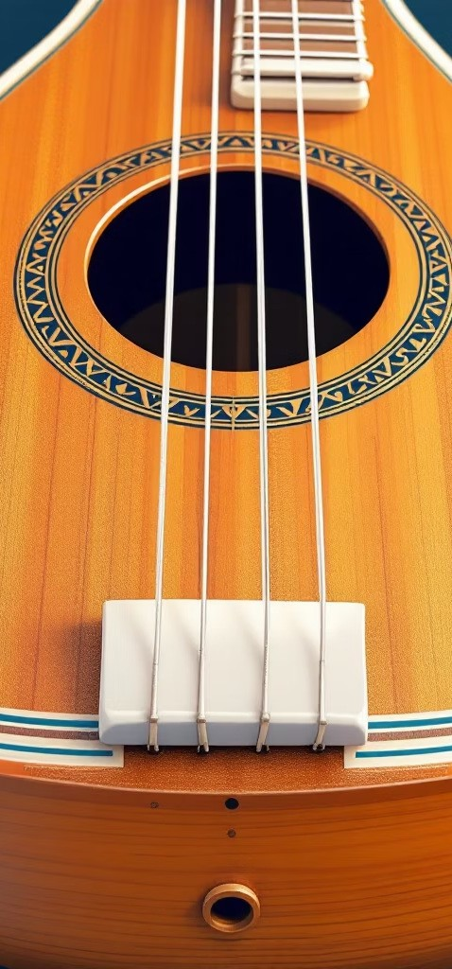



The Sitar
Northern Heritage
Developed in North India, influenced by Persian and Indian traditions
18–20 Strings
Playing strings, sympathetic strings, and drone strings create resonant depth
Movable Frets
Allows precise tuning adjustments for different ragas and scales
Meend Technique
Signature gliding between notes creates the instrument's distinctive voice

Slide 6
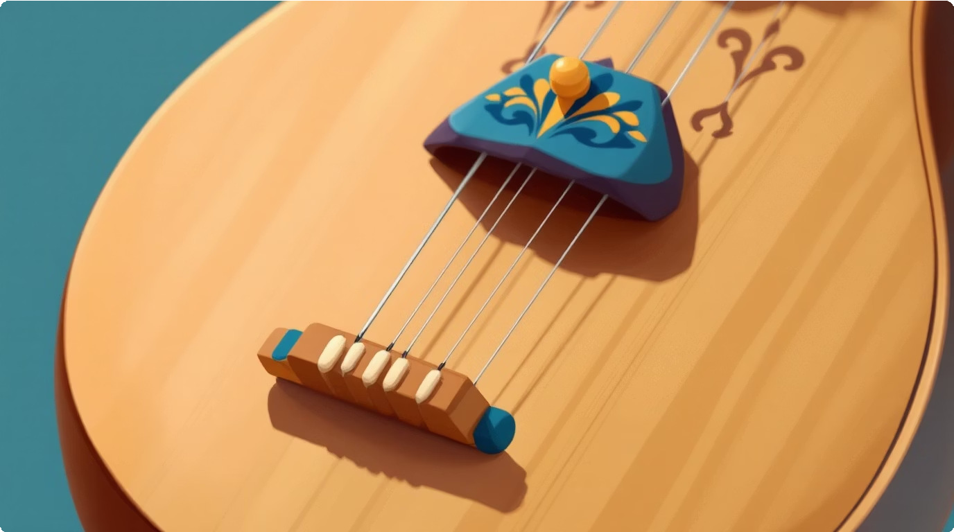
The Veena
South Indian Grandeur
The veena represents the classical music tradition of South India, with origins tracing back thousands of years. Its resonant tone and precise articulation have made it the queen of Carnatic music.
7 strings provide melodic and drone capabilities
Fixed frets ensure perfect intonation
Masterful gamakas express emotional nuances
Solid wood construction creates warm timbre

Slide 7

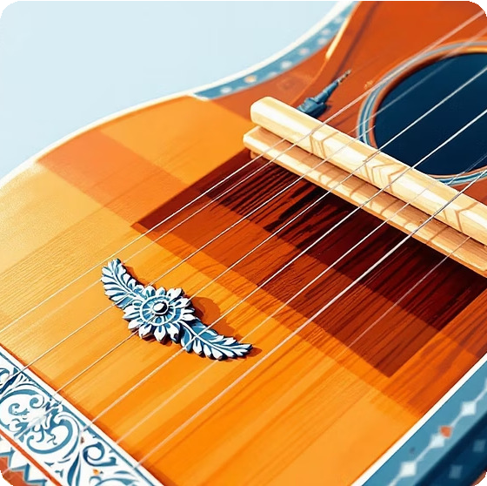
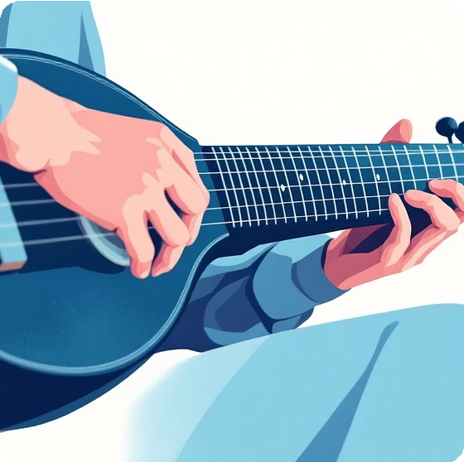
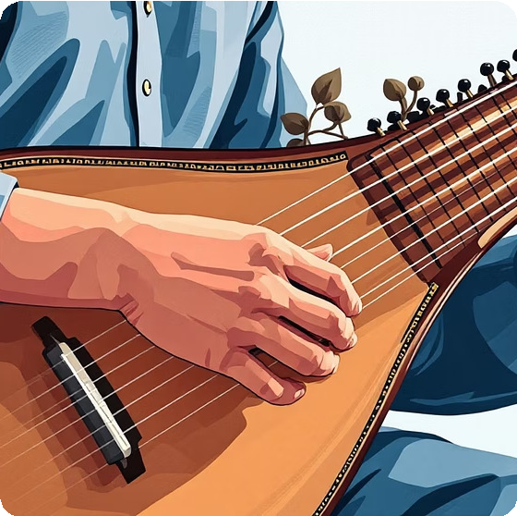
Two Worlds, One Purpose
Sitar Structure
Taraf sympathetic strings, large tumba resonator, curved neck with movable frets
Veena Structure
Dandi fingerboard, tala bridge, resonant body carved from jackwood
Sitar Playing
Expressive meend, resonant drone, fluid glides between notes
Veena Playing
Precise gamakas, rhythmic patterns, intricate ornamentation

Slide 8



Musical Architecture
Sympathetic Strings
11–13 taraf strings vibrate sympathetically, creating rich resonance
Tumba Resonator
Oblong gourd body amplifies sound with warm, mellow tonal quality
Movable Frets
20–25 frets can be adjusted for different ragas and tuning systems

Slide 9
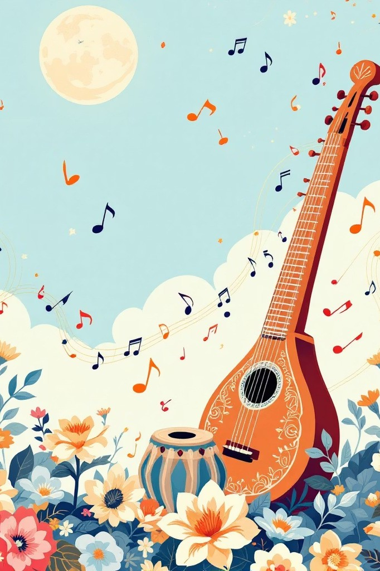
Expressive Voices
Sitar
Known for its expressive, flowing meend that glides seamlessly between notes. The sympathetic strings create a shimmering halo of sound around each note, evoking deep emotion and contemplative mood.
Veena
Renowned for precise gamakas that ornament each note with rhythmic vitality. The fixed frets ensure perfect intonation whilst allowing intricate variations in pitch and volume for dramatic expression.

Slide 10
Legends Who Shaped History
Pandit Ravi Shankar
Clobal ambassador of the sitar, introduced Indian classical music to Western audiences through collaborations with Ceorge Harrison and performances at major festivals worldwide
Ustad Vilayat Khan
Revolutionised sitar technique with his gayaki ang style, mimicking the human voice with extraordinary expressiveness and emotional depth
Dr. E. Gayathri
Contemporary veena virtuoso preserving Carnatic tradition whilst innovating with new compositions and international performances

Slide 11

Echoes Across the World
6
Continents
Where these instruments now inspire musicians
100+
Collaborations
Cross-genre fusions with jazz, rock, and electronic music
500M
Listeners
Estimated global audience reached annually
The sitar and veena continue to enchant new generations, bridging ancient wisdom with contemporary creativity. Their strings resonate not merely as instruments, but as living conduits of India's profound musical heritage, ensuring timeless melodies endure for centuries to come.

