Slide 1
By : Manish Deswal SID : 19968562 Session : Data Science Q4 2020
Analysing Wheat Seeds Dataset with Machine Learning

Slide 2
About the Dataset
Attribute | Data Type
Area, A | Real
Perimeter, P | Real
Compactness C = 4*pi*A/P^2, | Real
Length of kernel | Real
Width of kernel | Real
Asymmetry coefficient | Real
Length of kernel groove | Real
Class (1 = Kama, 2 = Rosa, 3= Canadian) | Categorical
The dataset contains measurements of geometrical properties of kernels belonging to three different varieties of wheat Kama, Rosa and Canadian
The data set contains seven real-valued attributes, one categorical attribute and total of 210 observations and can be used for the tasks of classification and cluster analysis

Slide 3
Data Pre-Processing
Preparing the data for input into the machine learning models
Handling Missing Data
Handling Categorical Data
Feature Scaling
Train/Test Split (Validation set)

Slide 4

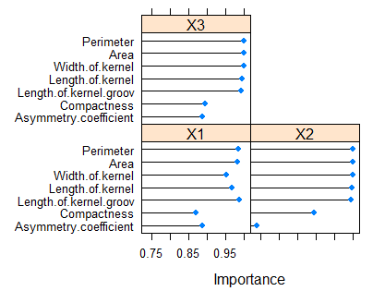
Ranking Features by Importance/Feature Selection
Ranking parameters according to contribution to output using Learning Vector Quantization (LVQ) model.

Slide 5
Supervised Learning Techniques
Supervised learning is a type of machine learning algorithm that uses a known dataset (called the training dataset) to make predictions. In supervised learning, we are given a data set and already know what our correct output should look like, having the idea that there is a relationship between the input and the output. It is basically categorized in two types: "regression" and "classification".

Slide 6
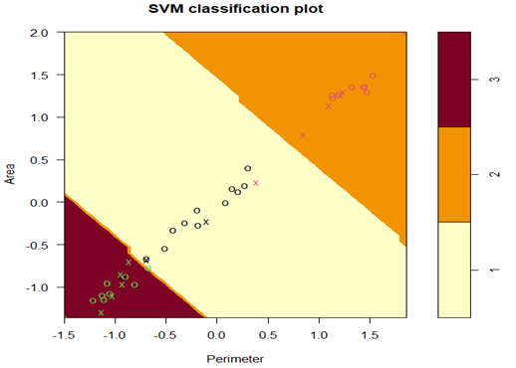
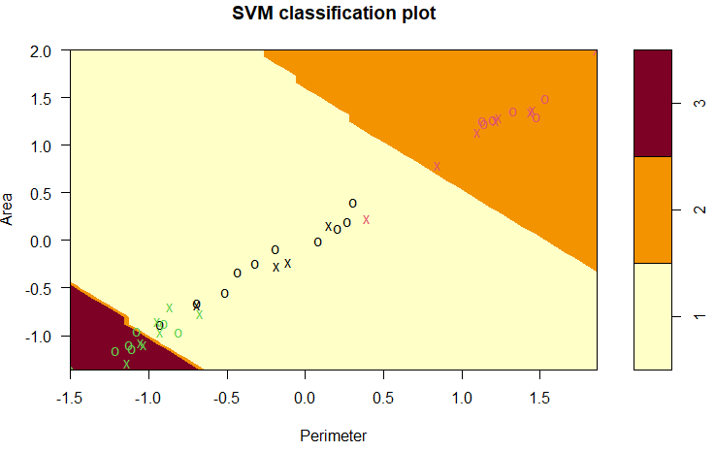
Support Vector Machines
Linear kernel. Accuracy = 92.85714 %
Radial kernel. Accuracy = 95.2381 %
Model Evaluation using K-fold cross Validation
Mean Accuracy Linear SVM : 93.51716%
Mean Accuracy Kernel SVM : 91.19199 %
Improving model performance using Grid Search
Optimal value for the Penalty Parameter C = 1 for both linear and kernel SVM

Slide 7
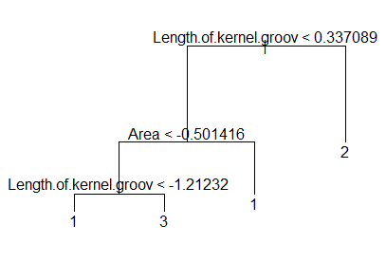
Decision Trees
Accuracy = 95.238 %
Mean accuracy using k fold cross validation = 88.095 %
Pruned decision Tree

Slide 8
Unsupervised Learning Techniques
Unsupervised learning involves learning from data, but without the goal of prediction. In the unsupervised case, the goal is to discover patterns, deep insights, understand variation.

Slide 9
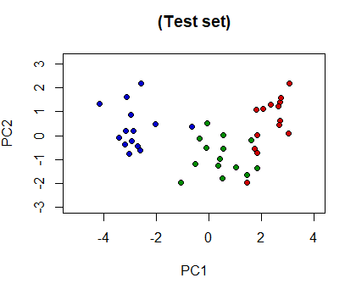
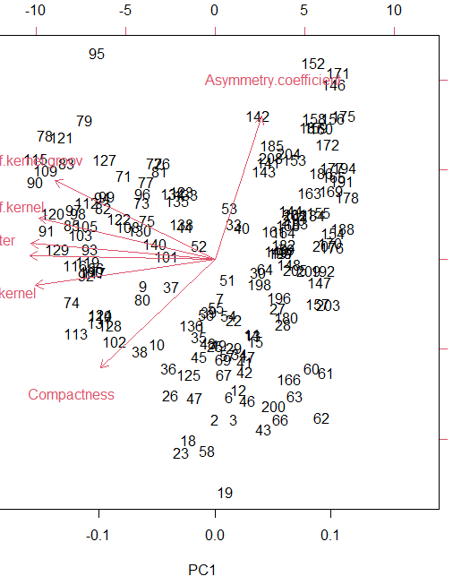
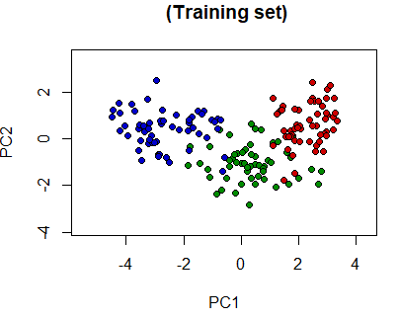
Principal Component Analysis
PCA is a very popular unsupervised dimensionality reduction algorithm for feature extraction. The goal of PCA is to identify and detect the correlation between variables. If there is a strong correlation and it's found, then it could reduce the dimensionality.

Slide 10
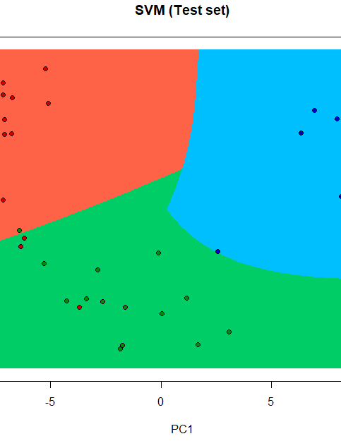
Kernel PCA
Kernel PCA is a version of PCA where the data is mapped to a higher dimension using the kernel trick.

Slide 11
Conclusion:
linear kernel SVM performed best among all other techniques discussed.
The data seems to perform better on linear algorithms than nonlinear algorithms hence data can be almost linearly separable.
The Rosa variety is better recognized whereas Kama variety and Canadian variety are less successfully predicted.
Asymmetry coefficient and Compactness are least contributing across all classes and least related to other parameters.
The data reduced to 2 dimensions after applying the Principal Component Analysis produced same accuracy with linear kernel SVM.

