Slide 1
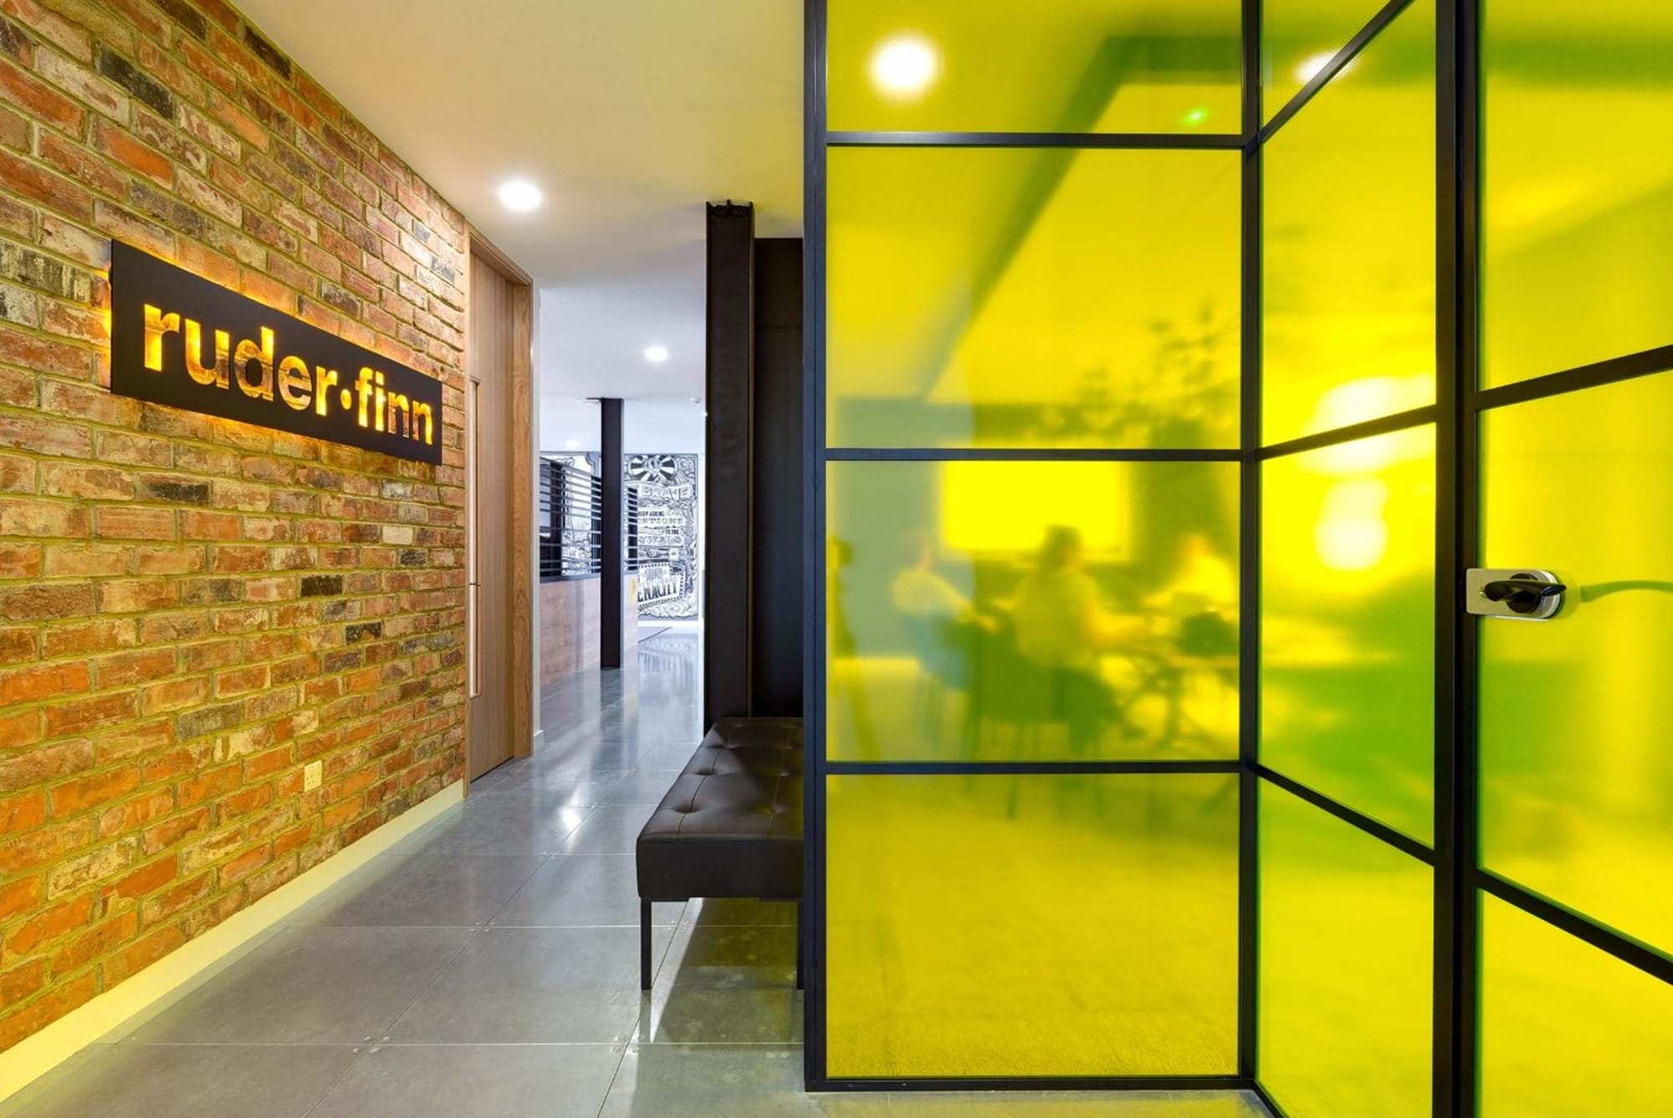


Slide 2

Problem Statement
Analyzing brand values and prospects before a pitch is quite tedious and time consuming
Standardization of content for a pitch deck takes more man hours.
Inappropriate usage of multimedia contents.

Slide 3
Traditional Process
Step 01
Step 02
Step 03
Step 04
Step 05
Brand Analysis
Collecting Relevant Data
Deciding the Pitch Contents
Making up a PPT.
Revising PPT before the Pitch.

Slide 4
Major Drawback
Access to Resources
Time Consuming
Inappropriate
Contents
Failing
to Meet the quality

Slide 5
RF DECK
Bundle Packed
Instant Resource
Interactive Design
Diverse View
Appropriate Multimedia
Automate
Access to Data
Through WhatsApp
Mailing

Slide 6
The New Way
Step 01
Step 02
Step 03
Enter the Brand Name
Download the PPT
Prepare Using
WhatsApp

Slide 7
In Few Clicks
Get the generated PPT with Meaning Full insights.
4
Steps
Merges dynamic data from user and the machine.
Process the data and derive inferences from the data.
Collects data on an organization
from various media.

Slide 8






Interactive data from
Similar Web
Twitter
News API
Crunchbase
Instagram
Clear Bit

Slide 9


Be a Pro
Get access to insights within a single click.
Enhanced Data Storage and retrieval.
Built on Recent tech stacks and upgradable
Create multiple PPT’s in a short span.
Integrate data with any tool using our API

Slide 10
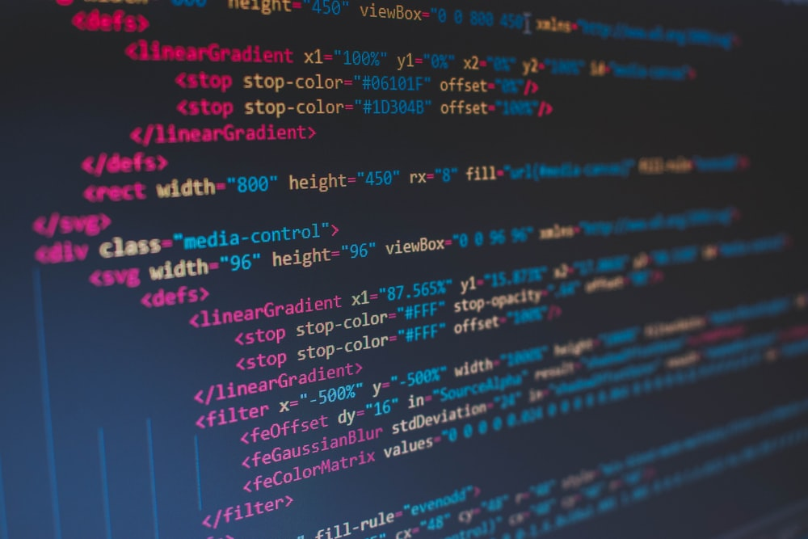





Tech Stacks
Time Frame for development – 3 to 4 months

