Slide 1
Selenium WebDriver 3.0

Slide 2
Features
Selenium automates browsers. It is used to automate web based applications only. It can’t automate desktop based applications.
It is available in form of APIs. There is no UI
Used for Functional and Regression testing of an application
WebDriver is an interface
Reference - https://www.seleniumhq.org/

Slide 3
OS, Languages and browsers support
Operating Systems
Windows
Mac
Linux
Supported Browsers
Google Chrome
Mozilla Firefox
MS Internet Explorer
MS Edge
Safari
Opera
Supported Languages
Java
C#
Perl
Python
Ruby
Javascript

Slide 4
Advantages of Selenium
It is an open source automation tool
Supports multiple browsers (Chrome, Firefox, IE etc…)
Support multiple programming languages (Java, C#, Python etc ..)
Supports various operating systems (Windows, Mac, Linux)
It supports parallel testing
It uses less hardware resources. There is no UI and it is available in form of APIs, so less burden on local system

Slide 5
Selenium Suite
Selenium is a suite of –
Selenium IDE – It is a Chrome and Firefox add on which is used to create, edit and execute test cases.
Selenium RC –It is used to control browsers locally or remotely. Outdated/Deprecated.
Selenium WebDriver – It is a programming interface to create and execute test cases.
Selenium Grid – It supports test cases execution across multiple browsers, operating systems and machines in parallel.

Slide 6
History of Selenium
Selenium first came to life in 2004.
In 2007, WebDriver was launched.
In 2011, WebDriver was merged with Selenium to create more powerful tool called Selenium 2.0.
Selenium 1.0 = Selenium IDE + Selenium RC + Selenium Grid.
Selenium 2.0 = Selenium IDE + Selenium RC + Selenium Grid + Selenium WebDriver.

Slide 7
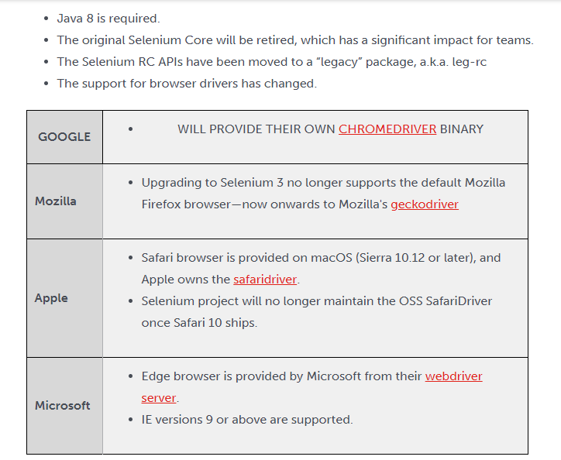

What’s new with Selenium 3.0

Slide 8
For Automation learn ..
Eclipse – Editor to write test cases
Selenium WebDriver – To create and execute test cases using element locators and WebDriver API commands
Java Programming – To enhance test cases like inserting verification points, error handling, parameterization, synchronization, adding comments etc..
TestNG testing framework – Primary purpose is to group test cases, execute test batches and generate detailed test reports
Excel sheets – For test data
Maven – Build tool
Extent Report – For HTML Reporting
Jenkins – As a CI tool
GitHuB – Version Control

Slide 9
How to configure Eclipse
Download from https://www.eclipse.org/downloads/
Download .exe file based on win32 or win64 version of your OS
Using eclipse installer, configure the Eclipse IDE for Enterprise Java Developers
Run eclipse.exe to start Eclipse

Slide 10
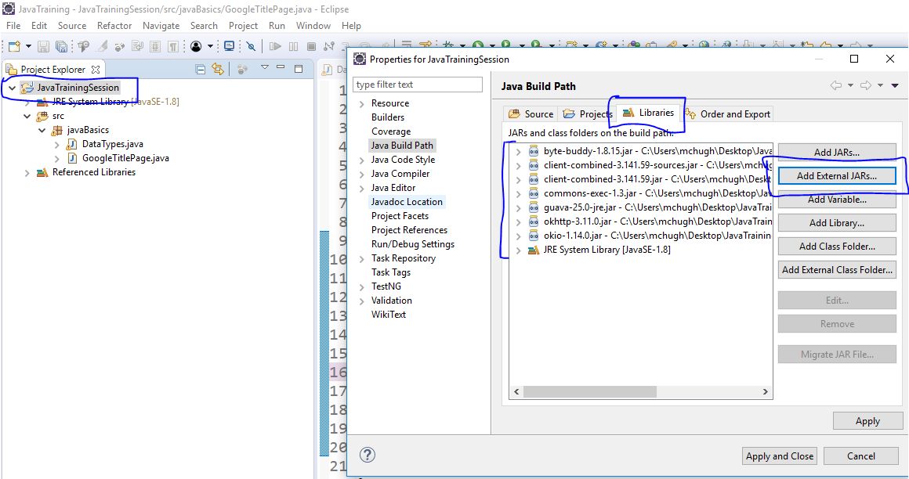
Adding Selenium JARs to a project
Download from https://www.seleniumhq.org/download/ and add to your project:
Project->Properties->Java Build Path ->Libraries ->Add External JARs->Add the following JARs -> Apply and Close

Slide 11
How to download chromedriver.exe
Download from https://www.seleniumhq.org/download/
Download chromedriver_win32.zip zip file
Extract the files from this zipped folder
The extracted folder will have chromedriver.exe

Slide 12
Project Hierarchy
Project -> src -> package ->class
In Eclipse, on the Project Explorer pane right click and select
New->Project->Java Project->Next->Project Name->Finish
Under the project, right click on the src folder and click New->Package->Package Name->Finish
Right click on package->New->Class->Name-> select public static void main(String []args)->Finish

