Slide 1
Training

Slide 2
Aroma Therapy
Course Description
This course is designed to add to the existing aromatherapy knowledge of practitioners to further the benefit of our patients.
We will learn about the benefits of the most common essential oils, and in which manner they are most easily applied and most helpful.
Presented by Thomas Hammond, CMT #59099

Slide 3
Learning Outcomes
Upon Successful Completion of this course;
Students will gain a better understanding of how to appropriately apply essential oils in a treatment
All students will learn the indications and contraindications of essential oils
Students will be given a brief history, and how they affect humans
Each participant will learn how essential oils affect the brain
Students will learn about the benefits of most common oils used in spas or clinical settings
Participants will go through a refresher on basic anatomy of the human brain

Slide 4
What Are Essential Oils?
Essential oils aren’t oils at all, but instead concentrated organic elements.
Fragrance oils are not essential oils and should not contain the word fragrance in their description.
These concentrates have been pressed or distilled from plants, and contain no fatty acid component
Oils may endure rectification wherein they are redistilled to remove unwanted constituents
All essential Oils are adaptogens, by that they illicit a reaction in the body to suppress, or accelerate, or normalize some bodily functions and healing processes.

Slide 5
Essential Oil Usage
At Home
Many essential oil enthusiasts will use them for diffusion in the home to clear unwanted smells
Enthusiasts may also employ them for use in household cleaners, pest deterrents and medicinally
In Spa
Spa treatments may include diffusion throughout the clinic to illicit a state of mind
They also enhance the effects of bodywork when applied with carrier oils or directly inhaled (the most effective form of usage)

Slide 6
Indications & Contraindications
Who essential oils are Indicated for;
Healthy individuals with no comorbidities affected or provoked by fragrance or allergens
People suffering from stress, anxiety, restlessness, pain, or fatigue
Contraindications;
Pregnancy
Cancer or chemotherapy
Hypertension
Cardiac Disease
Excessive sun exposure (especially with citrus)
High or Low Blood pressure
Epilepsy
Children under the age of 5 years old

Slide 7
A Brief History of Essential Oils
Essential oils were used in Ayurveda practices in India, Ancient Egypt, Rome and Greece
Modern pharmaceuticals started in the middle ages, with the first drugstore in Baghdad in 754
The late 1800’s saw the boom of Big Pharma like Parke-Davis, Squibb, Upjohn, Pfizer, J&J and others who produced both plant based, and synthetic medicines
At the start of the 20th century, consumers had strayed from plant derived medicine in favor of convenient preparations by drug manufacturers.
In WWII, Dr. Jean Valnet used eucalyptus oil as a bactericide when he ran out of anti-biotics.

Slide 8
How Oils Affect Us
When diffused into the air or through the skin, miniscule amounts of the chemicals from essential oils enter the bloodstream
As the molecules of the oils diffuse into the air, they can kill bacteria and viruses that would otherwise be inhaled
After inhalation, many studies have shown that an increase in cerebral blood flow in witnessed which will provide greater cognitive abilities
Specific essential oils will incite a psychological effect within the brain by way of olfaction

Slide 9

The Human Brain

Slide 10
Mechanisms of the Brain
Smell, the earliest of senses in our ancestors, occurs when a mucus-covered patch of tissue called the Olfactory Epithelium contacts particulate from inhalation or mastication.
3-4 centimeters wide, the Olfactory Epithelium has more than 100 million receptor cells of which there are 400-450 different types of receptors specifically designed for aromas which allows us to differentiate nearly 1 trillion different types.
Neurons from the olfactory receptors bundle together to form the Olfactory Nerve which travel to the Olfactory Bulb, to the Limbic System, triggering structures responsible for adrenal flow, emotion, behavior, motivation, long-term memory, & olfaction.
The Amygdala, as part of the Limbic system, is responsible for integrating emotion, behavior, etc,.
The Hypothalamus links the nervous system to the endocrine system by way of the pituitary glad, which triggers the brain to start or stop the production of hormones.

Slide 11
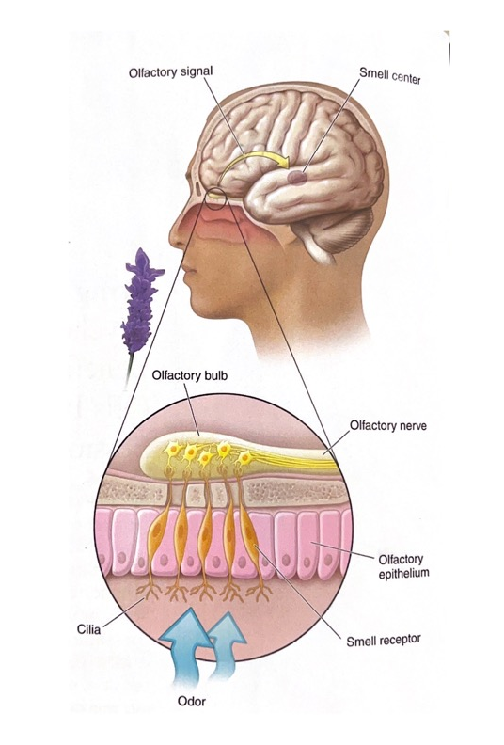
Olfaction:
Through an olfactory response, essential oils influence the CNS, amygdala, brain chemistry, and sense of emotional equilibrium.

Slide 12
Amygdala Soothing
Almond shaped, these sets of neurons located in the medial temporal lobe are associated with fear responses, and pleasure.
Anxiety, autism, depression, PTSD, and phobias correspond to abnormal functioning in this region of the brain.
This part of the brain is responsible for the Fight or flight response.
Valerian, Lavender, Bergamot, & Rose are the most effective at at reducing hypervigilance in an overactive amygdala

Slide 13
Antidepressants
Non-clinical depression is considered transitionary, as it is usually due to painful life events during periods of adjustment.
Essential Oils with counter effects can reduce non-clinical depression with symptoms of sadness, fear, hopelessness, emotional fatigue and dejection.

Slide 14
Neurosedatives
Neurosedatives act on the brain by increasing Gamma-Aminobutyric Acid (GABA) levels, triggering their matched receptors, thereby inhibiting excitatory neurotransmitters.
When GABA levels are high, we feel sleepy, and relaxed; visually tranquilized in the eyes of others.

Slide 15
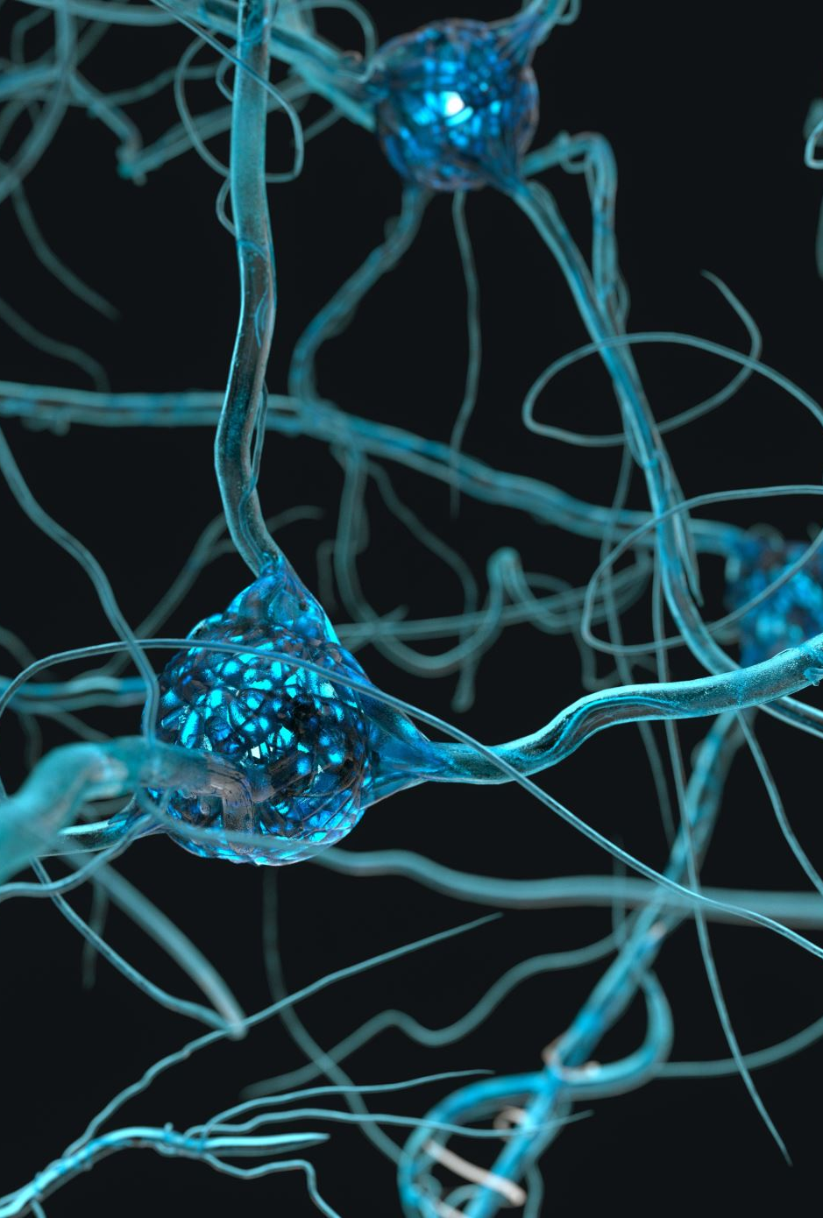
Neurostimulants
By stimulating the CNS, a sense of alertness is produced causing an increase in cerebral blood flow, beta wave activity, and stimulating the Locus Coeruleus (section of the brain associated with the production of norepinephrine).
Norepinephrine helps us focus attention, increase alertness, & promotes forming memories and also retrieving them.
High levels of this is associated with the fight or flight response system.
Some Neurostimulants block receptor sites for GABA, reducing GABA activity and improves alertness and attention.

Slide 16
Dopamine Balancers
Dopamine is the brain’s reward system, where behaviors associated with biologicals advantages bring a sense of gratification.
Drugs like nicotine, amphetamines, and activities like eating and coitus induce the production dopamine.
Dopamine plays a major role in motor activity, mood, sensations of well-being, sleep patterns, attention allocation, & learning.

Slide 17
Serotonin Stimulants
Serotonin is associated with mood, sleep, sexuality, & appetite, but low serotonin levels are associated with depression, anger, aggression, anxiety, and OCD. Moreover, it may also be linked to migraines and Fibromyalgia.

Slide 18
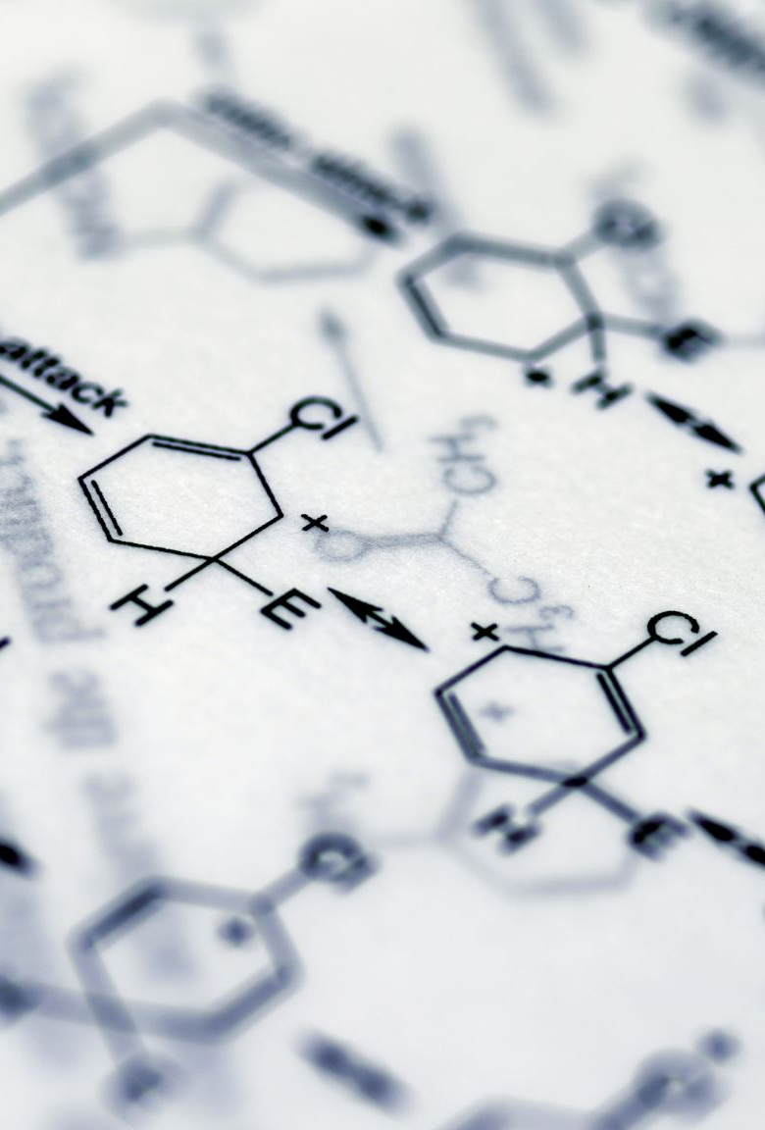
Euphorics
Agents that promote positive feeling of expansion, connection, and consciousness. This occurs by way of an increase of activity in the prefrontal cortex, but also on some types of serotonin receptors.
Euphorics sedate the amygdala and Thalmus, which regulate pleasure, fear, sleep, alertness, and wakefullness.

Slide 20
Application in Clinic
In our clinic, we diffuse oils site wide, but with each session we purposefully provide direct inhalation of a chosen oil for maximum effectiveness
Obtain two drops of a selected oil and disperse between two hands which will be directly applied to the non-contact surface of the face cradle cover. Ensure the oil will have no chance of contacting the client’s skin when in the prone position
Any remaining essential oil on the practitioner’s hands will be diffused when combined with their chosen emollient
After the client has turned to the supine position, the practitioner will distribute another two drops of the essential oil to then be dispersed between two hands and applied to the sheet near the client’s shoulders. Ensure the oil will have no chance of contacting the client’s skin when in the supine position
Any remaining essential oil on the practitioner’s hands will be diffused when combined with their chosen emollient

