Slide 1
In-House GenAI Engineering Platform
Architecture Design · Observability · Governance · RAG Reference Stack
50+ Developers · 10+ Teams · 2× DGX A100 · LiteLLM · Langfuse · Milvus · Kubeflow
Platform Architecture Review
May 2026
GenAI Engineering Platform
1 / 34

Slide 2
Agenda
What we will cover in 30 minutes
01
Infrastructure & Models
02
AI Gateway & Observability
03
Data & MLOps Layer
Physical GPU servers, model catalog, NGINX proxy
LiteLLM, Langfuse, automated tracing
Milvus vector DB, Kubeflow, Airflow
04
Data Flow Diagrams
05
RAG End-to-End Architecture
06
Governance & Roadmap
LLM request, RAG query, ingestion pipeline
Indexing · Query · Evaluation full stack
Access, cost, data governance + 16-week plan
GenAI Engineering Platform
2 / 34

Slide 3
Platform at a Glance
Scale, capability, and components
50+
10+
16
Developers
Teams
A100 80GB GPUs
1.28TB
8
3
Total VRAM
Deployed Models
K8s Clusters
AI Gateway
Auto-Tracing
RAG Templates
Governance
Unified LLM access via LiteLLM with per-team API keys, budgets, and rate limits
Every LLM call traced in Langfuse automatically — zero developer instrumentation
Kubeflow pipeline templates + Airflow ingestion DAGs ready to fork
PII scrubbing, model aliases, cost showback, RBAC across all layers
GenAI Engineering Platform
3 / 34

Slide 4
Why a Centralized GenAI Platform?
Problems we are solving
Shadow LLM Calls
No Trace Lineage
Teams calling external APIs directly — no visibility, no cost control, no governance
Impossible to debug or improve RAG quality without end-to-end observability
Duplicated Infra
Cost Surprises
Every team rebuilding the same ingestion → embed → search → generate stack
No per-team budgets → runaway LLM spend discovered at month end
Model Coupling
No Eval Culture
Code tied to specific model versions → impossible to upgrade or A/B test
No standardized evaluation → quality regressions go undetected in production
GenAI Engineering Platform
4 / 34

Slide 5
01
Infrastructure
& Model Serving
Physical GPU servers · Model catalog · NGINX proxy · Kubernetes clusters
GenAI Engineering Platform
5 / 34

Slide 6
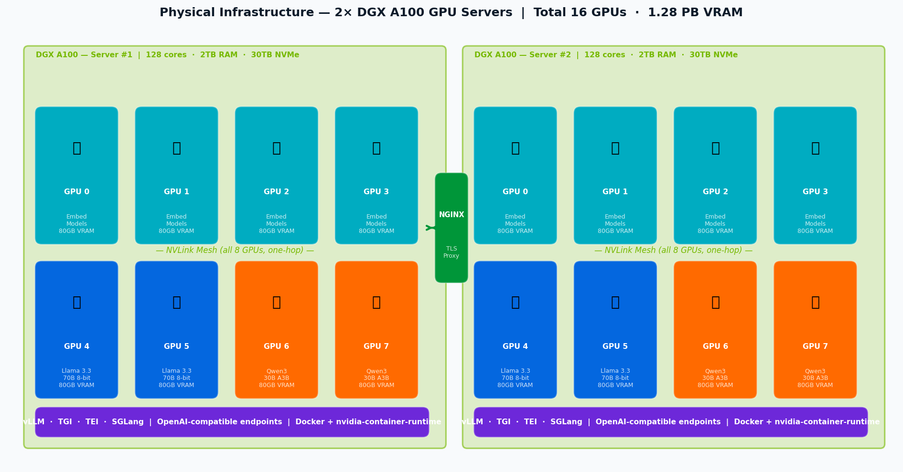
Physical GPU Infrastructure
2× NVIDIA DGX A100 · 16 GPUs · 1.28TB VRAM · NVLink mesh
GenAI Engineering Platform
6 / 34

Slide 7
Deployed Model Catalog
All models registered in LiteLLM with OpenAI-compatible endpoints
LiteLLM Alias
Model
Type
Quantization
Replicas
VRAM/rep
Context
text-gen
Llama 3.3 70B
Text Generation
8-bit AWQ
2
~42GB
128K
reasoning
Qwen3 30B A3B
Reasoning/CoT
BF16 MoE
2
~24GB
32K
embed-v1
BGE-M3
Embedding
FP32
2
~2.4GB
8K
embed-v2
E5-Large-v2
Embedding
FP32
2
~1.3GB
512
embed-v3
UAE-Large-V1
Embedding
FP32
2
~1.3GB
512
embed-v4
NV-Embed-v2
Embedding
FP32
2
~7GB
32K
embed-v5
GTE-Qwen2-7B
Embedding
FP16
2
~14GB
32K
• All models served via vLLM / TGI / SGLang with OpenAI-compatible REST endpoints
• NGINX reverse proxy provides HTTPS termination — teams never call GPU servers directly
• LiteLLM routes traffic across replicas with automatic load balancing and failover
GenAI Engineering Platform
7 / 34

Slide 8
02
AI Gateway
& Observability
LiteLLM · Langfuse · Automated tracing · LLM judge evaluation
GenAI Engineering Platform
8 / 34

Slide 9
LiteLLM — AI Gateway
Single entry point for all LLM calls across 50+ developers
Tenant Hierarchy
Organization
search-team | reco-team | nlp-team | finance-team ...
Project
doc-search-prod | doc-search-dev | chatbot-v2 | qa-pipeline ...
API Key
Developer key | CI/CD service account | Budget + Rate limit + Model allowlist
Model Routing
Budget Limits
Rate Limiting
Routes to correct vLLM/TGI replica Load balancing + failover chains
Hard block when $ cap exceeded Soft alert at 80% → Slack/email
RPM / TPM limits per project Prevents one team starving others
eg: text-gen → replica-1 → replica-2 → alert
eg: Per-project monthly token budgets
eg: Configurable per API key
Model Aliases
PII Hooks
Langfuse CB
Teams call "text-gen" not "llama-3.3-70b" Admin swaps alias — zero app changes
Pre-call hook scrubs PII before logging to Langfuse
Automatic trace for every LLM call Tokens, cost, latency, errors
eg: Immutable API surface for developers
eg: Regex + NER-based redaction
eg: Zero developer instrumentation needed
GenAI Engineering Platform
9 / 34

Slide 10
Langfuse — Observability Platform
Auto-tracing via LiteLLM callback · RAG spans · LLM judge scores
How Tracing Works — Zero Config for LLM Calls
LiteLLM is configured server-side with a Langfuse callback. Every LLM call made with a team's API key is automatically traced — no Langfuse SDK import required in application code. Teams get full input/output traces, token usage, latency, and cost attribution out of the box.
Trace Anatomy (one user turn)
TRACE · trace_id, session_id, user_id, project, timestamp
SPAN: retrieval · query, docs[], scores[], collection, top_k
GENERATION: llm_call · prompt, completion, tokens, cost, latency
SPAN: rerank · input_docs[], output_docs[], scores[]
USER FEEDBACK · thumbs_up / thumbs_down / custom score
SCORES (async LLM judge) · faithfulness: 0.87 | answer_relevance: 0.91 | context_precision: 0.79
LLM Judge Pipeline (Async · Airflow DAG · Qwen3 30B as evaluator)
After each RAG response: Airflow fetches trace → sends to Qwen3 judge with structured eval prompt → writes scores back to Langfuse Scores API → p50/p95 eval metrics aggregated on team dashboards → regression alerts if quality drops.
GenAI Engineering Platform
10 / 34

Slide 11
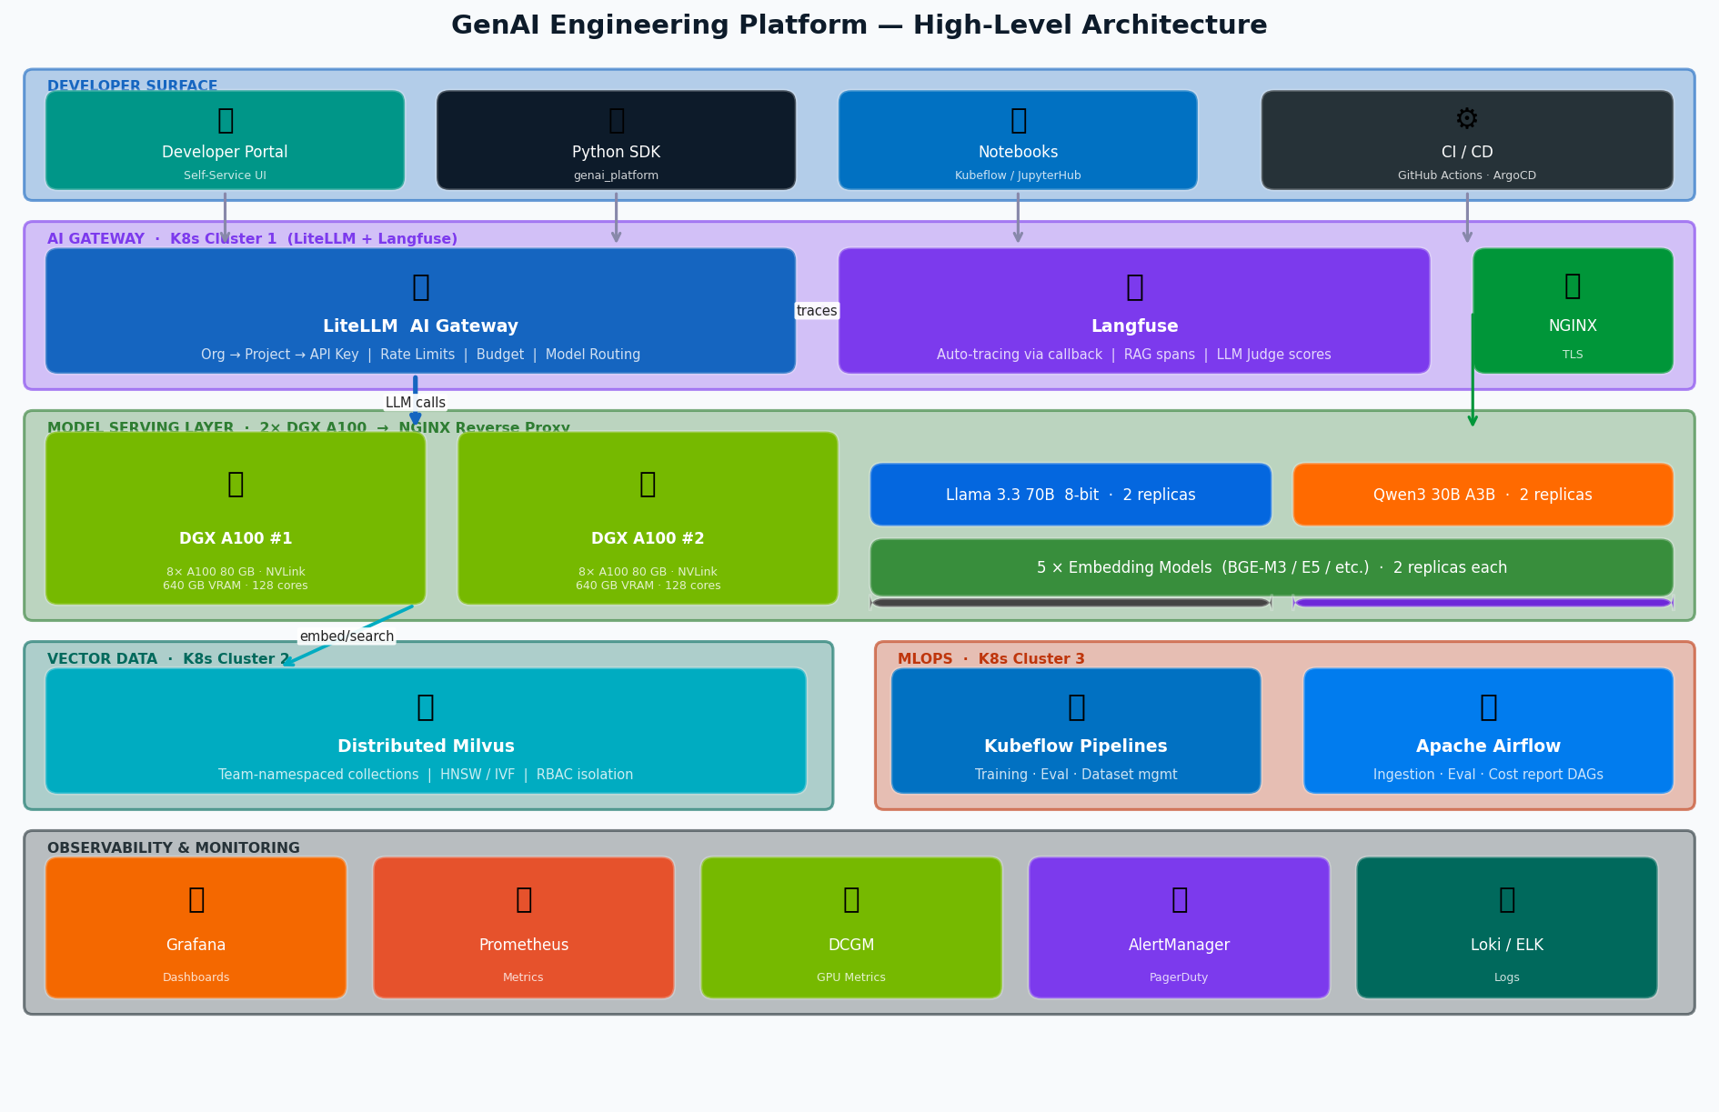
High-Level Architecture
Five-layer platform overview — infrastructure to developer surface
GenAI Engineering Platform
11 / 34

Slide 12
03
Data & MLOps
Layer
Milvus vector DB · Kubeflow pipelines · Apache Airflow · Namespace isolation
GenAI Engineering Platform
12 / 34

Slide 13
Milvus — Distributed Vector Database
K8s Cluster 2 · Team-namespaced collections · HNSW & IVF indexes · RBAC
Namespace Isolation Model
Index Configurations
team_<slug>_<env>_<collection_name>
HNSW
search-team
RBAC: isolated credentials
Dense semantic search Best recall, higher mem nlist=1024, ef=200
team_search_prod_knowledge_base
IVF_FLAT
Large-scale retrieval Lower mem, fast nlist=4096
team_search_dev_knowledge_base
team_search_prod_products
DISKANN
Billion-scale vectors Disk-based index For very large corpora
reco-team
RBAC: isolated credentials
team_reco_prod_user_interactions
Chunking Strategy by Doc Type
team_reco_dev_catalog
Dense Prose
512 tokens, 10% overlap, recursive char split
Source Code
AST-based, function/class boundaries
finance-team
RBAC: isolated credentials
team_finance_prod_reports
Tables
Row-level + header injection
team_finance_prod_policies
Long Docs
Hierarchical: parent + child chunks (parent doc retrieval pattern)
GenAI Engineering Platform
13 / 34

Slide 14
MLOps Platform — Kubeflow + Airflow
K8s Cluster 3 · Pipeline templates · Scheduled DAGs · Eval automation
Kubeflow Pipelines
Airflow DAGs
RAG Eval Benchmark
ingestion_dag
Trigger: PR merge / weekly
@daily or event
LLM judge scores → Langfuse datasets Regression alert if p50 drops >10%
scrape → chunk → embed → upsert → log
Fine-Tuning Pipeline
eval_dag
Trigger: manual / data drift
@weekly + post-deploy
Model artifact → internal registry GPU: 4×A100, ~6h
fetch traces → LLM judge → write scores → alert
Dataset Curation
cost_report_dag
Trigger: Airflow → Kubeflow
@weekly (Monday)
Dedup + quality filter → Langfuse datasets
pull LiteLLM usage → aggregate → dashboard
Embed Model Compare
index_health_dag
Trigger: manual
@hourly
Recall@k report across 5 embedding models
check Milvus segment health → alert on drift
Kubeflow for GPU-heavy ML workflows · Airflow for data pipelines with complex scheduling dependencies
GenAI Engineering Platform
14 / 34

Slide 15
04
Data Flow
Diagrams
LLM request journey · RAG query pipeline · Document ingestion · Async evaluation
GenAI Engineering Platform
15 / 34

Slide 16
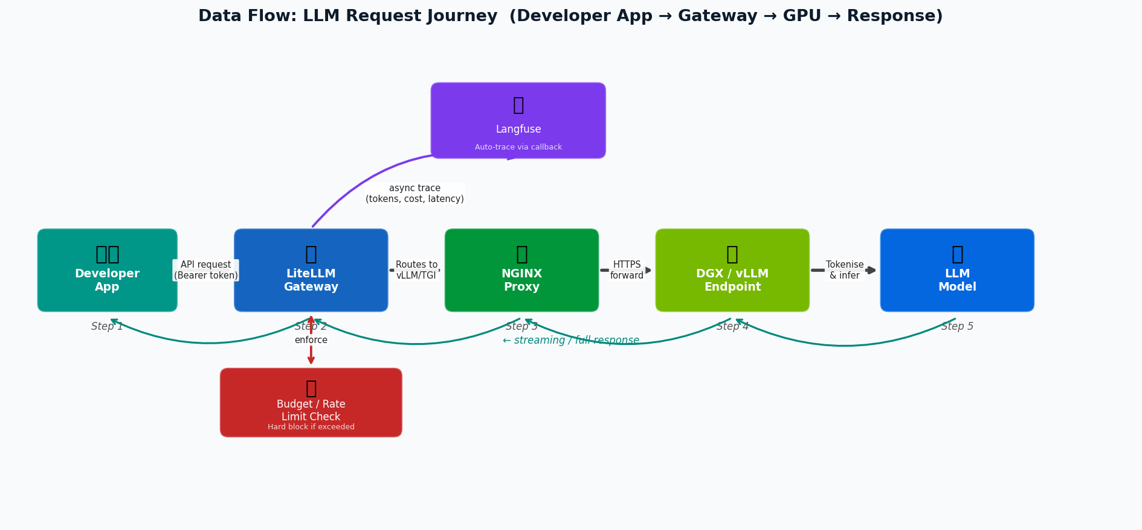
Data Flow: LLM Request Journey
Developer app → LiteLLM → NGINX → vLLM → streaming response
GenAI Engineering Platform
16 / 34

Slide 17
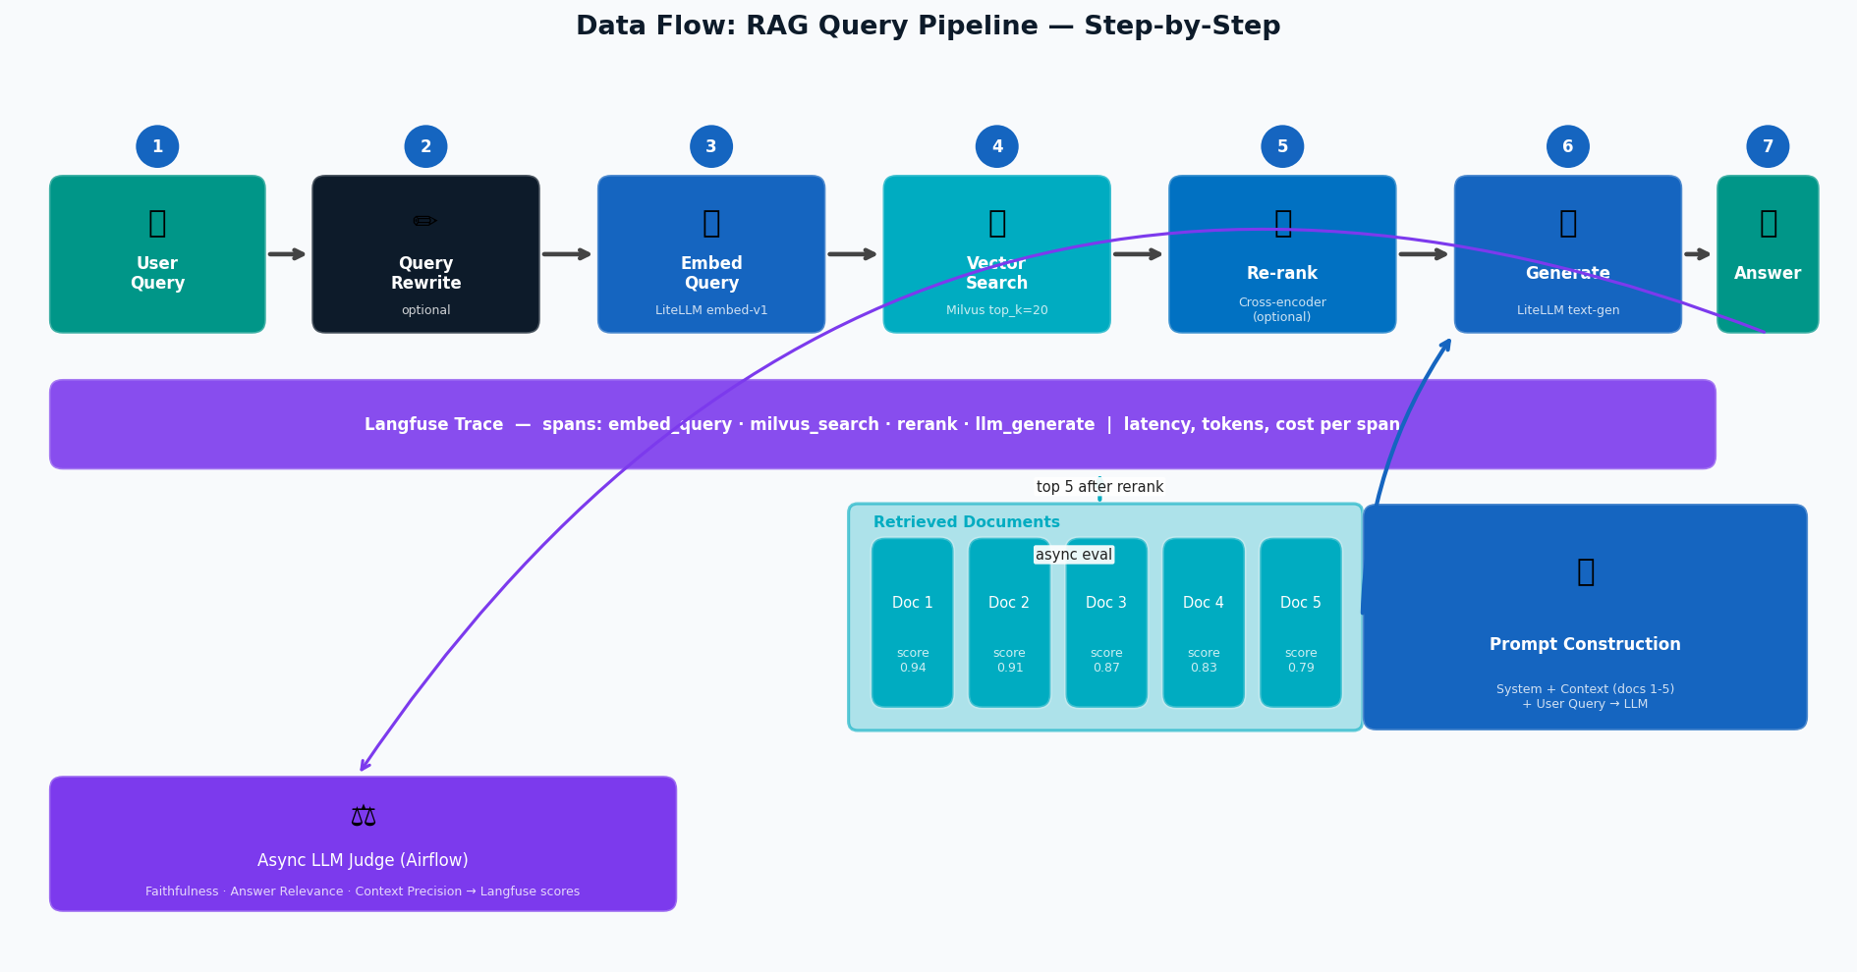
Data Flow: RAG Query Pipeline
7-step pipeline with Langfuse tracing and async LLM judge evaluation
GenAI Engineering Platform
17 / 34

Slide 18
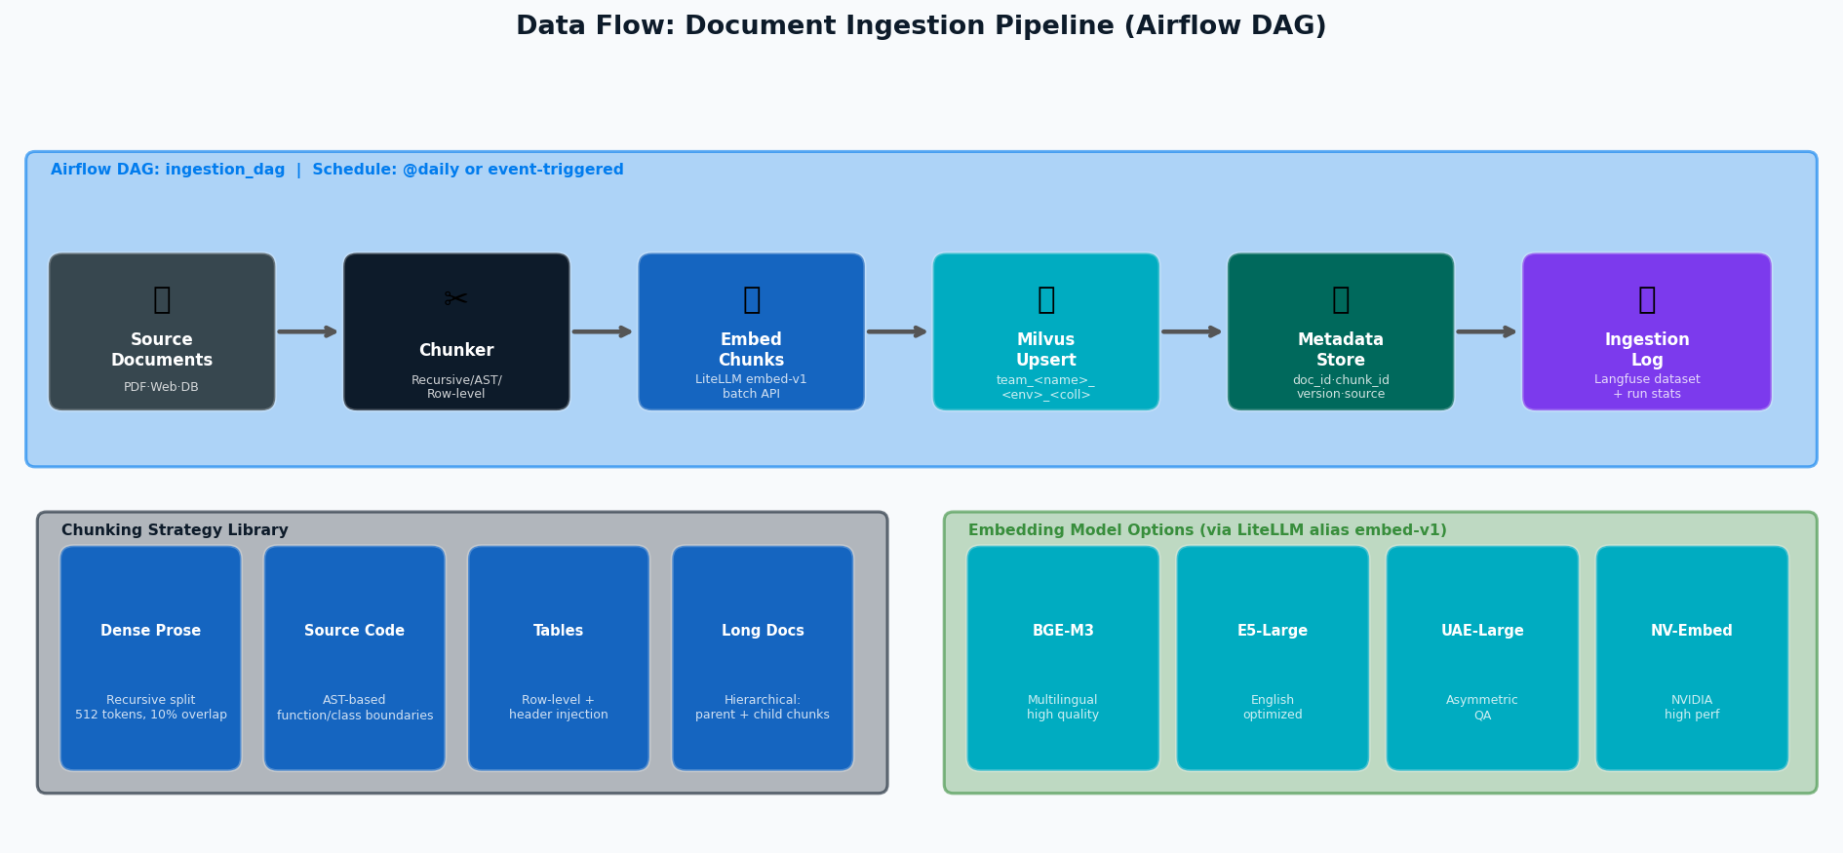
Data Flow: Document Ingestion Pipeline
Airflow DAG — source docs → chunk → embed → Milvus upsert
GenAI Engineering Platform
18 / 34

Slide 19
Tenant Onboarding — Step by Step
New team onboarded in under 15 minutes via self-service portal
1
Visit Portal
2
Create Org
3
Create Project
4
Get API Key
developer.genai.internal Select "New Team Onboard"
Team slug created in LiteLLM eg: org=search-team
App/environment scope eg: project=doc-search-prod
LiteLLM key issued + budget + model allowlist
5
Milvus NS
6
Kubeflow Profile
7
SDK Install
8
First Trace
team_search_prod_* namespace + RBAC credentials issued
K8s namespace + RBAC + GPU quota assigned
pip install genai_platform Includes LiteLLM + observe
Make first LLM call Verify in Langfuse dashboard
Step 1-4: LiteLLM + Langfuse · Step 5: Milvus · Step 6: Kubeflow · Step 7-8: Dev SDK · Total time: < 15 minutes
GenAI Engineering Platform
19 / 34

Slide 20
05
RAG End-to-End
Architecture
Indexing · Query · Evaluation — complete reference stack with zero-config observability
GenAI Engineering Platform
20 / 34

Slide 21
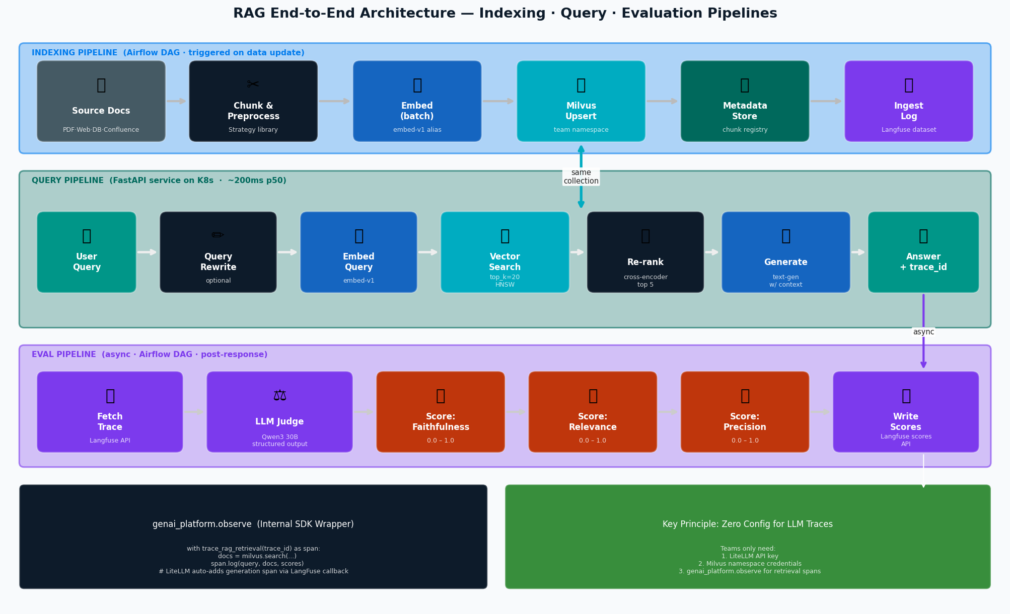
RAG Architecture — Full Stack
Indexing · Query · Evaluation pipelines with observability wired throughout
GenAI Engineering Platform
21 / 34

Slide 22
RAG: Indexing Pipeline — Deep Dive
Airflow DAG triggered on data update · configurable chunking · batch embedding
Supported Source Connectors
Confluence
SharePoint
PostgreSQL
REST API
S3 / GCS
GitHub
Wiki & docs
Enterprise docs
Structured data
Web content
File uploads
Code + READMEs
GenAI Engineering Platform
22 / 34

Slide 23
RAG: Query Pipeline — Step by Step
7 numbered steps with latency targets and Langfuse span coverage
Latency Budget (p50 targets)
Query Rewrite
Embed Query
Vector Search
Re-rank
LLM Generate
Total (typical)
~80ms
~15ms
~10ms
~120ms
~800ms
~200ms
optional, Llama 3.3
single vector, batch possible
HNSW index, top_k=20
cross-encoder, top 5
streaming, first token ~200ms
w/o rewrite; ~280ms with rewrite
GenAI Engineering Platform
23 / 34

Slide 24
RAG: LLM Judge Evaluation Pipeline
Qwen3 30B as async evaluator · 3 eval dimensions · scores in Langfuse
Faithfulness
Answer Relevance
Context Precision
Does the answer follow only from the retrieved context? No hallucinations beyond what the docs support.
Does the answer actually address what the user asked? Not just topically related — directly responsive.
Were the retrieved chunks actually relevant and used? Penalizes irrelevant context pollution.
Input: context + answer Output: score 0-1 + explanation
Input: question + answer Output: score 0-1 + explanation
Input: question + context chunks Output: score 0-1 per chunk
Evaluator Model: Qwen3 30B A3B (MoE — only ~3B active params → low inference cost) · Async via Airflow · Scores written to Langfuse Scores API
Example Eval Output (one trace)
{ "trace_id": "tr_a1b2c3d4", "scores": { "faithfulness": { "value": 0.87, "comment": "Answer supported by chunk 1 and 3; minor extrapolation in sentence 2" }, "answer_relevance": { "value": 0.91, "comment": "Directly addresses question about pricing tiers" }, "context_precision": { "value": 0.79, "comment": "Chunk 4 (unrelated FAQ) retrieved but not used — reduce top_k" } } }
GenAI Engineering Platform
24 / 34

Slide 25
Internal SDK — genai_platform
Thin wrapper: retrieval spans for Langfuse + LiteLLM integration
What the SDK provides
SDK Responsibilities
# pip install genai_platform from genai_platform.observe import trace_rag_retrieval from genai_platform.client import get_llm_client # LiteLLM client pre-configured with team's API key client = get_llm_client() # reads GENAI_API_KEY env var # Wrap retrieval in a Langfuse span with trace_rag_retrieval(session_id="sess-001") as span: query_vec = client.embed("embed-v1", user_query) docs = milvus.search( collection="team_search_prod_kb", vectors=query_vec, top_k=10 ) span.log( query=user_query, results=docs, # ids + scores + payloads collection="team_search_prod_kb", ) # LiteLLM adds generation span automatically response = client.chat( model="text-gen", # alias, never changes messages=build_prompt(docs, user_query), trace_id=span.trace_id # stitches spans together )
+ Create Langfuse trace + retrieval span
+ Log query, docs, scores to span
+ Pass trace_id to LiteLLM call
+ LiteLLM adds generation span (auto)
+ Scores added async by eval pipeline
What teams DON'T need to do
- Import Langfuse SDK directly
- Configure Langfuse credentials
- Handle LLM auth or routing
- Implement cost tracking
- Build evaluation pipeline
- Manage model versions
GenAI Engineering Platform
25 / 34

Slide 26
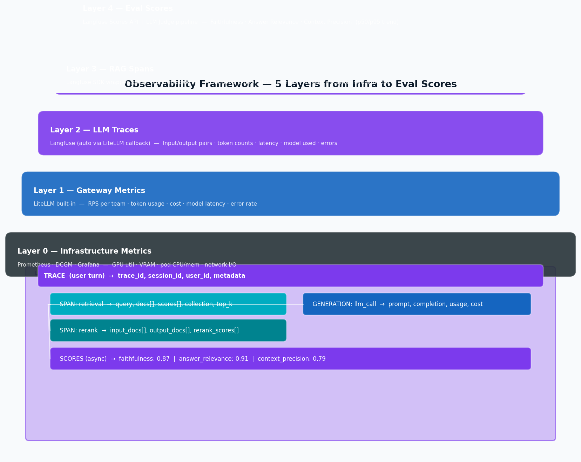
Observability Framework
Five layers from GPU metrics to LLM eval scores
GenAI Engineering Platform
26 / 34

Slide 27
06
Governance
& Roadmap
Access control · Cost governance · Data policies · Model lifecycle · 16-week delivery plan
GenAI Engineering Platform
27 / 34

Slide 28
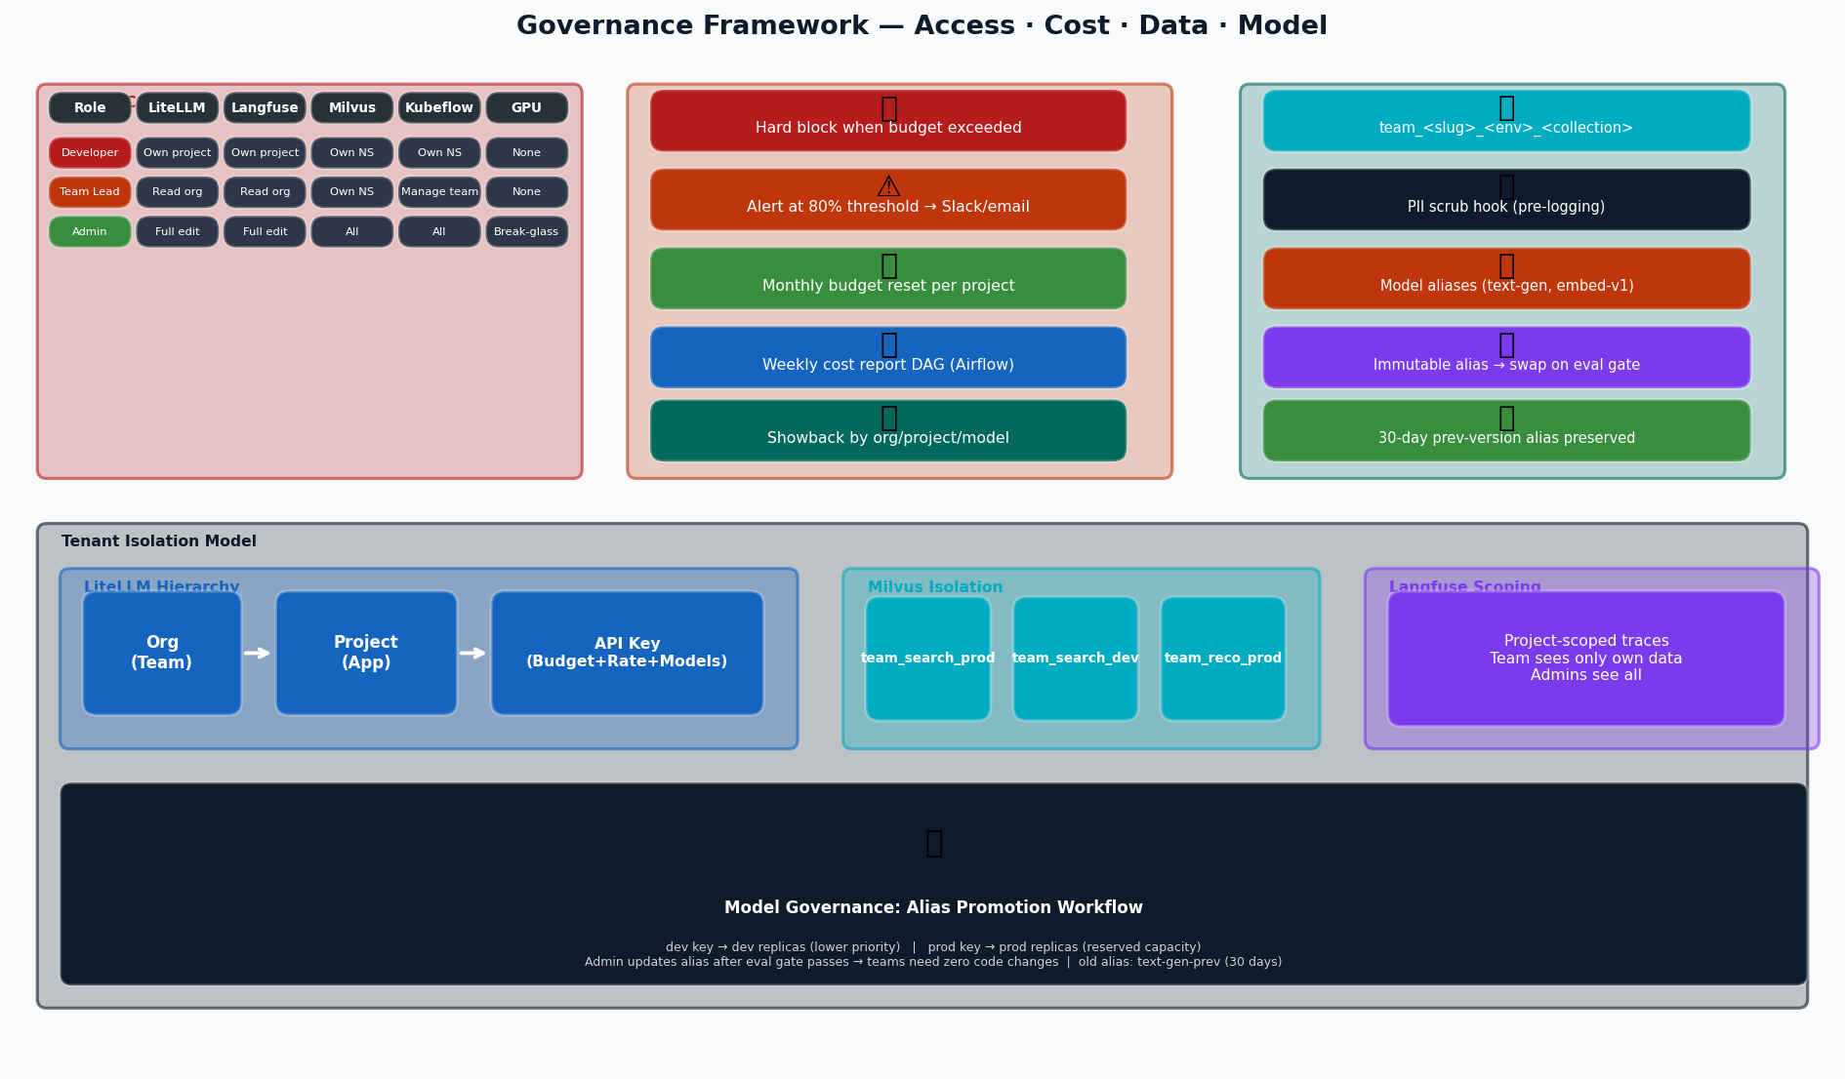
Governance Framework
Access control · Cost & budget · Data governance · Model lifecycle
GenAI Engineering Platform
28 / 34

Slide 29
Access Control — RBAC Matrix
Role-based access across all platform systems
Role
LiteLLM
Langfuse
Milvus
Kubeflow
DGX/GPU
Developer
Read own project
Read own project
Own namespace only
Own namespace
None
Team Lead
Read org-wide
Read org-wide
Own namespace + creds
Manage team NS
None
Platform Admin
Full edit + config
Full edit + config
All namespaces
All namespaces
Break-glass SSH
CI/CD SA
Create API keys
No access
Own namespace
Deploy workloads
None
Model Access Tiers
Tier 1 — All Teams
embed-*, text-gen (Llama 3.3)
No approval needed — default allocation
→ No approval needed
Tier 2 — Approved Teams
reasoning (Qwen3 30B)
Business justification + admin approval required
→ Business justification + admin approval required
Tier 3 — Platform Admin
Direct NGINX endpoints
Break-glass debugging only, fully audited
→ Break-glass debugging only, fully audited
GenAI Engineering Platform
29 / 34

Slide 30
Cost & Budget Governance
Per-team budgets, hard limits, automated showback reports
Budget Enforcement Flow
API Request
Check Budget
Hard Block
Soft Alert
Log & Trace
Weekly Report
Team calls LiteLLM with API key
Current spend vs project hard cap
Request rejected if cap exceeded
Slack/email at 80% threshold
Token usage logged to Langfuse + DB
Airflow DAG aggregates spend
→
→
→
→
→
LiteLLM Budget Config (per project)
Weekly Showback Report (Airflow DAG)
litellm_settings: default_team_settings: max_budget: 500 # USD/month soft_budget: 400 # 80% alert max_parallel_requests: 20 tpm_limit: 100000 rpm_limit: 200 team_overrides: team_finance: # sensitive, lower limit max_budget: 200 team_search: # high-traffic team max_budget: 1000 rpm_limit: 500
Team
Model
Requests
Tokens
Cost USD
search-team
text-gen
12,450
8.2M
$82.00
search-team
embed-v1
45,000
18.5M
$9.25
reco-team
text-gen
3,200
2.1M
$21.00
finance-team
reasoning
890
1.4M
$28.00
TOTAL
—
61,540
30.2M
$140.25
GenAI Engineering Platform
30 / 34

Slide 31
Data & Model Governance
PII scrubbing · Milvus RBAC · Model aliases · Promotion workflow
Data Governance
Model Alias Promotion Workflow
Milvus namespace: team_<slug>_<env>_<collection> Cross-team reads require admin approval + read-only creds No team can delete another team's collection Retention policy: 90 days for non-prod, indefinite for prod
1
Admin deploys new model version
New replica on DGX, new internal endpoint
2
Point staging alias
text-gen-staging → new model
3
Run eval benchmark (Kubeflow)
Must pass: faithfulness p50 > 0.80 no regression vs text-gen-prev
PII Scrubbing
4
2-week team notification
Teams notified: alias re-pointing in 14 days
Pre-call hook in LiteLLM before logging to Langfuse Regex + NER-based entity detection Configurable per org (finance = stricter rules) Redacted as [REDACTED:<entity_type>]
5
Admin updates live alias
text-gen → new model (zero app changes for teams)
6
Old alias preserved 30 days
text-gen-prev → old model for rollback window
GenAI Engineering Platform
31 / 34

Slide 32
Key Design Decisions
Architectural choices and their rationale
LiteLLM as sole LLM entry point
Langfuse via callback, not SDK
Single choke point for cost, rate limits, auth, tracing
LiteLLM callback = zero instrumentation for LLM calls
Impact: Teams cannot route around governance; all spend visible
Impact: RAG spans need thin wrapper only; not two SDKs
Model aliases not model IDs
Qwen3 30B as LLM judge
Teams call "text-gen" not "llama-3.3-70b"
MoE: only ~3B active params → cheap inference
Impact: Admin can upgrade model with zero app code changes
Impact: Smart enough for structured eval; ~10× cheaper than dense 30B
Async eval, not inline
Milvus namespace isolation
Sync eval adds 2-5s per request
Not separate clusters per team
Impact: Run out-of-band; score p50/p95 trends over time
Impact: Cost-efficient; RBAC handles multi-tenancy; operationally feasible
Airflow + Kubeflow split
Dev/prod key separation
Airflow for data pipelines; Kubeflow for GPU ML
Dev keys → lower priority replicas
Impact: Each tool in its strength zone; shared K8s Cluster 3
Impact: Prod workloads have reserved capacity; dev cannot starve prod
GenAI Engineering Platform
32 / 34

Slide 33
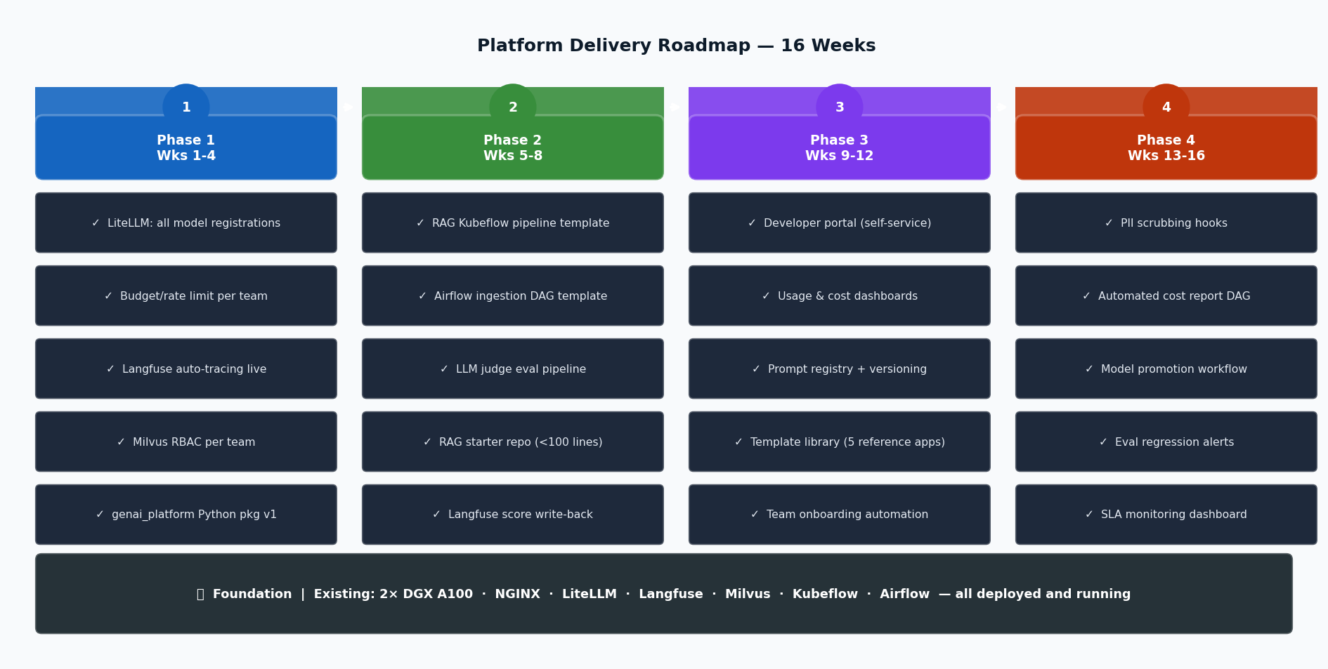
Platform Delivery Roadmap
16 weeks · 4 phases · 50+ developers productive from Week 8
GenAI Engineering Platform
33 / 34

Slide 34
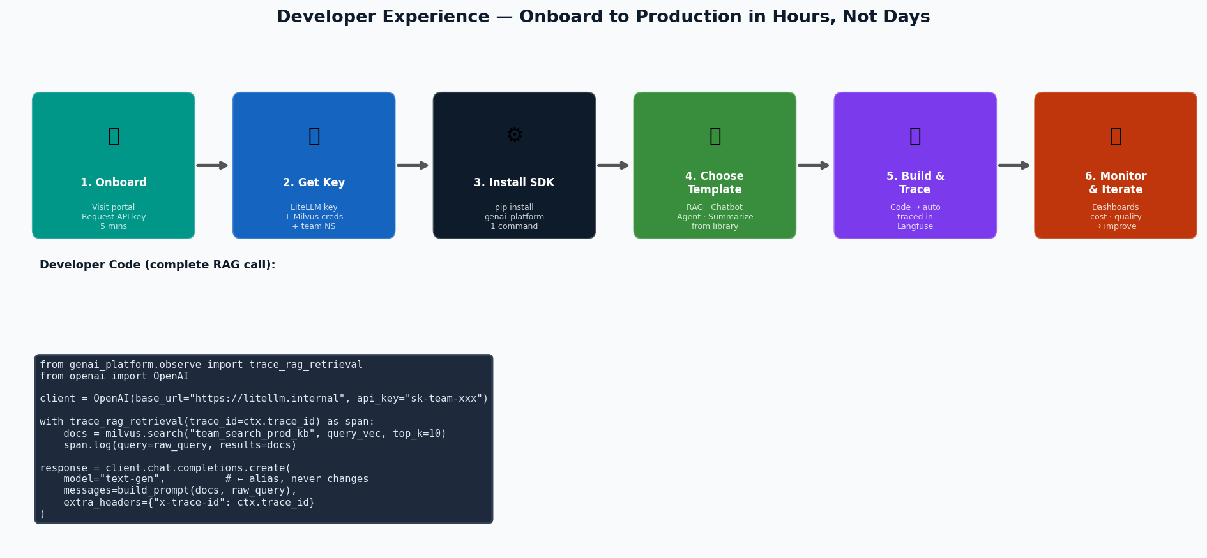
Developer Experience
Onboard to production in hours, not days
GenAI Engineering Platform
34 / 34

Slide 35
Success Metrics & KPIs
How we measure platform health and developer productivity
Platform Adoption
Observability
Teams onboarded
Trace coverage
≥ 10 teams by Week 8
100% of LLM calls traced
Active API keys
RAG span coverage
> 80 keys in use by Week 16
> 80% of RAG pipelines
LLM calls/day
Eval score coverage
> 10,000 by Week 12
p50/p95 for all prod apps
Quality
Cost Governance
RAG faithfulness p50
Budget overruns
> 0.80 across all teams
Zero budget surprises
Answer relevance p50
Cost attribution
> 0.75 across all teams
100% spend allocated to team
Regression detection
Cost/query trend
< 48h to detect quality drop
Decreasing over model upgrades
GenAI Engineering Platform
35 / 34

Slide 36
Thank You
Questions & Discussion
2× DGX A100 (16 GPUs) → NGINX → LiteLLM → Langfuse → Milvus → Kubeflow
Unified AI gateway: every LLM call governed, traced, and cost-attributed automatically
RAG reference stack: Airflow ingest + Kubeflow eval + LLM judge scores in Langfuse
16-week delivery roadmap: Phase 1 (infra) → Phase 2 (RAG) → Phase 3 (portal) → Phase 4 (governance)
Platform Architecture Review · May 2026
GenAI Engineering Platform
36 / 36

