Slide 1
Retail Sales Dashboard using Tableau
Data Analytics Internship Project
By Manish Kumar Gangala

Slide 2
Objective : To analyze retail sales data and derive business insights
Tool: Tableau (Interactive Dashboard)
Dataset: Kaggle Retail Sales (Demographics + Transactions)
Deliverables: Dashboard + PPT Summary + GitHub Repo

Slide 3
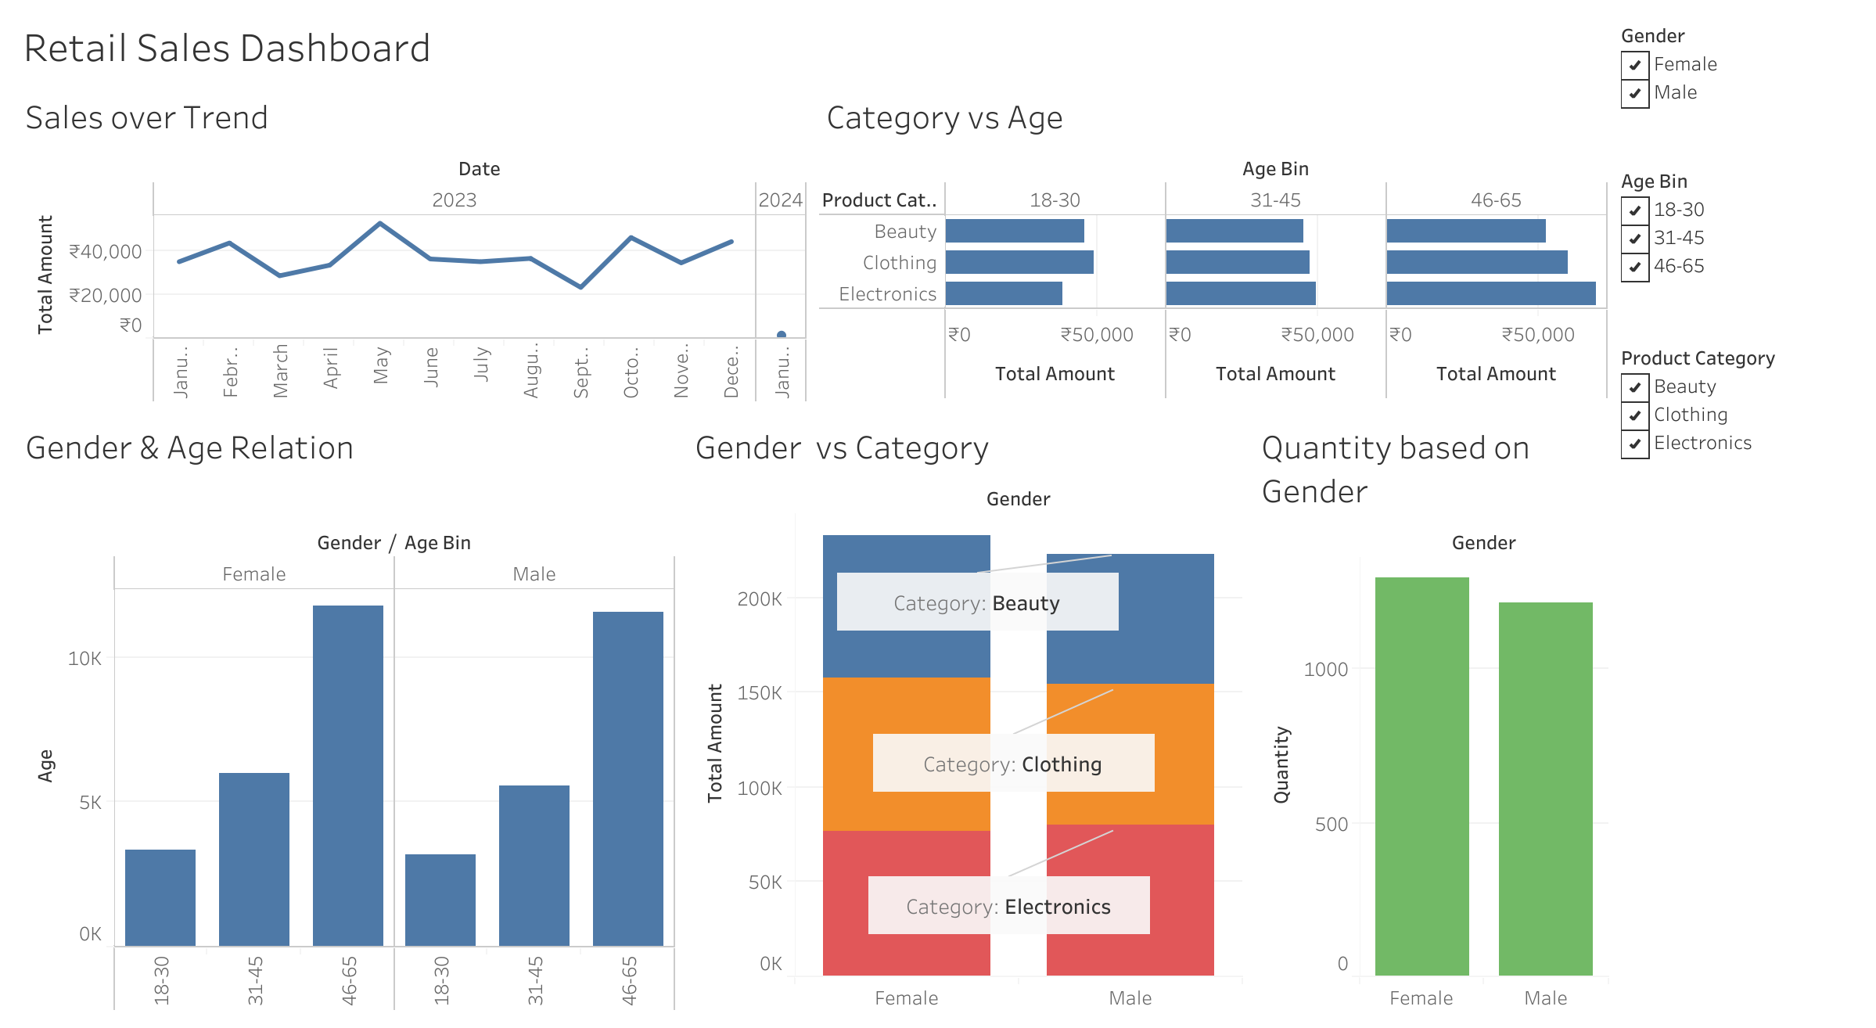

Slide 4
Key Insights
Sales peaked in May (₹53,150) and October (₹46,580); lowest in September (₹23,620).
Age Preferences: 18–30 → Clothing & Beauty; 31–45 → balanced; 46–65 → Electronics & Clothing.
Gender Preferences: Women spend more overall; dominate Beauty category (₹75K vs ₹68K).
Demographics: Highest customers from 46–65, lowest from 18–30

Slide 5
Conclusion
Women and middle-aged customers are core drivers of sales.
Electronics and Clothing categories attract wider age groups, while Beauty is female-dominated.
Seasonal peaks suggest opportunities for targeted promotions in May & October.
The dashboard enables quick exploration of sales by demographics and category for better decision-making.

