Slide 1
What is Software Engineering?
The term software engineering is the product of two words, software, and engineering.
The software is a collection of integrated programs.
Software subsists of carefully-organized instructions and code written by developers on any of various particular computer languages.
Computer programs and related documentation such as requirements, design models and user manuals.
Engineering is the application of scientific and practical knowledge to invent, design, build, maintain, and improve frameworks, processes, etc.

Slide 2
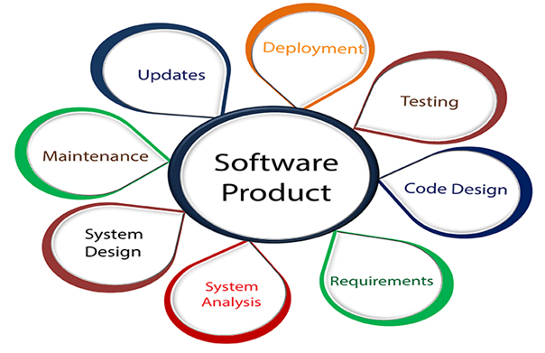

Slide 3
Software Engineering is an engineering branch related to the evolution of software product using well-defined scientific principles, techniques, and procedures. The result of software engineering is an effective and reliable software product.
Why is Software Engineering required?
Software Engineering is required due to the following reasons:
To manage Large software
For more Scalability
Cost Management
To manage the dynamic nature of software
For better quality Management

Slide 4
Need of Software Engineering
The necessity of software engineering appears because of a higher rate of progress in user requirements and the environment on which the program is working.
Huge Programming: It is simpler to manufacture a wall than to a house or building, similarly, as the measure of programming become extensive engineering has to step to give it a scientific process.
Adaptability: If the software procedure were not based on scientific and engineering ideas, it would be simpler to re-create new software than to scale an existing one.
Cost: As the hardware industry has demonstrated its skills and huge manufacturing has let down the cost of computer and electronic hardware. But the cost of programming remains high if the proper process is not adapted.
Dynamic Nature: The continually growing and adapting nature of programming hugely depends upon the environment in which the client works. If the quality of the software is continually changing, new upgrades need to be done in the existing one.
Quality Management: Better procedure of software development provides a better and quality software product.

Slide 5
Architectural design is a process for identifying the sub-systems making up a system and the framework for sub-system control and communication. The output of this design process is a description of the software architecture. Architectural design is an early stage of the system design process. It represents the link between specification and design processes and is often carried out in parallel with some specification activities. It involves identifying major system components and their communications.
Software architectures can be designed at two levels of abstraction:
Architecture in the small is concerned with the architecture of individual programs. At this level, we are concerned with the way that an individual program is decomposed into components.
Architecture in the large is concerned with the architecture of complex enterprise systems that include other systems, programs, and program components. These enterprise systems are distributed over different computers, which may be owned and managed by different companies.
Three advantages of explicitly designing and documenting software architecture:
Stakeholder communication: Architecture may be used as a focus of discussion by system stakeholders.
System analysis: Well-documented architecture enables the analysis of whether the system can meet its non-functional requirements.
Large-scale reuse: The architecture may be reusable across a range of systems or entire lines of products.

Slide 6
Uses of architectural models:
As a way of facilitating discussion about the system design
A high-level architectural view of a system is useful for communication with system stakeholders and project planning because it is not cluttered with detail. Stakeholders can relate to it and understand an abstract view of the system. They can then discuss the system as a whole without being confused by detail.
As a way of documenting an architecture that has been designed
The aim here is to produce a complete system model that shows the different components in a system, their interfaces and their connections.
Architectural design decisions
Architectural design is a creative process so the process differs depending on the type of system being developed. However, a number of common decisions span all design processes and these decisions affect the non-functional characteristics of the system:
Is there a generic application architecture that can be used?
How will the system be distributed?
What architectural styles are appropriate?
What approach will be used to structure the system?
How will the system be decomposed into modules?
What control strategy should be used?
How will the architectural design be evaluated?
How should the architecture be documented?

Slide 7
Architectural views
Each architectural model only shows one view or perspective of the system. It might show how a system is decomposed into modules, how the run-time processes interact or the different ways in which system components are distributed across a network. For both design and documentation, you usually need to present multiple views of the software architecture.
4+1 view model of software architecture:
A logical view, which shows the key abstractions in the system as objects or object classes.
A process view, which shows how, at run-time, the system is composed of interacting processes.
A development view, which shows how the software is decomposed for development.
A physical view, which shows the system hardware and how software components are distributed across the processors in the system.
Related using use cases or scenarios (+1).

Slide 8
Architectural patterns
Patterns are a means of representing, sharing and reusing knowledge. An architectural pattern is a stylized description of a good design practice, which has been tried and tested in different environments. Patterns should include information about when they are and when the are not useful. Patterns may be represented using tabular and graphical descriptions.
Model-View-Controller

Slide 9
The use of architectural styles is to establish a structure for all the components of the system.
Taxonomy of Architectural styles:
Data centred architectures:
A data store will reside at the center of this architecture and is accessed frequently by the other components that update, add, delete or modify the data present within the store.
The figure illustrates a typical data centered style. The client software access a central repository. Variation of this approach are used to transform the repository into a blackboard when data related to client or data of interest for the client change the notifications to client software.
This data-centered architecture will promote integrability. This means that the existing components can be changed and new client components can be added to the architecture without the permission or concern of other clients.
Data can be passed among clients using blackboard mechanism.

Slide 10
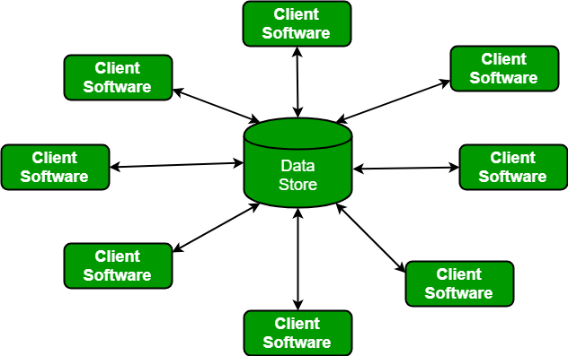

Slide 11
Data flow architectures:This kind of architecture is used when input data to be transformed into output data through a series of computational manipulative components.
The figure represents pipe-and-filter architecture since it uses both pipe and filter and it has a set of components called filters connected by pipes.
Pipes are used to transmit data from one component to the next.
Each filter will work independently and is designed to take data input of a certain form and produces data output to the next filter of a specified form. The filters don’t require any knowledge of the working of neighboring filters.
If the data flow degenerates into a single line of transforms, then it is termed as batch sequential. This structure accepts the batch of data and then applies a series of sequential components to transform it.

Slide 12
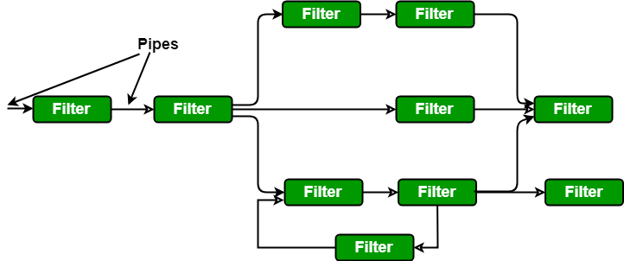

Slide 13
Call and Return architectures: It is used to create a program that is easy to scale and modify. Many sub-styles exist within this category. Two of them are explained below.Remote procedure call architecture: This components is used to present in a main program or sub program architecture distributed among multiple computers on a network.
Main program or Subprogram architectures: The main program structure decomposes into number of subprograms or function into a control hierarchy. Main program contains number of subprograms that can invoke other components.

Slide 14
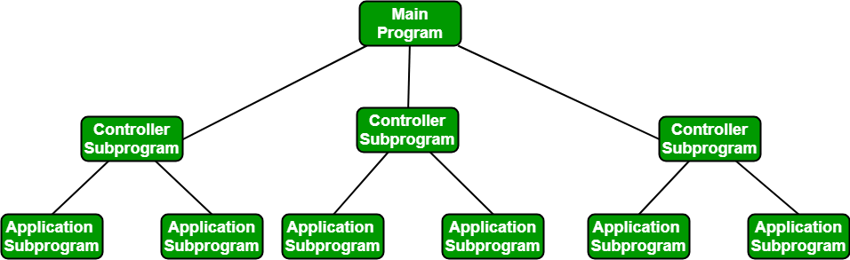

Slide 15
Object Oriented architecture: The components of a system encapsulate data and the operations that must be applied to manipulate the data. The coordination and communication between the components are established via the message passing.
Layered architecture:
A number of different layers are defined with each layer performing a well-defined set of operations. Each layer will do some operations that becomes closer to machine instruction set progressively.
At the outer layer, components will receive the user interface operations and at the inner layers, components will perform the operating system interfacing(communication and coordination with OS)
Intermediate layers to utility services and application software functions.

Slide 16
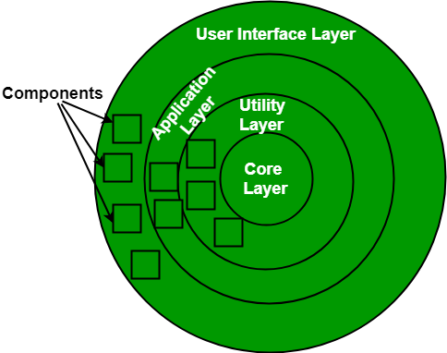

Slide 17
Software Testing Strategies
Software Testing is a type of investigation to find out if there is any default or error present in the software so that the errors can be reduced or removed to increase the quality of the software and to check whether it fulfills the specifies requirements or not. According to Glen Myers, software testing has the following objectives:
The process of investigating and checking a program to find whether there is an error or not and does it fulfill the requirements or not is called testing.
When the number of errors found during the testing is high, it indicates that the testing was good and is a sign of good test case.
Finding an unknown error that’s wasn’t discovered yet is a sign of a successful and a good test case.

Slide 18
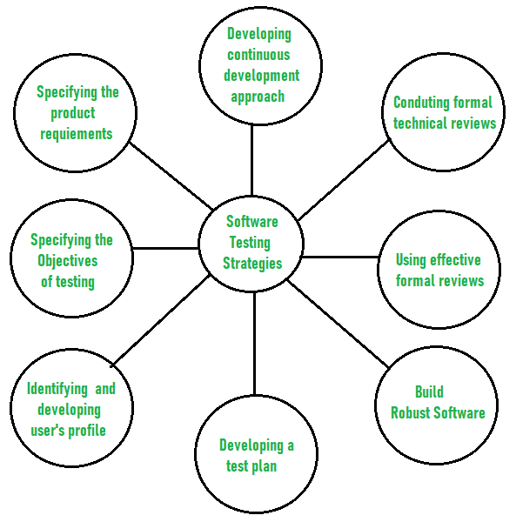
The main objective of software testing is to design the tests in such a way that it systematically finds different types of errors without taking much time and effort so that less time is required for the development of the software.
The overall strategy for testing software includes:

Slide 19
Before testing starts, it’s necessary to identify and specify the requirements of the product in a quantifiable manner. Different characteristics quality of the software is there such as maintainability that means the ability to update and modify, the probability that means to find and estimate any risk, and usability that means how it can easily be used by the customers or end-users. All these characteristic qualities should be specified in a particular order to obtain clear test results without any error.
Specifying the objectives of testing in a clear and detailed manner. Several objectives of testing are there such as effectiveness that means how effectively the software can achieve the target, any failure that means inability to fulfill the requirements and perform functions, and the cost of defects or errors that mean the cost required to fix the error. All these objectives should be clearly mentioned in the test plan.

Slide 20
For the software, identifying the user’s category and developing a profile for each user. Use cases describe the interactions and communication among different classes of users and the system to achieve the target. So as to identify the actual requirement of the users and then testing the actual use of the product.
Developing a test plan to give value and focus on rapid-cycle testing. Rapid Cycle Testing is a type of test that improves quality by identifying and measuring the any changes that need to be required for improving the process of software. Therefore, a test plan is an important and effective document that helps the tester to perform rapid cycle testing.

Slide 21
Robust software is developed that is designed to test itself. The software should be capable of detecting or identifying different classes of errors. Moreover, software design should allow automated and regression testing which tests the software to find out if there is any adverse or side effect on the features of software due to any change in code or program.
Before testing, using effective formal reviews as a filter. Formal technical reviews is technique to identify the errors that are not discovered yet. The effective technical reviews conducted before testing reduces a significant amount of testing efforts and time duration required for testing software so that the overall development time of software is reduced.
Conduct formal technical reviews to evaluate the nature, quality or ability of the test strategy and test cases. The formal technical review helps in detecting any unfilled gap in the testing approach. Hence, it is necessary to evaluate the ability and quality of the test strategy and test cases by technical reviewers to improve the quality of software.

Slide 22
For the testing process, developing a approach for the continuous development. As a part of a statistical process control approach, a test strategy that is already measured should be used for software testing to measure and control the quality during the development of software.
Software Testing | Security Testing
Security Testing is a type of Software Testing that uncovers vulnerabilities of the system and determines that the data and resources of the system are protected from possible intruders. It ensures that the software system and application are free from any threats or risks that can cause a loss. Security testing of any system is focuses on finding all possible loopholes and weaknesses of the system which might result into the loss of information or repute of the organization.
Goal of Security Testing: The goal of security testing is to:
To identify the threats in the system.
To measure the potential vulnerabilities of the system.
To help in detecting every possible security risks in the system.
To help developers in fixing the security problems through coding.

Slide 23
Principle of Security Testing: Below are the six basic principles of security testing:
Confidentiality
Integrity
Authentication
Authorization
Availability
Non-repudiation
Major Focus Areas in Security Testing:
Network Security
System Software Security
Client-side Application Security
Server-side Application Security

Slide 24
Types of Security Testing:
Vulnerability Scanning: Vulnerability scanning is performed with the help of automated software to scan a system to detect the known vulnerability patterns.
Security Scanning: Security scanning is the identification of network and system weaknesses. Later on it provides solutions for reducing these defects or risks. Security scanning can be carried out in both manual and automated way.
Penetration Testing: Penetration testing is the simulation of the attack from a malicious hacker. It includes analysis of a particular system to examine for potential vulnerabilities from a malicious hacker that attempts to hack the system.
Risk Assessment: In risk assessment testing security risks observed in the organization are analysed. Risks are classified into three categories i.e. low, medium and high. This testing endorses controls and measures to minimize the risk.

Slide 25
Security Auditing: Security auditing is an internal inspection of applications and operating systems for security defects. An audit can also be carried out via line by line checking of code.
Ethical Hacking: Ethical hacking is different from malicious hacking. The purpose of ethical hacking is to expose security flaws in the organization system.
Posture Assessment: It combines security scanning, ethical hacking and risk assessments to provide an overall security posture of an organization.

Slide 26
Types of Software Testing
Introduction:-
Testing is a process of executing a program with the aim of finding error. To make our software perform well it should be error free.If testing is done successfully it will remove all the errors from the software.
Principles of Testing:-
(i) All the test should meet the customer requirements (ii) To make our software testing should be performed by third party (iii) Exhaustive testing is not possible.As we need the optimal amount of testing based on the risk assessment of the application. (iv) All the test to be conducted should be planned before implementing it (v) It follows pareto rule(80/20 rule) which states that 80% of errors comes from 20% of program components. (vi) Start testing with small parts and extend it to large parts.

Slide 27
Types of Testing:-
1. Unit Testing
It focuses on smallest unit of software design. In this we test an individual unit or group of inter related units.It is often done by programmer by using sample input and observing its corresponding outputs.
Example:
a) In a program we are checking if loop, method or
function is working fine
b) Misunderstood or incorrect, arithmetic precedence.
c) Incorrect initialization

Slide 28
2. Integration Testing
The objective is to take unit tested components and build a program structure that has been dictated by design.Integration testing is testing in which a group of components are combined to produce output.
Integration testing is of four types: (i) Top down (ii) Bottom up (iii) Sandwich (iv) Big-Bang
Example
(a) Black Box testing:- It is used for validation.
In this we ignore internal working mechanism and
focuse on what is the output?.
(b) White Box testing:- It is used for verification.
In this we focus on internal mechanism i.e.
how the output is achieved?

Slide 29
3. Regression Testing
Every time new module is added leads to changes in program. This type of testing make sure that whole component works properly even after adding components to the complete program.
Example
In school record suppose we have module staff, students
and finance combining these modules and checking if on
integration these module works fine is regression testing

Slide 30
4. Smoke Testing
This test is done to make sure that software under testing is ready or stable for further testing
It is called smoke test as testing initial pass is done to check if it did not catch the fire or smoked in the initial switch on.
Example:
If project has 2 modules so before going to module
make sure that module 1 works properly

Slide 31
5. Alpha Testing
This is a type of validation testing.It is a type of acceptance testing which is done before the product is released to customers. It is typically done by QA people.
Example:
When software testing is performed internally within
the organization

Slide 32
6. Beta Testing
The beta test is conducted at one or more customer sites by the end-user of the software. This version is released for the limited number of users for testing in real time environment
Example:
When software testing is performed for the limited
number of people

Slide 33
7. System Testing
In this software is tested such that it works fine for different operating system.It is covered under the black box testing technique. In this we just focus on required input and output without focusing on internal working.
In this we have security testing, recovery testing , stress testing and performance testing
Example:
This include functional as well as non functional
testing

Slide 34
8. Stress Testing
In this we gives unfavorable conditions to the system and check how they perform in those condition.
Example:
(a) Test cases that require maximum memory or other
resources are executed
(b) Test cases that may cause thrashing in a virtual
operating system
(c) Test cases that may cause excessive disk requirement

Slide 35
9. Performance Testing
It is designed to test the run-time performance of software within the context of an integrated system.It is used to test speed and effectiveness of program. It is also called load testing. In it we check , what is the performance of the system in the given load.
Example:
Checking number of processor cycles.

Slide 36
Software Engineering | Seven Principles of software testing
Software testing is a process of executing a program with the aim of finding the error. To make our software perform well it should be error free. If testing is done successfully it will remove all the errors from the software.
There are seven principles in software testing:
Testing shows presence of defects
Exhaustive testing is not possible
Early testing
Defect clustering
Pesticide paradox
Testing is context dependent
Absence of errors fallacy

Slide 37
Testing shows presence of defects: The goal of software testing is to make the software fail. Software testing reduces the presence of defects. Software testing talks about the presence of defects and doesn’t talk about the absence of defects. Software testing can ensure that defects are present but it can not prove that software is defects free. Even multiple testing can never ensure that software is 100% bug-free. Testing can reduce the number of defects but not removes all defects.
2) Exhaustive testing is not possible: It is the process of testing the functionality of a software in all possible inputs (valid or invalid) and pre-conditions is known as exhaustive testing. Exhaustive testing is impossible means the software can never test at every test cases. It can test only some test cases and assume that software is correct and it will produce the correct output in every test cases. If the software will test every test cases then it will take more cost, effort, etc. and which is impractical.

Slide 38
3) Early Testing: To find the defect in the software, early test activity shall be started. The defect detected in early phases of SDLC will very less expensive. For better performance of software, software testing will start at initial phase i.e. testing will perform at the requirement analysis phase.
4) Defect clustering: In a project, a small number of the module can contain most of the defects. Pareto Principle to software testing state that 80% of software defect comes from 20% of modules.
5) Pesticide paradox: Repeating the same test cases again and again will not find new bugs. So it is necessary to review the test cases and add or update test cases to find new bugs.

Slide 39
6) Testing is context dependent: Testing approach depends on context of software developed. Different types of software need to perform different types of testing. For example, The testing of the e-commerce site is different from the testing of the Android application.
7) Absence of errors fallacy: If a built software is 99% bug-free but it does not follow the user requirement then it is unusable. It is not only necessary that software is 99% bug-free but it also mandatory to fulfill all the customer requirements.

Slide 40
Software Engineering | Black box testing
Last Updated: 30-04-2019
Prerequisite – Software Testing | Basics
Black box testing is a type of software testing in which the functionality of the software is not known. The testing is done without the internal knowledge of the products.
Black box testing can be done in following ways:
1. Syntax Driven Testing – This type of testing is applied to systems that can be syntactically represented by some language. For example- compilers,language that can be represented by context free grammar. In this, the test cases are generated so that each grammar rule is used at least once.
2. Equivalence partitioning – It is often seen that many type of inputs work similarly so instead of giving all of them separately we can group them together and test only one input of each group. The idea is to partition the input domain of the system into a number of equivalence classes such that each member of class works in a similar way, i.e., if a test case in one class results in some error, other members of class would also result into same error.

Slide 41
The technique involves two steps:
Identification of equivalence class – Partition any input domain into minimum two sets: valid values and invalid values. For example, if the valid range is 0 to 100 then select one valid input like 49 and one invalid like 104.
Generating test cases –
(i) To each valid and invalid class of input assign unique identification number.
(ii) Write test case covering all valid and invalid test case considering that no two invalid inputs mask each other.

Slide 42
To calculate the square root of a number, the equivalence classes will be: (a) Valid inputs:
Whole number which is a perfect square- output will be an integer.
Whole number which is not a perfect square- output will be decimal number.
Positive decimals
(b) Invalid inputs:
Negative numbers(integer or decimal).
Characters other that numbers like “a”,”!”,”;”,etc.

Slide 43
3. Boundary value analysis – Boundaries are very good places for errors to occur. Hence if test cases are designed for boundary values of input domain then the efficiency of testing improves and probability of finding errors also increase. For example – If valid range is 10 to 100 then test for 10,100 also apart from valid and invalid inputs.
4. Cause effect Graphing – This technique establishes relationship between logical input called causes with corresponding actions called effect. The causes and effects are represented using Boolean graphs. The following steps are followed:
Identify inputs (causes) and outputs (effect).
Develop cause effect graph.
Transform the graph into decision table.
Convert decision table rules to test cases.

Slide 44
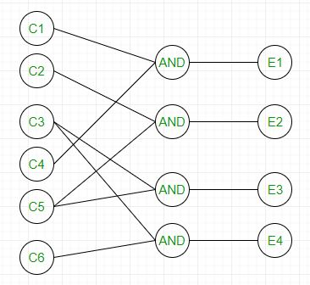

Slide 45
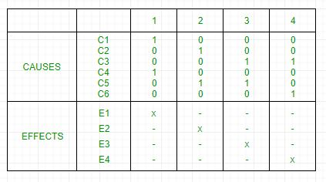
It can be converted into decision table like:

Slide 46
Each column corresponds to a rule which will become a test case for testing. So there will be 4 test cases.
5. Requirement based testing – It includes validating the requirements given in SRS of software system.
6. Compatibility testing – The test case result not only depend on product but also infrastructure for delivering functionality. When the infrastructure parameters are changed it is still expected to work properly. Some parameters that generally affect compatibility of software are:
Processor (Pentium 3,Pentium 4) and number of processors.
Architecture and characteristic of machine (32 bit or 64 bit).
Back-end components such as database servers.
Operating System (Windows, Linux, etc).

Slide 47
Software Engineering | White box Testing
Prerequisite – Software Testing | Basics
White box testing techniques analyze the internal structures the used data structures, internal design, code structure and the working of the software rather than just the functionality as in black box testing. It is also called glass box testing or clear box testing or structural testing.
Working process of white box testing:
Input: Requirements, Functional specifications, design documents, source code.
Processing: Performing risk analysis for guiding through the entire process.
Proper test planning: Designing test cases so as to cover entire code. Execute rinse-repeat until error-free software is reached. Also, the results are communicated.
Output: Preparing final report of the entire testing process.

Slide 48
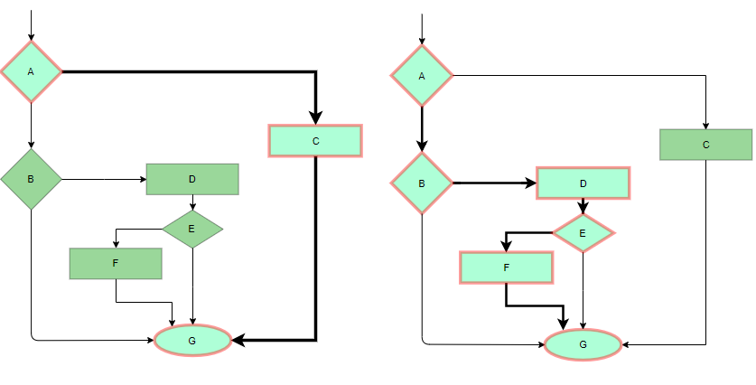
Testing techniques:
Statement coverage: In this technique, the aim is to traverse all statement at least once. Hence, each line of code is tested. In case of a flowchart, every node must be traversed at least once. Since all lines of code are covered, helps in pointing out faulty code.
Statement Coverage Example

Slide 49
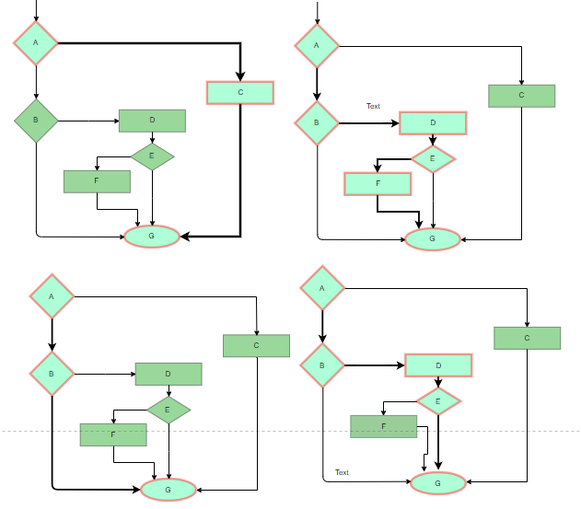
Branch Coverge: In this technique, test cases are designed so that each branch from all decision points are traversed at least once. In a flowchart, all edges must be traversed at least once.
4 test cases required such that all branches of all decisions are covered, i.e, all edges of flowchart are covered

Slide 50
Condition Coverage: In this technique, all individual conditions must be covered as shown in the following example:
READ X, Y
IF(X == 0 || Y == 0)
PRINT ‘0’
In this example, there are 2 conditions: X == 0 and Y == 0. Now, test these conditions get TRUE and FALSE as their values. One possible example would be:
#TC1 – X = 0, Y = 55
#TC2 – X = 5, Y = 0
Multiple Condition Coverage: In this technique, all the possible combinations of the possible outcomes of conditions are tested at least once. Let’s consider the following example:
READ X, Y
IF(X == 0 || Y == 0)
PRINT ‘0’
#TC1: X = 0, Y = 0
#TC2: X = 0, Y = 5
#TC3: X = 55, Y = 0
#TC4: X = 55, Y = 5
Hence, four test cases required for two individual conditions. Similarly, if there are n conditions then 2^{n} test cases would be required.

Slide 51
Basis Path Testing: In this technique, control flow graphs are made from code or flowchart and then Cyclomatic complexity is calculated which defines the number of independent paths so that the minimal number of test cases can be designed for each independent path. Steps:Make the corresponding control flow graph
Calculate the cyclomatic complexity
Find the independent paths
Design test cases corresponding to each independent path
Flow graph notation: It is a directed graph consisting of nodes and edges. Each node represents a sequence of statements, or a decision point. A predicate node is the one that represents a decision point that contains a condition after which the graph splits. Regions are bounded by nodes and edges.

Slide 52
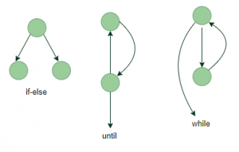

Slide 53
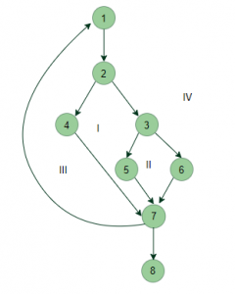
Cyclomatic Complexity: It is a measure of the logical complexity of the software and is used to define the number of independent paths. For a graph G, V(G) is its cyclomatic complexity.
Calculating V(G):
V(G) = P + 1, where P is the number of predicate nodes in the flow graph
V(G) = E – N + 2, where E is the number of edges and N is the total number of nodes
V(G) = Number of non-overlapping regions in the graph
Example:

Slide 54
V(G) = 4 (Using any of the above formulae) No of independent paths = 4
#P1: 1 – 2 – 4 – 7 – 8
#P2: 1 – 2 – 3 – 5 – 7 – 8
#P3: 1 – 2 – 3 – 6 – 7 – 8
#P4: 1 – 2 – 4 – 7 – 1 – . . . – 7 – 8
Loop Testing: Loops are widely used and these are fundamental to many algorithms hence, their testing is very important. Errors often occur at the beginnings and ends of loops.
Simple loops: For simple loops of size n, test cases are designed that:
Skip the loop entirely
Only one pass through the loop
2 passes
m passes, where m < n
n-1 ans n+1 passes
Nested loops: For nested loops, all the loops are set to their minimum count and we start from the innermost loop. Simple loop tests are conducted for the innermost loop and this is worked outwards till all the loops have been tested.
Concatenated loops: Independent loops, one after another. Simple loop tests are applied for each. If they’re not independent, treat them like nesting.

Slide 55
Advantages:
White box testing is very thorough as the entire code and structures are tested.
It results in the optimization of code removing error and helps in removing extra lines of code.
It can start at an earlier stage as it doesn’t require any interface as in case of black box testing.
Easy to automate.
Disadvantages:
Main disadvantage is that it is very expensive.
Redesign of code and rewriting code needs test cases to be written again.
Testers are required to have in-depth knowledge of the code and programming language as opposed to black box testing.
Missing functionalities cannot be detected as the code that exists is tested.
Very complex and at times not realistic.

Slide 56
Software Engineering | Debugging
Introduction: In the context of software engineering, debugging is the process of fixing a bug in the software. In other words, it refers to identifying, analyzing and removing errors. This activity begins after the software fails to execute properly and concludes by solving the problem and successfully testing the software. It is considered to be an extremely complex and tedious task because errors need to be resolved at all stages of debugging.
Debugging Process: Steps involved in debugging are:
Problem identification and report preparation.
Assigning the report to software engineer to the defect to verify that it is genuine.
Defect Analysis using modeling, documentations, finding and testing candidate flaws, etc.
Defect Resolution by making required changes to the system.
Validation of corrections.

Slide 57
Debugging Strategies:
Study the system for the larger duration in order to understand the system. It helps debugger to construct different representations of systems to be debugging depends on the need. Study of the system is also done actively to find recent changes made to the software.
Backwards analysis of the problem which involves tracing the program backward from the location of failure message in order to identify the region of faulty code. A detailed study of the region is conducting to find the cause of defects.
Forward analysis of the program involves tracing the program forwards using breakpoints or print statements at different points in the program and studying the results. The region where the wrong outputs are obtained is the region that needs to be focused to find the defect.
Using the past experience of the software debug the software with similar problems in nature. The success of this approach depends on the expertise of the debugger.

Slide 58
Debugging Tools: Debugging tool is a computer program that is used to test and debug other programs. A lot of public domain software like gdb and dbx are available for debugging. They offer console-based command line interfaces. Examples of automated debugging tools include code based tracers, profilers, interpreters, etc. Some of the widely used debuggers are:
Radare2
WinDbg
Valgrind
Difference Between Debugging and Testing: Debugging is different from testing. Testing focuses on finding bugs, errors, etc whereas debugging starts after a bug has been identified in the software. Testing is used to ensure that the program is correct and it was supposed to do with a certain minimum success rate. Testing can be manual or automated. There are several different types of testing like unit testing, integration testing, alpha and beta testing, etc. Debugging requires a lot of knowledge, skills, and expertise. It can be supported by some automated tools available but is more of a manual process as every bug is different and requires a different technique, unlike a pre-defined testing mechanism.

Slide 59
Software Metrics
A software metric is a measure of software characteristics which are measurable or countable. Software metrics are valuable for many reasons, including measuring software performance, planning work items, measuring productivity, and many other uses.
Within the software development process, many metrics are that are all connected. Software metrics are similar to the four functions of management: Planning, Organization, Control, or Improvement.
Classification of Software Metrics
Software metrics can be classified into two types as follows:
1. Product Metrics: These are the measures of various characteristics of the software product. The two important software characteristics are:
Size and complexity of software.
Quality and reliability of software.
These metrics can be computed for different stages of SDLC.
2. Process Metrics: These are the measures of various characteristics of the software development process. For example, the efficiency of fault detection. They are used to measure the characteristics of methods, techniques, and tools that are used for developing software.

Slide 60
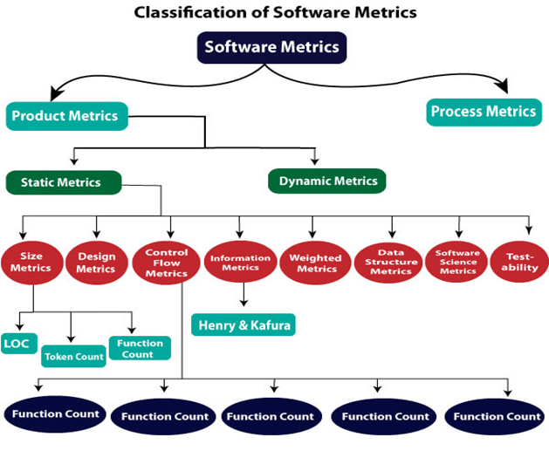

Slide 61
Types of Metrics
Internal metrics: Internal metrics are the metrics used for measuring properties that are viewed to be of greater importance to a software developer. For example, Lines of Code (LOC) measure.
External metrics: External metrics are the metrics used for measuring properties that are viewed to be of greater importance to the user, e.g., portability, reliability, functionality, usability, etc.
Hybrid metrics: Hybrid metrics are the metrics that combine product, process, and resource metrics. For example, cost per FP where FP stands for Function Point Metric.
Project metrics: Project metrics are the metrics used by the project manager to check the project's progress. Data from the past projects are used to collect various metrics, like time and cost; these estimates are used as a base of new software. Note that as the project proceeds, the project manager will check its progress from time-to-time and will compare the effort, cost, and time with the original effort, cost and time. Also understand that these metrics are used to decrease the development costs, time efforts and risks. The project quality can also be improved. As quality improves, the number of errors and time, as well as cost required, is also reduced.

Slide 62
Advantage of Software Metrics
Comparative study of various design methodology of software systems.
For analysis, comparison, and critical study of different programming language concerning their characteristics.
In comparing and evaluating the capabilities and productivity of people involved in software development.
In the preparation of software quality specifications.
In the verification of compliance of software systems requirements and specifications.
In making inference about the effort to be put in the design and development of the software systems.
In getting an idea about the complexity of the code.
In taking decisions regarding further division of a complex module is to be done or not.
In guiding resource manager for their proper utilization.
In comparison and making design tradeoffs between software development and maintenance cost.
In providing feedback to software managers about the progress and quality during various phases of the software development life cycle.
In the allocation of testing resources for testing the code.

Slide 63
Disadvantage of Software Metrics
The application of software metrics is not always easy, and in some cases, it is difficult and costly.
The verification and justification of software metrics are based on historical/empirical data whose validity is difficult to verify.
These are useful for managing software products but not for evaluating the performance of the technical staff.
The definition and derivation of Software metrics are usually based on assuming which are not standardized and may depend upon tools available and working environment.
Most of the predictive models rely on estimates of certain variables which are often not known precisely.

Slide 64
Size Oriented Metrics
LOC Metrics
It is one of the earliest and simpler metrics for calculating the size of the computer program. It is generally used in calculating and comparing the productivity of programmers. These metrics are derived by normalizing the quality and productivity measures by considering the size of the product as a metric.
Following are the points regarding LOC measures:
In size-oriented metrics, LOC is considered to be the normalization value.
It is an older method that was developed when FORTRAN and COBOL programming were very popular.
Productivity is defined as KLOC / EFFORT, where effort is measured in person-months.
Size-oriented metrics depend on the programming language used.
As productivity depends on KLOC, so assembly language code will have more productivity.
LOC measure requires a level of detail which may not be practically achievable.
The more expressive is the programming language, the lower is the productivity.
LOC method of measurement does not apply to projects that deal with visual (GUI-based) programming. As already explained, Graphical User Interfaces (GUIs) use forms basically. LOC metric is not applicable here.
It requires that all organizations must use the same method for counting LOC. This is so because some organizations use only executable statements, some useful comments, and some do not. Thus, the standard needs to be established.
These metrics are not universally accepted.

Slide 65
Based on the LOC/KLOC count of software, many other metrics can be computed:
Errors/KLOC.
$/ KLOC.
Defects/KLOC.
Pages of documentation/KLOC.
Errors/PM.
Productivity = KLOC/PM (effort is measured in person-months).
$/ Page of documentation.
Advantages of LOC
Simple to measure
Disadvantage of LOC
It is defined on the code. For example, it cannot measure the size of the specification.
It characterizes only one specific view of size, namely length, it takes no account of functionality or complexity
Bad software design may cause an excessive line of code
It is language dependent
Users cannot easily understand it

Slide 66
Halstead's Software Metrics
According to Halstead's "A computer program is an implementation of an algorithm considered to be a collection of tokens which can be classified as either operators or operand."
Token Count
In these metrics, a computer program is considered to be a collection of tokens, which may be classified as either operators or operands. All software science metrics can be defined in terms of these basic symbols. These symbols are called as a token.
The basic measures are
n1 = count of unique operators. n2 = count of unique operands. N1 = count of total occurrences of operators. N2 = count of total occurrence of operands.
In terms of the total tokens used, the size of the program can be expressed as N = N1 + N2.

Slide 67
Halstead metrics are:
Program Volume (V)
The unit of measurement of volume is the standard unit for size "bits." It is the actual size of a program if a uniform binary encoding for the vocabulary is used.
V=N*log₂n
Program Level (L)
The value of L ranges between zero and one, with L=1 representing a program written at the highest possible level (i.e., with minimum size).
L=V*/V
Program Difficulty
The difficulty level or error-proneness (D) of the program is proportional to the number of the unique operator in the program.
D= (n1/2) * (N2/n2)
Programming Effort (E)
The unit of measurement of E is elementary mental discriminations.
E=V/L=D*V

Slide 68
Potential Minimum Volume
The potential minimum volume V* is defined as the volume of the most short program in which a problem can be coded.
V* = (2 + n2*) * log₂ (2 + n2*)
Here, n2* is the count of unique input and output parameters
Size of Vocabulary (n)
The size of the vocabulary of a program, which consists of the number of unique tokens used to build a program, is defined as:
n=n1+n2
where
n=vocabulary of a program n1=number of unique operators n2=number of unique operands
Language Level - Shows the algorithm implementation program language level. The same algorithm demands additional effort if it is written in a low-level program language. For example, it is easier to program in Pascal than in Assembler.
L' = V / D / D lambda = L * V* = L² * V

Slide 69
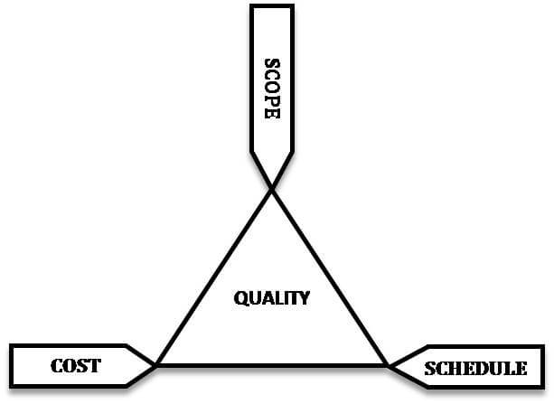
Software Testing Metrics
Software Testing Metrics are the quantitative measures used to estimate the progress, quality, productivity and health of the software testing process. The goal of software testing metrics is to improve the efficiency and effectiveness in the software testing process and to help make better decisions for further testing process by providing reliable data about the testing process.
A Metric defines in quantitative terms the degree to which a system, system component, or process possesses a given attribute. The ideal example to understand metrics would be a weekly mileage of a car compared to its ideal mileage recommended by the manufacturer.

Slide 70
What are the maintenance metrics?
There are two categories of maintenance key performance indicators which include the leading and lagging indicators. The leading indicators signal future events and the lagging indicators follow the past events.
The leading indicator comprises from metrics like the Estimated vs actual performance and PM Compliance, while the lagging indicatorare reflected in maintenance metrics like the Mean Time To Repair (MTTR) , Overall Equipment Effectiveness OEE and Mean time between failure (MTBF).
Using these maintenance metrics and turning the data into actionable information, organizations can acquire both qualitative and quantitative insights.
And there is no better way to spot opportunities for improvement.
Here are some important maintenance metrics you should track if you want to improve and optimize your maintenance operations.

Slide 71
1. Planned maintenance percentage (PPC)
This metrics represents the percentage of time spent on planned maintenance activities against the unplanned.
In simpler terms, this metric tells you how much maintenance work done on a particular asset was a part of your preventive maintenance plan versus how much time you’ve spent repairing it because it unexpectedly broke down.
In a great system, 90% of the maintenance should be planned.
The calculation is as follows:
PPC= (scheduled maintenance time/total maintenance hours) x 100
2. Overall Equipment Effectiveness (OEE) OEE is the measure of the productivity of a piece of equipment. It gives informed data on how effective organization’s maintenance processes is running based on factors like equipment quality, performance, and availability.
A 100% OEE means that your system is producing no defects, as fast as possible, and with no stops in the production.
understanding OEE and the underlying losses , organizations can gain significant insights into how to improve their manufacturing processes. Using this metric, you can identify what has a negative impact on your production, so you can eliminate it.

Slide 72
3. Mean time to repair (MTTR)
MTTR is the measure of the repairable items maintainability.
The MTTR clock starts ticking when the repairs start and it goes on until operations are restored. This includes repair time, testing period, and return to the normal operating condition.
The goal of every organizations is to reduce MTTR as much as possible. This is especially important for critical assets as ever additional hour you need to restore an asset to a working condition amount to huge losses for your firm.
To calculate MTTR, you divide the downtime period by the total number of downtimes:
MTTR= (SUM of downtime periods/ total number of repairs)
4. Mean time between failure (MTBF)
MTBF is the measure of the predicted time between one breakdown to the next during normal operation.
In essence, MTBF tells you the expected lifetime for a specific piece of equipment. Higher MTBF means that the part (or product) you bought will work longer before it experiences failure.
If you know how long a specific part/equipment will last, it gets much easier to predict and prepare for a failure or schedule some preventive work.
To calculate the MTBF, you divide the total operational time by the number of failures:
MTBF= (SUM of operational time/total number of failures)

Slide 73
5. Preventive maintenance compliance (PMC)
PM compliance is defined as the percentage of the preventive work scheduled and completed in a set time.
For example, you might have 60 Work Orders (that are a part of the PM plan) scheduled but 51 completed at the end of the month.
In this case:
PMC= (51/60) x 100 = 85%
This tells you that 85% of all preventive WO’s have been covered for selected month.
The disadvantage of this metric is that it doesn’t tell you if the WO’s have been completed on time.
That is why you need to invest some additional effort and also track if the Work Orders are actually being finished on time.
By fat the best way to do that is to use a CMMS as it allows you to quickly create, assign, and track all of your WO’s from one place.
Conclusion
The best way to track if your actions have a positive impact on your maintenance operations is to accurately track metrics that can show you if you are going in the right direction.
Improvements based on your “feeling” can never be as good as relying on hard data.

Slide 74
Software Measurement: A measurement is an manifestation of the size, quantity, amount or dimension of a particular attributes of a product or process. Software measurement is a titrate impute of a characteristic of a software product or the software process. It is an authority within software engineering. Software measurement process is defined and governed by ISO Standard.
Need of Software Measurement: Software is measured to:
Create the quality of the current product or process.
Anticipate future qualities of the product or process.
Enhance the quality of a product or process.
Regulate the state of the project in relation to budget and schedule.
Classification of Software Measurement: There are 2 types of software measurement:
Direct Measurement: In direct measurement the product, process or thing is measured directly using standard scale.
Indirect Measurement: In indirect measurement the quantity or quality to be measured is measured using related parameter i.e. by use of reference.

Slide 75
Measuring Software Quality using Quality Metrics
In Software Engineering, Software Measurement is done based on some Software Metrics where these software metrics are referred as the measure of various characteristics of a Software.
In Software engineering Software Quality Assurance (SAQ) assures the quality in the software. Set of activities in SAQ are continuously applied through out the software process. Software Quality is measured based on some software quality metrics.
There is a number of metrics available based on which software quality is measured. But among them there are few most useful metrics which are most essential in software quality measurement. They are –
Code Quality
Reliability
Performance
Usability
Correctness
Maintainability
Integrity
Security

Slide 76
Now let’s understand each quality metrics in detail –
1. Code Quality – Code quality metrics measure the quality of code used for the software project development. Maintaining the software code quality by writing Bug-free and semantically correct code is very important for a good software project development. In code quality both Quantitative metrics like number of lines, complexity, functions, rate of bugs generation etc and Qualitative metrics like readability, code clarity, efficiency, maintainability etc are measured.
2. Reliability – Reliability metrics measure what is the software of software in different conditions. The software is able to provide exact service in the right time or not is checked. Reliability can be checked using Mean Time Between Failure (MTBF) and Mean Time To Repair (MTTR).
3. Performance – Performance metrics are used to measure the performance of a software. Each software has been developed for some specific purposes. Performance metrics measures the performance of the software by determining whether the software is fulfilling the user requirements or not, by analyzing how much time and resource it is utilizing for providing the service.

Slide 77
4. Usability – Usability metrics checks whether the program is user friendly or not. Each software is used by the end user. So it is important to measure that the end user is happy or not by using this software.
5. Correctness – Correctness is one of the important software quality metric as this checks whether the system or software is working correctly without any error by satisfying the user. Correctness gives the degree of service each function provides as per developed.
6. Maintainability – Each software product requires maintenance and up gradation. Maintenance is an expensive and time consuming process. So if the software product provides easy maintainability then we can say software quality is up to mark. Maintainability metrics include time requires to adapt to a new features/functionality, Mean Time to Change (MTTC), performance in changed environments etc.
7. Integrity – Software integrity is important in terms of how much it is easy to integrate with other required software’s which increases software functionality and what is the control on integration from unauthorized software’s which increases the chances of cyber attacks.
8. Security – Security metrics measures how much secure the software is ? In the age of cyber terrorism, security is the most essential part of every software. Security assures that there no unauthorized changes, no fear of cyber attacks etc when the software product is in use by the end user.

Slide 78
UNIT IV - RISK MANAGEMENT
What is Risk?
"Tomorrow problems are today's risk." Hence, a clear definition of a "risk" is a problem that could cause some loss or threaten the progress of the project, but which has not happened yet.
These potential issues might harm cost, schedule or technical success of the project and the quality of our software device, or project team morale.
Risk Management is the system of identifying addressing and eliminating these problems before they can damage the project.
We need to differentiate risks, as potential issues, from the current problems of the project.
Different methods are required to address these two kinds of issues.
For example, staff storage, because we have not been able to select people with the right technical skills is a current problem, but the threat of our technical persons being hired away by the competition is a risk.

Slide 79
Risk Management
A software project can be concerned with a large variety of risks. In order to be adept to systematically identify the significant risks which might affect a software project, it is essential to classify risks into different classes. The project manager can then check which risks from each class are relevant to the project.
There are three main classifications of risks which can affect a software project:
Project risks
Technical risks
Business risks
1. Project risks: Project risks concern differ forms of budgetary, schedule, personnel, resource, and customer-related problems. A vital project risk is schedule slippage. Since the software is intangible, it is very tough to monitor and control a software project. It is very tough to control something which cannot be identified. For any manufacturing program, such as the manufacturing of cars, the plan executive can recognize the product taking shape.
2. Technical risks: Technical risks concern potential method, implementation, interfacing, testing, and maintenance issue. It also consists of an ambiguous specification, incomplete specification, changing specification, technical uncertainty, and technical obsolescence. Most technical risks appear due to the development team's insufficient knowledge about the project.
3. Business risks: This type of risks contain risks of building an excellent product that no one need, losing budgetary or personnel commitments, etc.

Slide 80
Other risk categories
1. Known risks: Those risks that can be uncovered after careful assessment of the project program, the business and technical environment in which the plan is being developed, and more reliable data sources (e.g., unrealistic delivery date)
2. Predictable risks: Those risks that are hypothesized from previous project experience (e.g., past turnover)
3. Unpredictable risks: Those risks that can and do occur, but are extremely tough to identify in advance.
Principle of Risk Management
Global Perspective: In this, we review the bigger system description, design, and implementation. We look at the chance and the impact the risk is going to have.
Take a forward-looking view: Consider the threat which may appear in the future and create future plans for directing the next events.
Open Communication: This is to allow the free flow of communications between the client and the team members so that they have certainty about the risks.
Integrated management: In this method risk management is made an integral part of project management.
Continuous process: In this phase, the risks are tracked continuously throughout the risk management paradigm.

Slide 81
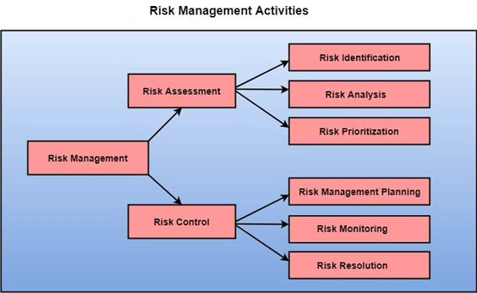
Risk Management Activities
Risk management consists of three main activities, as shown in fig:

Slide 82
Risk Assessment
The objective of risk assessment is to division the risks in the condition of their loss, causing potential. For risk assessment, first, every risk should be rated in two methods:
The possibility of a risk coming true (denoted as r).
The consequence of the issues relates to that risk (denoted as s).
Based on these two methods, the priority of each risk can be estimated:
p = r * s
Where p is the priority with which the risk must be controlled, r is the probability of the risk becoming true, and s is the severity of loss caused due to the risk becoming true. If all identified risks are set up, then the most likely and damaging risks can be controlled first, and more comprehensive risk abatement methods can be designed for these risks.
1. Risk Identification: The project organizer needs to anticipate the risk in the project as early as possible so that the impact of risk can be reduced by making effective risk management planning.
A project can be of use by a large variety of risk. To identify the significant risk, this might affect a project. It is necessary to categories into the different risk of classes.

Slide 83
There are different types of risks which can affect a software project:
Technology risks: Risks that assume from the software or hardware technologies that are used to develop the system.
People risks: Risks that are connected with the person in the development team.
Organizational risks: Risks that assume from the organizational environment where the software is being developed.
Tools risks: Risks that assume from the software tools and other support software used to create the system.
Requirement risks: Risks that assume from the changes to the customer requirement and the process of managing the requirements change.
Estimation risks: Risks that assume from the management estimates of the resources required to build the system
2. Risk Analysis: During the risk analysis process, you have to consider every identified risk and make a perception of the probability and seriousness of that risk.
There is no simple way to do this. You have to rely on your perception and experience of previous projects and the problems that arise in them.
It is not possible to make an exact, the numerical estimate of the probability and seriousness of each risk. Instead, you should authorize the risk to one of several bands:
The probability of the risk might be determined as very low (0-10%), low (10-25%), moderate (25-50%), high (50-75%) or very high (+75%).
The effect of the risk might be determined as catastrophic (threaten the survival of the plan), serious (would cause significant delays), tolerable (delays are within allowed contingency), or insignificant.

Slide 84
Risk Control
It is the process of managing risks to achieve desired outcomes. After all, the identified risks of a plan are determined; the project must be made to include the most harmful and the most likely risks. Different risks need different containment methods. In fact, most risks need ingenuity on the part of the project manager in tackling the risk.
There are three main methods to plan for risk management:
Avoid the risk: This may take several ways such as discussing with the client to change the requirements to decrease the scope of the work, giving incentives to the engineers to avoid the risk of human resources turnover, etc.
Transfer the risk: This method involves getting the risky element developed by a third party, buying insurance cover, etc.
Risk reduction: This means planning method to include the loss due to risk. For instance, if there is a risk that some key personnel might leave, new recruitment can be planned.

Slide 85
Risk Leverage: To choose between the various methods of handling risk, the project plan must consider the amount of controlling the risk and the corresponding reduction of risk. For this, the risk leverage of the various risks can be estimated.
Risk leverage is the variation in risk exposure divided by the amount of reducing the risk.
Risk leverage = (risk exposure before reduction - risk exposure after reduction) / (cost of reduction)
1. Risk planning: The risk planning method considers each of the key risks that have been identified and develop ways to maintain these risks.
For each of the risks, you have to think of the behavior that you may take to minimize the disruption to the plan if the issue identified in the risk occurs.
You also should think about data that you might need to collect while monitoring the plan so that issues can be anticipated.
Again, there is no easy process that can be followed for contingency planning. It rely on the judgment and experience of the project manager.
2. Risk Monitoring: Risk monitoring is the method king that your assumption about the product, process, and business risks has not changed.

Slide 86
R.M.M.M | Risk Mitigation Monitoring and Management: R.M.M.M stands for risk mitigation, monitoring and management. There are three issues in strategy for handling the risk is
Risk Avoidance
Risk monitoring
Risk management
Risk Mitigation: Risk mitigation means preventing the risk to occur (Risk Avoidance). Following are the steps to be taken for mitigating the risks.
Communicate with the concerned staff to find of probable risk.
Find out and eliminate all those causes that can create rick before the project starts.
Develop a policy in an organization which will help to continue the project even though some staff leaves the organization.
Everybody in the project team should be acquainted with the current development activity.
Maintain the corresponding documents in timely manner. This documentation should be strictly as per the standards set by the organization.
Conduct timely reviews in order to speed up the work.
For conducting every critical activity during software development, provide the additional staff if required.

Slide 87
Risk Monitoring: In risk monitoring process following things must be monitored by the project manager..
The approach of the team members as pressure of project varies.
The degree in which the team performs with the spirit of "team-work".
The type of co-operation among the team members.The types of problems that are occurring.Availability of jobs within and outside the organization.
The project manager should monitor certain mitigation steps. For example: If the current development activity is monitored continuously then everybody in the team will get acquainted with current development activity.
The objective of risk monitoring is to check whether the predicted risks really occur or not. To ensure the step defined to avoid the risk are applied properly or not. To gather the information which can be useful for analyzing the risk.
Risk management:

Slide 88
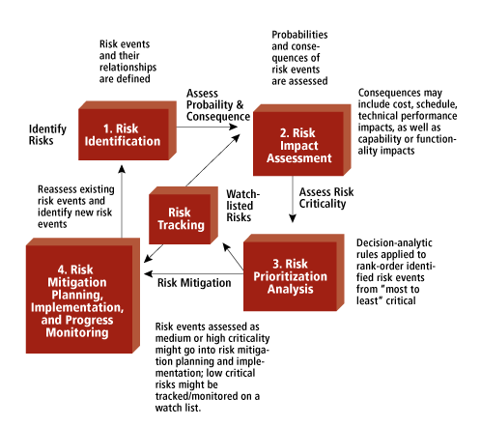

Slide 89
Project manager perform this task when risk becomes a reality. If project manager is successful in applying the project mitigation effectively then it becomes very much easy to manage the risks.
For example, Consider a scenario that many people are leaving the organization then if sufficient additional staff is available, if current development activity is know to everybody in the team, if latest and systematic documentation is available then any 'new comer' can easily understand current development activity. This will ultimately help in continuing the work without any interval.
R.M.M.M Plan: The R.M.M.M plan is a document in which all the risk analysis activities are described. Sometimes project manager includes this document as a part of overall project plan. Sometimes specific R.M.M.M plan is not created, however each risk can be described individually using risk information sheet. Typical template for R.M.M.M plan or risk information sheet can be,
Final Words: The Risk information sheet can be maintained by database systems. After documenting the risks using either R.M.M.M plan or risk information sheet the risk mitigation, monitoring and analysis activities are stopped.

Slide 90
Software Engineering | Software Quality Assurance
Software Quality Assurance (SQA) is simply a way to assure quality in the software. It is the set of activities which ensure processes, procedures as well as standards suitable for the project and implemented correctly.
Software Quality Assurance is a process which works parallel to development of a software. It focuses on improving the process of development of software so that problems can be prevented before they become a major issue. Software Quality Assurance is a kind of an Umbrella activity that is applied throughout the software process.
Software Quality Assurance have:
A quality management approach
Formal technical reviews
Multi testing strategy
Effective software engineering technology
Measurement and reporting mechanism

Slide 91
Major Software Quality Assurance Activities:
SQA Management Plan: Make a plan how you will carry out the sqa through out the project. Think which set of software engineering activities are the best for project.check level of sqa team skills.
Set The Check Points: SQA team should set checkpoints. Evaluate the performance of the project on the basis of collected data on different check points.
Multi testing Strategy: Do not depend on single testing approach. When you have lot of testing approaches available use them.
Measure Change Impact: The changes for making the correction of an error sometimes re introduces more errors keep the measure of impact of change on project. Reset the new change to change check the compatibility of this fix with whole project.
Manage Good Relations: In the working environment managing the good relation with other teams involved in the project development is mandatory. Bad relation of sqa team with programmers team will impact directly and badly on project. Don’t play politics.

Slide 92
Benefits of Software Quality Assurance (SQA):
SQA produce high quality software.
High quality application saves time and cost.
SQA is beneficial for better reliability.
SQA is beneficial in the condition of no maintenance for long time.
High quality commercial software increase market share of company.
Improving the process of creating software.
Improves the quality of the software.
Disadvantage of SQA: There are a number of disadvantages of quality assurance. Some of them include adding more resources, employing more workers to help maintain quality and so much more.

Slide 93
Software Review
Software Review is systematic inspection of a software by one or more individuals who work together to find and resolve errors and defects in the software during the early stages of Software Development Life Cycle (SDLC). Software review is an essential part of Software Development Life Cycle (SDLC) that helps software engineers in validating the quality, functionality and other vital features and components of the software. It is a whole process that includes testing the software product and it makes sure that it meets the requirements stated by the client.
Usually performed manually, software review is used to verify various documents like requirements, system designs, codes, test plans and test cases.
Objectives of Software Review: The objective of software review is:
To improve the productivity of the development team.
To make the testing process time and cost effective.
To make the final software with fewer defects.
To eliminate the inadequacies.

Slide 94
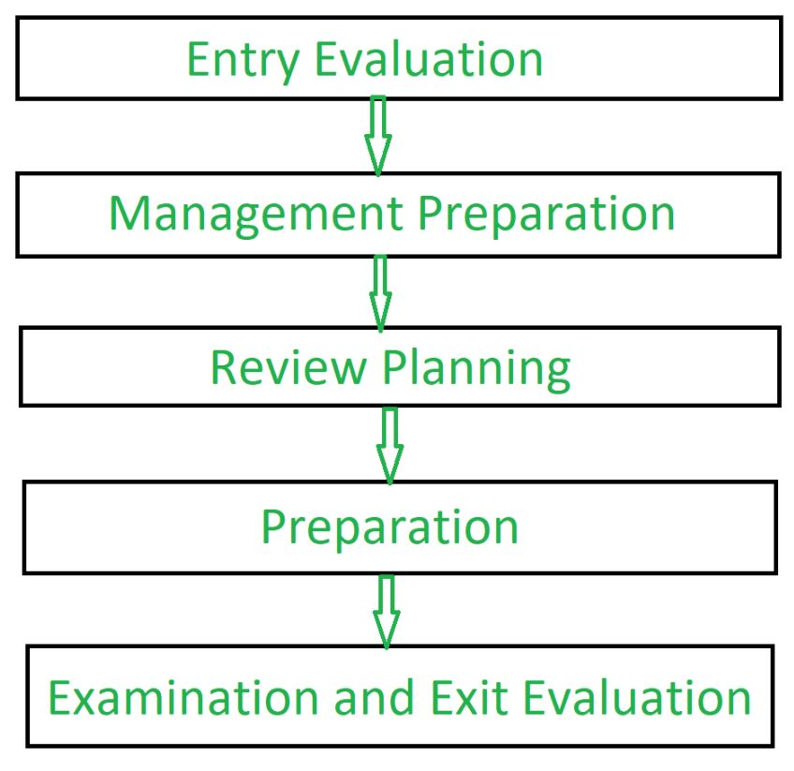
Process of Software Review:

Slide 95
Types of Software Reviews: There are mainly 3 types of software reviews:
Software Peer Review: Peer review is the process of assessing the technical content and quality of the product and it is usually conducted by the author of the work product along with some other developers. Peer review is performed in order to examine or resolve the defects in the software, whose quality is also checked by other members of the team.Peer Review has following types:
(i) Code Review: Computer source code is examined in a systematic way.
(ii) Pair Programming: It is a code review where two developers develop code together at the same platform.
(iii) Walkthrough: Members of the development team is guided bu author and other interested parties and the participants ask questions and make comments about defects.
(iv) Technical Review: A team of highly qualified individuals examines the software product for its client’s use and identifies technical defects from specifications and standards.
(v) Inspection: In inspection the reviewers follow a well-defined process to find defects.

Slide 96
Software Management Review:\
Software Management Review evaluates the work status. In this section decisions regarding downstream activities are taken.
Software Audit Review: Software Audit Review is a type of external review in which one or more critics, who are not a part of the development team, organize an independent inspection of the software product and its processes to assess their compliance with stated specifications and standards. This is done by managerial level people.
Advantages of Software Review:
Defects can be identified earlier stage of development (especially in formal review).
Earlier inspection also reduces the maintenance cost of software.
It can be used to train technical authors.

Slide 97
Formal Technical Review (FTR) in Software Engineering
Formal Technical Review (FTR) is a software quality control activity performed by software engineers.
Objectives of formal technical review (FTR): Some of these are:
Useful to uncover error in logic, function and implementation for any representation of the software.
The purpose of FTR is to verify that the software meets specified requirements.
To ensure that software is represented according to predefined standards.
It helps to review the uniformity in software that is development in a uniform manner.
To makes the project more manageable.

Slide 98
Statistical Software Quality Assurance Statistical
SQA is a technique that measures the quality in a quantitative fashion. It implies that information about defects is collected and categorized and an attempt is made to trace each defect to underlying cause. It uses Pareto Principle to identify vital causes (80% of defects can be traced to 20% of causes) and moves to correct the problems that have caused the defects.
Example
Let us assume that information about defects is collected for one year and categorized as follows:
1. Incomplete or erroneous specifications (IES)
2. Misinterpretation of customer communication (MCC)
3. Intentional deviation from specifications (IDS)
4. Violation of programming standards (VPS)
5. Error in data representation (EDR)
6. Inconsistent component interface (ICI)
7. Error in digital logic (EDL)
8. Incomplete or erroneous testing (IET)
9. Inaccurate or incomplete documentation (IID)
10. Error in programming language translation of design (PLT)
11. Ambiguous or inconsistent HCI (HCI)
12. Miscellaneous (MIS) The following data is collected for these categories

Slide 99
Software Testing | Reliability Testing
Reliability Testing is a testing technique that relates to test the ability of a software to function and given environmental conditions that helps in uncovering issues in the software design and functionality. It is defined as a type of software testing that determines whether the software can perform a failure free operation for a specific period of time in a specific environment. It ensures that the product is fault free and is reliable for its intended purpose.
Objective of Reliability Testing:
The objective of reliability testing is:
To find the perpetual structure of repeating failures.
To find the number of failures occurring is the specific period of time.
To discover the main cause of failure.
To conduct performance testing of various modules of software product after fixing defects.

Slide 100
Types of Reliability Testing:
There are three types of reliability testing:-
Feature Testing: Following three steps are involved in this testing:
Each function in the software should be executed at least once.
Interaction between two or more functions should be reduced.
Each function should be properly executed.
Regression Testing: Regression testing is basically performed whenever any new functionality is added, old functionalities are removed or the bugs are fixed in an application to make sure with introduction of new functionality or with the fixing of previous bugs, no new bugs are introduced in the application.
3
Load Testing: Load testing is carried out to determine whether the application is supporting the required load without getting breakdown. It is performed to check the performance of the software under maximum work load.

Slide 101
The study of reliability testing can be divided into three categories:-
Modelling
Measurement
Improvement
Measurement of Reliability Testing:
Mean Time Between Failures (MTBF):
Measurement of reliability testing is done in terms of mean time between failures (MTBF).
Mean Time To Failure (MTTF): The time between two consecutive failures is called as mean time to failure (MTTF).
Mean Time To Repair (MTTR): The time taken to fix the failures is known as mean time to repair (MTTR).
MTBF = MTTF + MTTR

Slide 102
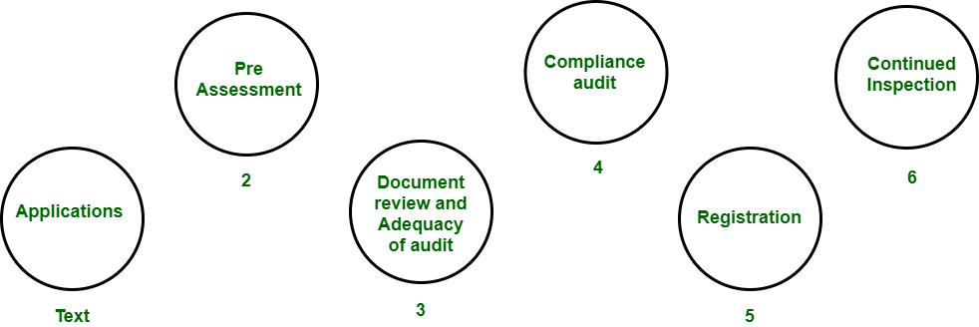
ISO 9000 Certification in Software Engineering
The International organization for Standardization is a world wide federation of national standard bodies. The International standards organization (ISO) is a standard which serves as a for contract between independent parties. It specifies guidelines for development of quality system.
Quality system of an organization means the various activities related to its products or services. Standard of ISO addresses to both aspects i.e. operational and organizational aspects which includes responsibilities, reporting etc. An ISO 9000 standard contains set of guidelines of production process without considering product itself.

Slide 103
Why ISO Certification required by Software Industry? There are several reasons why software industry must get an ISO certification. Some of reasons are as follows :
This certification has become a standards for international bidding.
It helps in designing high-quality repeatable software products.
It emphasis need for proper documentation.
It facilitates development of optimal processes and totally quality measurements.
Features of ISO 9001 Requirements :
Document control – All documents concerned with the development of a software product should be properly managed and controlled.
Planning – Proper plans should be prepared and monitored.
Review – For effectiveness and correctness all important documents across all phases should be independently checked and reviewed .
Testing – The product should be tested against specification.
Organizational Aspects – Various organizational aspects should be addressed e.g., management reporting of the quality team.

Slide 104
Advantages of ISO 9000 Certification : Some of the advantages of the ISO 9000 certification process are following :
Business ISO-9000 certification forces a corporation to specialize in “how they are doing business”. Each procedure and work instruction must be documented and thus becomes a springboard for continuous improvement.
Employees morale is increased as they’re asked to require control of their processes and document their work processes
Better products and services result from continuous improvement process.
Increased employee participation, involvement, awareness and systematic employee training are reduced problems.
Shortcomings of ISO 9000 Certification : Some of the shortcoming of the ISO 9000 certification process are following :
ISO 9000 does not give any guideline for defining an appropriate process and does not give guarantee for high quality process.
ISO 9000 certification process have no international accreditation agency exists.

