Slide 1
AI for Market Trend Analysis
Machine Learning Trend-Regime Prediction using Technical Indicators
Dataset: S&P 500 Index (Daily OHLCV)
Model: Random Forest Classifier
Output: Bullish vs Bearish regime (5 days ahead)
Presented by Manish Kumar Singh (iitrprai_24102019)
Notes:
[Sources]
- https://stooq.com/q/d/l/?i=d&s=%5Espx (data source link from Stooq)
[/Sources]

Slide 2
Problem & Motivation
Problem
Why AI / ML?
Markets alternate between bullish and bearish regimes.
Daily direction is noisy; trend regimes are more stable.
Goal: predict the trend regime 5 trading days ahead.
Combines many indicators (trend + momentum + volatility).
Learns non-linear relationships better than fixed rules.
Produces probabilities for decision support.
Project: AI for Market Trend Analysis
Notes:
[Sources]
- https://stooq.com/q/d/?s=%5Espx (Stooq historical data page)
[/Sources]

Slide 3
System Design (End-to-End Pipeline)
Input Dataset
(spx_daily.csv)
OHLCV
Feature Engineering
SMA, RSI, MACD
Returns/Volatility
Model Training
Random Forest
TimeSeriesSplit CV
Evaluation
Accuracy, ROC-AUC
Confusion Matrix
Deployment
Streamlit UI
Predict + Download
Project: AI for Market Trend Analysis
Notes:
[Sources]
- https://stooq.com/q/d/?s=%5Espx (Stooq historical data page)
[/Sources]

Slide 4
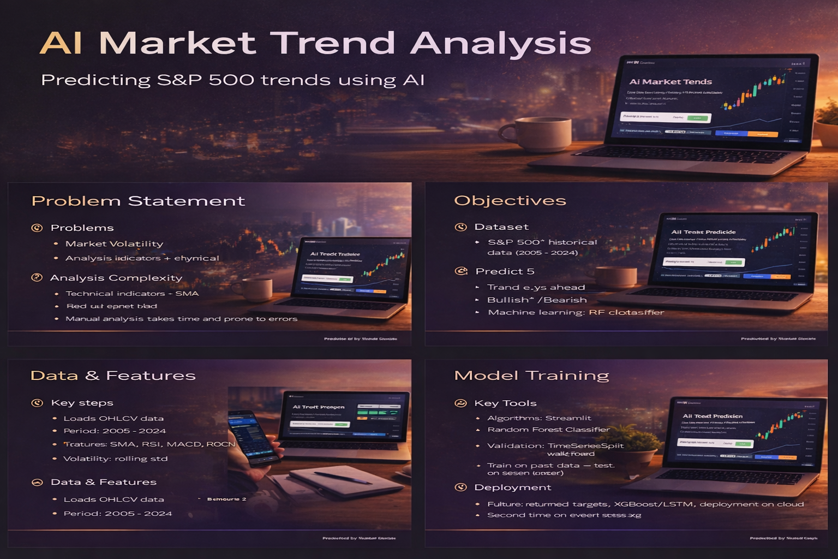
Demo Snapshots (Streamlit UI)
Notes:
[Sources]
- https://stooq.com/q/d/?s=%5Espx (Stooq historical data page)
[/Sources]

Slide 5
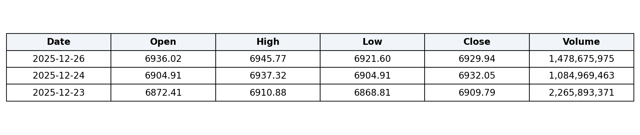
Dataset
Source: Stooq (S&P 500 index ^SPX) — daily OHLCV
Period used
Rows (processed)
Columns
2005-10-17 to 2025-12-26
5,081
Date, Open, High, Low, Close, Volume
Example rows (columns abbreviated)
Data: Stooq | Index: ^SPX
Notes:
[Sources]
- https://stooq.com/q/d/l/?i=d&s=%5Espx (CSV download)
[/Sources]

Slide 6
Trend Definition (Label)
We define a bullish regime using a moving-average crossover:
Bullish(t) = 1 if SMA20(t) > SMA50(t) (else 0)
Target: predict Bullish(t + 5 trading days)
Why this label?
Important note
Represents trend regime, not random daily noise.
Interpretable (common in technical analysis).
Useful for risk-on / risk-off decisions.
This is for educational analysis only.
Not financial advice; no trading/backtest included.
Notes:
[Sources]
- https://stooq.com/q/d/l/?i=d&s=%5Espx (data)
[/Sources]

Slide 7
Feature Engineering
Trend / Level
Momentum / Risk
Close vs SMA10 / SMA20 / SMA50 / SMA200 (normalized)
MACD line, signal line, histogram
Returns: 1d, 5d, 10d
Volatility: 10d, 20d rolling std
RSI (14)
Volume change: 5d % change
Indicators used in this project:
RSI measures momentum; MACD uses EMAs (12, 26) with a 9-period signal line.
Technical indicators computed from price/volume
Notes:
[Sources]
- https://www.investopedia.com/terms/r/rsi.asp (RSI definition)
- https://www.investopedia.com/terms/m/macd.asp (MACD definition)
[/Sources]

Slide 8
Model & Validation
Model
Validation
RandomForestClassifier (ensemble of decision trees)
Handles non-linear patterns
Provides feature importance
Chronological split: train 2005–2022
Test: 2023–2025
Optional: TimeSeriesSplit CV to avoid leakage
Pipeline
OHLCV → Indicators → Feature Matrix → Random Forest → Trend Regime Probability
Notes:
[Sources]
- https://scikit-learn.org/stable/modules/generated/sklearn.ensemble.RandomForestClassifier.html
- https://scikit-learn.org/stable/modules/generated/sklearn.model_selection.TimeSeriesSplit.html
[/Sources]

Slide 9
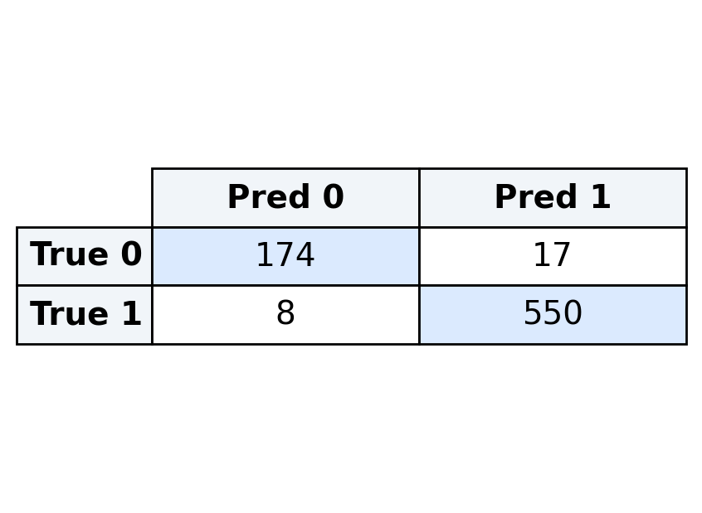
Results (Test Set: 2023–2025)
ROC-AUC
Accuracy
F1-score
0.996
0.967
0.978
Precision
Recall
0.970
0.986
Confusion Matrix
Takeaways
rows = true, cols = predicted
Model predicts trend regime reliably on test period.
Most errors occur near regime transitions.
Best used as trend/risk indicator (not exact price forecast).
Notes:
[Sources]
- https://stooq.com/q/d/l/?i=d&s=%5Espx (data)
- https://scikit-learn.org/stable/modules/generated/sklearn.ensemble.RandomForestClassifier.html
[/Sources]

Slide 10
Model Interpretation: Feature Importance
Top drivers for predicting trend regime
Interpretation: momentum/trend features (MACD, MA distances) dominate.
Notes:
[Sources]
- https://stooq.com/q/d/l/?i=d&s=%5Espx (data)
- https://scikit-learn.org/stable/modules/generated/sklearn.ensemble.RandomForestClassifier.html (feature importance available)
[/Sources]

Slide 11
ROC Curve
AUC = 0.996 (higher is better)
Notes:
[Sources]
- https://scikit-learn.org/stable/modules/generated/sklearn.model_selection.TimeSeriesSplit.html (time-series evaluation concept)
[/Sources]

Slide 12
Key Learning, Conclusion & Future Work
Key Learning
Conclusion
Time-series modeling requires leakage-safe validation (TimeSeriesSplit).
Feature engineering using indicators strongly impacts performance.
Chronological train/test split mimics real future prediction.
Saving model with joblib enables easy deployment to UI.
End-to-end pipeline delivery improves usability and reproducibility.
Built an end-to-end trend analysis pipeline.
Random Forest learns from technical indicators.
Predicts bullish/bearish regime 5 days ahead with strong test metrics.
Future Work
References (short)
• Stooq: ^SPX daily historical data
• scikit-learn: RandomForestClassifier, TimeSeriesSplit
• Investopedia: RSI, MACD
Try Gradient Boosting (XGBoost/LightGBM).
Add news/sentiment or macro features.
Backtest strategy with transaction costs.
Extend to multiple assets / sectors.
Thank you
Notes:
[Sources]
- https://stooq.com/q/d/l/?i=d&s=%5Espx
- https://scikit-learn.org/stable/modules/generated/sklearn.ensemble.RandomForestClassifier.html
- https://scikit-learn.org/stable/modules/generated/sklearn.model_selection.TimeSeriesSplit.html
- https://www.investopedia.com/terms/r/rsi.asp
- https://www.investopedia.com/terms/m/macd.asp
[/Sources]

