Slide 1

Application and
Process Integration
Paul Johannesson
Department of Computer and Systems Sciences, Stockholm University
Benkt Wangler
Department of Computer Science,
University of Skövde
Application A
Application B
Broker
Application C
Application D
Notes:
My name is Benkt Wangler and I will together with Professor Paul Johannesson give a brief introduction to the area of enterprise application integration as seen through a reserach project that we are involved in. The project is named ”ProcessBroker – A process broker approach to systems integration.
In this project the department of computer and systems sciences at the Royal Institute of Technology in Stockholm cooperates with the Atlanta based company Viewlocity, and relates to ongoing development work at Viewlocity.
The development concerns developing a business process oriented systems integration and process management environment.
The research project concerns trying the tool and methodology that constitute this environment on real cases in order to further refine and improve it.
Leaders of the research project is myself now at the university of Skövde and Prof Paul Johannesson of KTH.

Slide 2
Presentation Outline
Need for application integration
Levels of integration
Technologies for integration
Message brokers and process brokers
Research directions
Notes:
Our presentation goes as follows:
First I will motivate the research by giving an account of the so called stove-pipe problem
After that i will say a few words about integrating applications on different management and control levels vertically
Paul Johannesson will then talk about technologies for integration inclucing giving an account of message and process brokers.
Finally, I will come back and give an account of the research directions we are pursuing.

Slide 3
Organisational functions
A function is a unit in an organisation that
carries out a set of related activities.
Usually, these activities require
special competence or equipment.
Examples:
Marketing
Sales
Procurement
R&D
Systems
administration
Janitor
Course
registry
Teaching
Notes:
Traditionally companies are functionally organised, i.e. Organisationl units have been created to take care of specific functions in the company. The organisational units are specialised to deal with tasks and problems within a particular domain.
Examples in a typical company are marketing, sales, purchase, production, shipment etc. In a university department it might be such functions as those shown on the slide.

Slide 4

Processes
A business process is a sequence of activities
that result in value for a customer
Typically resources from several functions are
required to carry out a process
Notes:
A business process is usually defined to be a set of partially ordered activities that produce value for some (external or internal) customer. Each activity makes its contribution to the whole process, and hence adds some part of the total value to the product or service that is being produced.
Typically several functions need to be involved to carry through a process.

Slide 5
Stovepipe syndrome
IT systems
Functions
in an
organisation
Personnel
R&D
Market/
Sales
Production
Service
Financials
Each IT system supports its
own function
Notes:
Typically, separate systems have been created to support each function. Usually, each of hese systems has been created and renewed separately. This means they may have been developed using different platforms and technology. Some may be batch oriented, others may be on-line systems supporting work in real time. Some may be quite old. It is not unusual to have systems that are 10 – 20 years old. They
As a consequence the functional systems are very difficult to make to work together, i.e. To integrate.
As a further consequence they contain a lot of redundancy: information about customers, for instance, may be present in the market and sales database, in the service system database and in personnel database, i.e. If employees are customers. This will undoubtedly lead to inconsistency in data.
This is usually referred to as the stove-pipe syndrom, i.e. Functional systems may work well within a function and support well the tasks of that organisational unit. But it is extremely difficult to make them seamlessly support a business process that spans several functional units.

Slide 6
Integrated IT support
Order- handling
Product- development
Customer- service
Financial
reporting
Personnel
R&D
Market/
Sales
Production
Service
Financials
Notes:
Important business are typically cross-functional. For instance, order-handling may require resources from personnel and involve market and sales, production and financial tasks. Product development may involve utilizing resources and taking into account knowledge from many functional aeas. Hence one would like to have an information systems infrastructure that seemlessly supports each of those business processes in an integrated manner.

Slide 7
Business Processes Spanning One or More Organizations
Company 1
P1.1
P1.3
P1.4
P1.2
Company 3
Company 2
Notes:
Integrating between various disparate applications require mechanisms for
Routing messages
translating between message formats
Trend to CBD and componentization causes functional systems to be split up in smaller pieces each responsible for its own task and service. By combining these task-oriented components in new and different ways organizations are able to design new services or service combinations. Moreover customers should be able to specify themselves the service combination then want.
For instance it should be possible in the ordering process for the customer to choose which combination of services as regards e.g. Delivery of ordered goods or method of payment he prefers. This calls for the ability of enterprise application integration software to dynamically restructure processes and introduce new applications.
2. Several companies may be involved in the process in order to satisfy all customer needs
A separate transportation company takes care of delivering the goods to the customer
3. The process may involve several organizations like in virtual organizations where several companies come together to solve tasks they cannot cope with alone.
In interorganisational integration we deal with more or less autonomous organisations. Hence aspects of security become much more important.

Slide 8
From ERP to
Enterprise Systems
ERP definition
Software solution that addresses the enterprise needs taking the process view of an organisation to meet the organisational goals tightly integrating all functions of an enterprise
Customer Relationship management, CRM
Sales Force Automation, SFA
Supply Chain Management, SCM
Notes:
IE juni, s. 44
Enterprise Resource Planning
4 M:s
Man
Material
Machine
Money

Slide 9







Anatomy of an ES
Managers
Customers
Suppliers
Reporting
Sales force
Finan-
cials
Sales &
delivery
Back
office
Central
database
Manufac-
turing
Services
Inventory
Customer service
Human
resource
Employees
Notes:
Any organisation has to interface to their customers by means of front office functions such as sales and services, as well as to their suppliers by means of corresponding back office units. The organisational functions that need to be supported are hence such as
sales and delivery,
services,
financials,
Manufacturing
Inventory
But also the human resource has to be managed
And managers need to be supported by information and system functionality that help them make wise tactical and strategic decisions.
In an enterprise system all of this would be supported by an integrated set of databases with no unnecessary redundancy.

Slide 10




From Supply Chain to Value Network
Transfer
Transfer
Transfer
Transfer
Transfer
Transfer
Transfer
Transfer
Vendor
Manufacturing
Distribution
Store
Customer
Notes:
IE juni, s.42, orange ruta

Slide 11
Vertical Integration
Strategic
DSS
DM
OLAP
ERP
Data
Warehouse
ODS
Tactical
Operational
SCM
MES
Process control, NC
Notes:
Vertical intraorganizational integration aims to integrate systems at different administrative levels. As an example, a typical function may be production In manufacturing industry the this function may, at the lowest level be controlled by various control systems for eg. continuous process control, control of robots or NC machinery. These technical level systems need to be fed with control data stemming from higher level production planning and scheduling systems which in turn need information from higher level systems.
Low level systems may need to collect information about results and transfer it upwards in order to support higher level planning and decision making such as for purchasing. In data warehousing upward transfer of data may have to be done periodically in a process where data may have to be cleaned, transformed and pre-aggregated along several dimensions. This calls for a separate data staging activity into which data may be fed as it is created but from which it is forwarded to the data warehouse periodically. On top of the data warehouse sits various end-user applications such as desision support systems, statistical analysis systems, OLAP tools, data mining tools etc.
From these systems decisions are taken that will affect the way the business is run which in turn is controled by ERP systems and so on.
This differs from horizontal integration in that applications may be more disparate ranging from very precise and well-defined ”technical” systems to high-level OLAP tools providing decision support to senior managment
Nevertheless vertical integration forms also a process involving various applications and systems with clear integration problems that might be helped by sophisticated application integration aids.

Slide 12
Integrating Applications over Business Process
Message broker
Process broker
Notes:
A business process broker facility provides a higher level of abstraction than a message broker by giving the process designers the ability to define integration reqs through workflow and business process models.

Slide 13
Definition of EAI
Enterprise Application Integration (EAI) is “the unrestricted sharing of data and business processes among any connected applications and data sources in the enterprise”.
D. Linthicum
Notes:
Benkt has discussed the background and need for EAI. I will now introduce a number of technologies for realising application integration. A starting point is this definition from a book by David Linthicum, it says that ...

Slide 14
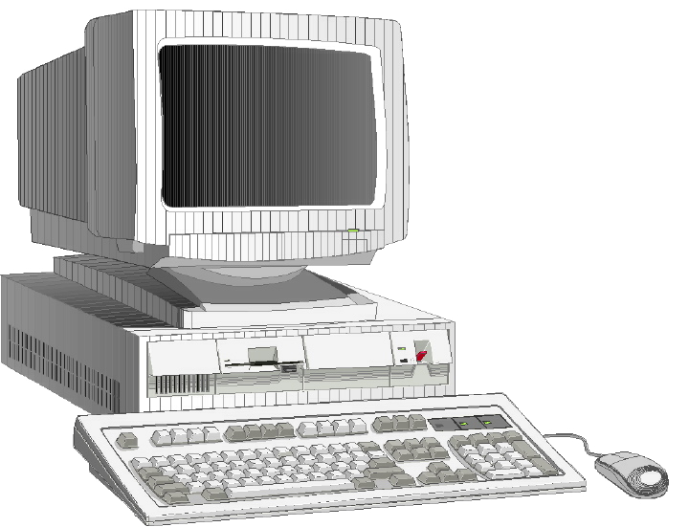
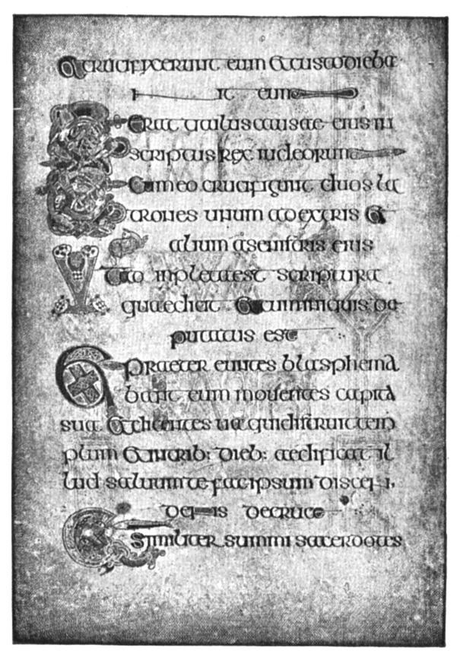

Levels of EAI
User interface
level
Presentation
Method level
Application
Application interface
level
Data level
Data
Notes:
Enterprise Application Integration can take place on different levels. Based on the three-level architecture of Data-Application-Presentation, it is possible to distinguish among four different kinds of EAI:
In data level integration, the integration takes place between data stores. Data is extracted from one database and used to update another database, possibly after modifications. An advantage of this approach is that it does not require any modifications of the existing applications. Furthermore, data integration uses inexpensive and established technology, i.e. database oriented middleware such as ODBC and JDBC.
On the Application Interface-level, application interfaces are used to services provided by the application. It is possible to distinguish between three types of services, : business, data, and object services. A business service provides access to some business logic, e.g. calculating prices or updating customer information. A data service provides a route to a database and is in this similar to data-level access tools. An object service is the combination of business and data services packaged as an object. An advantage of objects is that integrity constraints cannot be violated as updates to data are always carried out by the appropriate methods of an object.
In method level integration, applications are integrated by being able to share a set of common methods. These methods can be stored on a central server, or they can reside as distributed objects in a network. Method level integration is also closely related to reuse. By introducing a number of common methods, different applications can reuse these methods.
User interface level EAI (sometimes called “screen scraping”) is the most primitive form of EAI. Applications are integrated through the user interfaces, i.e. information are accessed from user screens by programmatic mechanisms. This approach may seem unattractive, but sometimes it is the only possible integration approach. Furthermore, it has the advantage of not requiring any changes to the applications to be integrated.

Slide 15
Architectures of EAI
Application A
Application A
Application A
Application B
Application B
Application B
Message Broker
Application C
Application C
Application C
Application D
Application D
Application D
Application A
Application A
Point to point
Many to many
Notes:
Integration of applications can be supported by different architectures. One architecture is the point-to-point solution where every application is directly connected to every other application. This solution could work for a small number of applications, but when more applications are added, the number of connections increases rapidly. Furthermore, when a new application is introduced, it needs potentially to be connected to every other application.
Another architecture is based on the notion of a Message Broker. The main idea is to reduce the number of interfaces by putting a Message Broker in the centre and thereby make it easier to support the interfaces. If any of the applications changes format, only one connection has to be changed: the one to the Message Broker. Likewise, if one application is added, only one new connection is required.

Slide 16
Middleware -
Technology for EAI
Middleware is software that facilitates communication between software systems.
Notes:
We will go into some detail on Message Brokers but before that we will consider a number of basic technologies for realising application integration. These technologies are usually called Middleware, which can be defined as...

Slide 17

Types of Middleware
RPCs (Remote Procedure Calls)
MOM (Message Oriented Middleware)
Distributed Objects
Database Oriented
Message Brokers
Process Brokers
Client
Server
Network
interface
Network
interface
Notes:
RPC, Remote Procedure Call, is a way of communicating with a remote computer. The client invokes a procedure on the server by making a simple function call. The client process making the call is suspended until it receives the reply from the server. RPCs are easy to use and they hide the complexity of the network. But they have two drawbacks for EAI. First, they are a typical point-to-point solution. Secondly, they require synchronous communication, which may degrade performance.

Slide 18

Types of Middleware
RPCs (Remote Procedure Calls)
MOM (Message Oriented Middleware)
Distributed Objects
Database Oriented
Message Brokers
Process Brokers
Client
Server
QM
QM
Queue
Manager
Queue
Manager
Notes:
In contrast to RPC, MOM is asynchronous. An important feature in MOM is message queuing. Messages sent from one application can be stored in a queue, and they can be taken care of by the other application at a later time without blocking the first application. MOM is thus particularly useful in situations where computers are not always up and running or when networks are not reliable.

Slide 19
Types of Middleware
RPCs (Remote Procedure Calls)
MOM (Message Oriented Middleware)
Distributed Objects
Database Oriented
Message Brokers
Process Brokers
Applications
Object Request Broker
Notes:
In method level integration, applications are integrated by sharing common methods. These methods can exist within distributed objects across a network. An advantage of this approach is that it can utilise well-established technologies with ORBs based on specifications like CORBA and DCOM. Furthermore, it can support efforts for reuse based on distributed objects. A disadvantage of the approach is that it typically requires extensive modifications of existing applications, often by moving methods within applications to new distributed objects.

Slide 20
Types of Middleware
RPCs (Remote Procedure Calls)
MOM (Message Oriented Middleware)
Distributed Objects
Database Oriented
Message Brokers
Process Brokers
Applications
Call-Level Interface
Databases
Notes:
Database oriented middleware is needed in all application integration, especially on the data-level. DB oriented middleware cannot only give access to data in databases, it can also carry out mappings between different formats, e.g. transform relational data so that it appears as objects in an application. Much DB middleware takes the form of Call-level interfaces. They can translate interface calls into specific database dialects and return the responses in a uniform representation. Two of the most widely spread CLIs are ODBC and JDBC. ODBC is a translation layer for relational databases on the Windows platform, while JDBC is a translation layer for the Java environment.
We will now return to the Message Brokers and give a more detailed view of their functionality. The Message Broker provides a number of services. The two most important ones are Message Translation and Intelligent Routing.

Slide 21

Message Translation
Source
Target
F. name: Benkt
L. name: Wangler
Affiliation: University
of Skövde, Skövde,
Sweden
Name: Benkt Wangler
Company: University
of Skövde
City: Skövde
Country: Sweden
Message Broker
Notes:
A Message Broker supports message translation. This means that data from one message is translated into a new message that is meaningful to the receiving applications. To do this, two types of conversions are needed: schema conversion as well as data conversion..
Schema conversion means that the structure of a message is changed. In this example, the field Affiliation is broken up into three separate fields.
Data conversion has to do with changes of actual data values. For example, deleting characters in a string, or converting a string into a numeric representation.
Most data conversion on ordinary formats, such as integers and alphanumeric, can be carried out automatically by the Message Broker. In other cases, when for example look-up tables are needed, the Message Broker will support rules that specify how specific data conversions should be carried out.

Slide 22
Intelligent Routing
Source Systems
Target Systems
Message Broker
Notes:
A Message Broker also performs intelligent Routing. This means that the Message Broker first receives a message from a source system,
it will then carry out required message translations,
when these have been processed,
the converted message will be routed to the appropriate target system.
The Message Broker determines which system it should send the message to, and this decision may take into account the content of the message.

Slide 23
Message Broker Services
Repository
Services
Intelligent
routing
Rules
processing
Message
Translation
Message
Warehousing
Adapters
Notes:
In addition to message translation and routing, a Message Broker also provides several other services.
One service is rules processing. It enables the programming of rules for translating messages between applications, and rules for determining the routing of messages. Typically, Message Brokers provide a simple application development environment in which designers can define the rules. The programming (or scripting) languages provided are simple, but they become more and more advanced as the Message Brokers mature.
Another service is message warehousing. A message warehouse is a database that is able to store messages flowing through a Message Broker. One use of the message warehouse is as persistent buffer - if a server goes down, the messages are stored in the warehouse and can be resent later. The message warehouse can also be used for auditing purposes, e.g. for examining traffic load. Finally, the message warehouse can support message mining analogously to data mining in an ordinary data warehouse.
A repository is a database that holds information about source and target applications. This may include locations of systems, metadata, translation information, and security information. The repository works as a centre of the Message Broker, where architects and programmers may get access to all information needed to integrate applications.
An adapter is a layer between the Message Broker and the source or target applications. An adapter maps to and from the interface of the Message Broker and the native interfaces of the applications to be integrated. In this way, the adapter hides the complexities of these interfaces from the designers. Typically, Message Broker vendors provide adapters for popular standard systems such as SAP and PeopleSoft.

Slide 24
Architectures of EAI
Application A
Application A
Application A
Application B
Application B
Application B
Message Broker
Process Broker
Application C
Application C
Application D
Application D
Application C
Application A
Person A
Notes:
We have now looked at the basic functionality of a Message Broker. And Message Brokers do solve many of the problems with a simple point-to point architecture. But it is possible to go one step further and add a level of process automation on top of the Message Broker. This means that we can manage the movement of data and the control flow within processes from one single point. This single point is often referred to as a Process Broker. The Process Broker, can be seen as an extension of the Message Broker. The Process Broker does not only translate and route messages. It also controls the order in which a set of applications are to be connected. Traditionally this process logic has been spread out and embedded in many different applications. But by separating process and application logic and collecting all process logic in a Process Broker, all the process logic can reside in one single place. This separation of concerns will improve flexibility and facilitate maintenance.

Slide 25



Levels of Technology
Process Integration
and Automation
Process Broker
Message Translation
Intelligent Routing
Rules Processing
Message Broker
Messaging Services
RPC, MOM, ...
Notes:
We can now identify three levels of technology. At the top level we have the process automation and integration. This level is where information movement and control flow is managed. The technology used is typically a Process Broker.
On the next level below, we have the message translation, routing, and rules processing. These are activities that can be carried out by a Message Broker.
On the lowest level, we have systems that actually move data between the connected applications. This can be carried out by, for example, RPC or MOM.

Slide 26

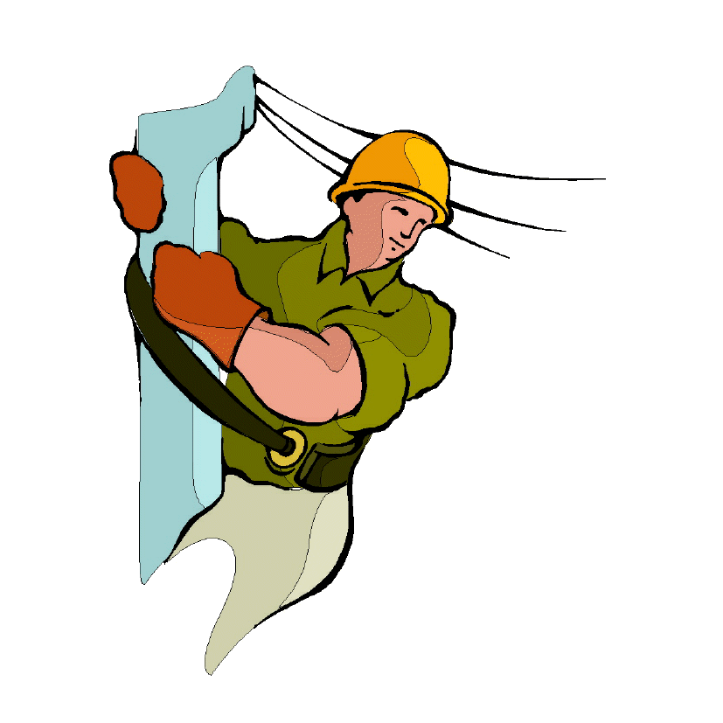

Common Models for
Different Stakeholders
Analysis
Design
Operations
Notes:
An advantage of the Process Broker technology is that different stakeholders can use the same notation and models. Business users should be able to model their processes in a simple graphical languages. Designers complement these models with more process and application logic. Finally, these models are directly used in the operations phase for executing and monitoring the processes. It should also be possible to let business users see abstract views of the process executions that hides minor details. By using the same language and models in all phases we ensure that the models are always accurate and up-to-date.

Slide 27
Process Broker Services
Process
Visualisation
Process
Design
Process
Simulation
Process
Monitoring
Process
Execution
Notes:
In addition to the services of a Message Broker, a Process Broker provides a number of other services.
It supports the Process Design by providing a graphical environment for defining processes as well as message translation and rules.
The processes can be visualised through the graphical environment.
It should also be possible to simulate different scenarios.
The Process Broker handles the Process Execution and carries out message translation as well as manages the control flow.
The Process Broker supports the monitoring of processes, e.g. to identify bottle necks in the process flow. It can also track individual process instances to find out where they are in the process.

Slide 28


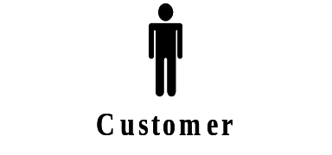
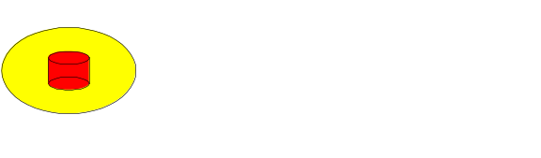
Business Modeling Language
Reg
Application
Operator
Nr
Application
Notes:
Well. Let´s look at a simple example, describing a customer ordering a mobile telephone subscription. We have a customer, an operator and two applications: a Nr application that contains information about booked and unbooked telephone numbers, and a Registry application, in which information about the subscriptions is stored. The customer, the operator, and the applications are connected to a Process Broker. The operator is notified if something goes wrong when the human actors and applications communicate.
We use an application integration modelling language called BML (Business Model Language) to visualise the integration. BML is developed by the company Viewlocity.

Slide 29
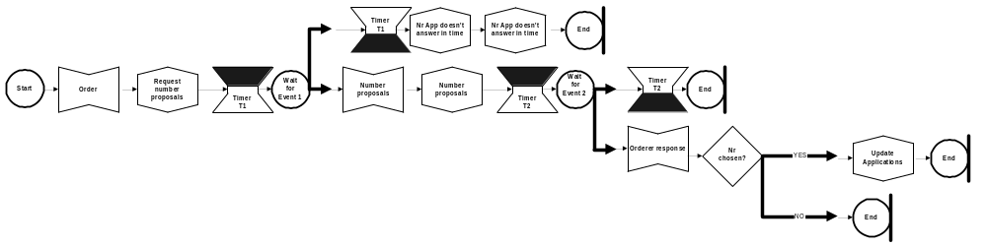
Business Modeling Language
Operator
Reg
Application
Nr
Application
Notes:
This slide describes the first part of the order process. The customer wants to order a mobile telephone subscription and sends a message to the Process Broker. The message contains information about the customer. The Process Broker receives the message from the customer and sends a message to the Nr application, requesting number proposals - and a timer is started. If the Nr Application doesn’t answer the request during a certain time, the Timer Expire and a message is sent to the customer informing that the system is not avaiable for the moment, and another message notifies the operator that the Nr Application doesn´t answer in time. Then the process stop.

Slide 30
Business Modeling Language
Operator
Reg
Application
Number handling process
Update Application Process
Nr
Application
Notes:
Another scenario is the following. As before the customer requests a subscription. And the Process Broker sends a request for number proposals to the Nr Application.
If the Nr Application does send a message back in time, that message is forward to the costumer. The message contains telephone number proposals which the orderer can choose among. A new timer is started. If the customer doesn´t answer during a certain time the process stops, but if the customer sends a message back in time the message is checked. If the customer has chosen a number, a message is sent to another process whichs update the Nr application (really book it in the Reg app) and the Registry application, otherwise no message is sent.

Slide 31
Sample Tools
Viewlocity TradeSync
Vitria BusinessWare
HP ChangeEngine
Extricity Alliance Manager
Crossworlds
Corus
Process
Brokers

Slide 32
Research Directions
Design methodology
Process libraries
Adaptive process management
Moving application logic into processes
Notes:
The research directions that we are currently pursuing are the ones listed on this slide. First of all
design methodology, where we have a process description methodology, BML – business modeling language , which is used in real cases where we try to improve it and also to come up with guidelines concerning how it would be best used.
Process libraries where we check out the possibility to create processes generic to specific tasks. We do that by
Process management
Finally, we strongly believe that the business logic should, as much as possible, be placed in the process definition and not in the application systems. In this activity we try to identify the various types of

Slide 33
Need for Methodology
Problem:
Complex and unstructured models
Exception handling
Extensive communication
Redundancy
Solution:
Design guidelines
Notes:
There is a clear need for a methodology since all kinds of different people are involvend in the analysis/design process
Starting with methods for design, we can identify several problems that make EAI particularly complex and therefore in need of adequate methods.
A general reason for the complexity of EAI specs is that they integrate autonomous applications that have not been designed to work together.
Another reason for the complexity of EAI spec. is the exception handling, which describes what to do when applications and human users do not respond in an expected way. The exception handling makes up a large part of an application integration specification and thereby easily obscures the main business logic.
The Process Broker does not maintain control over external applications, so these applications can be updated without the Broker being notified. Therefore, it is often desirable to maintain redundant information that duplicates parts of the information in the external applications. This redundant information enables the Process Broker to maintain a complete, correct, and easily available record of its interactions with customers. However, this duplication of information requires mechanisms for handling possible inconsistencies.

Slide 34
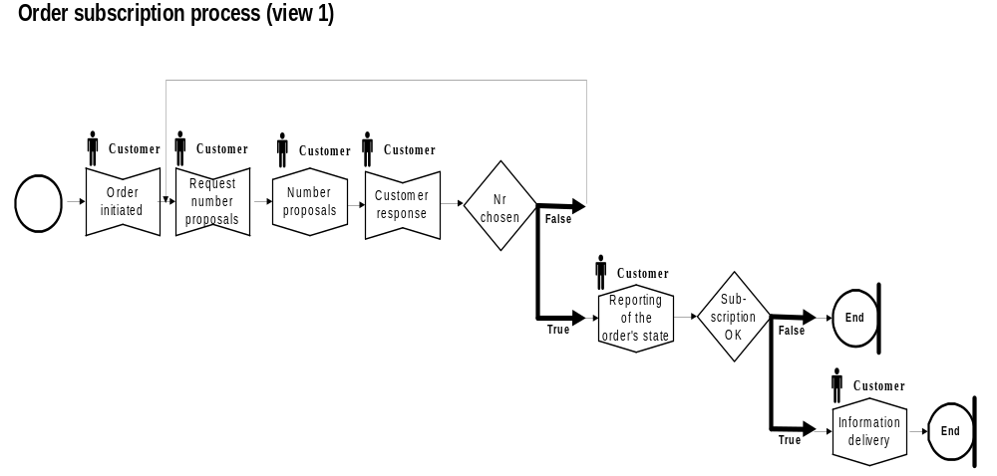
Methodology for Design
Notes:
The main idea in this methodology is to model a process through a series of views starting with a customer oriented view on the business level, which models the interactions between the process broker and the customer. The succeeding views add more and more details moving from a business perspective to a technical perspective by adding interactions with external applications, exception handling, etc. Each view is an extension of the previous one, either through adding subprocesses or through introducing new components into the existing diagrams. This approach gives the designer increased control by allowing her to focus on different aspects of a process in different views.

Slide 35
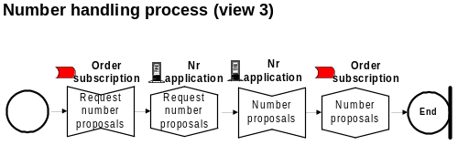
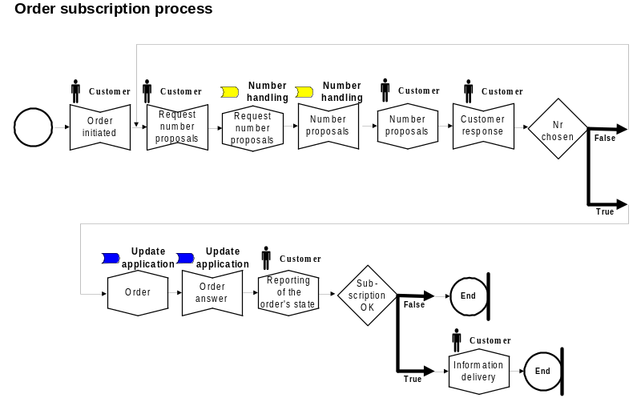
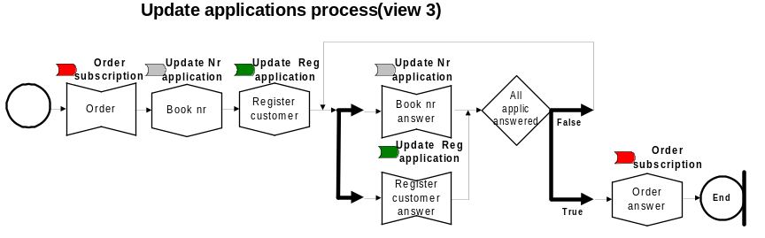
Methodology for Design

Slide 36
Process Libraries
Sell product
Presales
Postsales
Identify
Inform
Obtain
Deliver
Receive
customer
customer
order
product
payment
Sell by mail order
Presales
Postsales
Obtain
Mail to
Receive or-
Deliver
Receive
mailing list
mailing list
der
by mail
product
payment
Notes:
Another important topic is how process libraries can be used in the context of application and process integration.. A typical usage scenario is a business designer who constructs a new process for sales. She could navigate the process library to identify a variety of alternative sales processes, e.g. sales by retail, mail order, or Internet. After having compared the alternatives, she can choose one or more processes, combine parts of them, and restructure the resulting process. Using a process broker, she can finally generate software for supporting the process and integrate with requested applications.
One of the most important research problems for process libraries are mechanisms for structuring the libraries so they become easy to browse and search. Two basic structuring mechanisms are decomposition and specialisation. A process can be decomposed into subprocesses in several levels and finally into tasks. An example is shown in Fig. 5, where the “Sell product” process contains two subprocesses “Presales” and “Postsales”, which are decomposed into tasks such as “Identify customer” and “Receive payment”. Processes can also be organised in a specialisation hierarchy. This is similar to an object inheritance hierarchy in conventional object-oriented analysis and design. An object inheritance hierarchy consists of increasingly specialised objects that are associated with actions (i.e. methods). A process hierarchy, on the other hand, consists of increasingly specialised actions (i.e. processes and tasks) that are associated with objects. An example of a specialisation of the process in Fig. 5 is given in Fig. 6. Process hierarchies provide two main benefits for a process library. First, they enable concise representations.. Secondly, hierarchies facilitate navigation in a process library: users can traverse the hierarchy upward in order to identify more general versions of a process and they can move across the hierarchy to find related processes.

Slide 37
Adaptive Process Management
Types of exceptions:
Basic failures
Application failures
Expected exceptions
Unexpected exceptions
Notes:
Current software systems for supporting process management are effective for predictable and repetitive processes. However, they are typically unable to adapt to a dynamic environment where exceptions may occur. It is possible to identify among four different types of exceptions : basic failures, which are failures of the software system or its environment; application failures, which are failures of the applications that are invoked by the software system; these two types of failures are usually handled by the underlying layers of the process management system, e.g. by a database management system that supports recovery.
A third type of exceptions are expected exceptions, which are predictable deviations from the normal flow of the process; . expected exceptions can be caused by temporal events (e.g. the expiration of a deadline) or by actions by external agents (e.g. a customer cancels a booking). Such events typically take place asynchronously with the tasks in the process, which means that they are not easily modelled by a graph of tasks. Instead, a more promising approach for representing expected exceptions is to use ECA (Event-Condition-Action) rules,
The fourth type of exceptions are unexpected exceptions, which are mismatches between the actual execution of a process and its definition in the software system. An unexpected exception is caused by a change in the process that could not have been anticipated at design time, e.g. a new government regulation. Unexpected exceptions can be handled in different ways. One approach is to modify the process definition so that also future process instances will execute according to the new definition. This gives rise to the problem on how to handle the already running process instances and to research issues to determine when a running instance can be migrated to a new process definition.

Slide 38
Moving Business Logic out of Applications
Sequencing
Customer service selection
Transaction integrity
Business rule represented only once simplifies change and reduces risk for inconsistency
Notes:
I think we have to distinguish business process logic, i.e. The rules that drive the process, from application logic, i.e. Rules that sits closer the particular applications. The latter may be e.g. Integrity constraint for database updates, wheras the business logic are controled event action rules that govern the sequencing of or rules that constrain the way applications and services are combined.

Slide 39
Conclusion
Application systems need to be integrated over
business processes so as to form an information systems
infrastructure that seamlessly supports each process.
This demands the introduction of technologies, methods,
and tools to easily define and manage business process
and their integration requirements.
Application A
Application B
Broker
Application C
Application D

Slide 40
Books
S. Abiteboul et.al.: Data on the Web: From Relations to Semi-Structured Data and XML, Morgan Kaufmann, 1999
M. Kirchmer: Business Process Oriented Implementation of Standard Software, Springer, 1998
D. Linthicum: Enterprise Application Integration, Addison-Weseley, 2000
J. Morgenthal: Enterprise Application Integration with XML and Java, Prentice Hall, 2000
R. Zahavi: Enterprise Application Integration with CORBA, John Wiley & Sons, 1999

Slide 41
Web sites
Resources
  EAI Journal: www.eaijournal.com
  Intelligent Enterprise: www.intelligententerprise.com
Companies
  Extricity: www.extricity.com
  HP: www.hp.com
  Viewlocity: www.viewlocity.com
  Crossworlds: www.crossworlds.com
  Vitria: www.vitria.com

Slide 42
Documentation
This presentation (in PowerPoint) and a number of related papers and links can be found on the following URL:
http://www.dsv.su.se/~pajo/arrange/index.html

