Slide 1
Importance of Adaptability to New Technologies and Tools
Created by – Manish Jha
Data Scientist

Slide 2
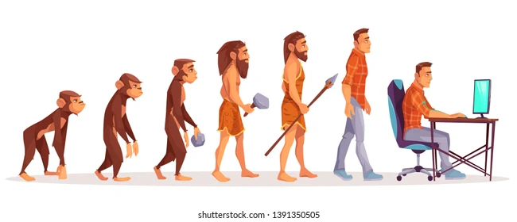
Picture 1

Slide 3
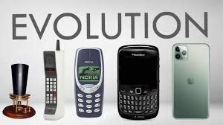
Picture 2

Slide 4
Examples from the Industry who could not adapt.
1. Kodak – Ignored Digital Photography
What happened: Despite inventing the first digital camera in 1975, Kodak stuck to film because they feared digital would hurt their core business.
Result: Digital photography took over, and Kodak filed for bankruptcy in 2012.
2. BlackBerry – Clung to Physical Keyboards
What happened: They underestimated the iPhone’s touchscreen revolution, believing business users would never leave their keyboard devices.
Result: iOS and Android took over; BlackBerry lost nearly all market share.
3. Yahoo – Missed the Internet Boom
What happened: Yahoo passed on buying Google for $1M and Facebook for $1B, and later struggled to define its core business.
Result: Lost relevance in search, mail, and news; eventually sold to Verizon for a fraction of its peak value.

Slide 5
Examples from the Industry who could adapt.
1. Netflix – From DVD Rentals to Streaming Giant
Then: Mailed DVDs to customers.
Now: Pivoted to streaming, then to content creation (Netflix Originals), and now AI-based recommendations.
2. Amazon – From Bookstore to Everything Store + Cloud Leader
Then: Online book retailer in the 1990s.
Now: E-commerce giant, cloud provider (AWS), and even hardware (Echo, Alexa).
3. Spotify – From Piracy Era to Streaming Pioneer
Then: Entered when piracy was rampant.
Now: Created a legal, user-friendly streaming platform, embraced AI recommendations and podcasts.

Slide 6
Why Adaptability Matters in the Tech World
“In today’s fast-paced tech landscape, tools and platforms evolve rapidly. What’s cutting-edge today may become obsolete tomorrow.”
Adaptability is your superpower — the ability to learn, unlearn, and relearn to keep pace with change.
✨ It’s not just about survival — it's about staying competitive, innovative, and ready for the next opportunity.
💡 Think of adaptability as the bridge between your current skill set and your future success.

Slide 7
🚀Technology Evolves — So Must You
“The only constant in technology is change.”
Just a few years ago, developers wrote plain JavaScript for web apps. Then came React, revolutionizing UI development. Now, ecosystems like Next.js are setting new standards for performance and scalability.
Similarly, in the world of Data Science: We began with Excel, transitioned to R and Python, and now leverage powerful tools like Large Language Models (LLMs) and cloud platforms.
🔁 What’s common in both journeys? Those who adapted kept growing. Those who resisted got left behind.
📌 In tech, clinging to old tools is like sailing with a broken compass — you may stay afloat, but you’ll never reach the new world.

Slide 8
💼 Employers Seek Agile Minds
“In a world that changes by the minute, the ability to adapt is more valuable than any single skill.”
Modern companies are not just hiring for what you know today — they’re hiring for how quickly you can learn tomorrow.
🌟 Adaptability means:
Picking up new tools and technologies with ease
Tackling unfamiliar challenges without hesitation
Choosing the best solutions — not just the ones you already know

Slide 9
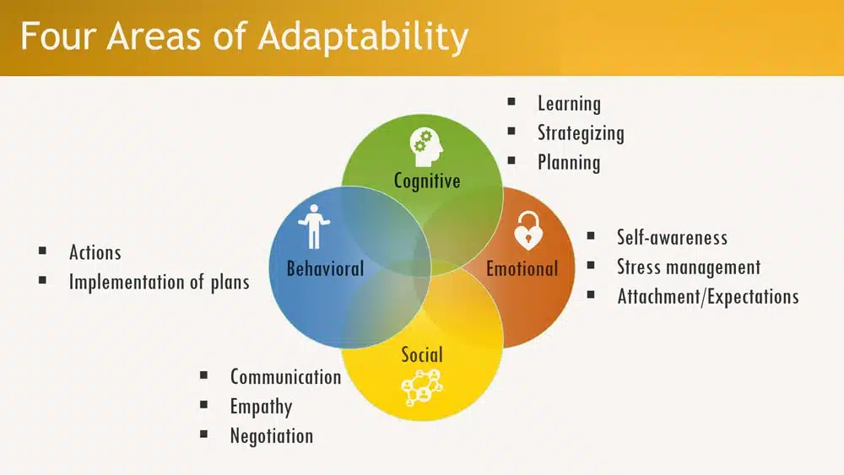

Slide 10
Practical Tips to Become More Adaptable
1. Set Weekly Learning Goals
Dedicate time each week to learn something new — a framework, a concept, or a tool. Small, consistent steps = big, long-term progress.
2. Break Out of Your Comfort Zone
Build quick, hands-on projects using tools you're unfamiliar with. This encourages real learning through experimentation and failure.
3. Follow GitHub Trends & Developer Communities
Stay plugged in to what the tech world is buzzing about. Communities like Reddit, Stack Overflow, Dev.to, Hashnode, and GitHub Explore reveal what’s next.
4. Embrace Discomfort as Growth
Growth is uncomfortable — that’s how you know you’re evolving. Don’t fear the unfamiliar — lean into it.

Slide 11
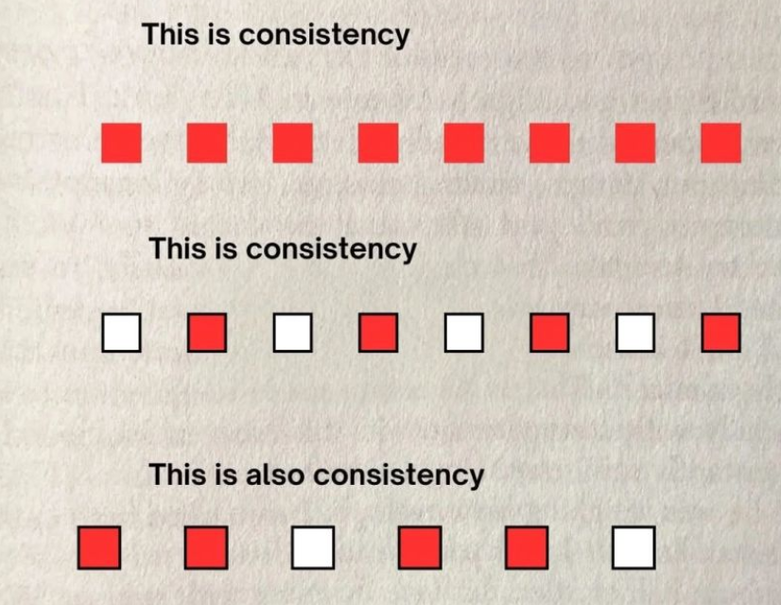
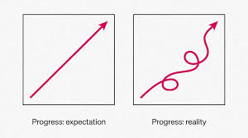

Slide 12
Tools to Watch (Data Science)
• Hugging Face: Pretrained LLMs and pipelines. • LangChain: LLM application framework. • DuckDB: Fast analytics engine. • Streamlit: Easy ML dashboards. • MLflow: ML lifecycle management.

Slide 13
Tools to Watch (Full Stack)
Next.js – React framework with server-side rendering
Remix – Full stack React framework focused on performance
SvelteKit – Lightweight and fast alternative to React
Tailwind CSS – Utility-first CSS framework
Vite – Fast frontend build tool
tRPC – End-to-end typesafe APIs with TypeScript
NestJS – Scalable Node.js backend framework
Socket.IO – Real-time communication library (e.g., chats, live updates)

Slide 14
Your Career Depends on Learning Agility
Adaptability is more than knowing tools — it's a mindset. Are you ready to learn what’s needed when it's needed? If yes, you’ll always find your place in the fast-moving tech world.

Slide 15
Closing Thoughts
Your degree or certification gets you started. But adaptability ensures you stay in the race. Celebrate learning, embrace change, and stay open to growth. The future belongs to the adaptable.

