Slide 1


Slide 2
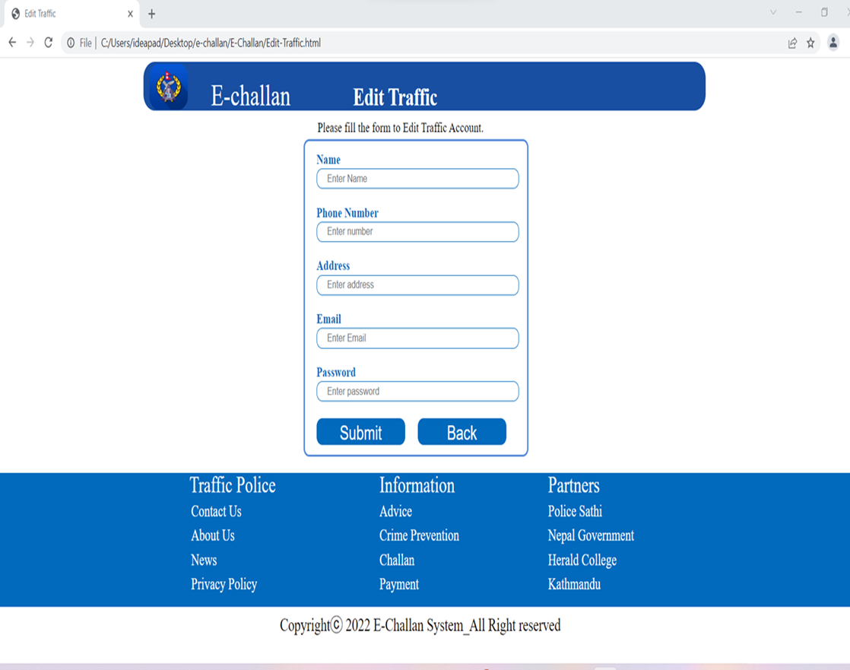
Traffic edit page
Edit traffic (frontend)
It is a feature for editing the information of the traffic.
The field required to fill are name phone ,address , email, password.
There are two buttons submit and back the back button leads back to the admin dashboard

Slide 3
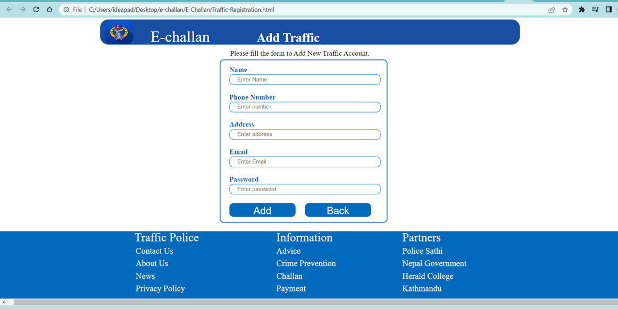
Traffic Registration
Add Traffic (frontend)
It is a feature for adding the information of the traffic.
The field required to fill are name phone ,address , email, password.
There are two buttons add and back the back button leads back to the admin dashboard

