Slide 1
JDBC
Manish Kumar

Slide 2
Introduction
JDBC is a standard java API for independent database connection between a java program and wide range of relational database.
JDBC API is present in the “java.sql” package
Database independence

Slide 3
Architecture

Slide 4
Types of JDBC Drivers
Type 1; jdbc-odbc bridge driver
Type 2; native API partly java driver.
Type 3; net protocols all java driver.
Type 4; native protocols all java driver.

Slide 5
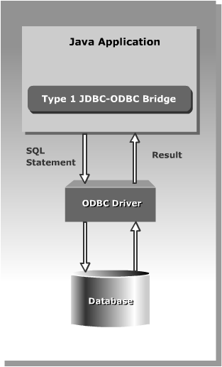
Type-1 Driver
Also known as a JDBC-ODBC Bridge it converts JDBC methods into ODBC function calls. The driver is a platform dependent because it uses ODBC which is depends on native libraries of the operating system and also the driver needs other installation for example, ODBC must be installed on the computer and the database must support ODBC driver.

Slide 6
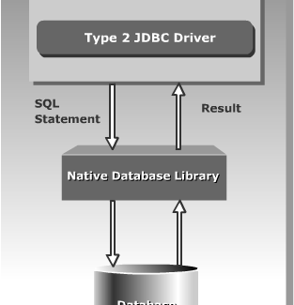
Type-2 Driver
The JDBC type 2 driver is uses the libraries of the database which is available at client side and this driver converts the JDBC method calls into native calls of the database so this driver is also known as Native-API driver.

Slide 7
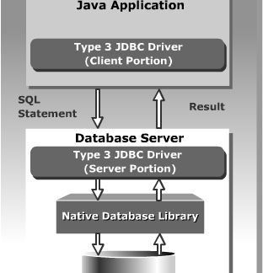
Type-3 Driver
The JDBC type 3 driver uses the middle tier(application server) between the calling program and the database and this middle tier converts JDBC method calls into the vendor specific database protocol and the same driver can be used for multiple databases also so it’s also known as a Network-Protocol driver as well as a JAVA driver for database middleware.

Slide 8
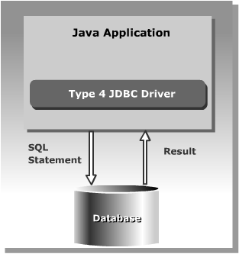
Type -4 Driver
The JDBC type 4 driver converts JDBC method calls directly into the vendor specific database protocol and in between do not need to be converted any other formatted system so this is the fastest way to communicate quires to DBMS and it is completely written in JAVA because of that this is also known as the “direct to database Pure JAVA driver”.

Slide 9
JDBC Driver Usage
If you are accessing one type of database, such as Oracle, MYSQL, or IBM, the preferred driver type is 4.
If your Java application is accessing multiple types of databases at the same time, type 3 is the preferred driver.
Type 2 drivers are useful in situations, where a type 3 or type 4 driver is not available yet for your database.
The type 1 driver is not considered a deployment-level driver, and is typically used for development and testing purposes only.

Slide 10
Using JDBC API
Using JDBC API
The JDBC API classes and interfaces are available in the java.sql and the javax.sql packages.
The commonly used classes and interfaces in the JDBC API are:
DriverManager class: Loads the driver for a database.
Driver interface: Represents a database driver. All JDBC driver classes must implement the Driver interface.
Connection interface: Enables you to establish a connection between a Java application and a database.
Statement interface: Enables you to execute SQL statements.
ResultSet interface: Represents the information retrieved from a database.
SQLException class: Provides information about the exceptions that occur while interacting with databases.

Slide 11
Steps to connect?
Define the connection URL.
Established the connection.
Create the Statement object.
Execute a query.
Process the results.
Close the connection.

Slide 12
Define the connection URL.
static String url = "jdbc:mysql://localhost:3306/demo";

Slide 13
Establish the Connection
import java.sql.Connection;
import java.sql.DriverManager;
static String user ="root";
static String pass = "rootpassword";
Connection myCon = DriverManager.getConnection(url, user, pass);

Slide 14
Create the Statement object.
Statement st = myCon.createStatement();

Slide 15
Execute a query.
String sql = "select * from student";
ResultSet result = st.executeQuery(sql);

Slide 16
Process the results
while(result.next()) {
System.out.println(result.getString("firstname"));
}

Slide 17
Close the Connection
finally {
myCon.close();
}

Slide 18
Transactions and JDBC
JDBC allows SQL statements to be grouped together into a single transaction
Transaction control is performed by the Connection object, default mode is auto-commit, I.e., each sql statement is treated as a transaction
We can turn off the auto-commit mode with con.setAutoCommit(false);
And turn it back on with con.setAutoCommit(true);
Once auto-commit is off, no SQL statement will be committed until an explicit is invoked con.commit();
At this point all changes done by the SQL statements will be made permanent in the database

Slide 19
Handling Errors with Exceptions
Programs should recover and leave the database in a consistent state.
If a statement in the try block throws an exception or warning, it can be caught in one of the corresponding catch statements
How might a finally {…} block be helpful here?
E.g., you could rollback your transaction in a catch { …} block or close database connection and free database related resources in finally {…} block

Slide 20
Exercise

