Slide 1

Student Management System

Slide 2

Introduction
Full Stack Application – Student Management
System)
A student management system is an application which is designed to manage all the details of students.
It is automated version of manual Student Management System.
The main function of this application is to maintain students data.

Slide 3
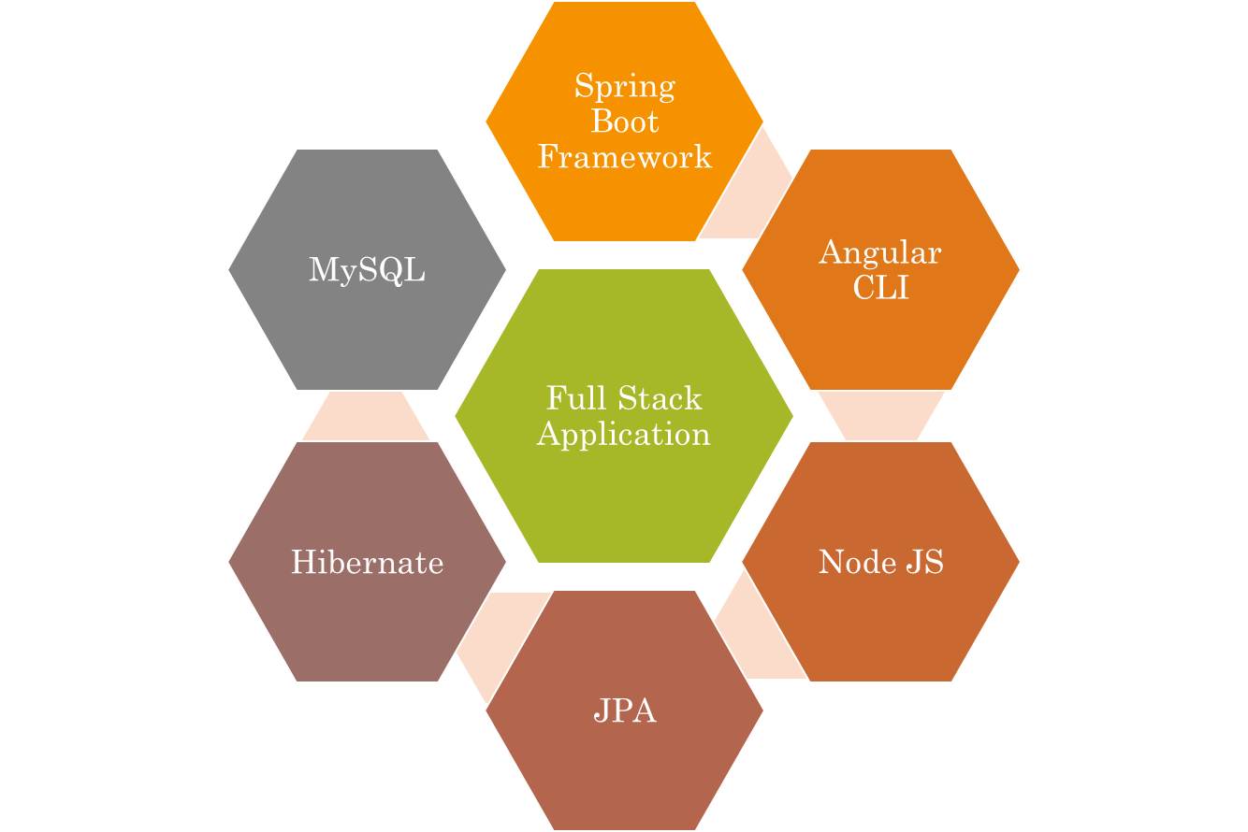
Technologies Used

Slide 4
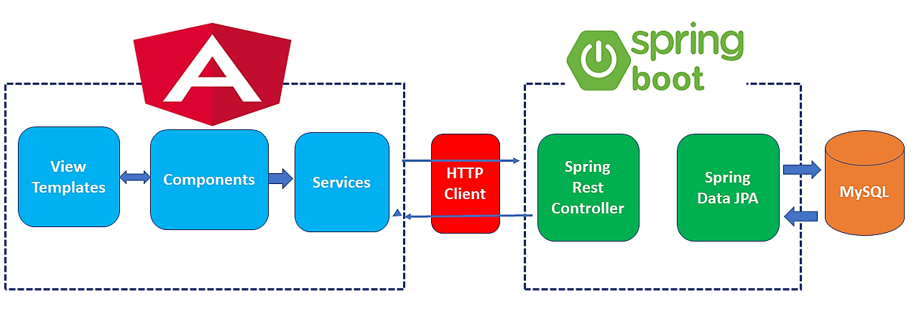
The Architecture of Angular, Spring
& database(MySQL)

Slide 5

CRUD OPERATION

Slide 6

Home Page

Slide 7
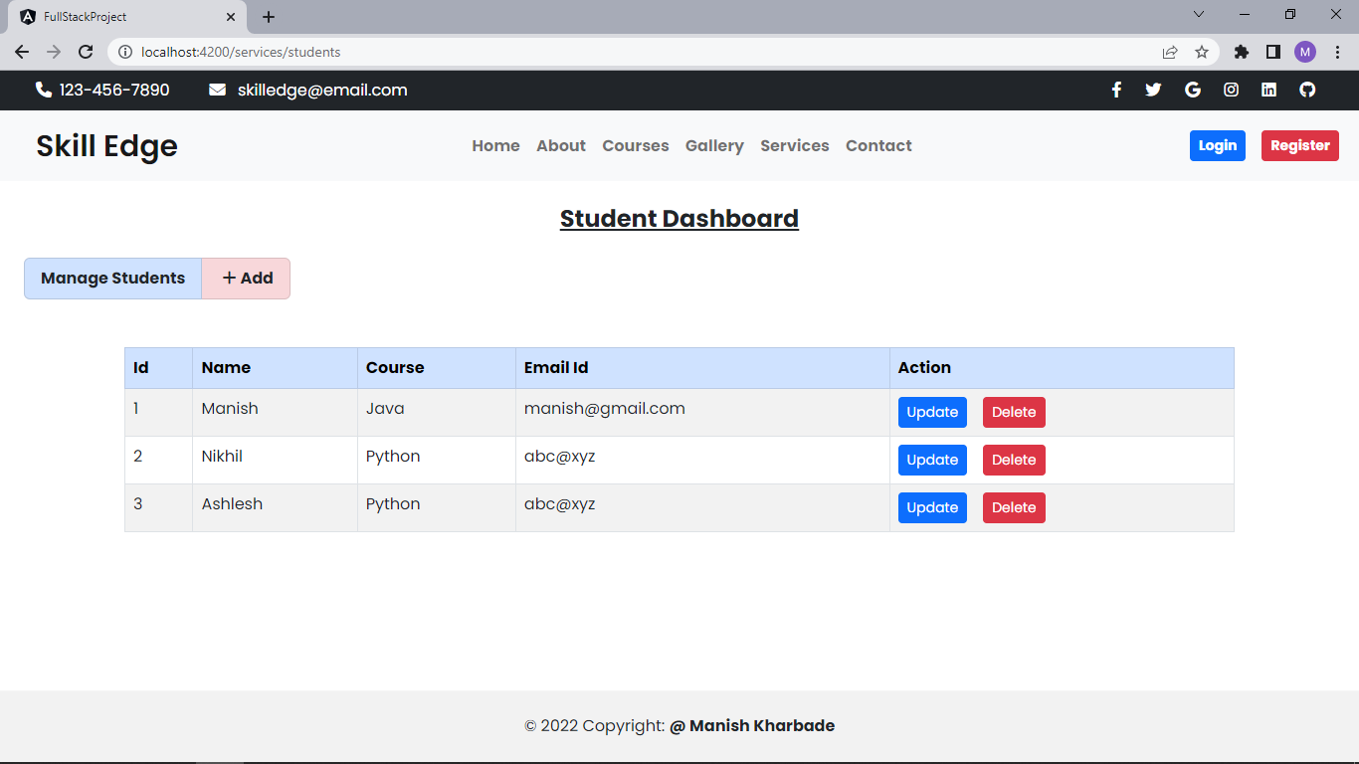
Service Page

Slide 8
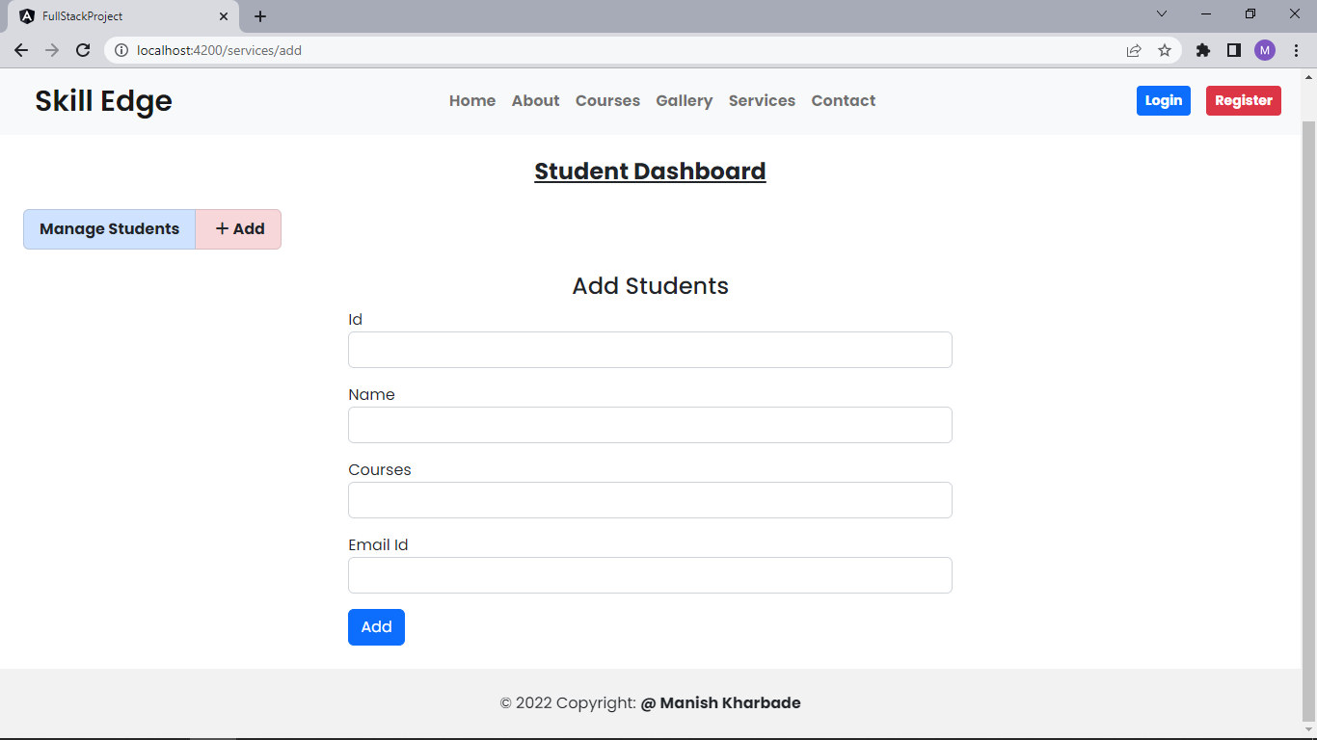
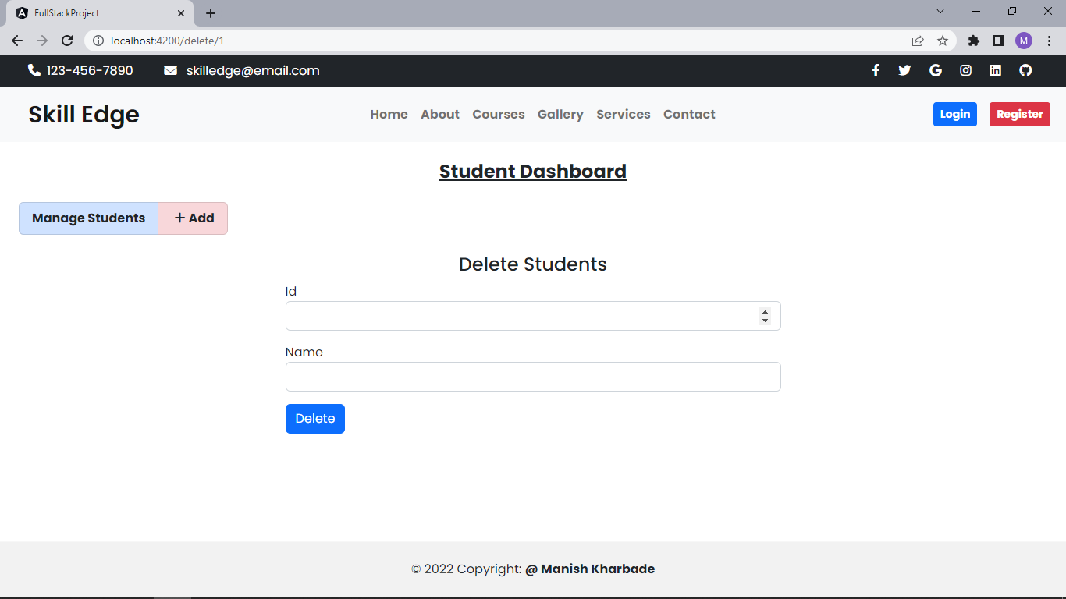
Add & Delete Page

Slide 9
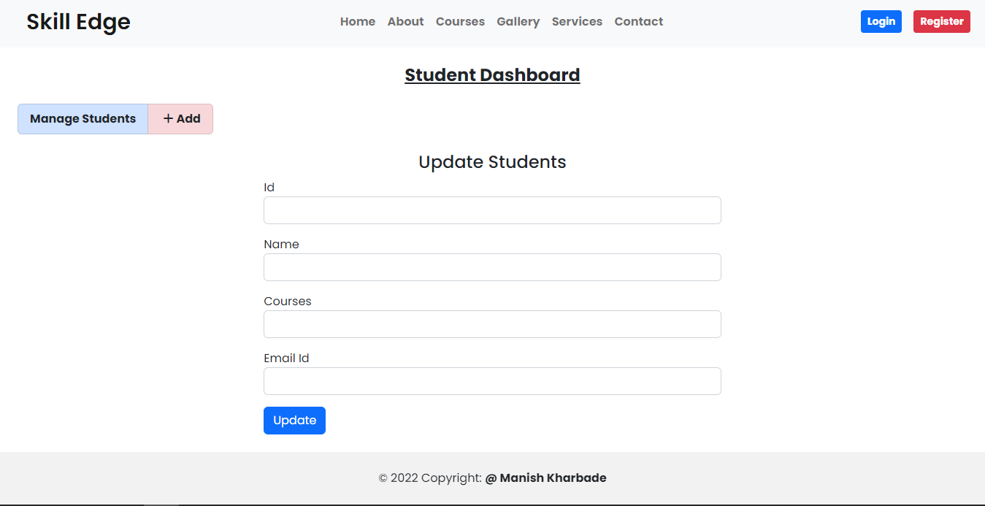
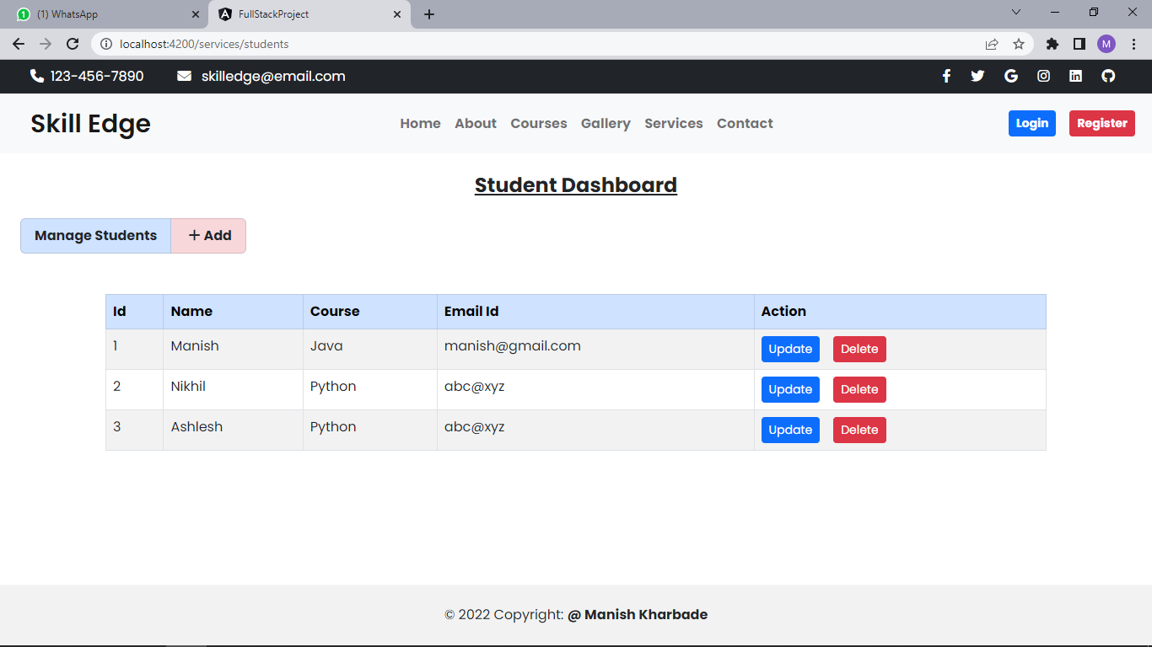
Update & View Page

Slide 10
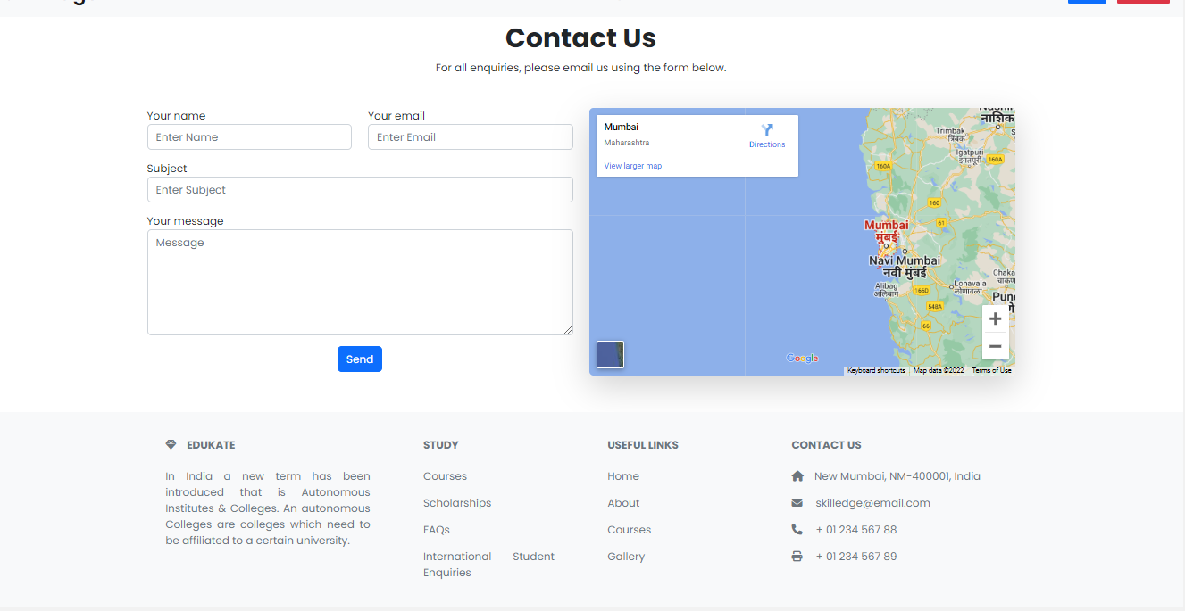
Contact Us Page

Slide 11
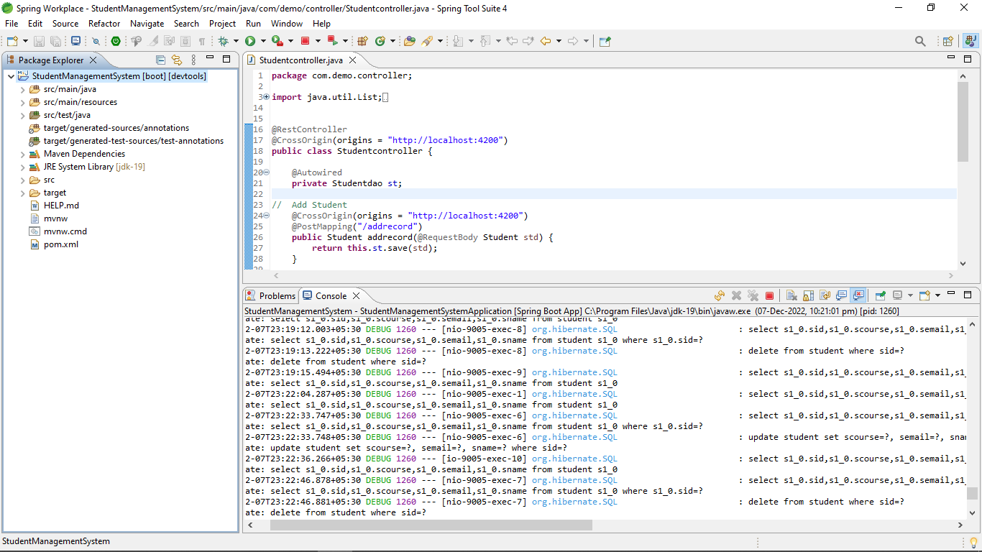
Spring Boot Application

Slide 12
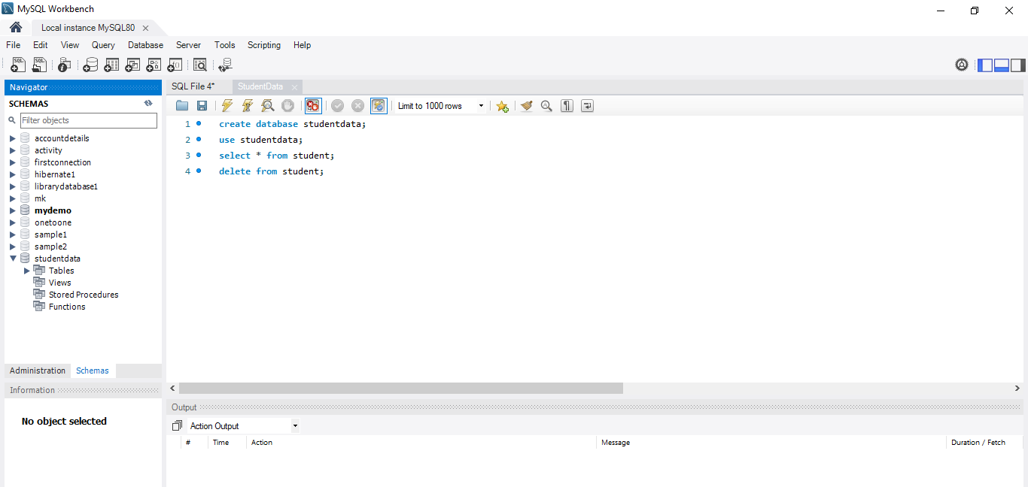
MySQL Code

Slide 13
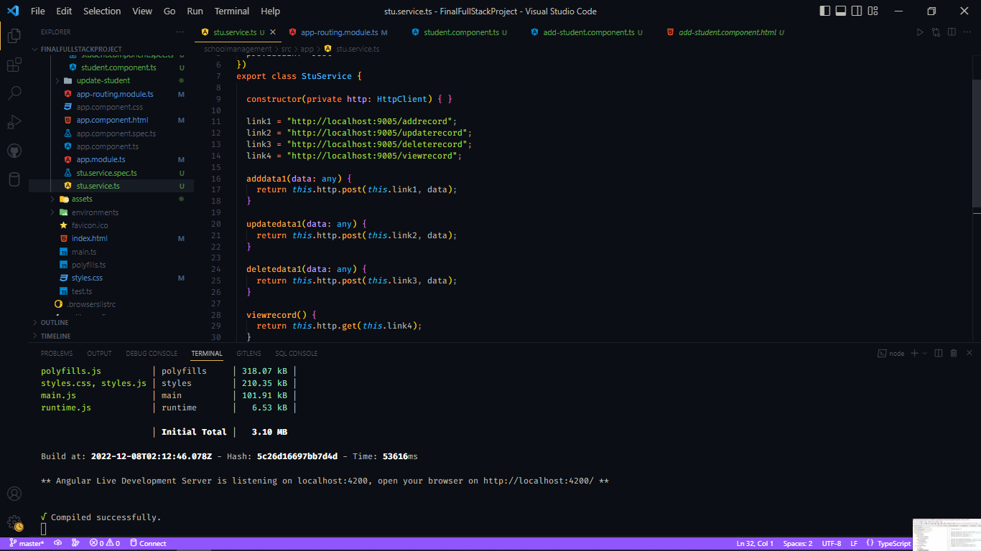
Frontend- Angular Code

Slide 14

The scope of this project is as follows:
In the Future Student can also be able to upload or download notes.
We will see the entire system more interactive and also be able to give statistics data.
We can run the entire system in any operating system and also we have an mobile application of this entire system.

Slide 15

GitHub Link
https://github.com/mkharbade

Slide 16

Thank You

