Slide 1
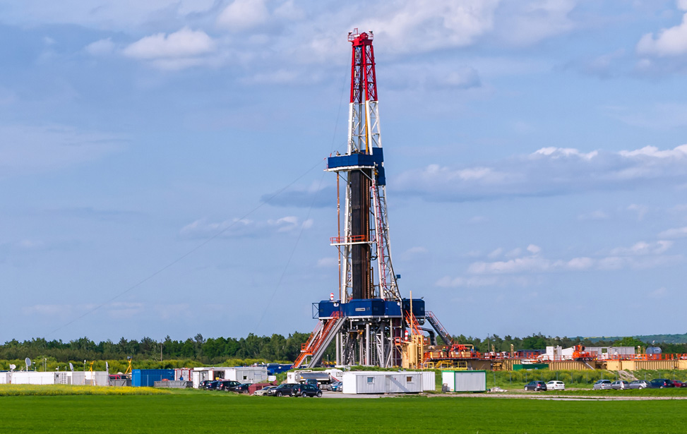
PROBLEM STATEMENT
To predict ROP (Rate of penetration) using real time downhole data such as Weight on Bit, Average rotary speed, measured depth etc
Presented by-Manish Kumar

Slide 2
Solution Approach
01
02
03
Exploratory Data Analysis
Removal of Outliers
Removing correlated features
04
05
Model Training
Predicting ROP
Importing Data ,Checking for Nan, missing values and using various visualization techniques
Outliers are replaced by the upper quartile range and lower quartile range respectively
Removing highly correlated features and features which are least correlated with rate of penetration
Training Extra Trees Regressor model with given data and cross validating the model
Using the trained model to predict rate of penetration

Slide 3
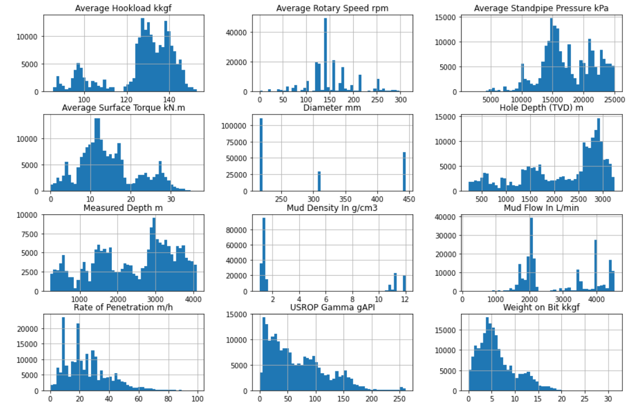
Exploratory Data Analysis
Importing data, checking for missing values, Nan, repeated values.
Using pair plots and histograms we observe that most of the features are not normally distributed and only a few features show linear relationship.
Presence of outlier is also indicated.

Slide 4
Removal of outliers
Removing correlated feature
Upper quartile range and lower quartile range calculated for each feature
Outliers were replaced by Upper quartile range and lower quartile range
Scaling is not used as Extra Trees Regressor is not affected by scaling.
Use of spearman correlation to determine correlation coefficient
Features having Correlation coefficient greater than 0.8 were removed
Features which were having correlation coefficient less than 0.10 with ROP were also removed
Average Rotary Speed, Average Surface Torque, Diameter, Hole Depth (TVD) were removed after this step
Notes:
as seen from histograms the data is not normally distributed.

Slide 5
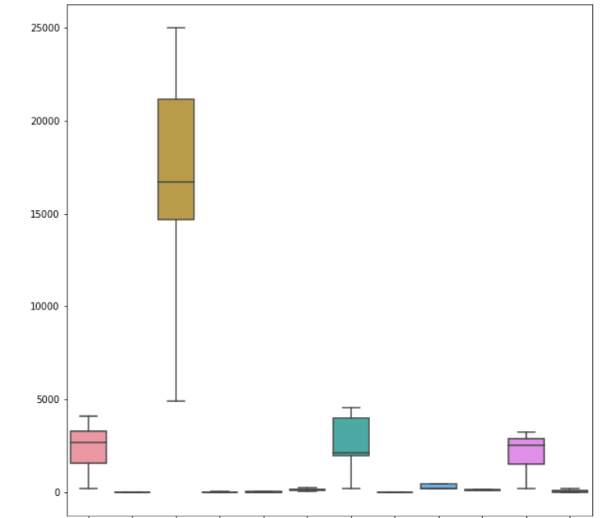
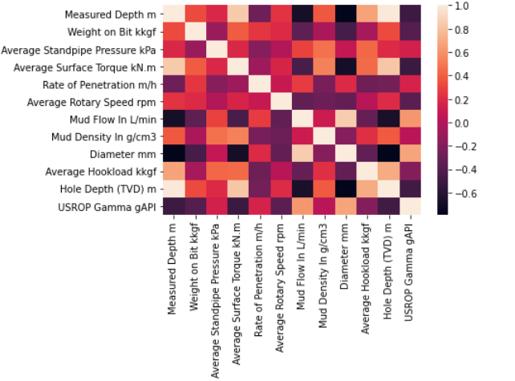
Box plot (just an illustration) to detect outliers Heatmap of correlation matrix

Slide 6
Why Extra Trees Regressor?
Hyper-parameter Tuning
Computationally faster than Random Forest
Random Split to divide parent node into child node
No Bootstrapping to minimize bias.
Randomness comes from random splits
Extra trees seem to have higher performance in presence of noisy features.
Parameters are tuned using randomized search cv.
Following parameters were found
max_depth=40
max_features=4
max_samples=0.63
n_estimators=350
random_state=43

Slide 7
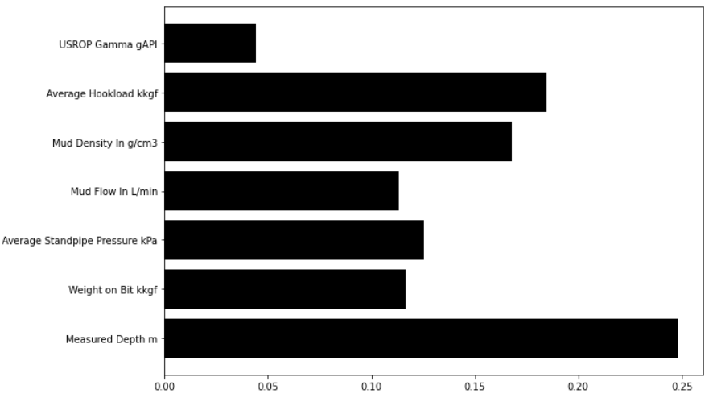
Feature Importance
Cross validation and Prediction
MAE on test data=0.041994
Cross Validation score with MAE as scoring criteria =-0.11203096, -0.11350096
Pickling the trained model
Preprocessing new data and predicting ROP

Slide 8
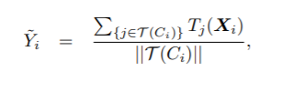
Improvements
Bias corrected Extra Trees can be tested for more better results
Grow a Extra Trees on training set(ET_{p} )
Calculate the prediction for training set (Y_{i})
Calculate prediction error on each data point(B_{i})
Grow another Extra Trees on prediction error(B_{i}) using training features (ET_{b})
Predict test data both on ET_{p} to get Y and ET_{b} to determine B
Final predicted value is Y-B
Tj (Xi) to be the predicted response value for case Ci by tree T
||T (Ci)|| is the number of elements in set T (Ci)
B_{i}=Y_{i}-Y , Y is actual value Y_{i} is predicted value

Slide 9
Conclusion
Predicting the rate of penetration (ROP) is critical for drilling optimization because maximization of ROP can greatly reduce expensive drilling costs
In this model we have used Extra Trees Regressor for predicting Rate of Penetration
7 features were selected for predicting ROP
Further improvements can be done for predicting ROP
Using combination of boosting and random forest can be used , however due to high computational cost it is not used.

Slide 10
Why me?
Interested in working towards autonomous drilling
Love to work in groups and have won International Case study competition organised by UPES student Chapter and Reliance E&P, Petro vision organised by PDEU Student Chapter
Technical Paper on “Technological Advances in Water-less Fracking: A Case Study” to be presented at The 45th Indonesian Petroleum Association Convention & Exhibition
Secured 2nd highest CGPA in first year
Love to constantly learn and implement
Self motivated and love to contribute towards betterment of technology in petroleum sector.
Would love to build my expertise in machine learning domain which would be beneficial for me as well as your organisation

