Slide 1
TRANSCRIPT INTELLIGENCE
Data Analysis & Insights — Take-Home Assignment
Manish Kumar
100 call transcripts · Python · Ollama (llama3.2:3b) · pandas · matplotlib
Support · External · Internal

Slide 2
What we built & found
01
Dataset Overview
05
Bonus B — Feature Gaps
100 calls · 3 types · 6 files each
69 signals · 18 high urgency
02
Task 1 — Topic Categorization
06
Bonus C — Churn Risk
11 macro-categories from 351 tags
36 of 70 customer calls flagged
03
Task 2 — Sentiment Analysis
07
Recommendations
Trends by type, category & arc
What to do next
04
Bonus A — Agent Performance
6 agents scored on 5 metrics

Slide 3
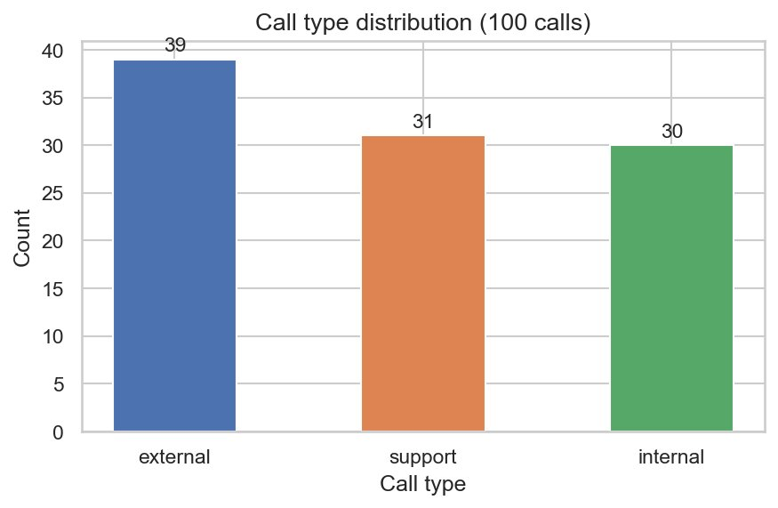
DATASET OVERVIEW
100 calls. 3 types. Rich structured data.
100
30.3m
6 files
351
Total calls
Avg call duration
Per call folder
Unique topic tags
About the dataset
Well balanced: 39 external / 31 support / 30 internal
External = renewals, QBRs, outage escalations with customers
Support = customer-initiated issue resolution calls
Internal = engineering syncs, war rooms, postmortems
Data pre-enriched: sentiment scores, topic tags, key moments, and action items already generated per call

Slide 4
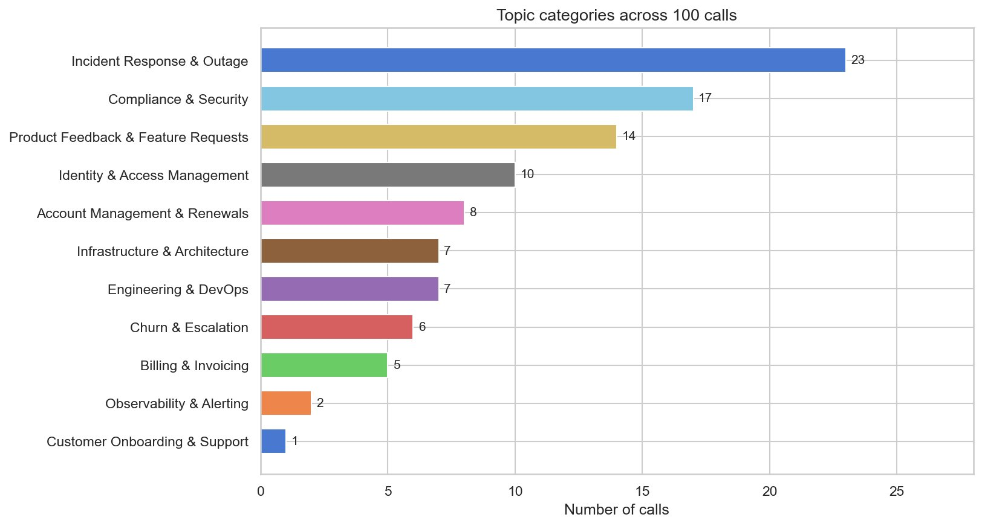
TASK 1 — TOPIC CATEGORIZATION
11 meaningful categories from 351 raw tags
Approach
Hybrid: seed tags + LLM clustering
Existing topic[] arrays from summary.json used as seeds — avoids hallucination
LLM groups semantically related tags (k-means can't know 'seat overage' = 'billing dispute')
Rule-based consolidation ensures consistent 12 standard categories
Key finding
Incident Response & Outage dominates (23 calls) — the Detect pipeline failure cascades across ALL call types: war rooms, customer escalations, and billing disputes are all outage-related.

Slide 5
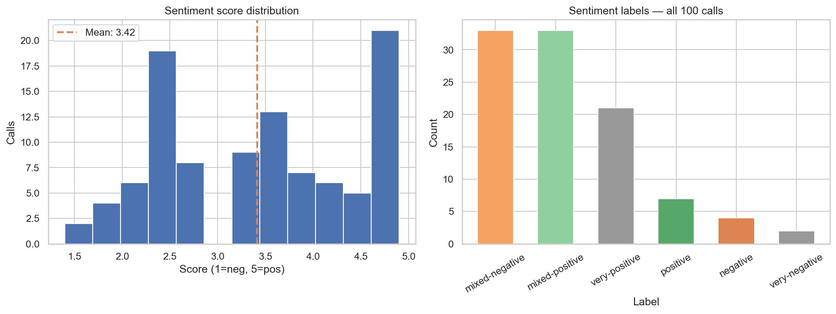
TASK 2 — SENTIMENT ANALYSIS
Avg 3.42 / 5.0 — but the story is in the distribution

Slide 6
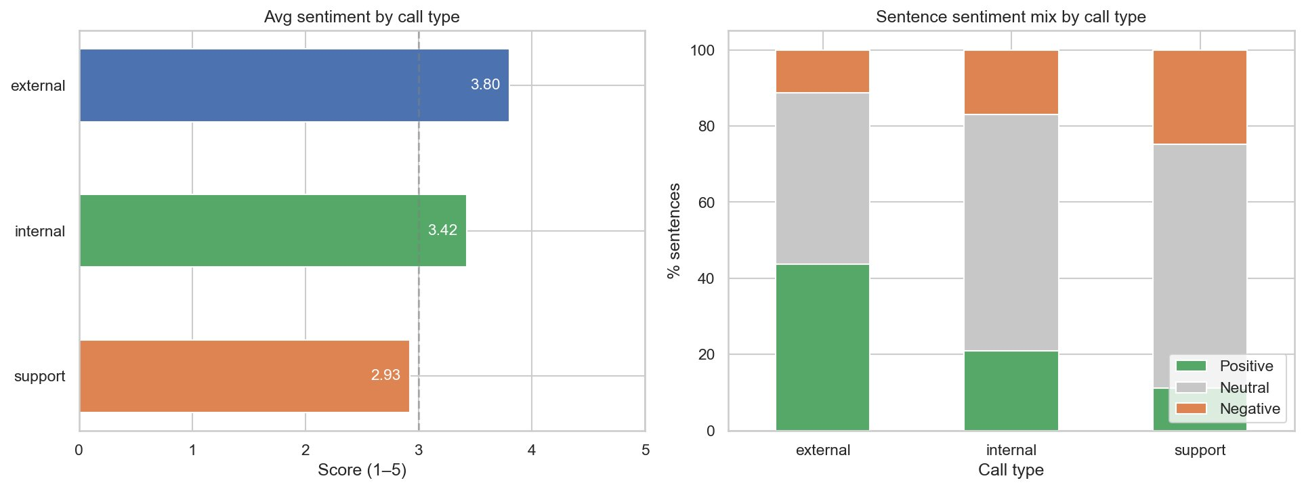
TASK 2 — SENTIMENT BY CALL TYPE
Support calls are in pain. External calls lead with positivity.
2.93 — Support avg
3.42 — Internal avg
3.80 — External avg

Slide 7
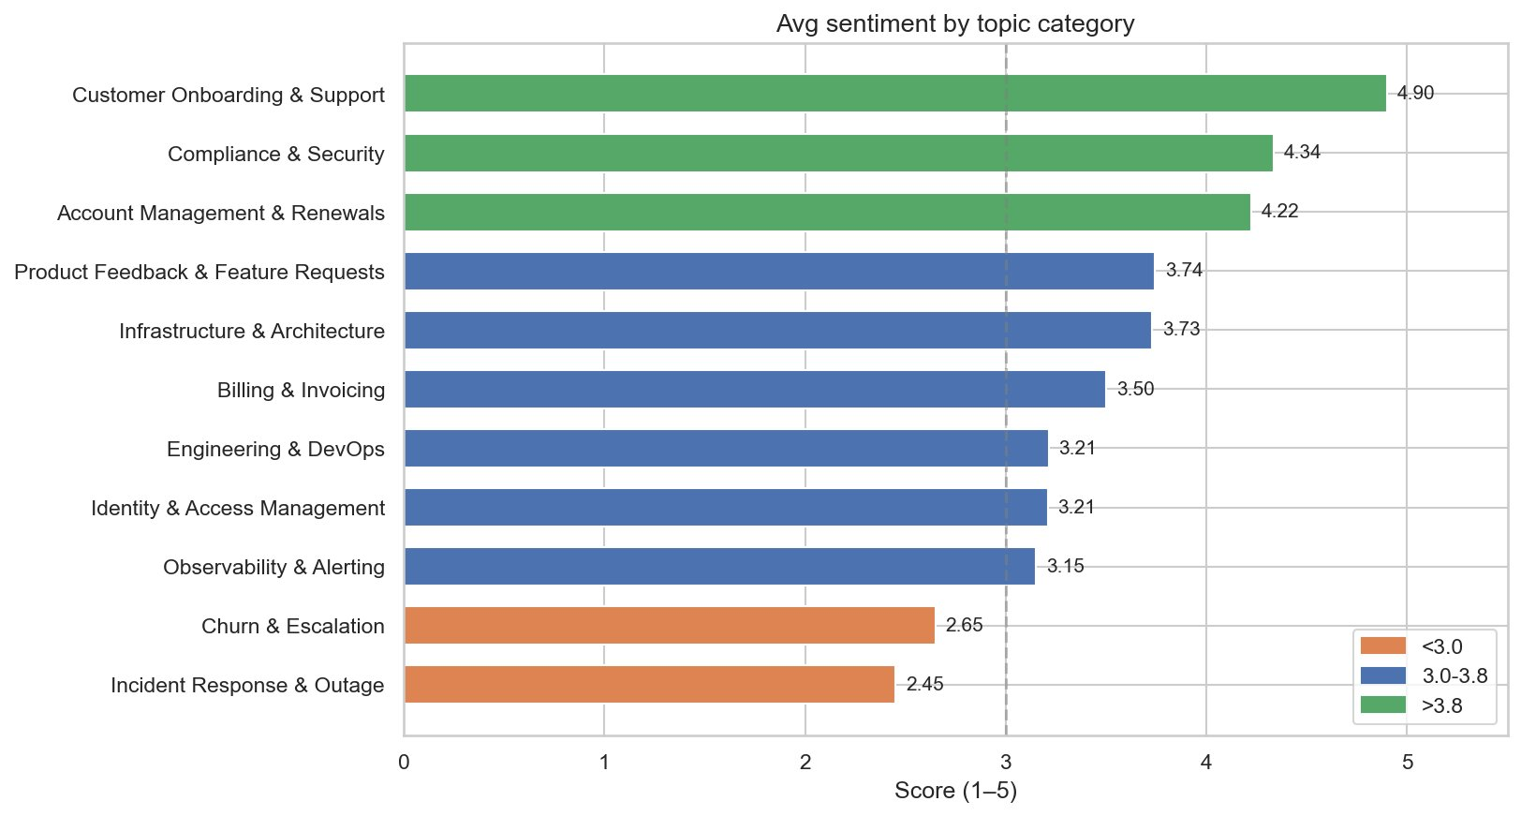
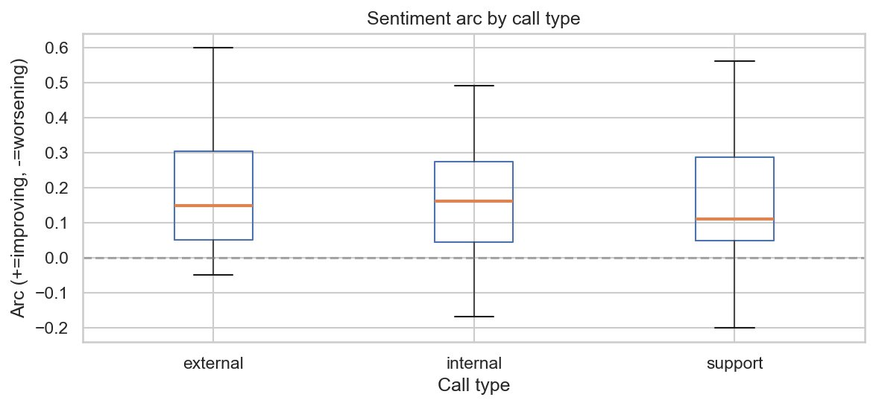
TASK 2 — CATEGORY SENTIMENT & ARC
Onboarding delights. Outages hurt. Agents generally recover well.
Sentiment arc insight
All 3 call types have median arcs above zero — meaning calls generally improve as they progress. Only 5% of calls worsened by end. Agents are effectively de-escalating.

Slide 8
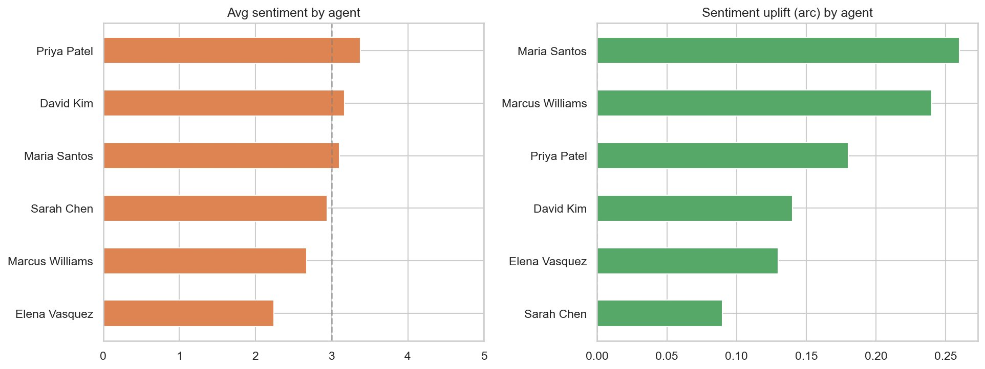
BONUS A — AGENT PERFORMANCE
Measure what matters: not just scores, but sentiment uplift.
Stakeholder
Support leaders
Highlights
Maria Santos: best uplift (0.25) — turns hard calls around
Elena Vasquez: lowest score AND arc — coaching needed
Priya Patel: highest avg score (3.3)
Talk ratio
How much agent vs customer speaks
Arc score
Did customer sentiment improve?
Avg sentiment
Overall call quality handled
Avg duration
Resolution efficiency
Action items
Follow-through accountability

Slide 9
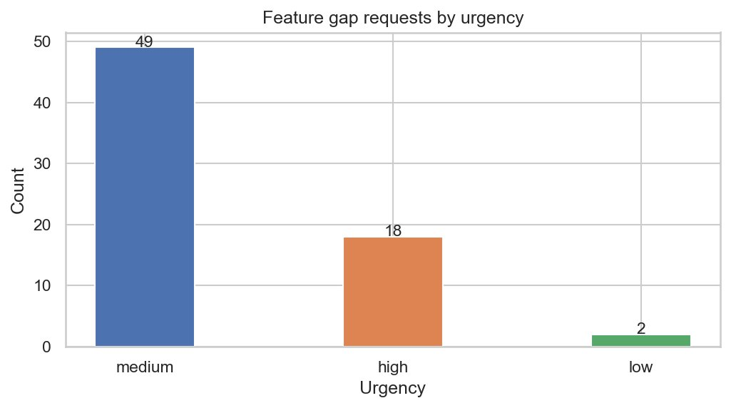
BONUS B — FEATURE GAP DETECTION
69 product signals hidden in transcripts — no survey needed.
Stakeholder: Product Managers
How it works
Step 1 (fast): Extract pre-flagged feature_gap key moments from summary.json
Step 2 (LLM): Scan transcript text for unmet needs, workarounds, missing functionality
Real examples
Usage threshold alerts (billing call)
Granular restore UX improvement
PDF export for compliance reports
Alert deduplication & fatigue reduction
18 HIGH urgency · 49 medium · 2 low · Found across support + external calls — the calls where customers have skin in the game

Slide 10
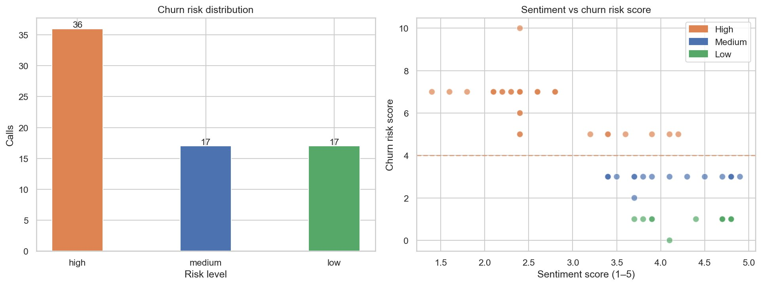
BONUS C — CHURN RISK SIGNALS
51% of customer calls show high churn risk — before it's too late.
+2
Billing dispute in topics
+2
Sentiment score < 3.0
+2
Escalation keywords
+2
churn_signal key moments
+1
Worsening sentiment arc
+1
> 3 open action items

Slide 11
CROSS-CALL INTELLIGENCE
One outage. Three call types. A cascading business impact.
Mar 10
9:14 AM
Mar 10–12
Mar 12–14
Mar 16+
Pipeline crash
Support tickets flood
Customer calls
Recovery plan
INCIDENT: Detect Pipeline Failure — War Room
Single node hits memory ceiling. No redundancy. Score: 1.8
47–112 open support tickets. Enterprise customers
Harmon Financial & TerraLogix escalating. Data loss feared.
Northstar Pharma, Meridian Capital, Fortex all on calls.
CISOs requesting competitive eval of SentinelShield.
Remediation Review call: redundant nodes + circuit breaker
Committed. Comply product confirmed unaffected.

Slide 12
RECOMMENDATIONS
What this data is telling us to do.
Product
Surface the 18 high-urgency feature gaps in next sprint planning. Threshold alerts and PDF export came up in multiple independent calls — not one-offs.
Customer Success
Contact all 36 high-risk accounts immediately. Accounts scoring 7+ (billing dispute + low sentiment + competitor mention) are at acute churn risk before renewal.
Support Leaders
Elena Vasquez needs coaching. Pair with Maria Santos who consistently delivers the highest sentiment uplift despite handling difficult calls.
Engineering
The single-point-of-failure architecture was a known risk flagged in calls but not prioritized. Calls show customers expect redundancy as table stakes.

Slide 13
Thank you
100 calls analyzed
69 feature gap signals
3 call types, 0% uncategorized
18 high urgency for product roadmap
11 topic categories
36 high churn risk calls
From 351 unique topic tags
51% of customer calls — act now
Avg sentiment 3.42 / 5.0
Support = 2.93 · External = 3.80
Manish Kumar · Transcript Intelligence Take-Home · 2026

