Slide 1
Deployment Architecture
Manish Kushwaha

Slide 2
Physical Deployment architecture view
DMZ
TRUSTED
Internet
www
My
Apps
Gateway
https
Products (could be services)
My App
Company Premise

Slide 3
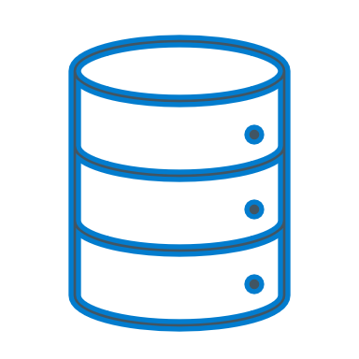
Deployment Architecture
https environment
Load Balancer
Communication through internet
Same as Primary
Service Discovery
Config. Server
MS1
App
IAM
Gateway
MS2
API documentation
Config Product
MS3
Component-group-1 on VM1
Component-group-2 on VM1
Component-group-3 on VM1
VM2 same as all Component as in VM1
Primary Environment
Secondary Environment
DB1
DB2
DB3
Cache like Ignite or Redis
Component-DB and Cache on another VM

Slide 4
Overall Deployment architecture view
My App Consumers
https
VPN/Internet
https
LB
Gateway 1
Gateway 2
Company
Premise
DMZ
. . .
Service Dis. 1
Service Dis. 2
TRUSTED
. . .
DB
Apps1
Apps1
Products are nothing but services
Product1
Product2
. . .
MS1
MS2
MS3

