Slide 1


Slide 2

Mini Project (01CE0609)
Review 2 (12/04/2025)
QUIZ APP
Team ID: 6CE_130
Team Member
MANISH KUMAR
92201703116
Guided By
Internal Guide Name: Prof Parth Shah
Department of Computer Engineering,
Faculty of Engineering & Technology

Slide 3


Quiz App

Slide 4

Project Overview
Purpose: Online Quiz Platform for Admins & Students
Tech Stack:
Frontend: React, Vite, Material-UI
Backend: Node.js, Express
Database: MongoDB

Slide 5

System Architecture
Diagram:
Frontend (Vite/React) → Backend (Express) → MongoDB
Key Components:
Frontend: Quiz Editor, Dashboard, User Views
Backend: REST API, Auth Middleware
Database: Quiz, User, Result Models

Slide 6
Frontend Highlight
Dynamic quiz interface with Material-UI
Responsive design (Grid/Flexbox)
Form validation & error handling

Slide 7
Backend API Structure
Endpoints:
POST /api/auth/login
GET /api/quiz
DELETE /api/admin/quiz/:id
Middleware:
JWT authentication
Role-based access (admin/student)

Slide 8
Authentication Flow
JWT Implementation:
User login → Server generates token
Token stored (localStorage)
Subsequent requests include token in headers
Security: HTTPS, token expiration (5h)

Slide 9
Features of the App
User authentication
Admin Dashboard
Dynamic quiz Creation
Performance Graph
Real-time Leaderboard
Quiz Containing atleast 10 Question.
Score tracking and result analytics
CURD Operation.

Slide 10
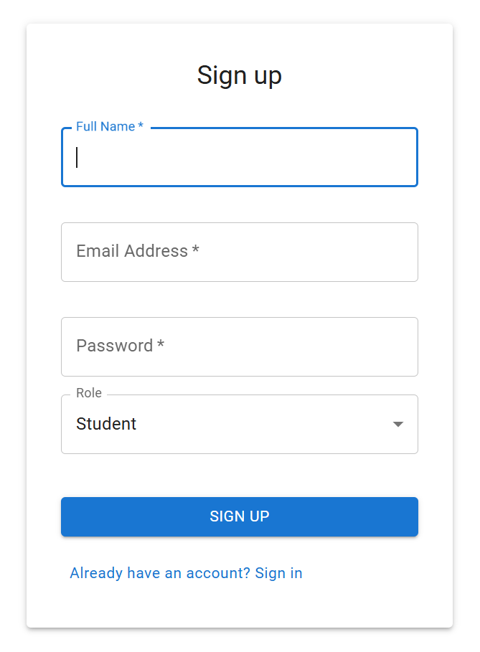
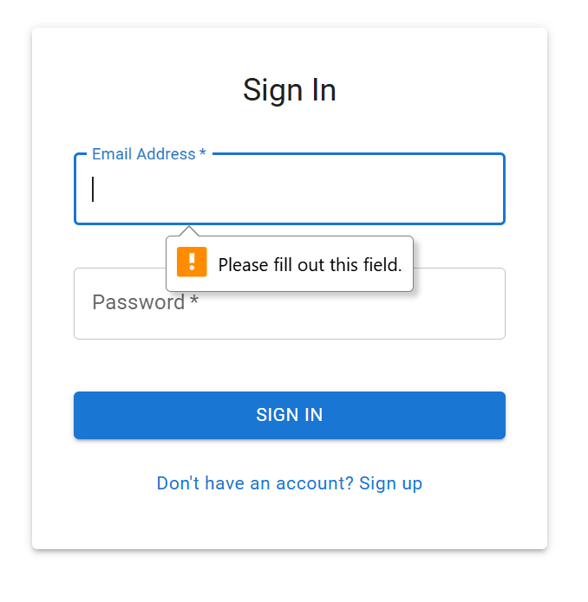
Key Features:
User authentication (JWT)

Slide 11
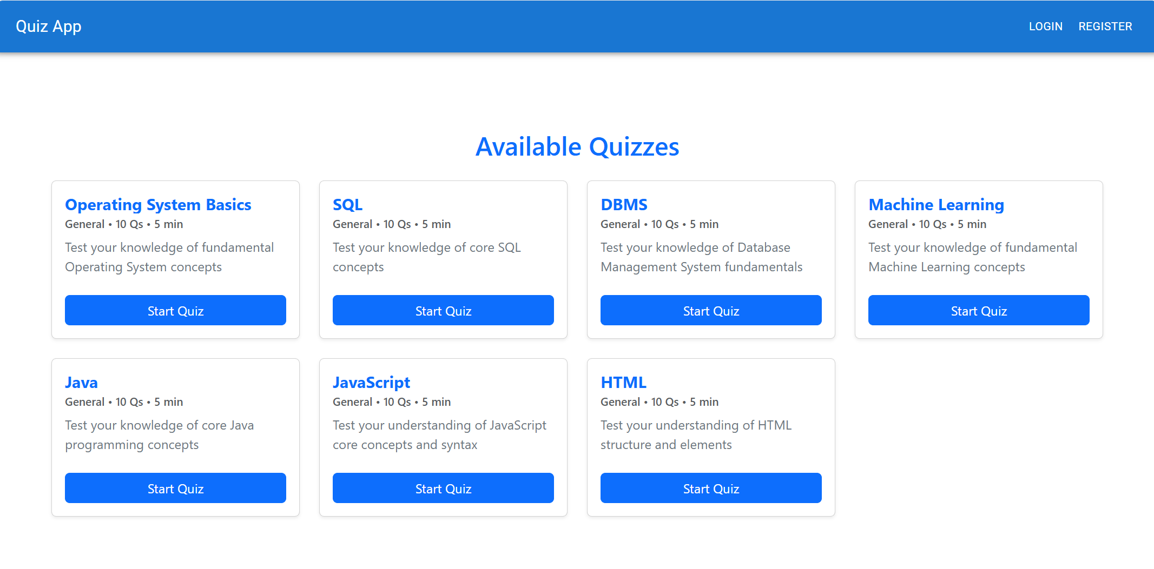
Key Features:

Slide 12
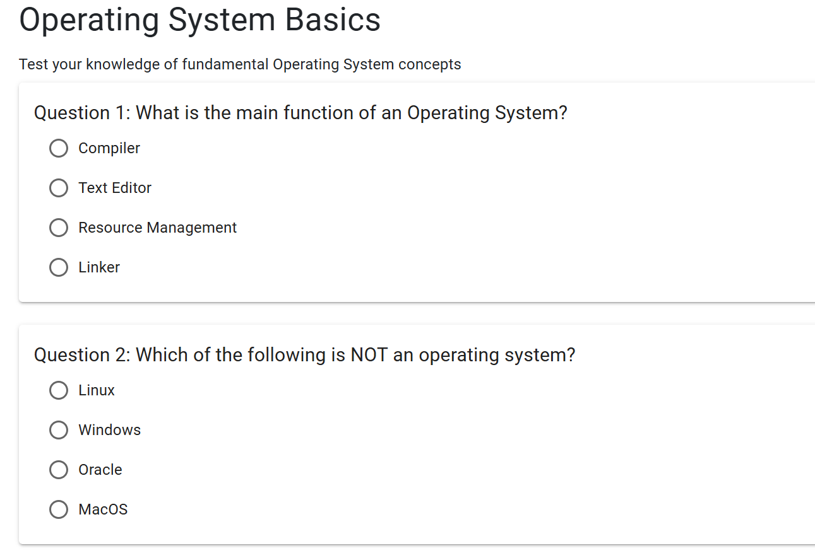
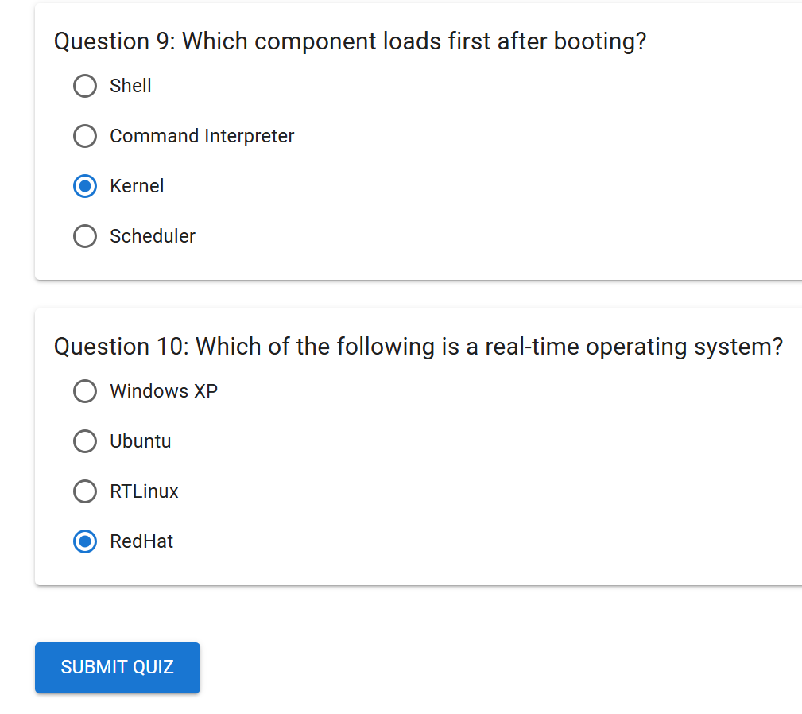
Question
Key Features:

Slide 13
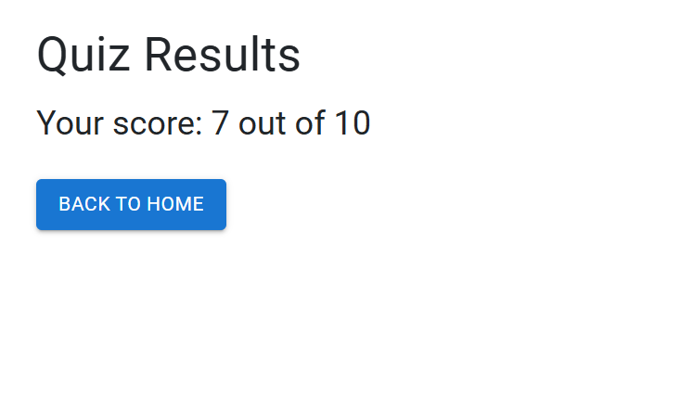
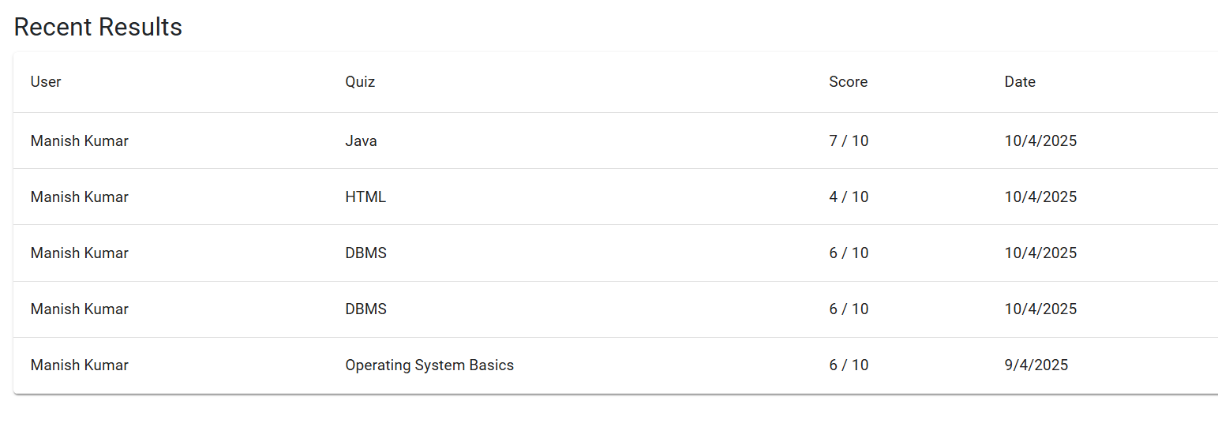
Results and History

Slide 14
Admin Features
Quiz Management:
Create/edit/delete quizzes
View results dashboard

Slide 15
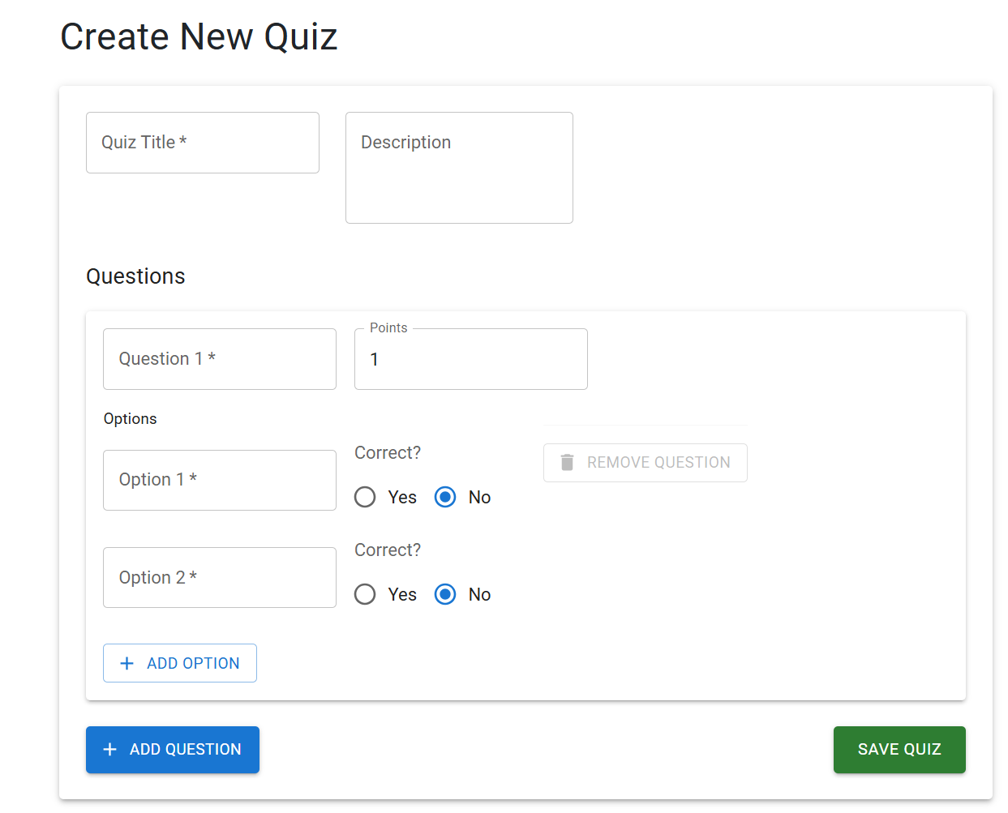
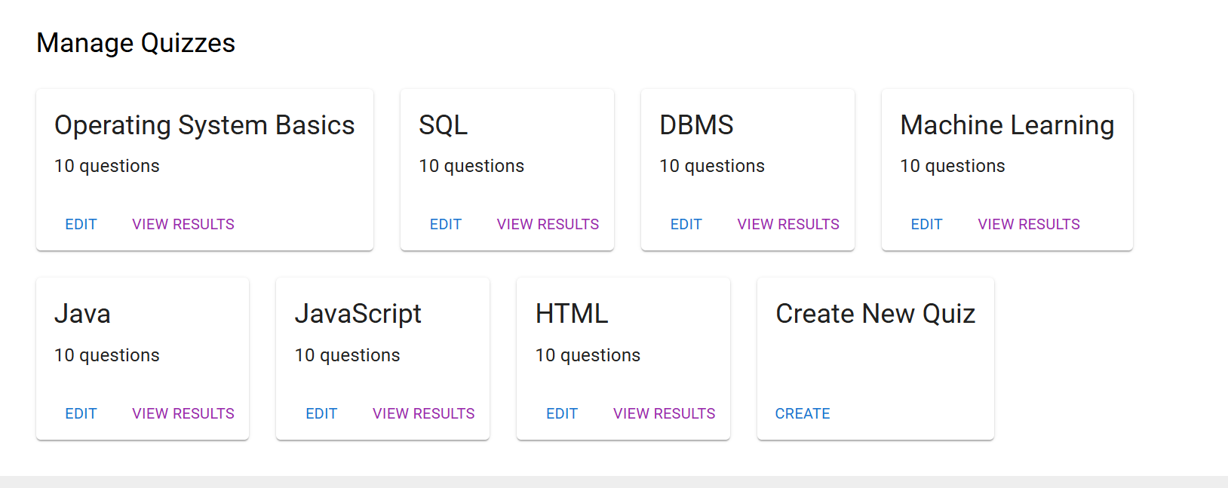
Key Features:
Quiz creation & management

Slide 16
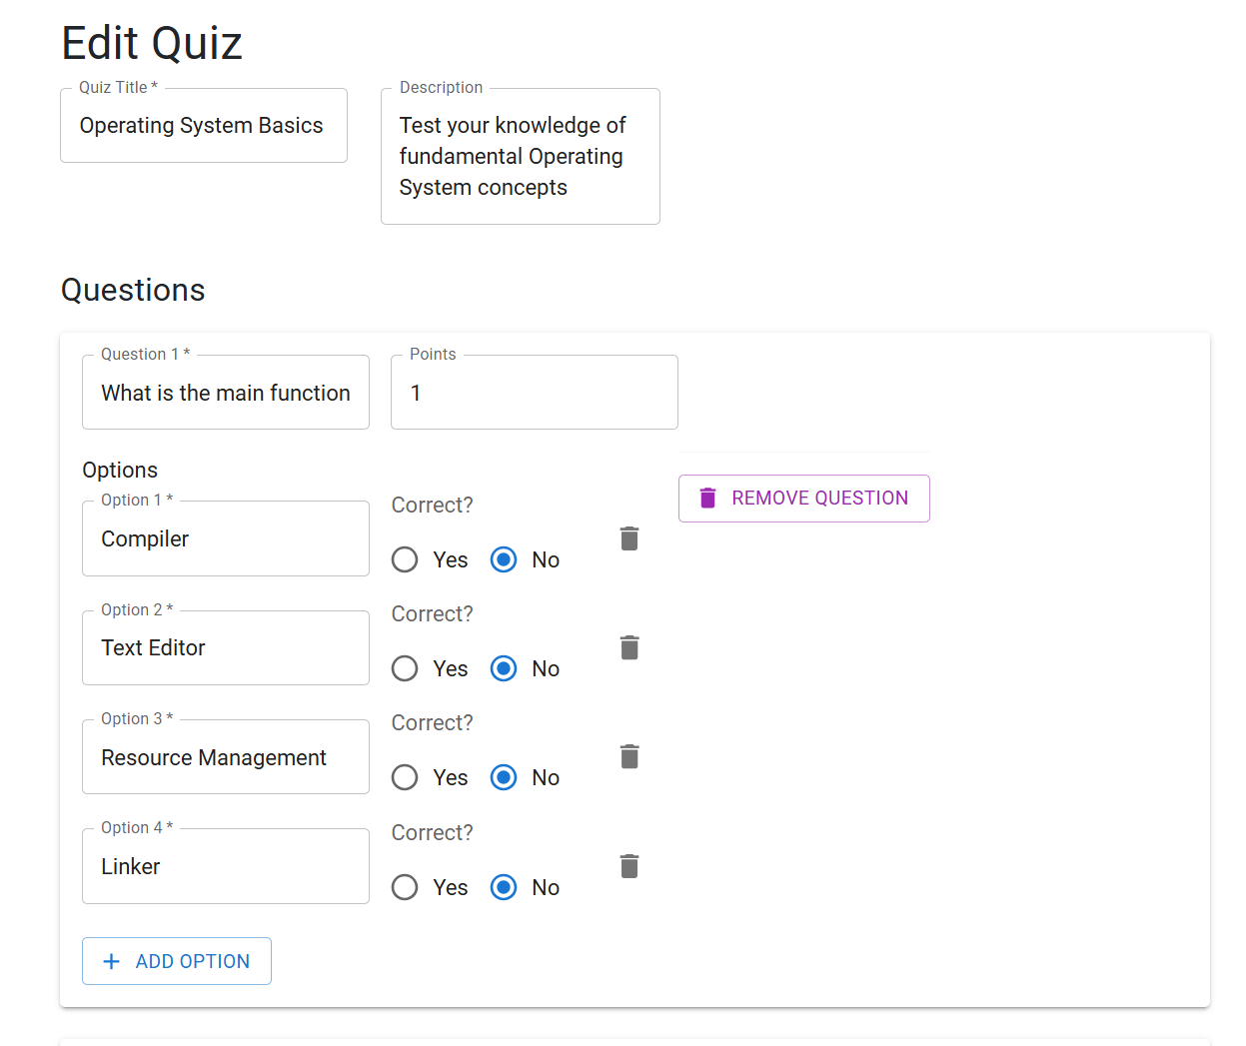
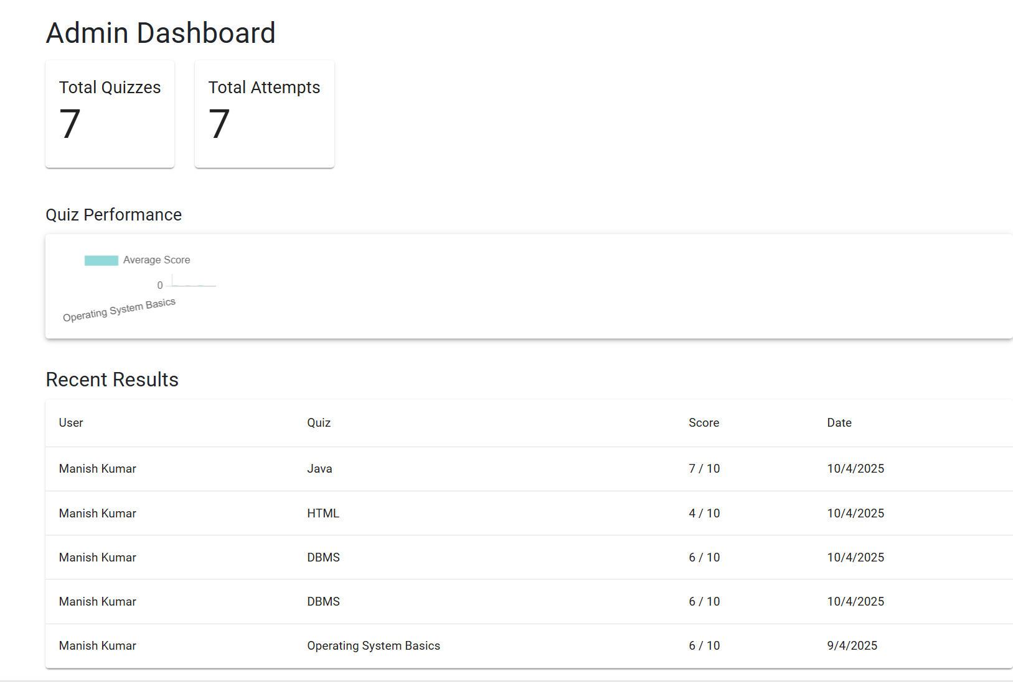
Admin Edit Quiz
Admin Dashboard

Slide 17
Future Enhancements
Timer for quizzes
Question randomization
PDF report generation

Slide 18


