Slide 1
Predicting readmission of Diabetic patients
Group Number 1
Team Details
1. Veeresh Kanthi
2. Ditto Paul
3. Mangala Naikar
4. Manish Mohan
5. Shabaz Khan
6. Shammu Raj U
Mentor
Jatinder Bedi

Slide 2
CONTENT
Problem Statement
Introduction
Types of Features
Analysis of Target Variable
Exploratory Data Analysis
Feature Engineering
Model Building
Model Building with SMOTE

Slide 3
Problem Statement :
To build a model that accurately predicts whether the patient having diabetes would getting readmitting or not after taking the medication.
Introduction :
Diabetes is an illness caused because of high glucose level in a human body. Nowadays, diabetes is a major public health challenge and a worldwide problem. Diabetes should not be ignored, if it is untreated then it may cause chronic damage and disfunction of various tissues, especially the eyes, kidneys, heart, blood vessels, and nerves . Diabetes can be controlled if it is predicted earlier.
To achieve this goal, a clinical database (101766 unique encounters corresponding to 71518 unique patients) was analysed to find future directions which might lead to improvements in patient safety.

Slide 4
Types of Features
Shape of the dataset :
Rows --> 101766
Columns --> 50 (49 independent and 1 dependent variable)
Numerical Variables(13) : encounter_id, patient_nbr, admission_type_id, discharge_disposition_id, admission_source_id, time_in_hospital,num_lab_procedures, num_procedures, num_medications,number_outpatient, number_emergency, number_inpatient, number_diagnoses
Categorical Variables(36) : race, gender, age, weight, payer_code, medical_specialty, diag_1, diag_2, diag_3, max_glu_serum, A1Cresult, metformin, repaglinide, netaglinide, chlorpropamide, glimepiride, acetohexamide, glipizide, glyburide , tolbutamide, pioglitazone, rosiglitazone, acarbose, miglitol, troglitazone, tolazamide, examide, citoglipton, insulin, glyburide-metformin, glipizide-metformin, glimepiride-pioglitazone , metformin-rosiglitazone, metformin-pioglitazone , change , diabetesMed
Target variable : Readmitted

Slide 5
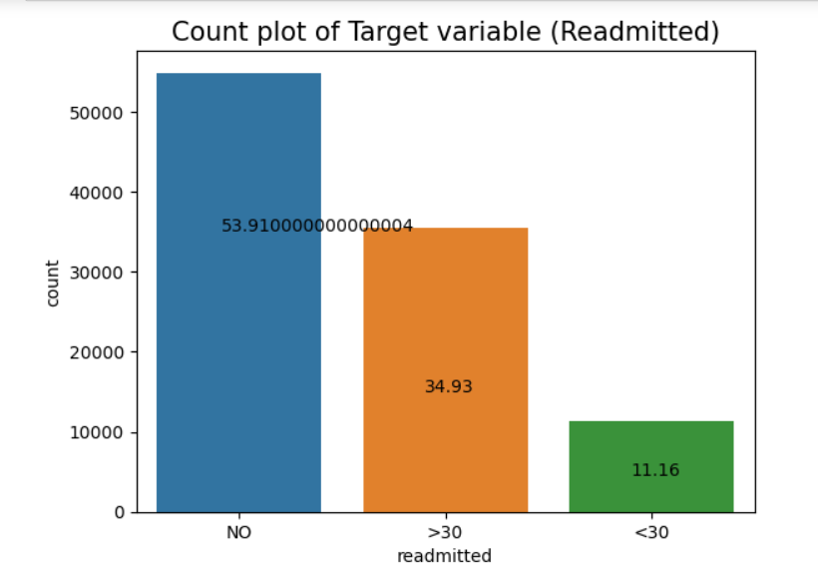
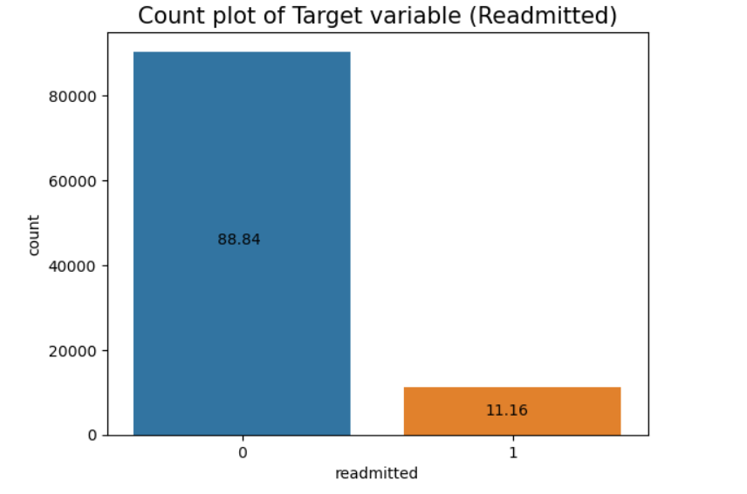
Analysis of Target Variable
‘Readmitted’ is the target variable and it is of Categorical (Nominal) data type.
There are 3 levels in the variable :
No Readmission
Readmission < 30 Days
Readmission > 30 Days
Categorized the target variable into two levels:
0 : Not Readmitted = (NO or >30 days)
1 : Readmitted = < 30 days
A data imbalance is observed for the target variable which might affect the accuracy of the model.

Slide 6
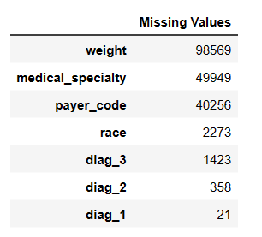
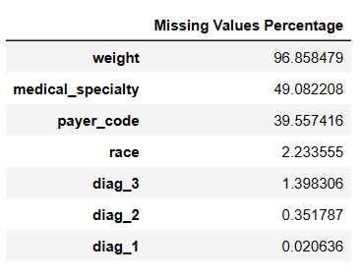
Exploratory Data Analysis
Observations :
Even though there are no missing values, there are many places question marks (?) were found
‘?’ were replaced by nan values
The chances of readmittance is more if the patient has admission type “Emergency” as compared to other admission type
In the columns medical_specialty weight, and payer_code there were more than 40% of missing values. Hence, those columns were removed
Category called "other" is present in the race column. Therefore the null value were replaced by the "other"
Removed the missing values in "diag_1“, “diag_2” and “diag_3”

Slide 7
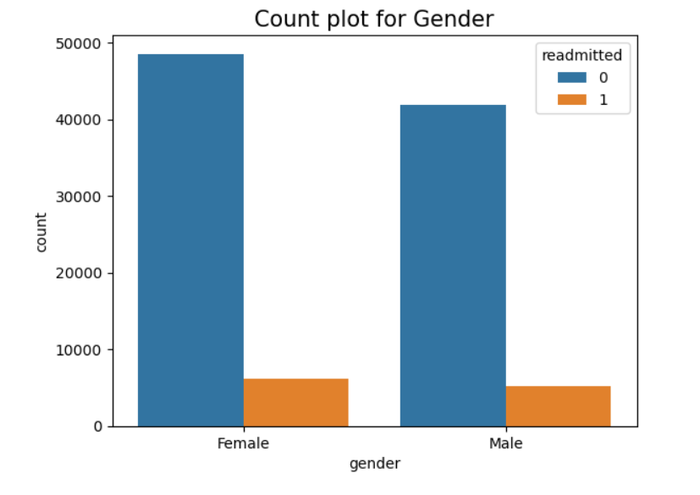
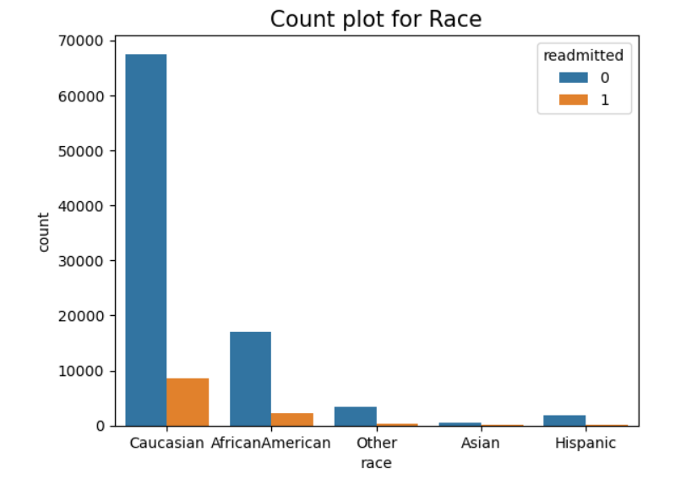
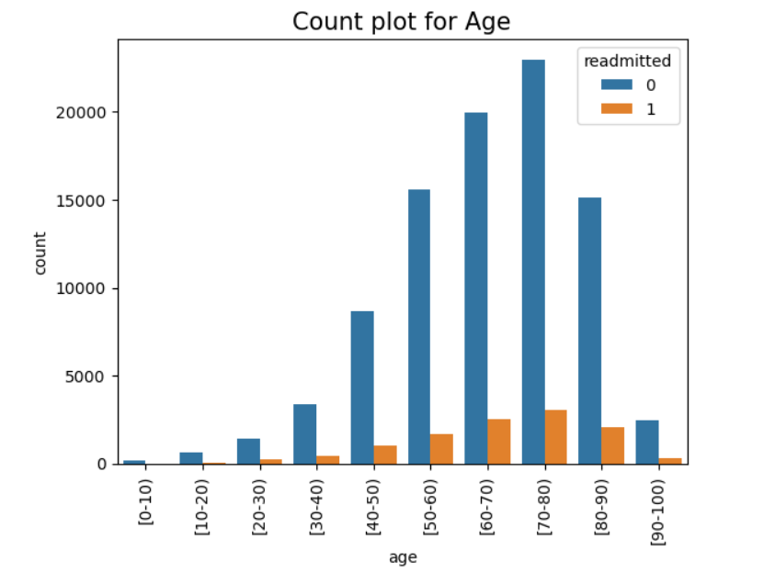
Univariate Analysis :
Observations :
From this graph it is clear that caucasian race has the highest rate of readmission
Gender does not have a much impact on readmission of the patients
Patients in the age range [70-80) has a higher chance of readmission followed by [60-70) and [80-90)

Slide 8
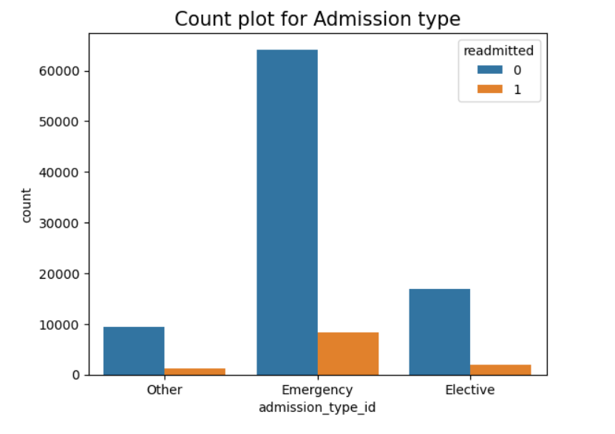
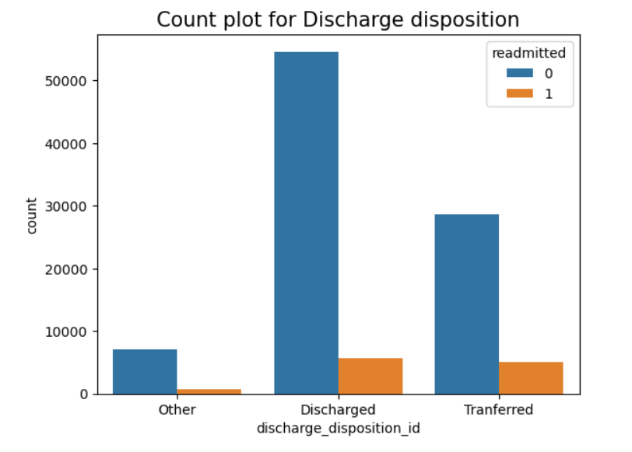
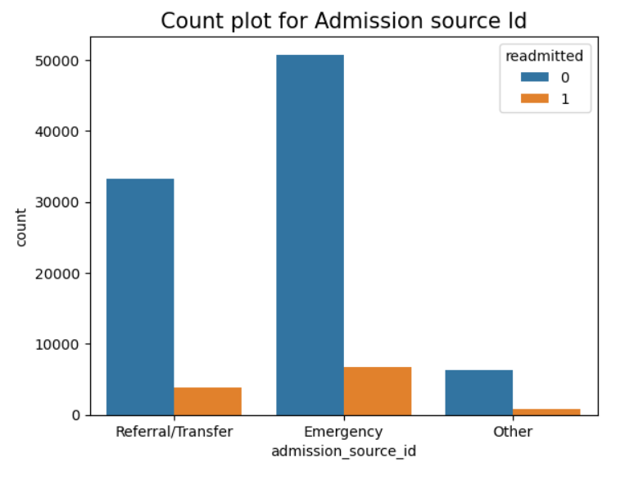
Observations :
Chance of readmission is high if the patient has admission type "Emergency“ for admission_type_id and admission_source_id
The chance of readmission is more for discharged patients for the case of discharge_disposition_id

Slide 9
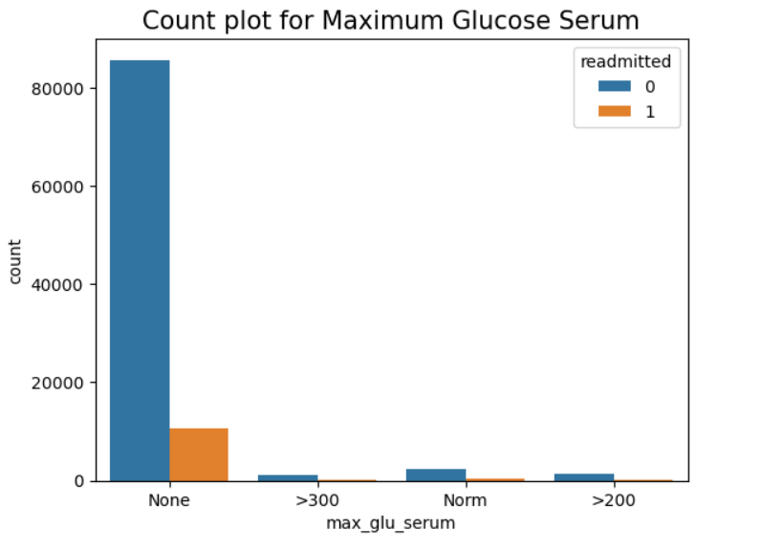
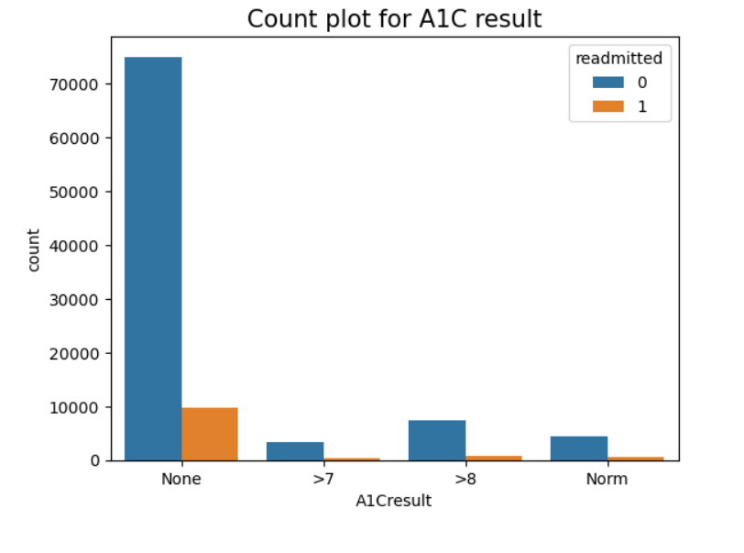
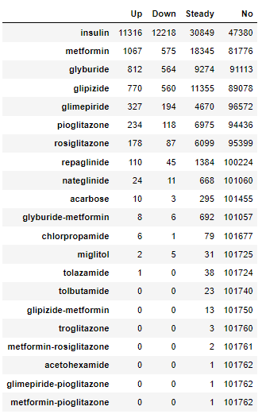
Observations :
Chance of readmission is high if the patient has Maximum Glucose Serum as “None"
The chances of readmittance is more if the patient has AIC result of ‘None’ as compared to other admission type.
A few medicines like metformin-pioglitazone, glimepiride-pioglitazone, acetohexamide, metformin-rosiglitazone and troglitazone are consumed by a very few people.
Most medicines consumed by people are Insulin and Metformin.

Slide 10
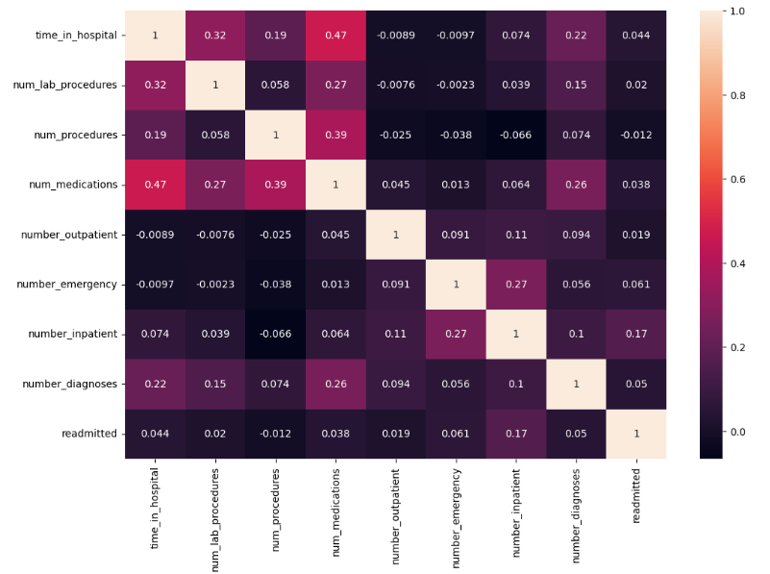
Observations :
The features with comparatively high correlation:
Time_in_hospital – num_medications : 0.47
Time_in_hospital – num_lab_procedures : 0.32
Num_procedures – num_medications : 0.39

Slide 11
Feature Engineering
Encoding :
Dummy encoding : If feature is having two categories
Label encoding : If feature is having category count from 3 to 10
Target encoding : If feature is having more than 10 categories
Scaling :
Numeric variables are scaled using StandardScaler
Train Test Split :
The Encoded and Scaled data are concatenated as features
Then defined target variable
Data was separated into train and test

Slide 12
Model Building – Evaluation Metrics
An evaluation metric quantifies the performance of a predictive model. It depends on the type of our problem statement.
In our case, if readmitted patient is predicted as non-admitted then there is a risk of patient life.
It will leads to hospital law suits, loss of reputation, huge business loss.
So our main target is to decrease the false negative which can be done by using RECALL and F1 SCORE.

Slide 13
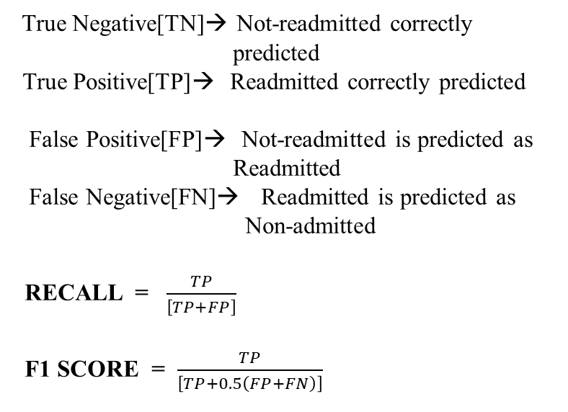
True Negative[TN]→ Not-readmitted correctly predicted
True Positive[TP]→ Readmitted correctly predicted
False Positive[FP]→ Not-readmitted is predicted as
Readmitted
False Negative[FN]→ Readmitted is predicted as
Non-admitted
RECALL = $\frac{TP}{\left[TP+FP\right]}$
F1 SCORE = $\frac{TP}{\left[TP+0.5\left(FP+FN\right)\right]}$
Not-readmitted
Readmitted
TN
FP
FN
TP
Not-readmitted
Readmitted

Slide 14
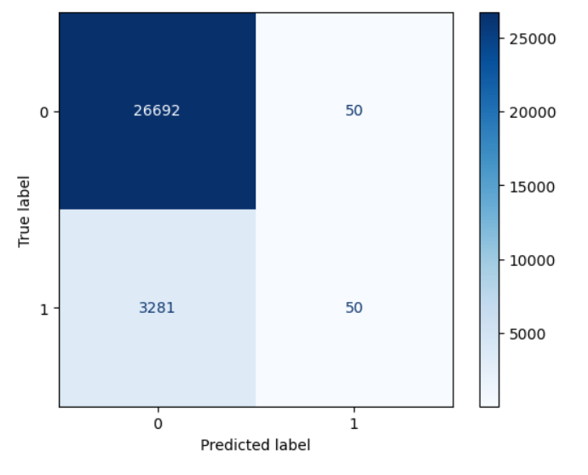
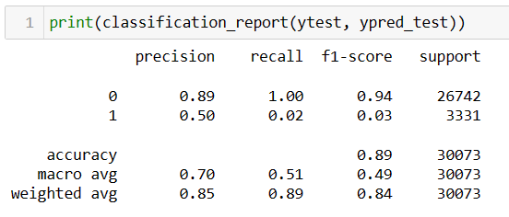
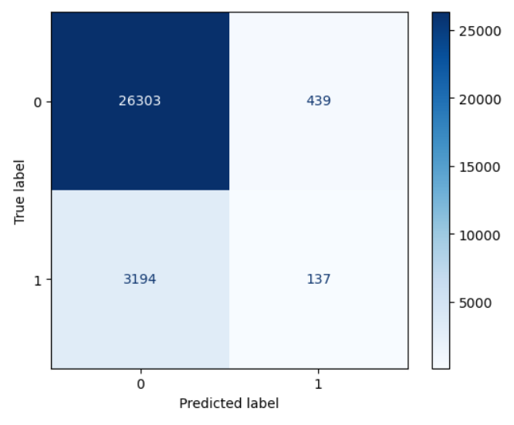
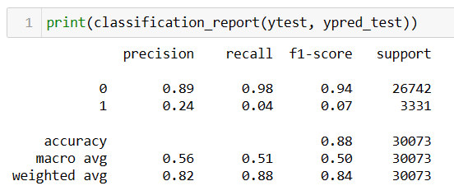
Model Building
Logistic Regression :
KNN :

Slide 15
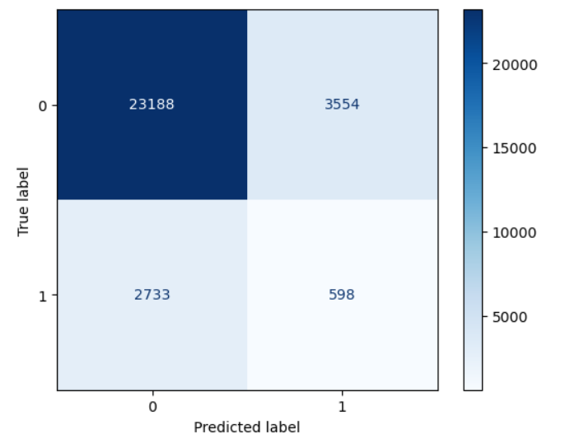
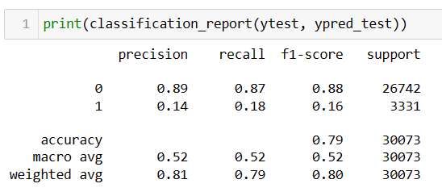
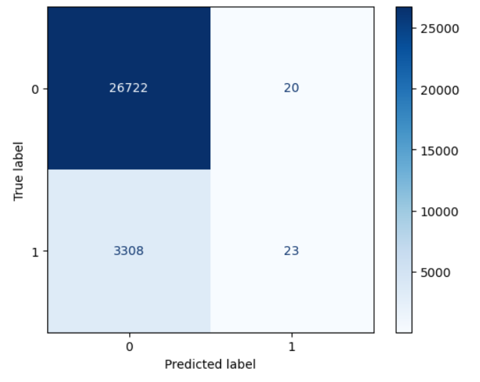
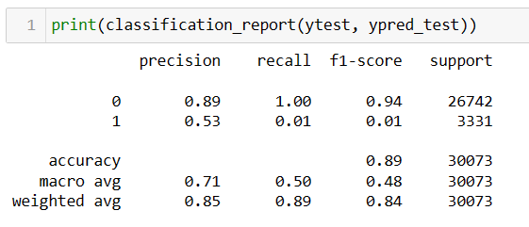
Decision Tree Classifier :
Random Forest Classifier :

Slide 16
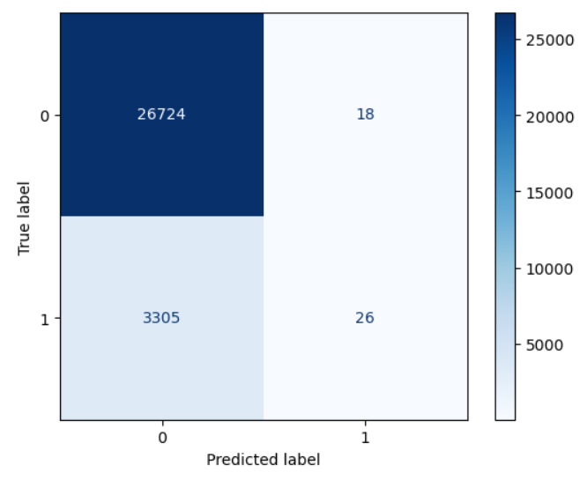
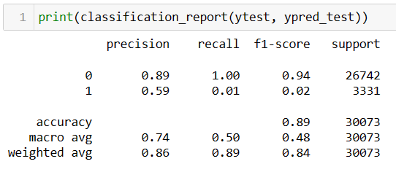
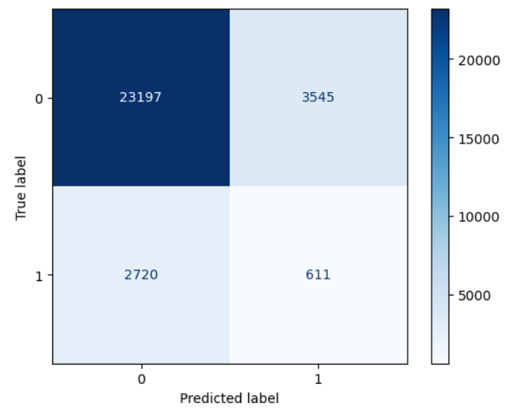
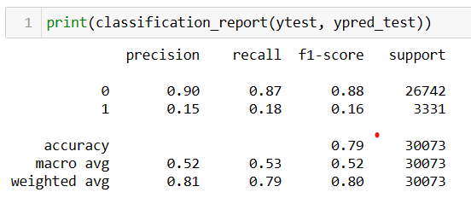
Gradient Descend:
ADA Boost:

Slide 17
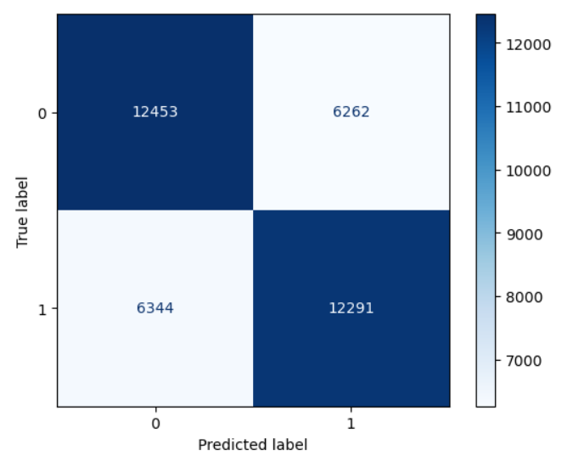
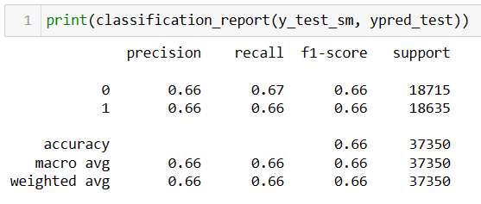
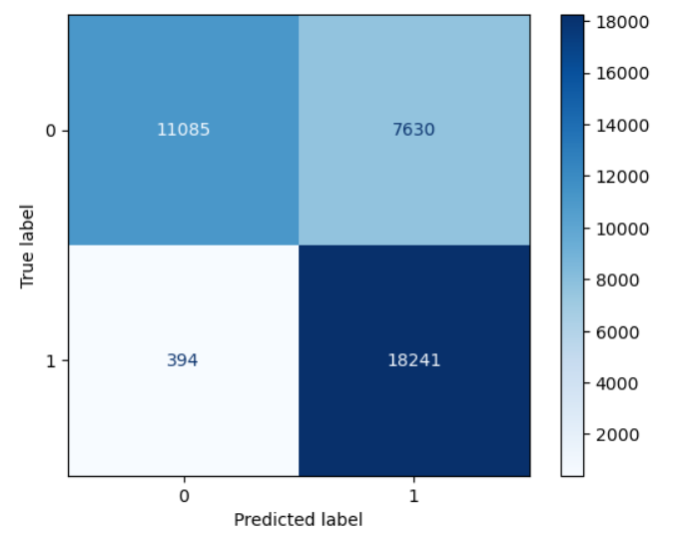
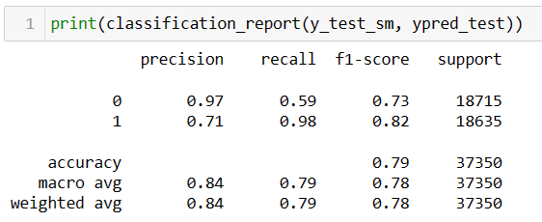
Model Building with SMOTE
Logistic Regression :
KNN :

Slide 18
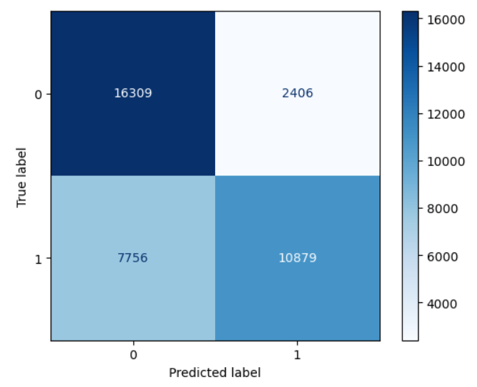
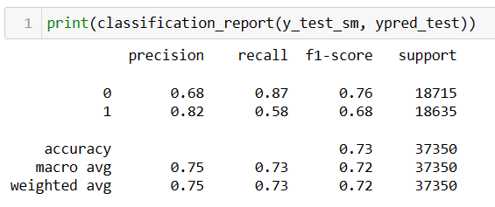
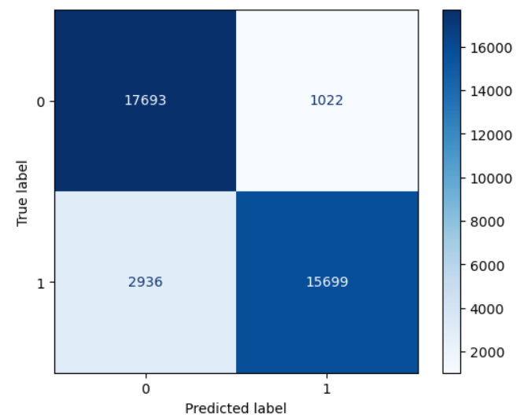

Decision Tree :
Random Forest :

Slide 19
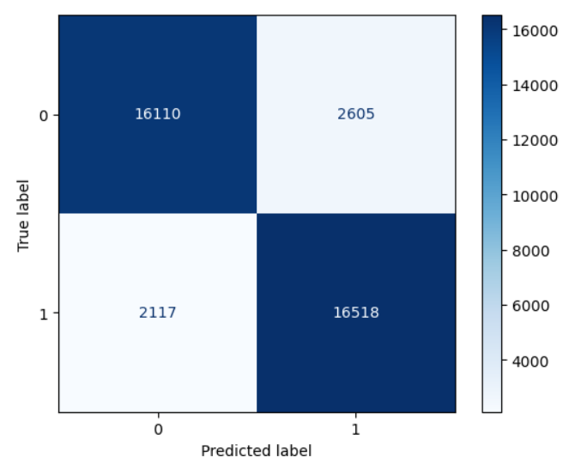
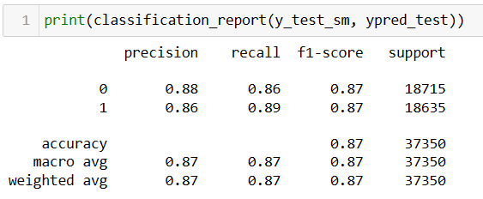
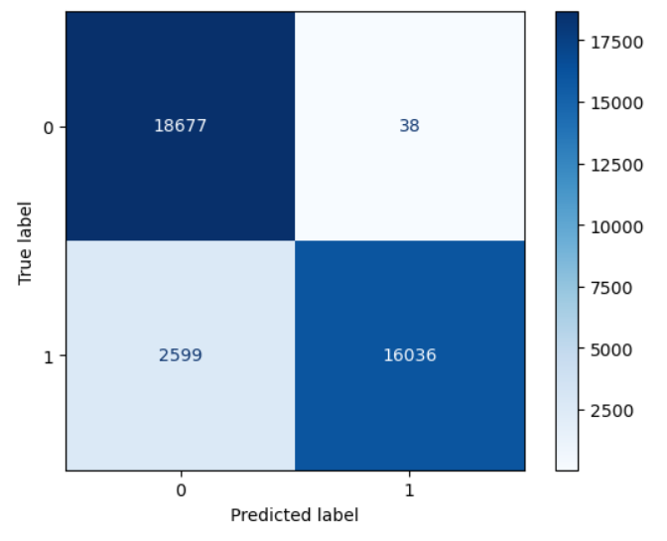
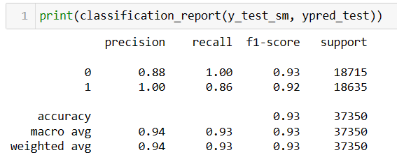
ADA boost :
Gradient boost :

Slide 20
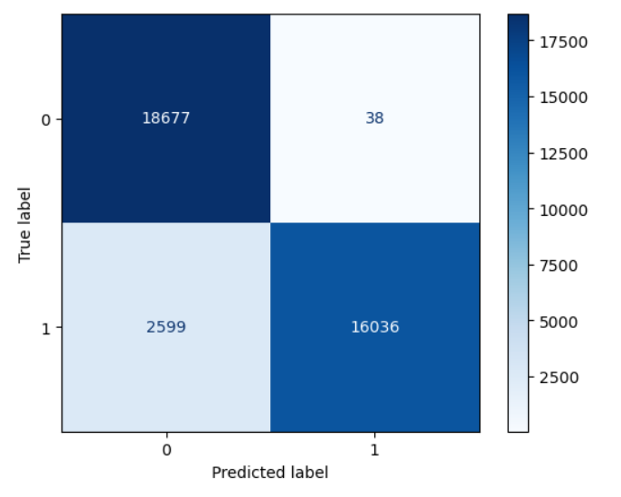
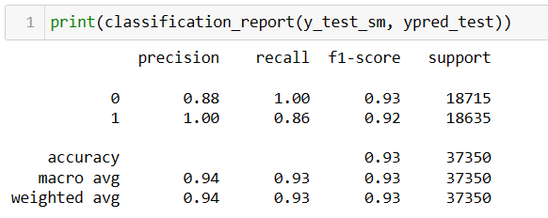
XG boost :

Slide 21
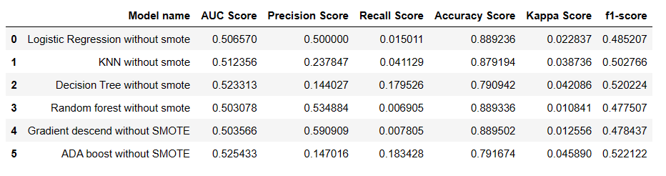
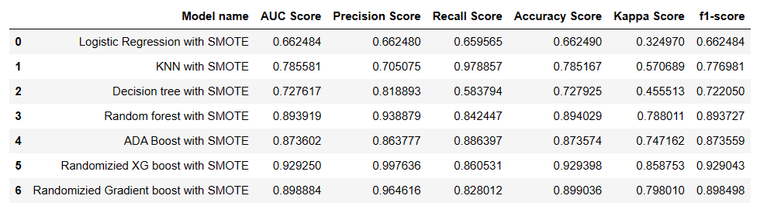
Summarized Model Report:

Slide 22
Results:
Without SMOTE:
Best Model : ADA Boost
Accuracy : 0.79
F1 Score : 0.52
With SMOTE:
Best Model : XG Boost
Accuracy : 0.92
F1 Score : 0.93

Slide 23
Business Findings:
From exploratory data analysis we inferred business interpretations as below:
“Insulin” is the medicine that has more impact on all diabetic patients followed by “Metformin”, “Glyburide” and then “Glipizide”.
Can observe more encounters of senior citizens between age group 55-85 and the chance of readmission can also be seen.
Patients under type “Emergency” are high and their readmission chances are also high.

Slide 24
Limitations:
Lack of Domain Knowledge.
SMOTE technique needed to be applied on the dataset to get good results.
Converts multiclass classification problem into simple classification problem.
Future Works:
Can Deploy the model as a web application.
By this it will be helpful to the Hospital management which is our client.

Slide 25
Thank You!

