Slide 1
DISCOVER MALICIOUS WEBSITES USING DATA MINING ALGORITHMS
By (Team 2):
Srinivas Gutta
Sai Gowtham Ande
Manish Mapakshi
Pratibha Awasthi

Slide 2
WHY THIS DATA SET?
To give you an idea: 74% of U.S. organizations experienced a successful phishing attack in 2020, a 14% increase from 2019. According to the FBI, phishing is the most common type of cybercrime. In 2020, they saw 12 times more phishing attacks than in 2016.
COVID-19 phishing scams likely accelerated the increase in 2020. The pandemic introduced new opportunities for scammers, and some estimate that drove up cybercrime by 600%!

Slide 3
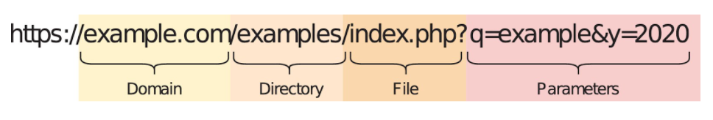
DATA SET DESCRIPTION
Our Data set is divided into 6 Different parts as
Attributes based on the whole URL properties
Attributes based on the domain properties
Attributes based on the URL directory properties
Attributes based on the URL file properties
Attributes based on the URL parameter properties
Attributes based on the URL resolving data and external metrics

Slide 4
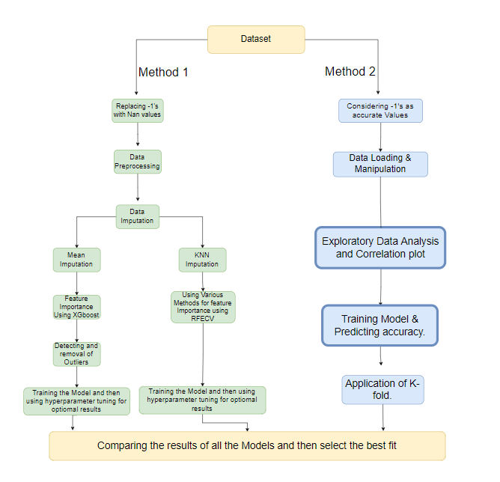
Work Flow

Slide 5
METHOD 1
PREPROCESSING
Dropping all the Columns whose value is Unique Throughout the column using Variance Threshold Method
Delete Duplicate rows (if any)
Convert the -1’s to NAN values

Slide 6
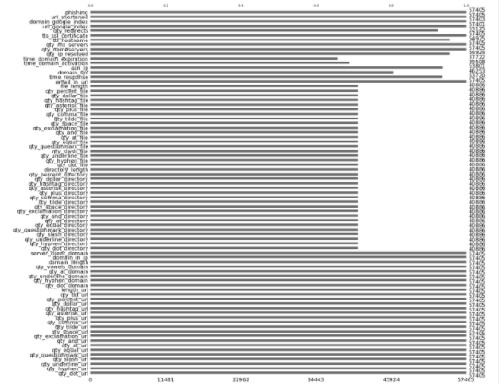
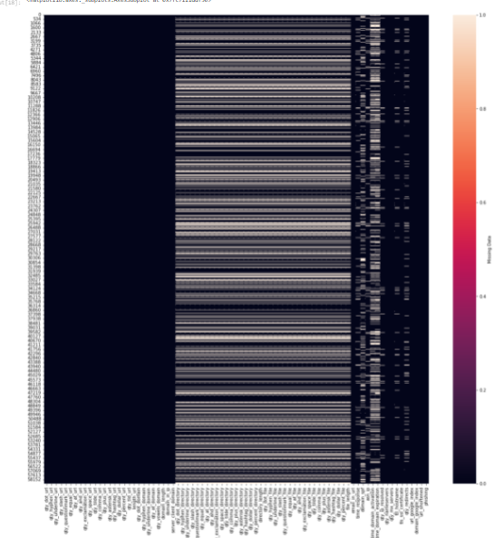
VISUALIZATION
Visualize the Missing data using a Heat map and bar chart using the Missing number library.

Slide 7
Approach
For Mean Imputed data
Feature Importance using XGBoost
Hyper Parameter Tuning of XGBoost
Detection and Removal of Outliers
Visualization and Analysis of data
Model Training by leveraging Hyperparameter tuning
for Obtaining Optimal Results
For KNN Imputed data
Data Analysis on Categorical Features
Correlation between dependent Feature and Independent feature
Feature Selection using Recursive feature elimination with cross-validation
Data Standardization
Model Training by leveraging Hyperparameter tuning
for Obtaining Optimal Results

Slide 8
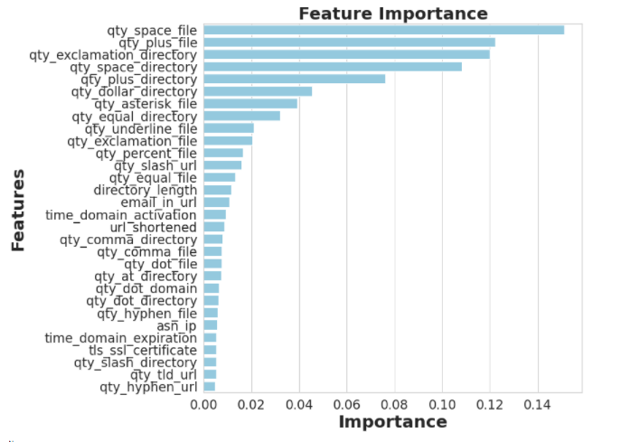
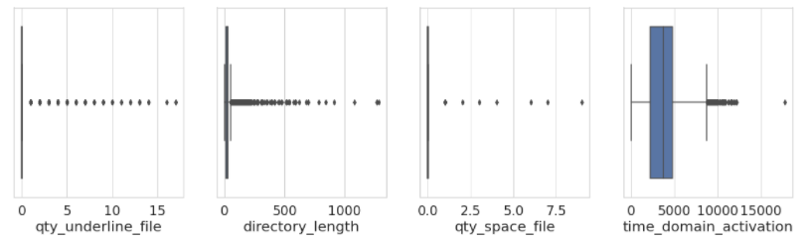
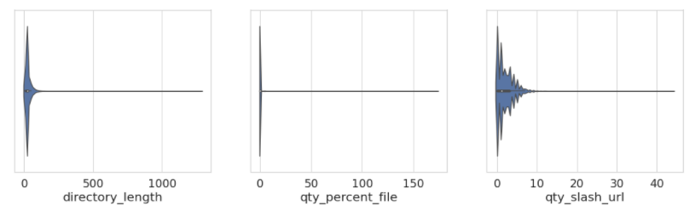
MEAN IMPUTED DATA
Feature Importance using XGBoost
Detecting Outliers

Slide 9
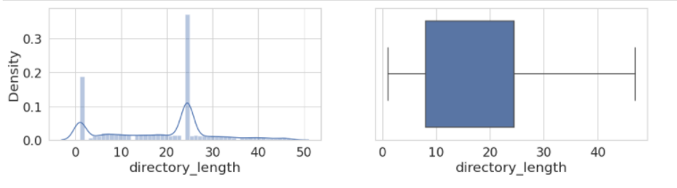
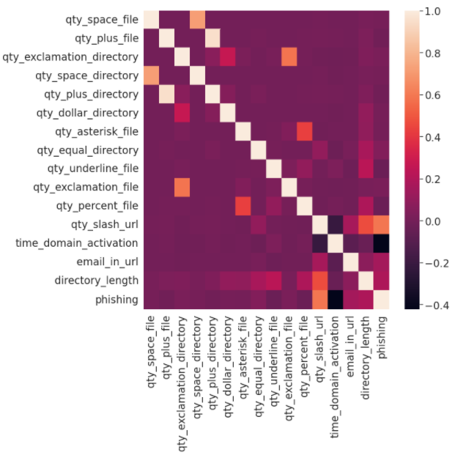
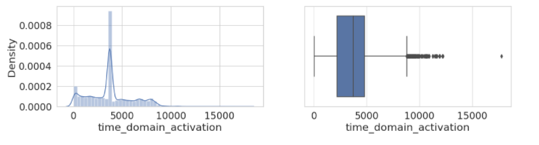
MEAN IMPUTED DATA
Post Removal of Outliers using IQR
Correlation between Phishing and other features
20XX

Slide 10
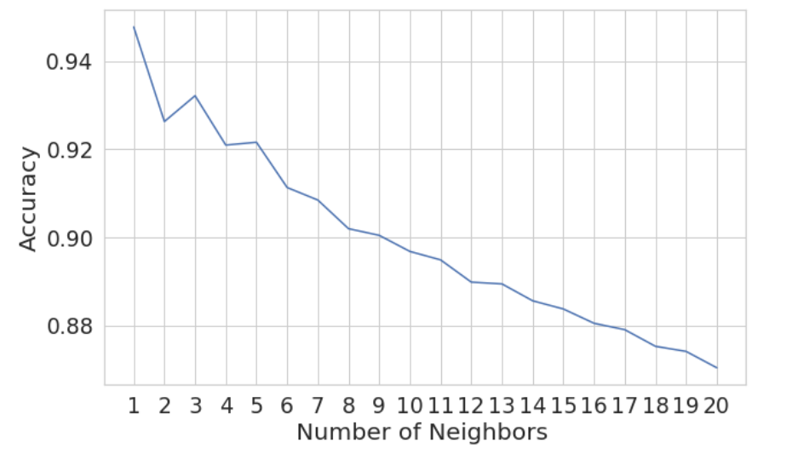
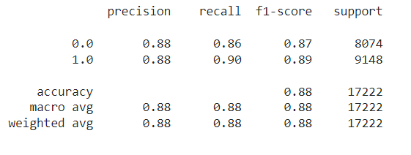
RESULTS OBTAINED FOR MEAN IMPUTED DATA
Using KNN Classifier hyperparameter tuning
20XX
PRESENTATION TITLE
‹#›

Slide 11
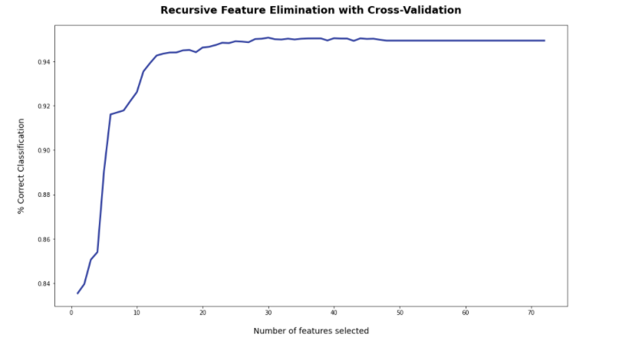
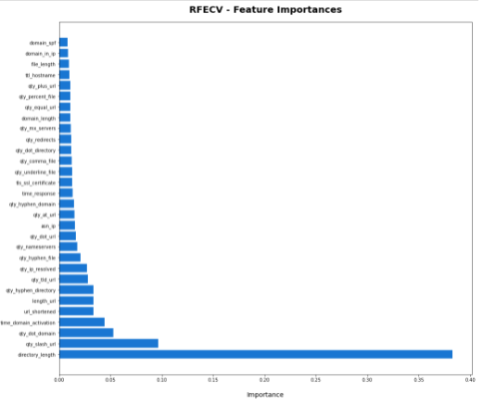
KNN IMPUTED DATA
Accuracy vs Features selected
Feature Importance using RFECV
20XX
PRESENTATION TITLE
‹#›

Slide 12
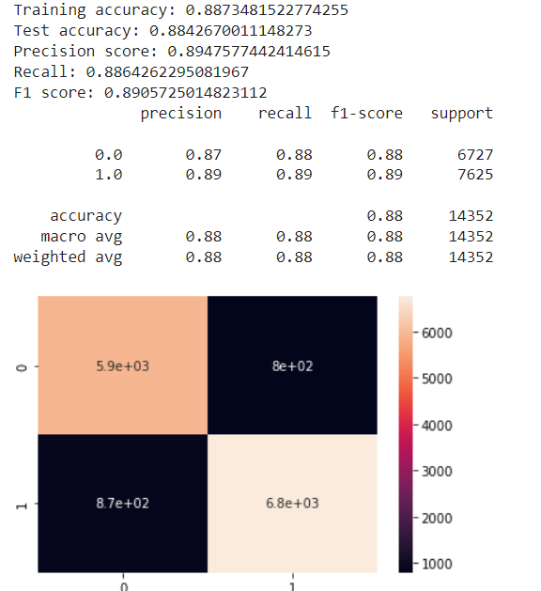
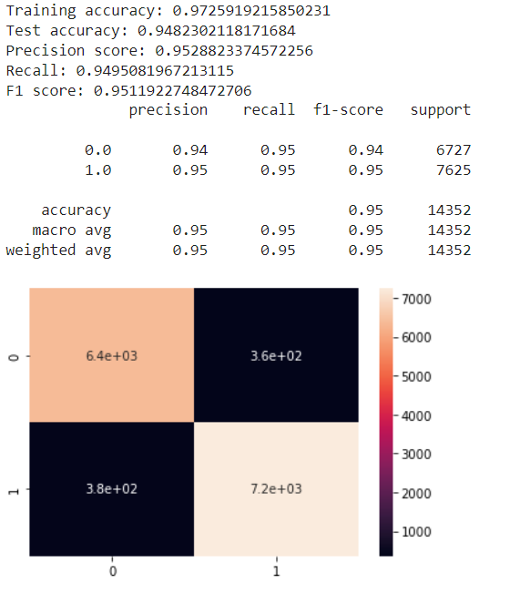
RESULTS OBTAINED FOR KNN IMPUTED DATA
Using Logistic Regression hyperparameter tuning
Using XGBoost hyperparameter tuning
20XX
PRESENTATION TITLE
‹#›

Slide 13
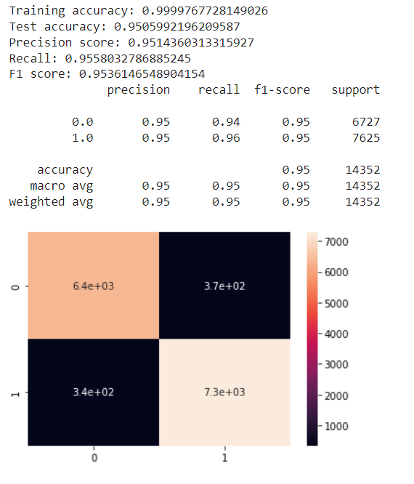
RESULTS OBTAINED FOR KNN IMPUTED DATA
Using Random Forest Classifier hyperparameter tuning
20XX
PRESENTATION TITLE
‹#›

Slide 14
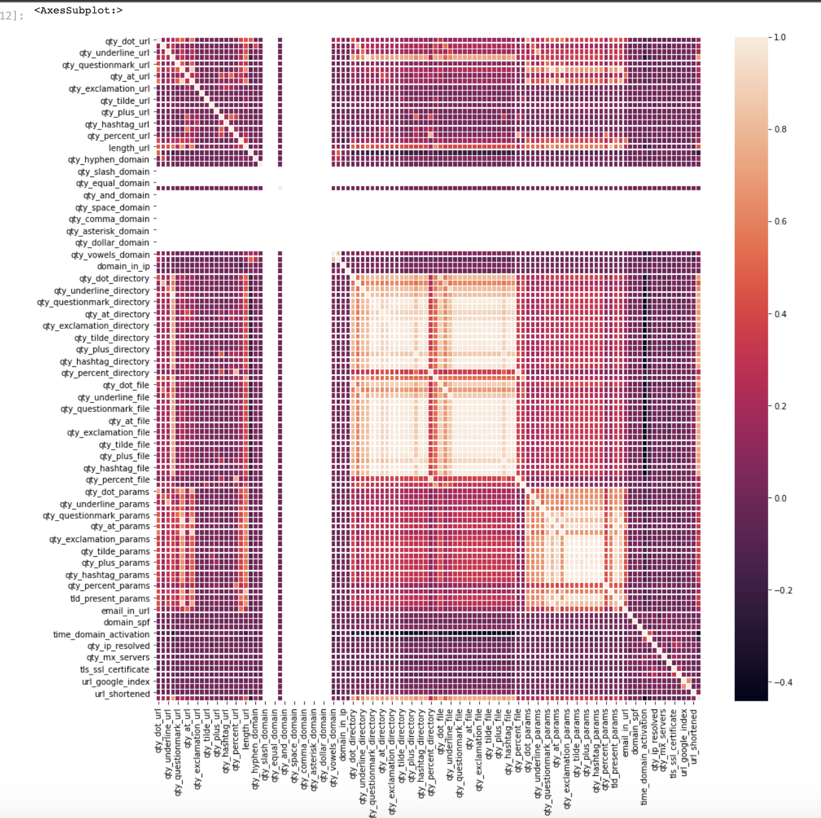
METHOD – II: DATA LOAD, MANIPULATION AND EDA
Data Load & Manipulation:
Checking for NA.
Later, unique values of data have been checked and printed.
Exploratory Data Analysis:
Analysis of data for 0s & 1s.
Heat Map visualization
20XX
PRESENTATION TITLE
‹#›

Slide 15
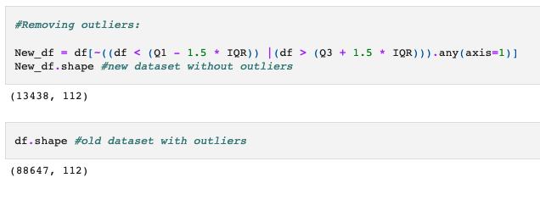
METHOD – II (CONT.)
Outliers:
The outliers are detected using the z score.
In this methodology, the threshold is kept to 3.
Using IQR, the outliers are removed, and a new dataset is generated.
20XX
PRESENTATION TITLE
‹#›

Slide 16
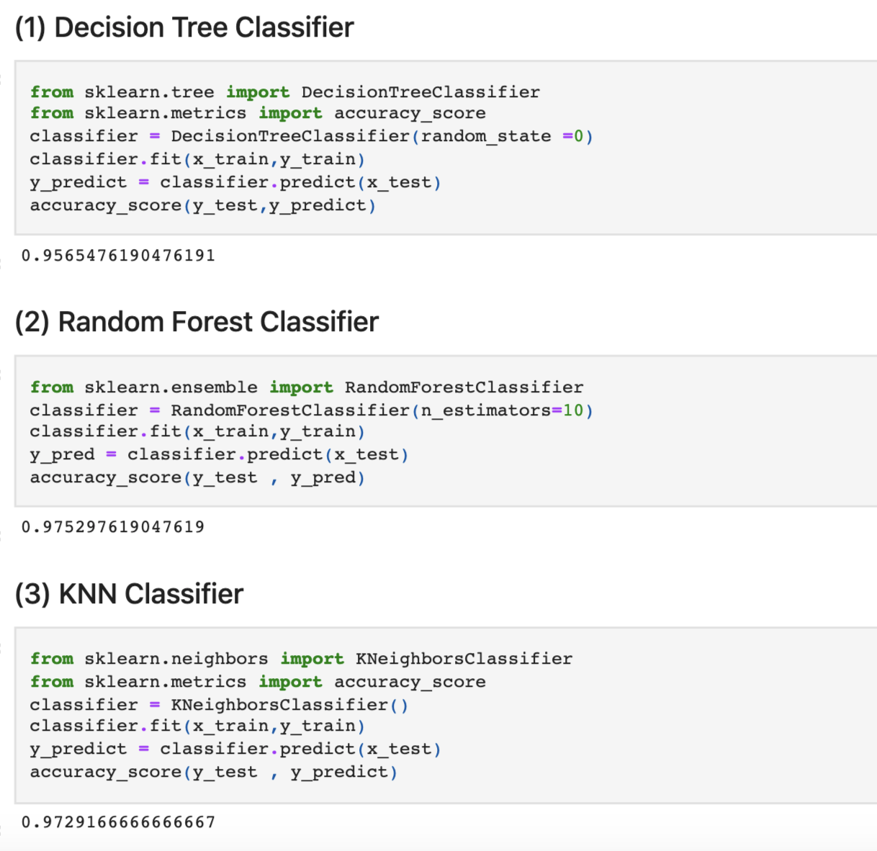
METHOD – II: MODELING & APPLICATION OF K-FOLD
The accuracy is retrieved using three different models. They are:
Decision Tree: The accuracy found through decision tree is 95.65%
Random Forest: The accuracy found through Random Forest is 97.52%
KNN: The accuracy found was 97.29%.
It is concluded that the Random forest detected the best accuracy for method - II.
20XX
PRESENTATION TITLE
‹#›

Slide 17
THANK YOU

